Slide 1
Ant Colony Optimization project report
Swarm Intelligence INFO-H-414
Aldar Saranov
Université libre de Bruxelles

Slide 2
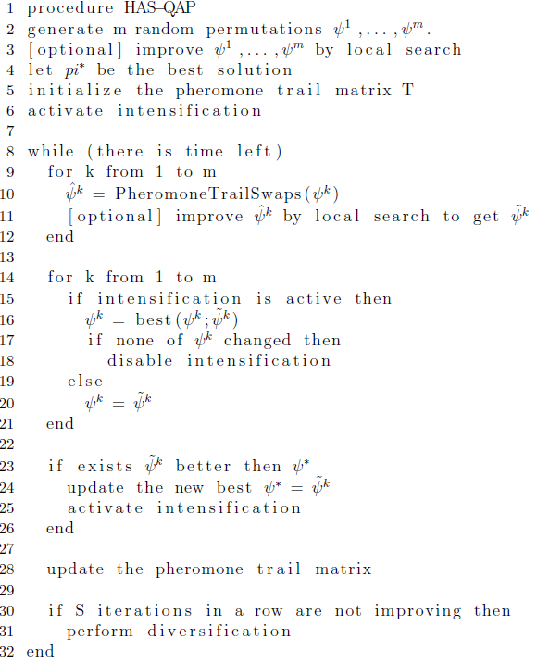
Initial solution generation
Local search
Solution modification
Applying intensification if necessary
Pheromone update (EAS and RAS)
Diversification

Slide 3
Initial Solution Generation
In out implementation, the algorithm takes the facilities one by one and assigns it to one of the free locations according to random uniform rule. This is an exploration step.

Slide 4
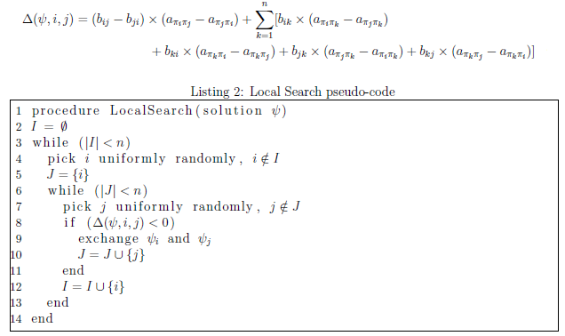
Local Search
May be applied to the initial solutions before setting the pheromone matrix and in each iteration.
Delta value of objective values are used. They can be compute in O(n).

Slide 5
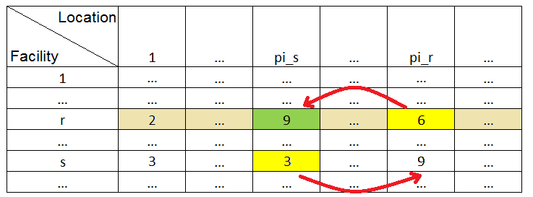

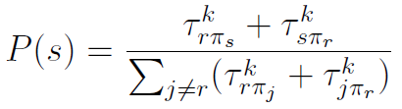
Pheromone Trail Swaps
Exploiting policy with probability Q
Exploring policy with probability 1 - Q

Slide 6
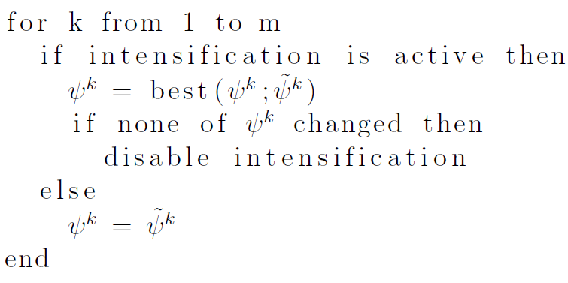
Intensification

Slide 7

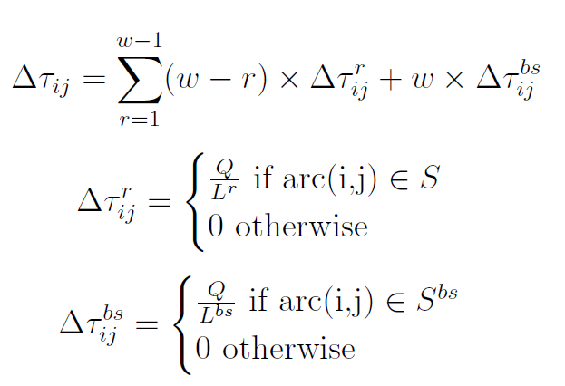
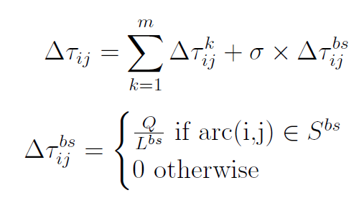
Pheromone update rule
Rank-based Ant System
Elitist Ant System

Slide 8
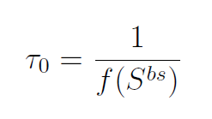
Diversification
Diversification is applied if during S iterations in a row there were no improvement.
Pheromone trail values are reset.
It promotes exploration.

Slide 9
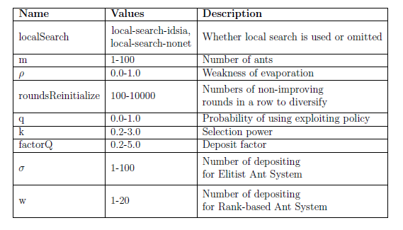
Automatic tuning
The program was tuned in irace. The overall parameters description is as follows.

Slide 10
Experimental - performance
Not tuned. EAS showed slightly better results with average relative solution quality 3.75%, however, it also had larger variation coefficient (meaning that some concrete instances may be solved by EAS worse than by RAS).
Local Search without tuning. The configurations, however, were inherited from the previous series. RAS showed much better results with average relative solution quality 0.2% and best quality 0.17%. There is a significant improvement for both EAS and RAS if local search is added.
Local Search with tuning. The results here are ambiguous, because the average relative quality of RAS is equal to 0:24% which is better than 0.66% of EAS, however, in the worst case EAS has 0:89%, whereas RAS has 1.01%.
In all cases Wilcoxon test cannot firmly reject that the mean of the performances of these algorithms is different.

Slide 11
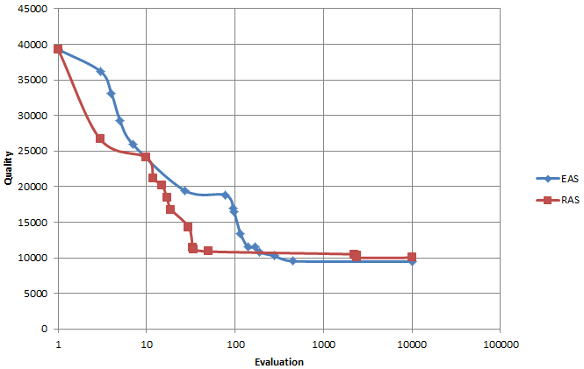
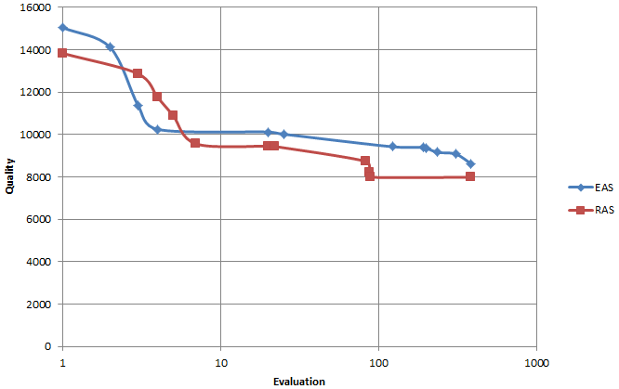
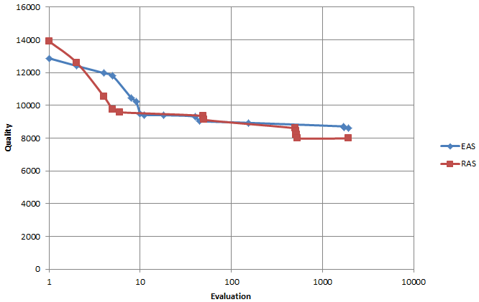
Experimental - convergence
No Local Search
Local Search (not tuned)
Local Search (tuned)

