Slide 1
Development of an automatically configurable ant colony optimization framework. State of the art.
Student: Aldar Saranov
Director: Thomas Stützle
Université libre de Bruxelles, 2017

Slide 2
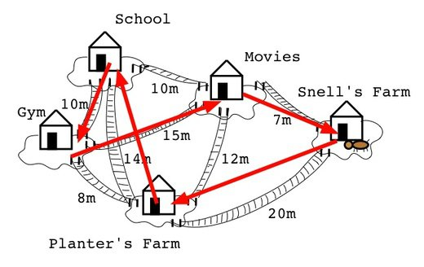
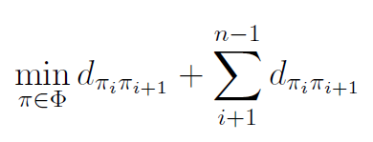
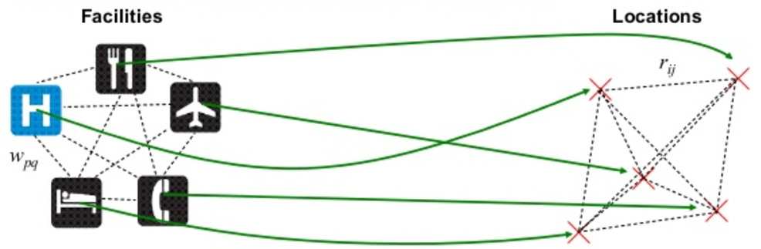
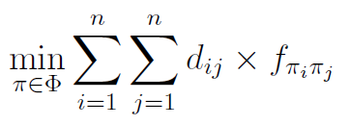
Combinatorial Optimization Problems
Traveling Salesman Problem illustration
Quadratic Assignment Problem illustration

Slide 3
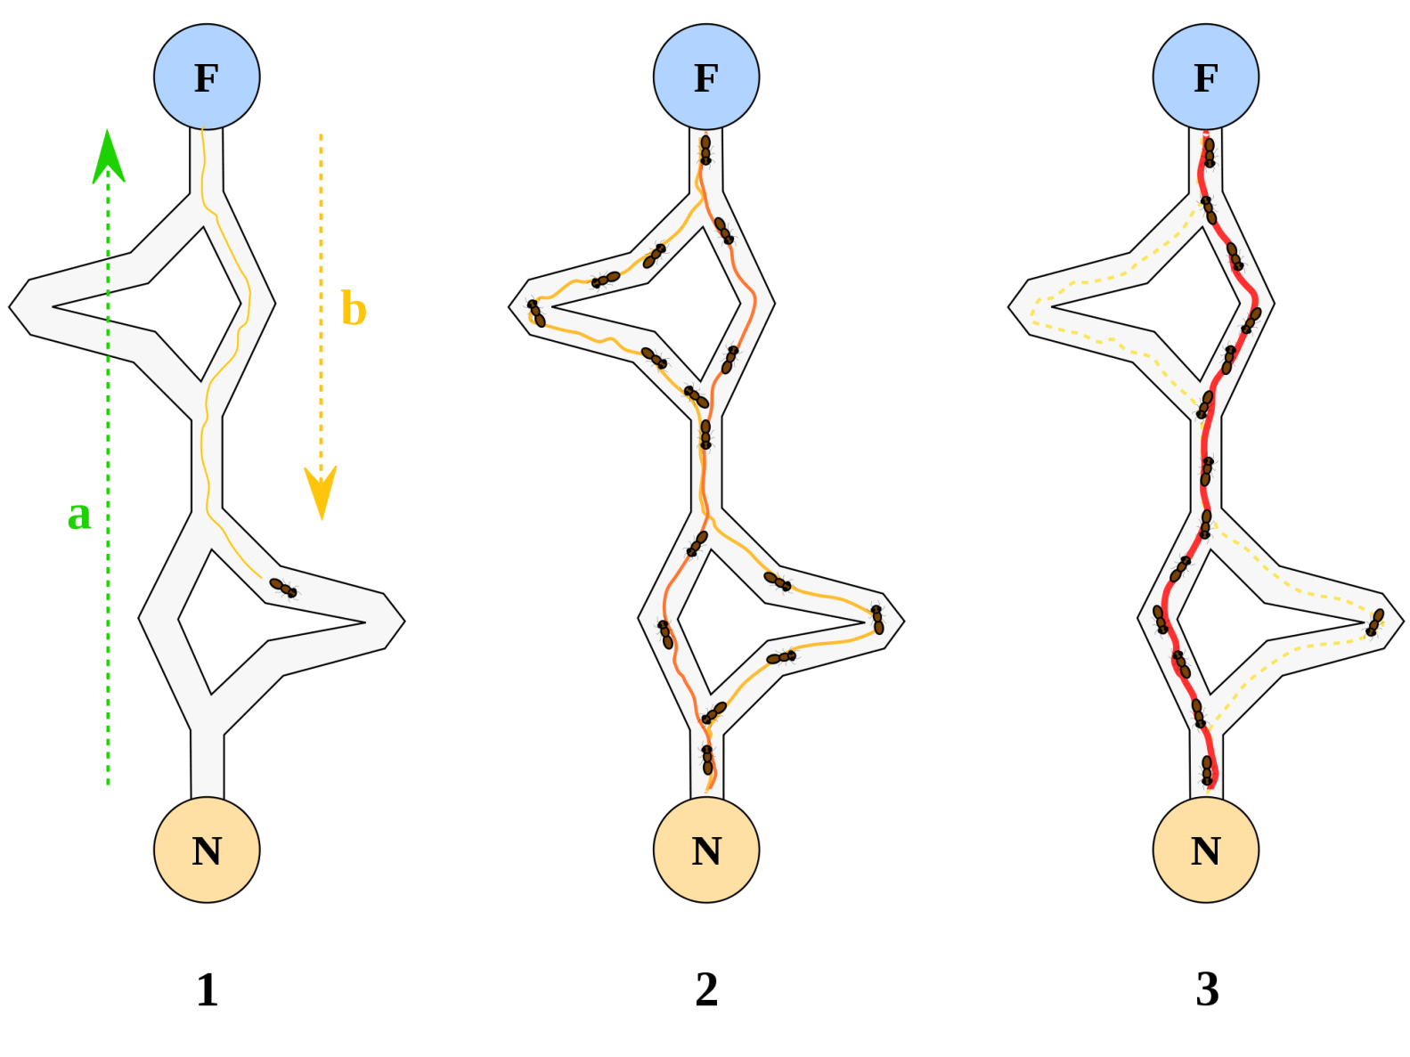
Ant Colony Optimization
The pheromone trail bias the solution construction.
The ant path represents a problem solution in this case.

Slide 4
ACO components
Solution component choice:
Standard
By Maniezzo
By Dorigo and Gambardella
Extensions:
Lookahead
Candidate list
Heuristic precomputuation.
Iterated Greedy:
External memory
Iterated ants
Cunning ants
Global pheromone update
Update techniques:
Ant system
Single update selections:
Iteration-base
Global-based
Restart-based
Systems:
Ant System
Ant Colony System
Max-Min Ant System
Rank-based Ant System
Elitist Ant System
Best-Worst Ant System
Local pheromone update
Local Search:
Search mode:
Best-improvement
First-improvement
Problem-specific implementation

Slide 5
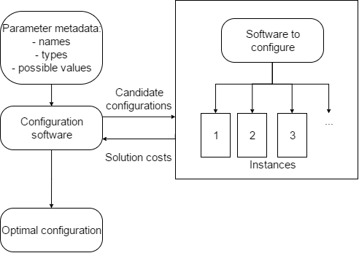
Automatic Configuration
Software components and major data flows scheme

Slide 6
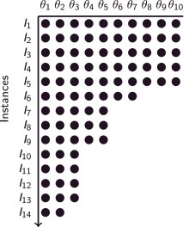
I-RACE
Sampling new configurations according to a particular distribution
Selecting the best configurations from the newly sampled ones by means of racing.
Updating the sampling distribution in order to bias the sampling towards the best configurations.
Extensions:
Initial configuration set-up
Soft-restart.
Instance population illustration

Slide 7
Possible improvements
Implementing resolution algorithms for new NP-hard problems within ACO framework (Vehicle Routing Problem, Subset-sum, Knapsack).
Object-oriented implementation.
Implementing the ACO algorithm stages as parallel algorithms.

