Slide 1
Development of an automatically configurable ant colony optimization framework. State of the art.
Student: Aldar Saranov
Director: Thomas Stützle
Université libre de Bruxelles, 2017

Slide 2
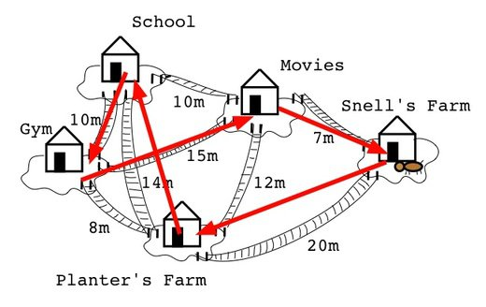
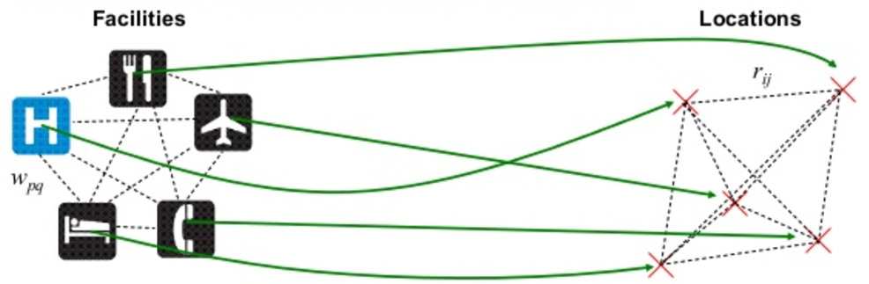
Combinatorial Optimization Problems
Traveling Salesman Problem illustration
Quadratic Assignment Problem illustration

Slide 3
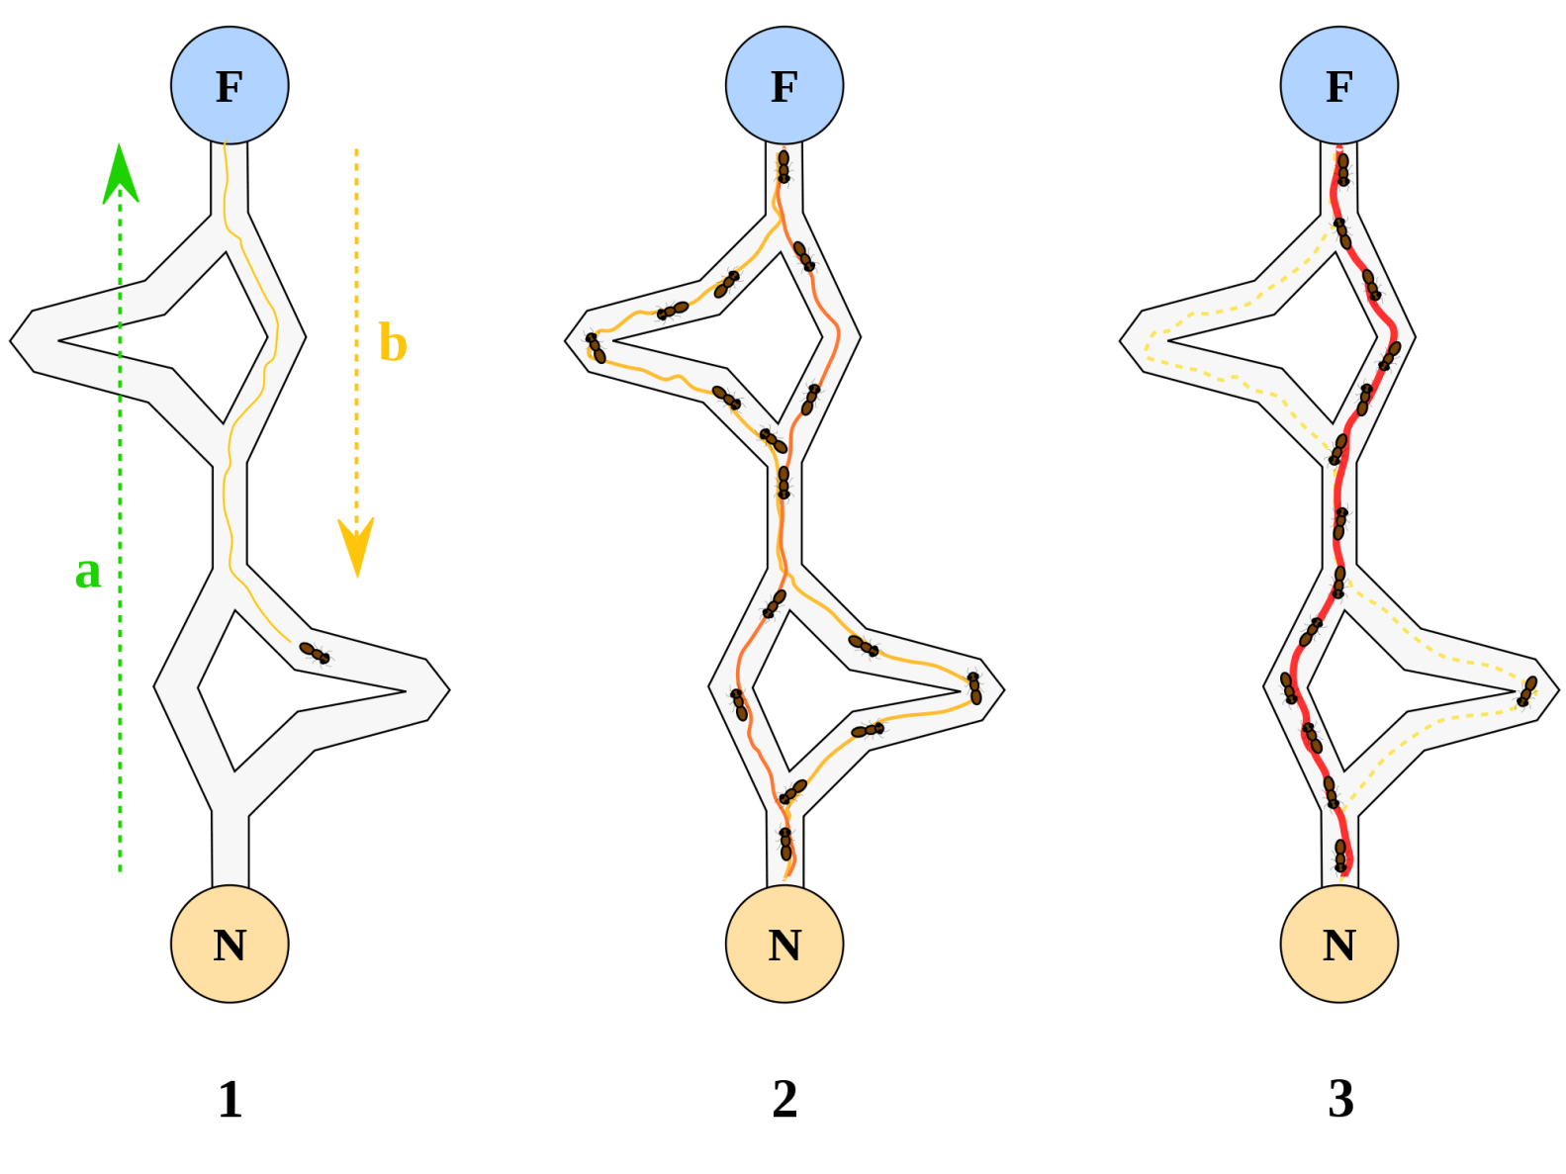
Ant Colony Optimization
The pheromone trail bias the solution construction.
The ant path represents a problem solution in this case.

Slide 4
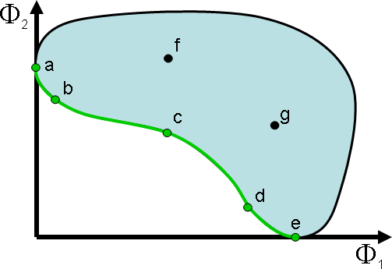
Multi-objective Optimization
The Pareto Front (set of non-dominated solutions) is the final purpose of the optimization process.

Slide 5
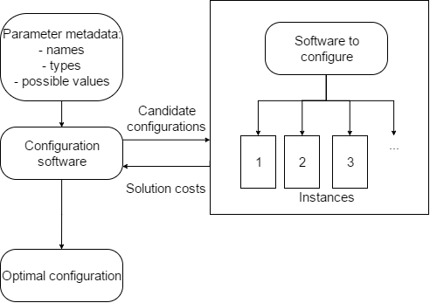
Automatic Configuration
Software components and major data flows scheme

Slide 6
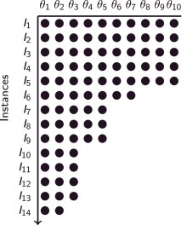
I-RACE
Configurations bypass several iterations of selection where the best ones win

Slide 7
Possible improvements
Implementing resolution algorithms for new NP-hard problems within ACO framework (VRP, SUBSET-SUM, KNAPSACK).
Object-oriented implementation.
Implementing the ACO algorithm stages as parallel algorithms.

