Slide 1
HELLO!

Slide 2
- S.O.L.I.D - Models for the Rescue - Domain Driven Design - DDD Introduction - DDD Strategic Design - DDD Tactical Design - Software Architecture (Parts I, II & III) - Application Lifecycle Management - Continuous Integration, Deployment, Delivery - Generic Domain as a Service - CQRS - Event Sourcing - oAuth 2.0 & OIDC - Lucene - Hystrix - Cassandra
NOW!
Notes:
Software Architecture
Boundaries,
CAP Theorem
Layered Architecture
Messaging
Microservices
Onion Architecture
Scalability
SOA
Logical Architecture vs Physical Architecture
Publish/Subscribe
Eventual Consistency

Slide 3
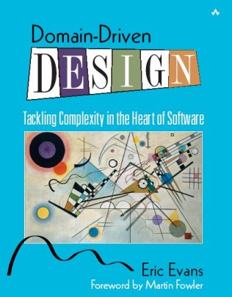
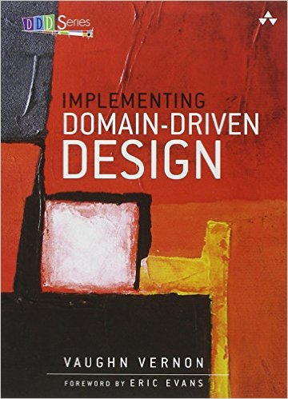
Domain Driven Design Introduction
Notes:
- How the Blue book is organized. Read Part IV: Strategic Design to the end and then the whole book.

Slide 4
Domain Driven Design Introduction
FOR MANAGERS
https://goo.gl/s5nd4C
Notes:
- How the Blue book is organized. Read Part IV: Strategic Design to the end and then the whole book.

Slide 5
Domain Driven Development

Slide 6
Domain Driven Development
Domain Driven Design

Slide 7
Draw me a diagram of your
system architecture

Slide 8
Draw me a diagram of your
system architecture
UI
Business Logic
Persistence

Slide 9
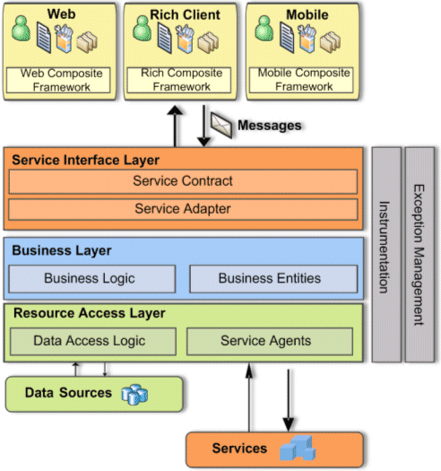

Slide 10
Sales
Reporting
Shipping
Billing
Orders
Notes:
Visualize the business process flows on high level
Visualize boundaries
Macro architecture
Much harder to introduce changes
Actually changes occur very rarely

Slide 11
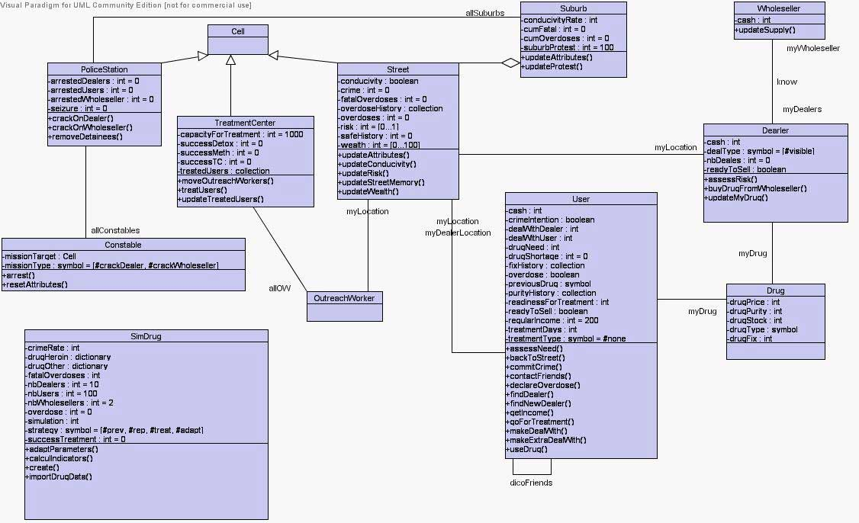
… at the beginning
Notes:
Micro level view

Slide 12
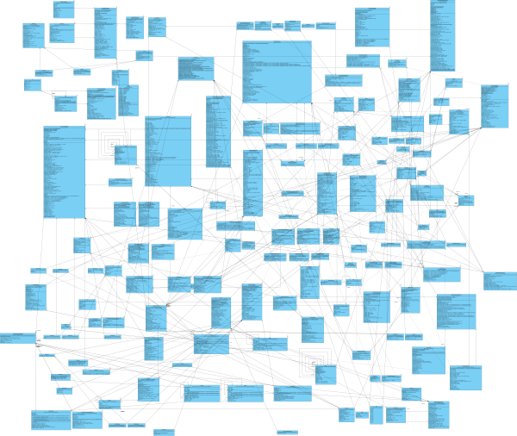
… after time

Slide 13
Big Ball of Mud
A Big Ball of Mud is a haphazardly structured, sprawling, sloppy, duct-tape-and-baling-wire, spaghetti-code jungle. These systems show unmistakable signs of unregulated growth, and repeated, expedient repair. Information is shared promiscuously among distant elements of the system, often to the point where nearly all the important information becomes global or duplicated. The overall structure of the system may never have been well defined. If it was, it may have eroded beyond recognition. Programmers with a shred of architectural sensibility shun these quagmires. Only those who are unconcerned about architecture, and, perhaps, are comfortable with the inertia of the day-to-day chore of patching the holes in these failing dikes, are content to work on such systems.
— Brian Foote and Joseph Yoder, Big Ball of Mud. Fourth Conference on Patterns Languages of Programs (PLoP '97/EuroPLoP '97) Monticello, Illinois, September 1997
Notes:
managers put pressure on developers => surgery
developer turnover
it works, at least at the moment it is developed

Slide 14
What is DDD
- Focus on the core complexity in the domain
- Explore models in a collaboration of domain experts and software experts
- Write software that expresses those models explicitly
Notes:
Community did bad thing. Frequent changes
- What is a software?
- Domain experts
- Software has to model the domain
- Puts the focus on the domain
- By reading the code you should be able to learn a lot about the domain
-Ubiquitous language

Slide 15
Why should use DDD
- Deliver business value, not ordinary software
- Reduce complexity
- Easier to maintain over time

Slide 16
organizations which design systems ... are constrained to produce designs which are copies of the communication structures of these organizations
M. Conway

Slide 17
Sales
Reporting
Shipping
Billing
Orders

Slide 18
When to use DDD
0 pts : CRUD
1 pts : up to 30 business ops / user stories
2 pts : up to 40 business ops / user stories or certain
features tends to creep toward complexity
3 pts : future complexity grow
4 pts : feature changes over time
5 pts : new or complex domain

Slide 19
How to apply DDD
- Find a domain expert
- Strategic design
- Tactical design
- Fail fast
! Steep learning curve !

Slide 20
Airplane Flight Control System
Tracks every flight over a certain area
Determines of the flight follows its supposed route
Prevent possibility of a collision

Slide 21
Developer: We want to monitor air traffic. Where do we start?
Expert: Let’s start with the basics. All this traffic is made up
of planes. Each plane takes off from a departure place, and
lands at a destination place.

Slide 22
Developer: We want to monitor air traffic. Where do we start?
Expert: Let’s start with the basics. All this traffic is made up
of planes. Each plane takes off from a departure place, and
lands at a destination place.
Departure
Airplane
Destination

Slide 23
Developer: That’s easy. When it flies, the plane can just
choose any air path the pilots like? Is it up to them to decide
which way they should go, as long as they reach destination?
Expert: Oh, no. The pilots receive a route they must follow.
And they should stay on that route as close as possible.
Destination
Airplane
Route
Departure

Slide 24
Developer: I’m thinking of this route as a 3D path in the air. If we use a Cartesian system of coordinates, then the route is simply a series of 3D points.
Expert: I don’t think so. We don’t see route that way. The route is actually the projection on the ground of the expected air path of the airplane. The route goes through a series of points on the ground determined by their latitude and longitude.
Developer: OK, then let’s call each of those points a fix, because it’s a fixed point of Earth’s surface. And we’ll use then a series of 2D points to describe the path. And, by the way, the departure and destination are just fixes. We should not consider them as separate concepts. The route reaches destination as it reaches any other fix.

Slide 25
Airplane
Route
Fix
2D Point

Slide 26
Developer: The plane must follow the route, but does that mean that it can fly as high or as low as it likes?
Expert: No. The altitude that an airplane is to have at a certain moment is also established in the flight plan.

Slide 27
Developer: The plane must follow the route, but does that mean that it can fly as high or as low as it likes?
Expert: No. The altitude that an airplane is to have at a certain moment is also established in the flight plan.

Slide 28
Developer: Flight plan? What is that?
Expert: Before leaving the airport, the pilots receive a detailed flight plan which includes all sorts of information about the flight: the route, cruise altitude, the cruise speed, the type of airplane, even information about the crew members.
Developer: Hmm, the flight plan seems pretty important to me. Let’s include it into the model.

Slide 29
Airplane
Flight Plan
Route
Fix
2D Point

Slide 30
Developer: That’s better. Now that I’m looking at it, I realize something. When we are monitoring air traffic, we are not actually interested in the planes themselves, if they are white or blue, or if they are Boeing or Airbus. We are interested in their flight. That’s what we are actually tracking and measuring. I think we should change the model a bit in order to be more accurate.

Slide 31
Flight
Flight Plan
Route
Fix
2D Point

Slide 32
Other System
Flight Plan
Type
Crew
Route
Flight Control System
Flight Plan
Route
Altitude
Speed

Slide 33
Credits
Domain-Driven Design: Tackling Complexity in the Heart of Software
Domain-Driven Design Quickly
Implementing Domain-Driven Design
https://domainlanguage.com/ddd/howtoreadthebook/ReadingDDDForManagers.pdf

Slide 34
- S.O.L.I.D - Models for the Rescue - Domain Driven Design - DDD Introduction - DDD Strategic Design - DDD Tactical Design - Software Architecture (Parts I, II & III) - Application Lifecycle Management - Continuous Integration, Deployment, Delivery - Generic Domain as a Service - CQRS - Event Sourcing - oAuth 2.0 & OIDC - Lucene - Hystrix - Cassandra
Coming up!
Notes:
Software Architecture
Boundaries,
CAP Theorem
Layered Architecture
Messaging
Microservices
Onion Architecture
Scalability
SOA
Logical Architecture vs Physical Architecture
Publish/Subscribe
Eventual Consistency

Slide 35
THANKS!
Any questions?

