Slide 1
S.O.L.I.D.

Slide 2
THE CODE
Notes:
Talk about the domain./

Slide 3
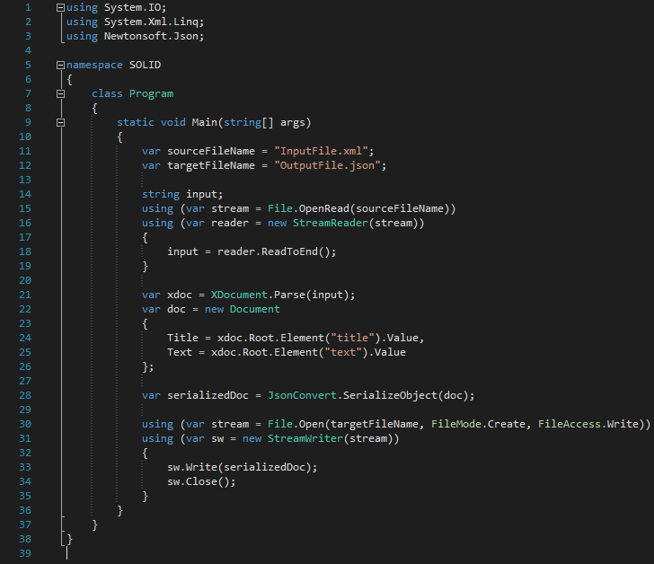

Slide 4
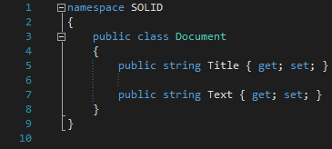

Slide 5
What was wrong in this picture?

Slide 6
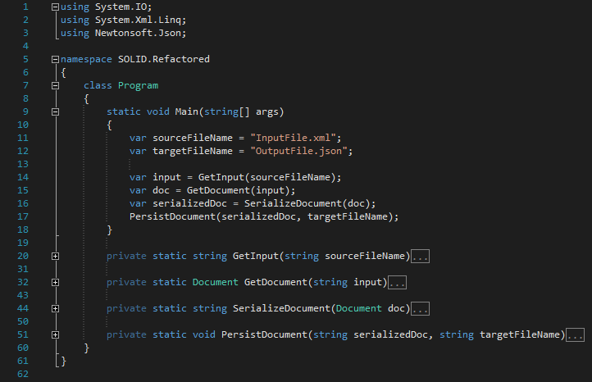

Slide 7
Is it better?

Slide 8
Single Responsibility Principle
1

Slide 9
“
"A class should have only one reason to change. “
OR
There can be only one requirement that, when changed, will cause a class to change.

Slide 10
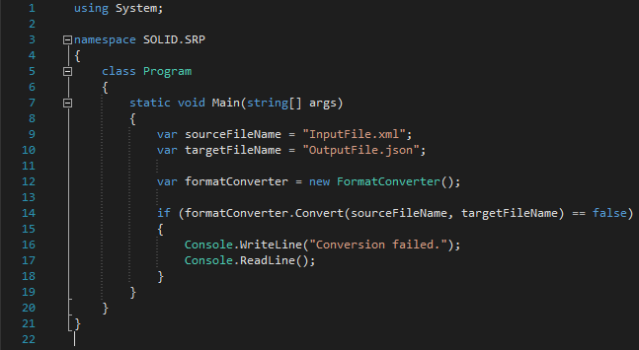

Slide 11
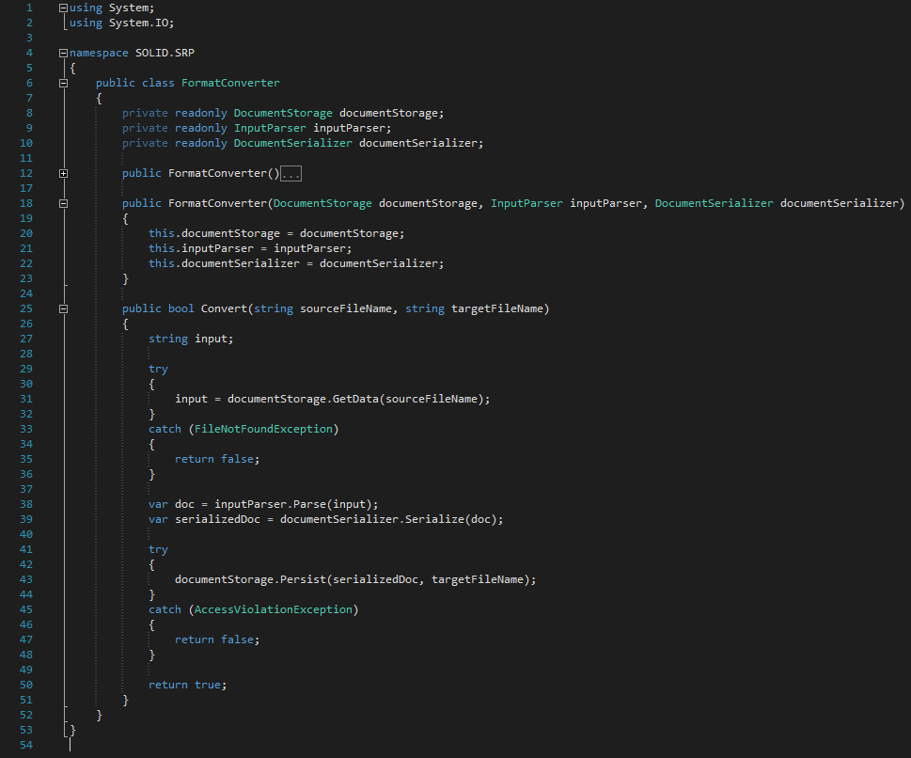

Slide 12
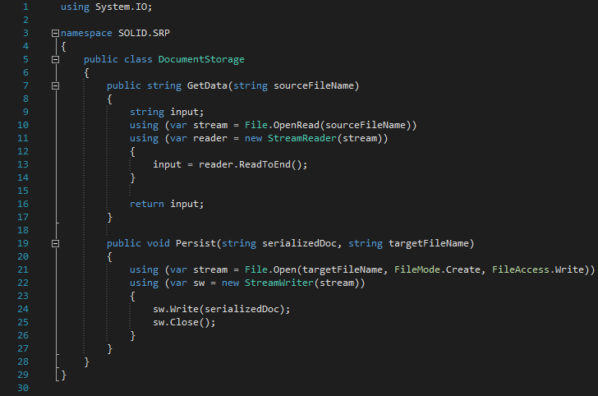

Slide 13
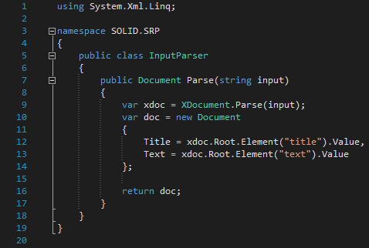

Slide 14
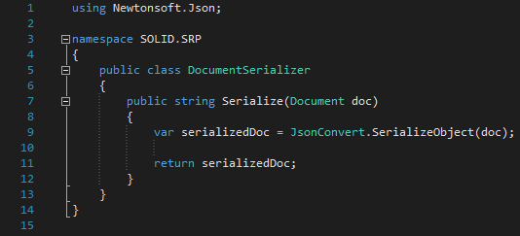

Slide 15
Benefits

Slide 16
Open/Close Principle
2

Slide 17
“
"Software entities should be open for extension, but closed for modification. “
OR
Once a class is done, it is DONE!
Notes:
Meyer vs. Polymorphic

Slide 18
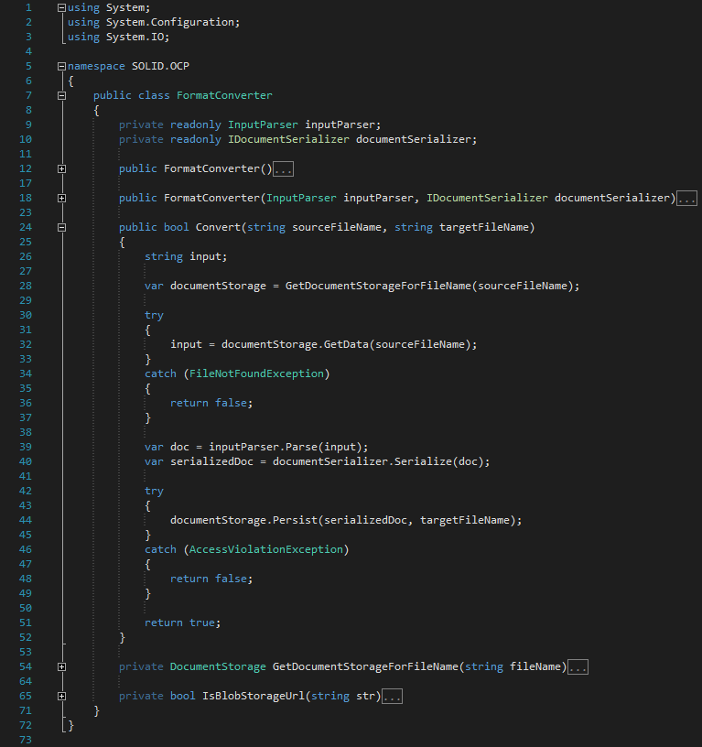

Slide 19
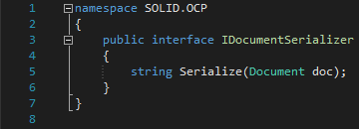

Slide 20
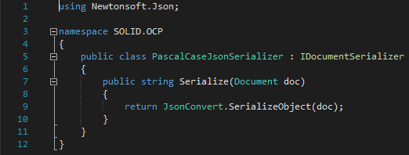

Slide 21
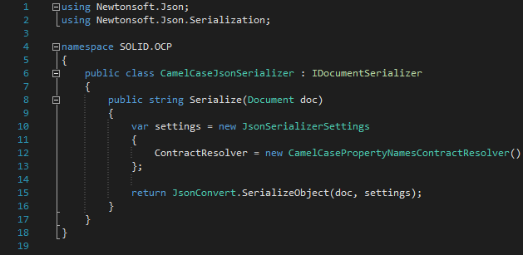

Slide 22
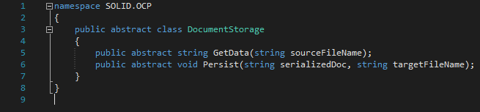

Slide 23
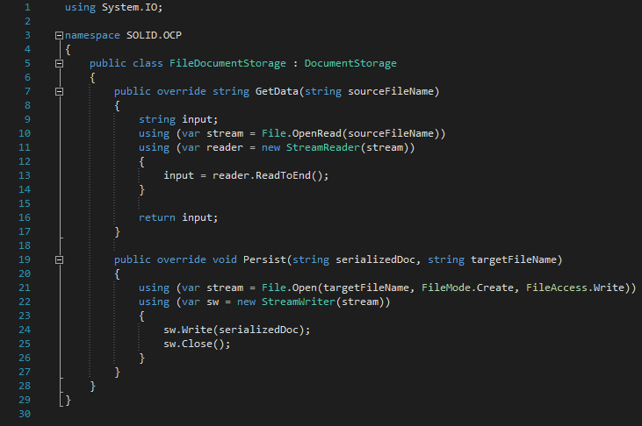

Slide 24
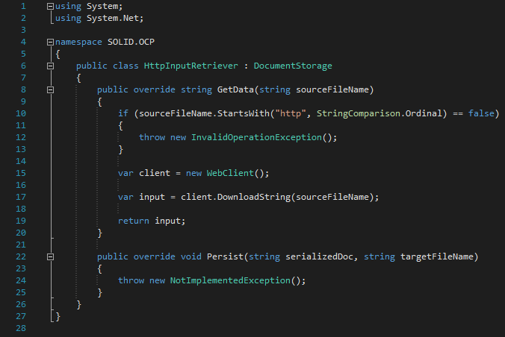

Slide 25
Benefits

Slide 26
Liskovs Substitution Principle
3

Slide 27
“
"Let q(x) be a property provable about objects x of type T. Then q(y) should be provable for objects y of type S where S is a subtype of T. “
- Barbara Liskov
OR
A subclass should behave in such a way that it will not cause problems when used instead of the superclass.
- Normal People
Notes:
Contravariance of method arguments in sub class is allowed.
Covariance of return types in sub class is not allowed.
No new exception types are allowed to be thrown, unless they are sub classes of previously used ones.
Preconditions cannot be strengthened in a subtype. Postconditions cannot be weakened in a subtype.
The history constraint(not allowed to change mutable to immutable and vice versa.)

Slide 28
“
Contra variance of method arguments in sub class is allowed.
Covariance of return types in sub class is not allowed.
No new exception types are allowed to be thrown, unless they are sub classes of previously used ones.
Preconditions cannot be strengthened in a subtype. Post conditions cannot be weakened in a subtype.
The history constraint(not allowed to change mutable to immutable and vice versa.)

Slide 29
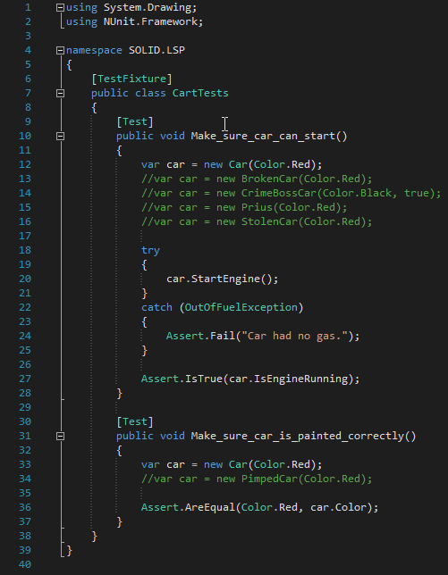

Slide 30
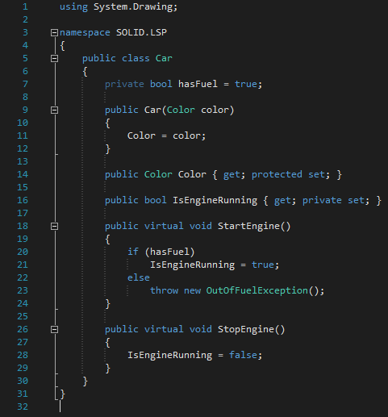

Slide 31
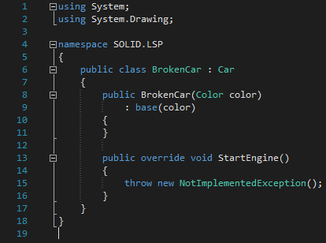
Notes:
Breaks:
No new exception types are allowed to be thrown, unless they are sub classes of previously used ones.
Preconditions cannot be strengthened in a subtype. Post conditions cannot be weakened in a subtype.

Slide 32
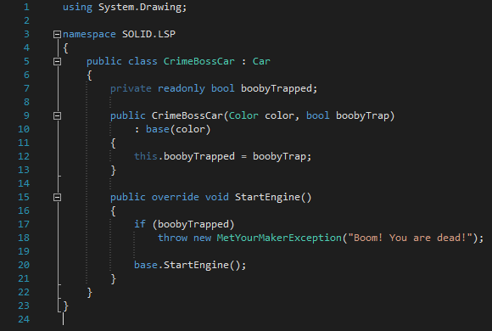
Notes:
Breaks:
No new exception types are allowed to be thrown, unless they are sub classes of previously used ones.

Slide 33
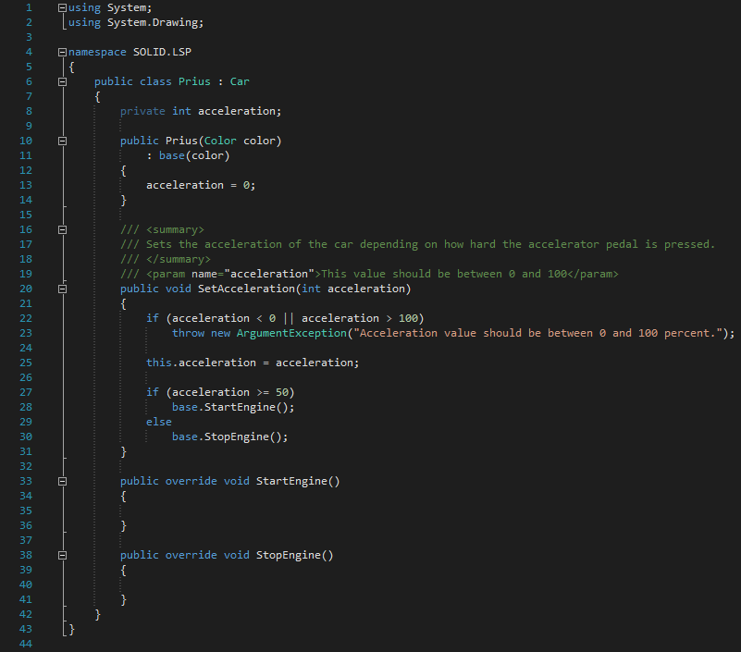
Notes:
Breaks:
Changing invariants.
No new exception types are allowed to be thrown, unless they are sub classes of previously used ones.

Slide 34
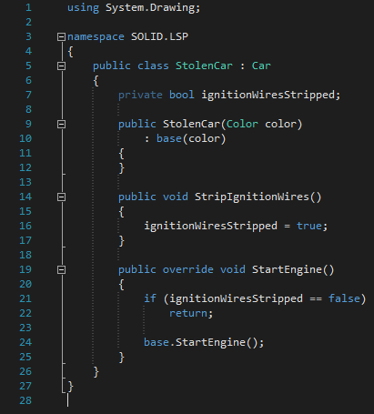
Notes:
Breaks:
Preconditions cannot be strengthened in a subtype.

Slide 35
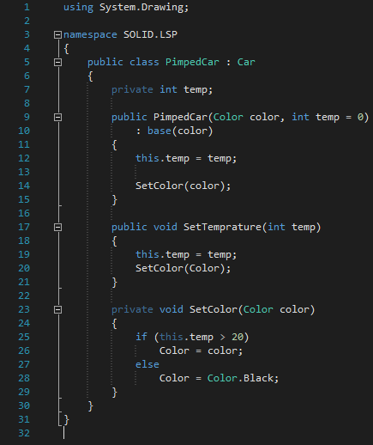
Notes:
Breaks:
The history constraint(not allowed to change mutable to immutable and vice versa.)

Slide 36
Benefits

Slide 37
Interface Segregation Principle
4

Slide 38
“
"Clients should not be forced to depend upon interfaces that they don't use.“

Slide 39
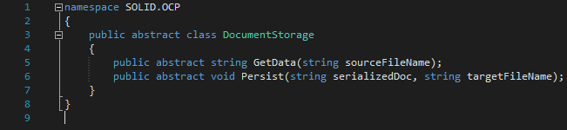

Slide 40
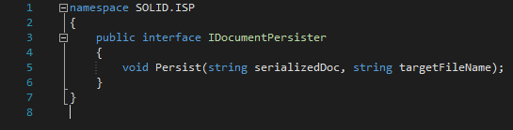

Slide 41
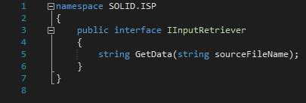

Slide 42
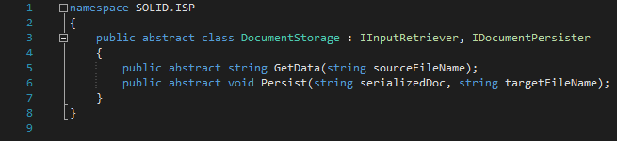

Slide 43
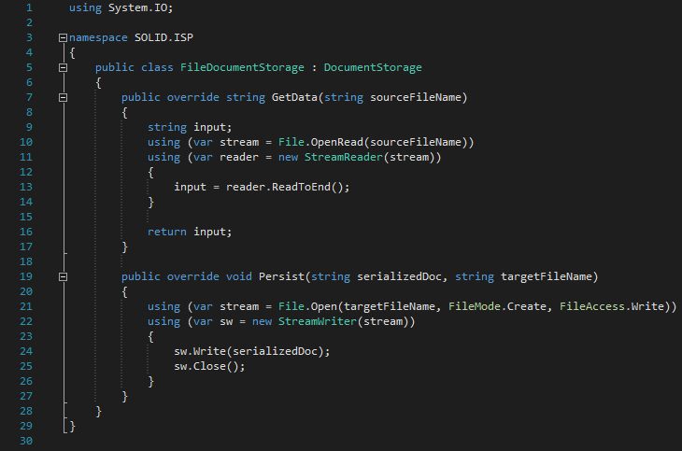

Slide 44
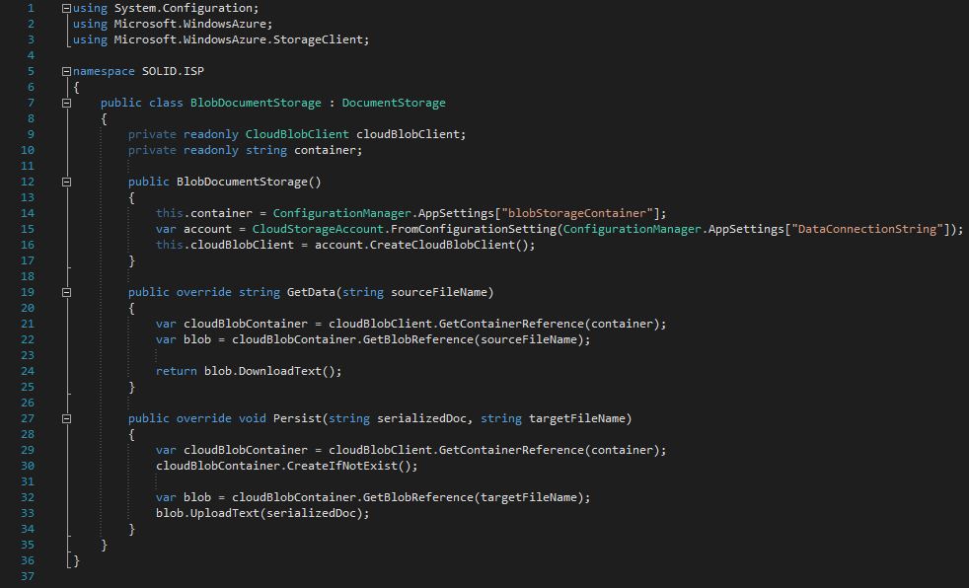

Slide 45
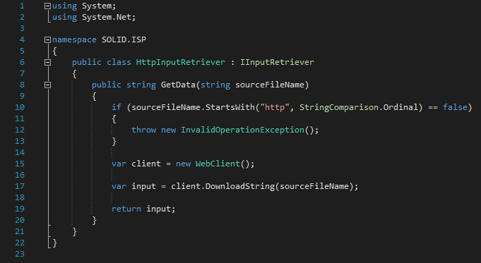

Slide 46
Benefits

Slide 47
Dependency Inversion Principle
5

Slide 48
Dependency Inversion ≠ Dependency Injection

Slide 49
“
"High-level modules should not depend on low-level modules. Both should depend on abstractions. Abstractions should not depend upon details. Details should depend upon abstractions.“
OR
By making sure classes don't depend on specific implementations, it becomes easy to change things around.

Slide 50
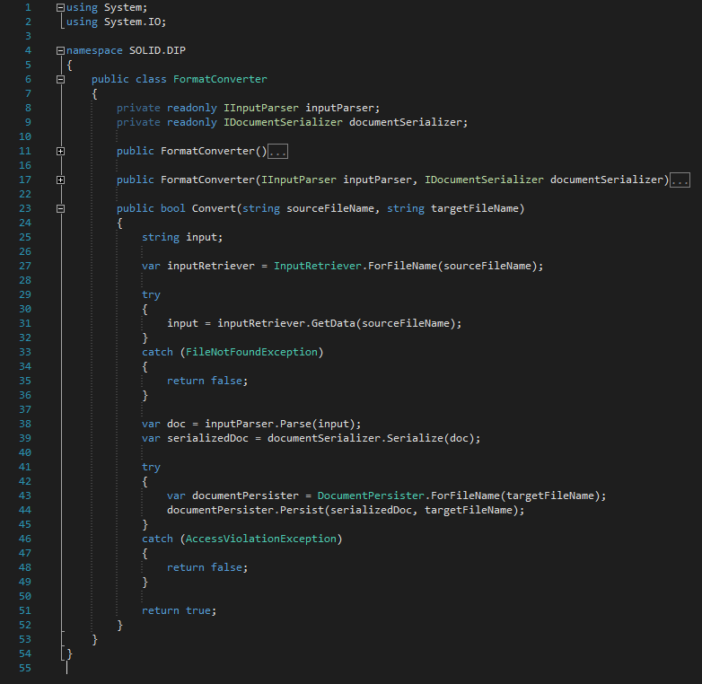

Slide 51
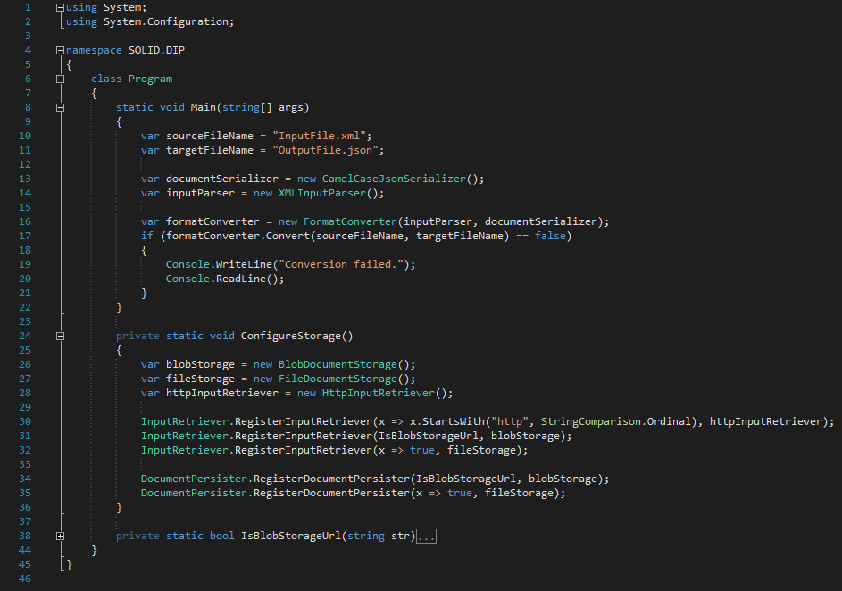

Slide 52
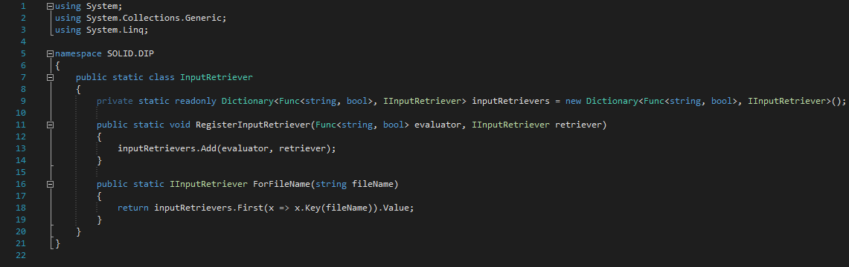

Slide 53
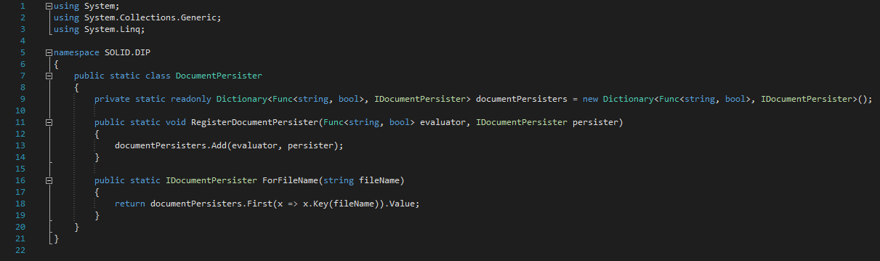

Slide 54
Benefits

Slide 55
THANKS!
Any questions?

