Slide 1
S.O.L.I.D.

Slide 2
Hello!

Slide 3
- S.O.L.I.D - Models for the Rescue - Domain Driven Design - DDD Introduction - DDD Strategic Design - DDD Tactical Design - Software Architecture (Parts I, II & III) - Application Lifecycle Management - Continuous Integration, Deployment, Delivery - Generic Domain as a Service - CQRS - Event Sourcing - oAuth 2.0 & OIDC - Lucene - Hystrix - Cassandra
Notes:
Software Architecture
Boundaries,
Actor Pattern
CAP Theorem
Layered Architecture
Messaging
Microservices
Monoliths,
Onion Architecture
ORMs
Scalability
SOA
Logical Architecture vs Physical Architecture
Decoupling
Publish/Subscribe
CQRS
Eventual Consistency
Event Sourcing

Slide 4
THE CODE
Notes:
Introduction to the domain

Slide 5
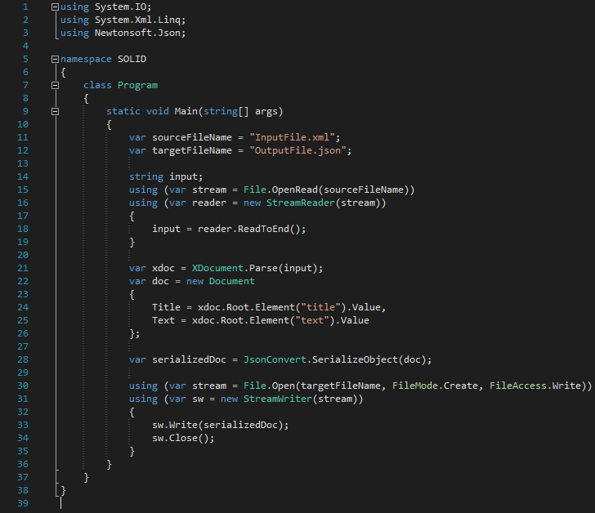

Slide 6
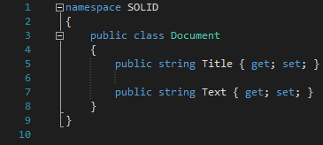

Slide 7
What was wrong in this picture?

Slide 8
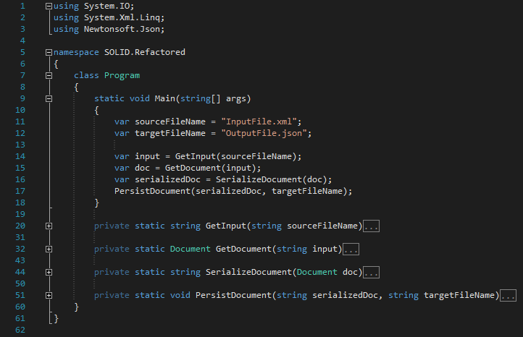

Slide 9
Is it better?

Slide 10
Single Responsibility Principle
1

Slide 11
“
"A class should have only one reason to change. “
OR
There can be only one requirement that, when changed, will cause a class to change.

Slide 12
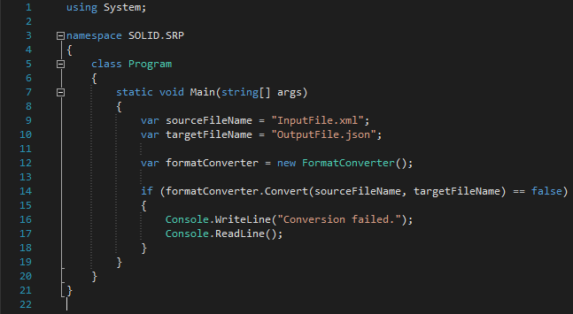

Slide 13
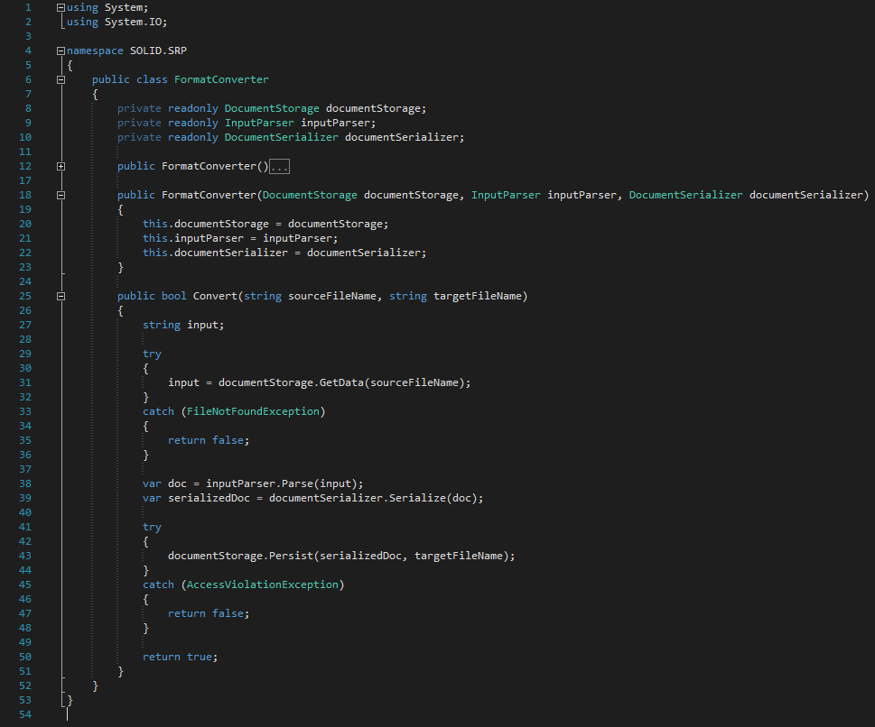

Slide 14
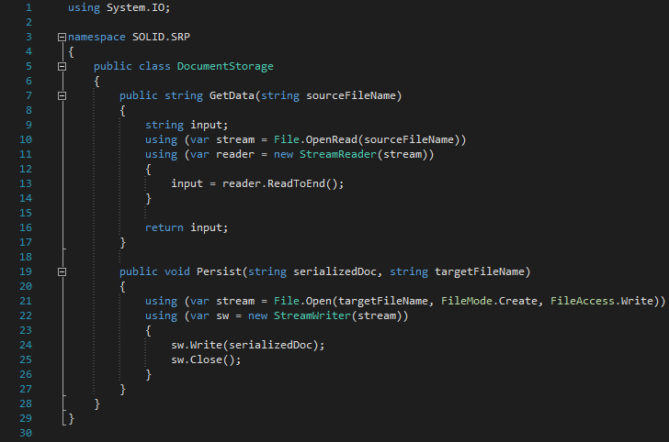

Slide 15
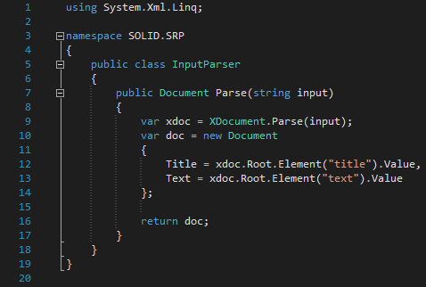

Slide 16
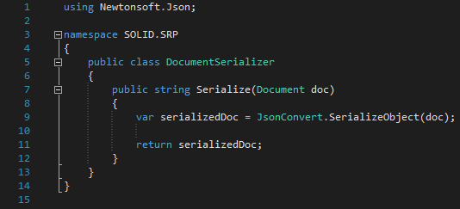

Slide 17
Benefits

Slide 18
Open/Close Principle
2

Slide 19
“
"Software entities should be open for extension, but closed for modification. “
OR
Once a class is done, it is DONE!
Notes:
Meyer vs. Polymorphic

Slide 20
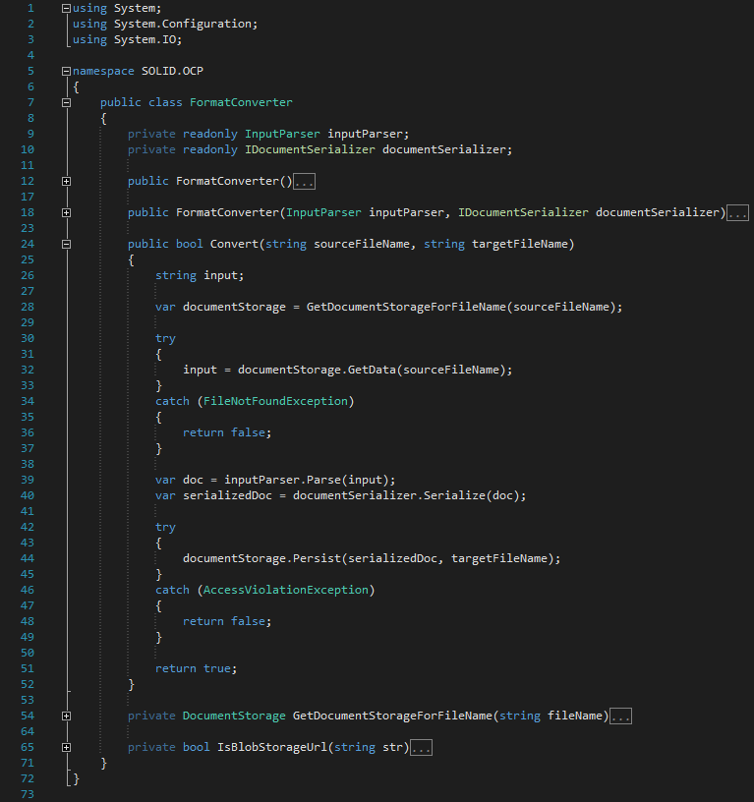

Slide 21
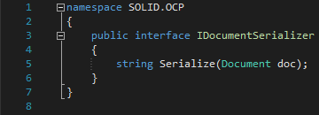

Slide 22
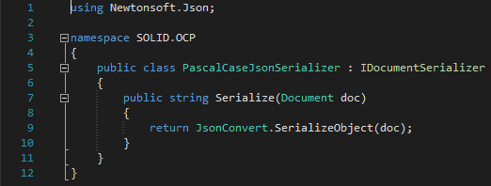

Slide 23
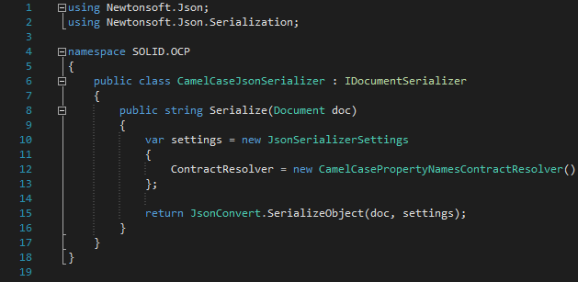

Slide 24
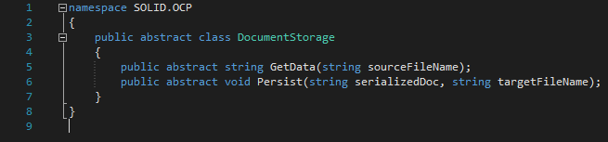

Slide 25
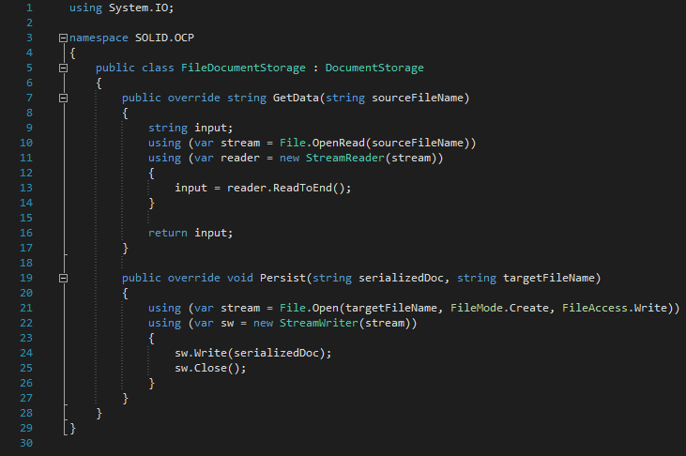

Slide 26
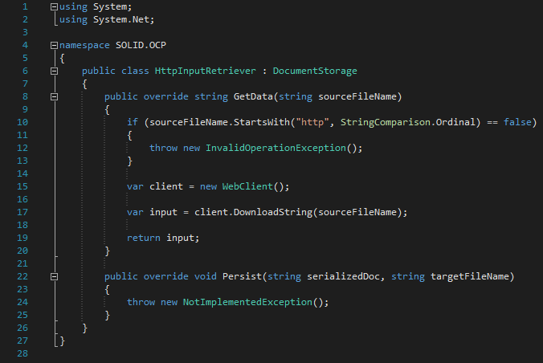

Slide 27
Benefits

Slide 28
Liskovs Substitution Principle
3

Slide 29
“
"Let q(x) be a property provable about objects x of type T. Then q(y) should be provable for objects y of type S where S is a subtype of T. “
- Barbara Liskov
OR
A subclass should behave in such a way that it will not cause problems when used instead of the superclass.
- Normal People
Notes:
Contravariance of method arguments in sub class is allowed.
Covariance of return types in sub class is not allowed.
No new exception types are allowed to be thrown, unless they are sub classes of previously used ones.
Preconditions cannot be strengthened in a subtype. Postconditions cannot be weakened in a subtype.
The history constraint(not allowed to change mutable to immutable and vice versa.)

Slide 30
“
Contra variance of method arguments in sub class is allowed.
Covariance of return types in sub class is not allowed.
No new exception types are allowed to be thrown, unless they are sub classes of previously used ones.
Preconditions cannot be strengthened in a subtype. Post conditions cannot be weakened in a subtype.
The history constraint(not allowed to change mutable to immutable and vice versa.)

Slide 31
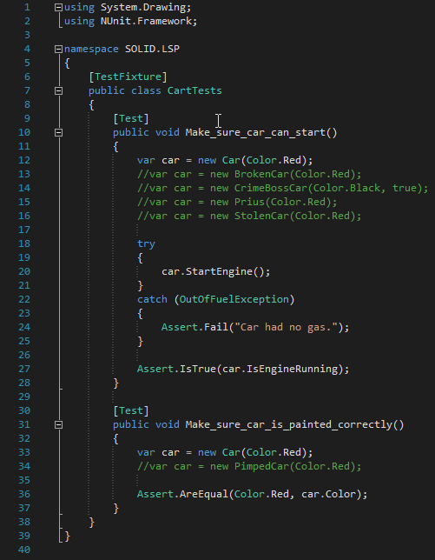

Slide 32
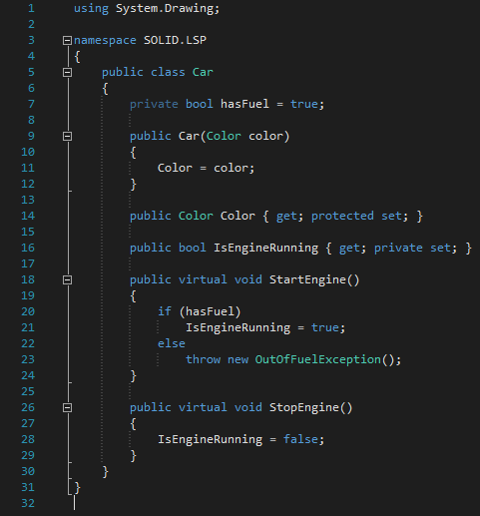

Slide 33
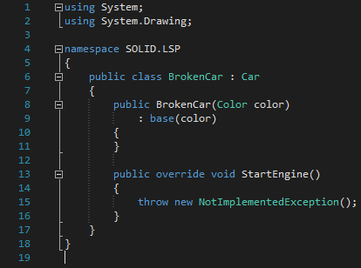
Notes:
Breaks:
No new exception types are allowed to be thrown, unless they are sub classes of previously used ones.
Preconditions cannot be strengthened in a subtype. Post conditions cannot be weakened in a subtype.

Slide 34
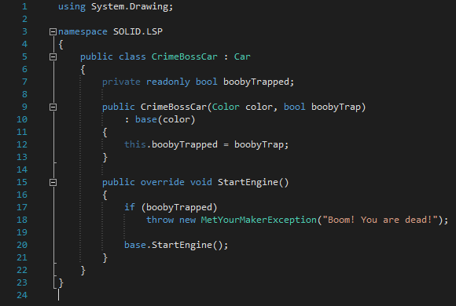
Notes:
Breaks:
No new exception types are allowed to be thrown, unless they are sub classes of previously used ones.

Slide 35
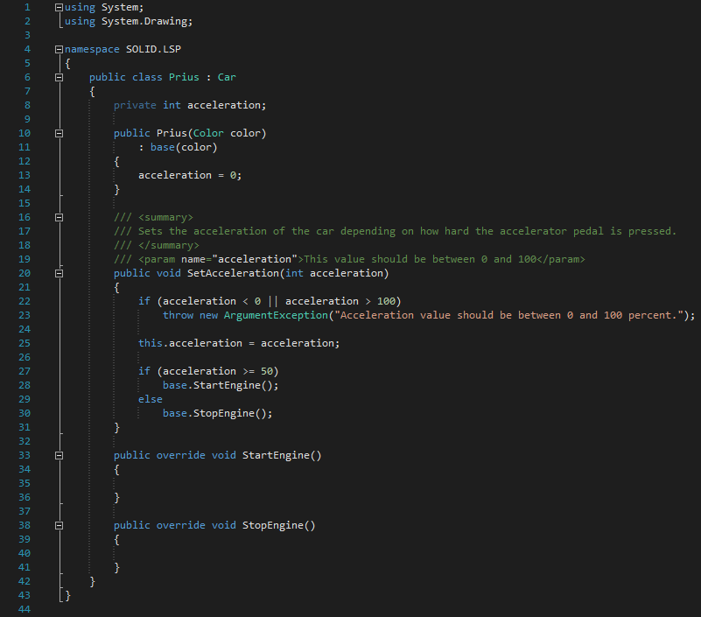
Notes:
Breaks:
Changing invariants.
No new exception types are allowed to be thrown, unless they are sub classes of previously used ones.

Slide 36
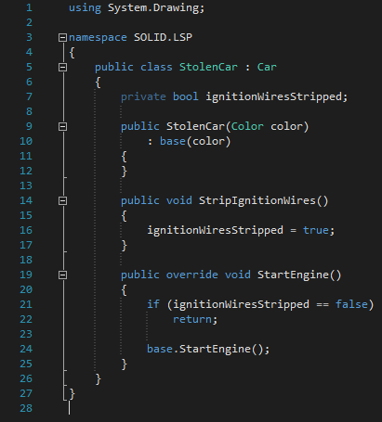
Notes:
Breaks:
Preconditions cannot be strengthened in a subtype.

Slide 37
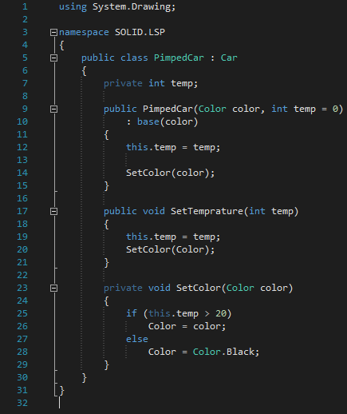
Notes:
Breaks:
The history constraint(not allowed to change mutable to immutable and vice versa.)

Slide 38
Benefits

Slide 39
Interface Segregation Principle
4

Slide 40
“
"Clients should not be forced to depend upon interfaces that they don't use.“

Slide 41
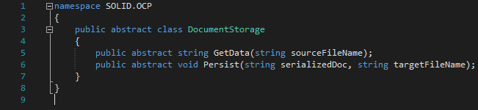

Slide 42
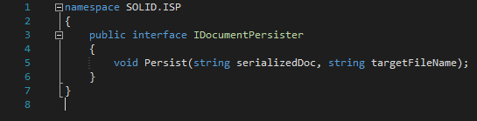

Slide 43
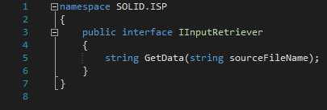

Slide 44
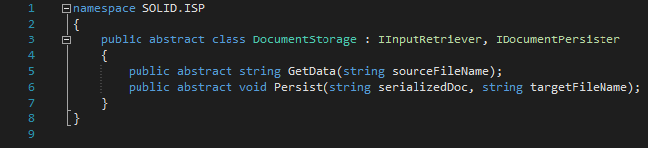

Slide 45
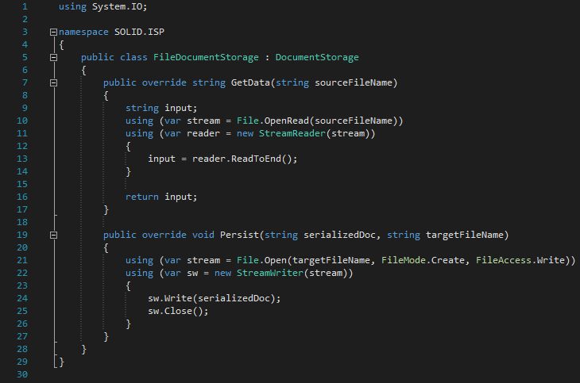

Slide 46
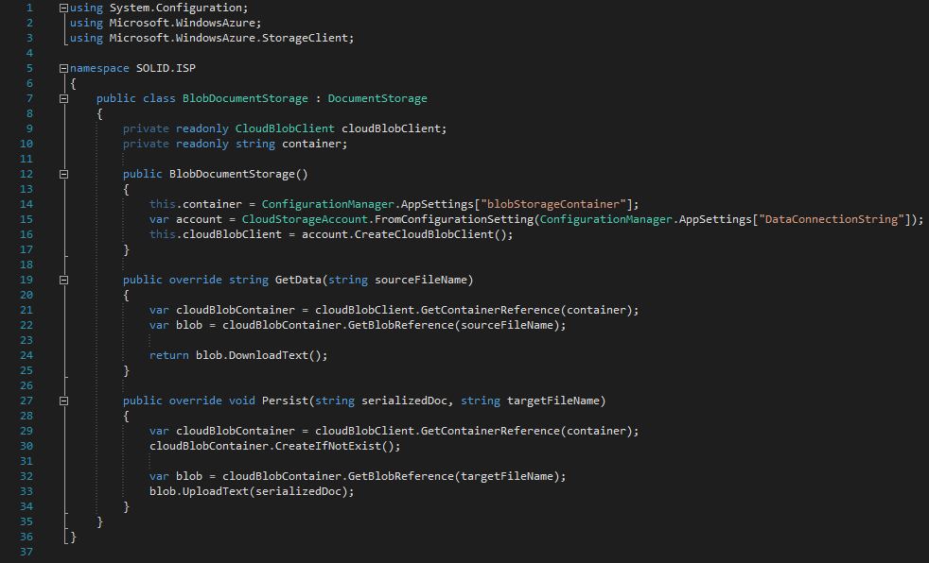

Slide 47
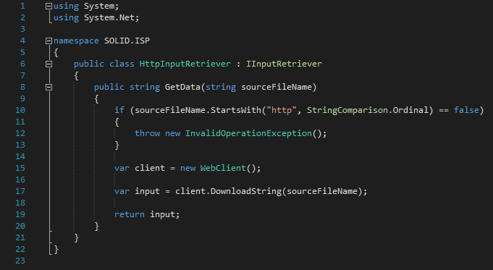

Slide 48
Benefits

Slide 49
Dependency Inversion Principle
5

Slide 50
Dependency Inversion ≠ Dependency Injection

Slide 51
“
"High-level modules should not depend on low-level modules. Both should depend on abstractions. Abstractions should not depend upon details. Details should depend upon abstractions.“
OR
By making sure classes don't depend on specific implementations, it becomes easy to change things around.

Slide 52
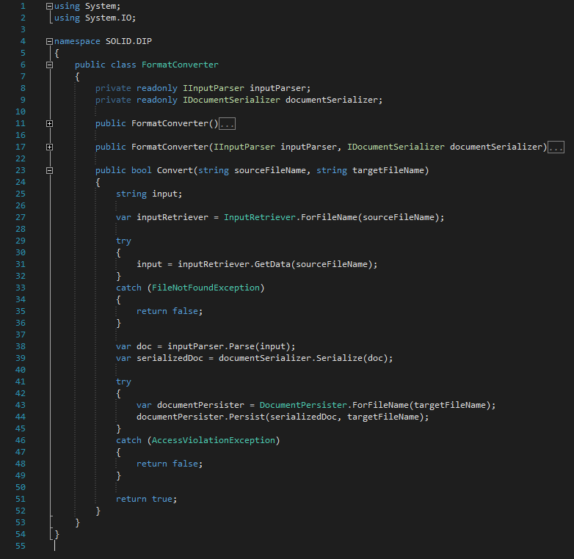

Slide 53
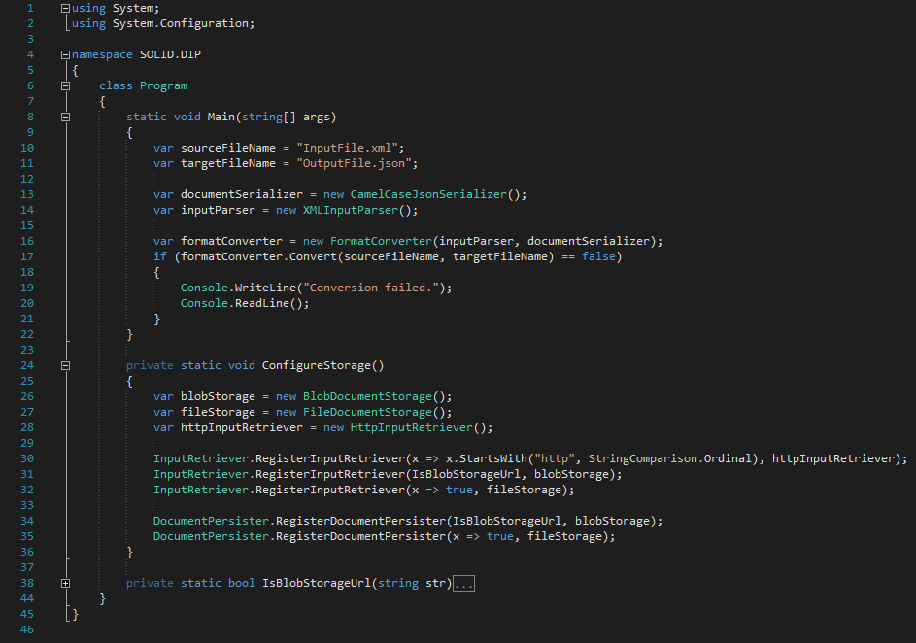

Slide 54
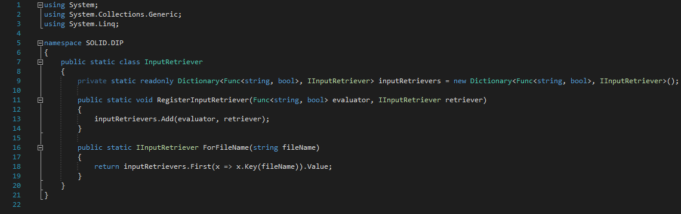

Slide 55
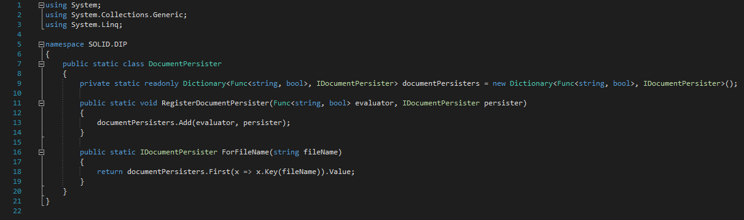

Slide 56
Benefits

Slide 57
Thanks!
Any questions?

