Slide 1
HELLO!

Slide 2
- S.O.L.I.D - Models for the Rescue - Domain Driven Design - DDD Introduction - DDD Strategic Design - DDD Tactical Design - Software Architecture - Application Lifecycle Management - Continuous Integration, Deployment, Delivery - Generic Domain as a Service - CQRS - Event Sourcing - oAuth 2.0 & OIDC - Lucene - Hystrix - Cassandra
NOW!
Notes:
Strategic design is macro oriented design.
SOLID applied at system level architecture

Slide 3
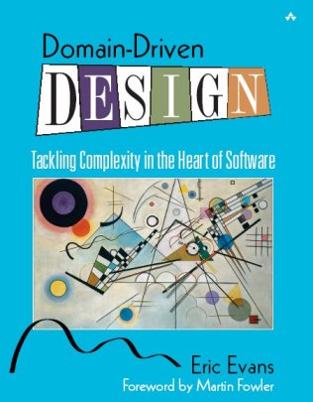
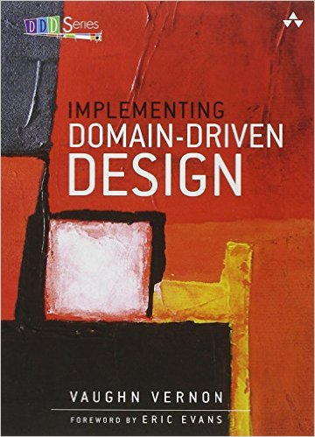
Domain Driven Design Tactical Design
Notes:
- How the Blue book is organized. Read Part IV: Strategic Design to the end and then the whole book.

Slide 4
Domain Driven Design Tactical Design
FOR MANAGERS
https://goo.gl/s5nd4C
Notes:
- How the Blue book is organized. Read Part IV: Strategic Design to the end and then the whole book.

Slide 5
Domain Driven Development
Notes:
iTS NOT Domain Driven Development

Slide 6
Domain Driven Development
Domain Driven Design

Slide 7
Recap
Finding the domain experts is essential
Establish Ubiquitous Language
Be aware of Conway’s Law
Big Ball of Mud
Notes:
The big ball of mud starts with a monolith

Slide 8
Even more RECAP
Establish UL
Define Boundaries
Create Bounded Contexts
Draw Context Maps
Notes:
- One concept can exists in two contexts designed with two different models.

Slide 9
Sales
Reporting
Shipping
Billing
Orders
Notes:
Visualize the business process flows on high level
Visualize boundaries
Macro architecture
Much harder to introduce changes
Actually changes occur very rarely

Slide 10
Zoom In
Shipping

Slide 11
Shipping
Value Objects
Entities
Aggregates
Domain Services
Specification Pattern
Domain Events
Notes:
Visualize the business process flows on high level
Visualize boundaries
Macro architecture
Much harder to introduce changes
Actually changes occur very rarely

Slide 12
C#
Value Object != Value Type

Slide 13
Value Object
Many objects have no conceptual identity.
These objects describe characteristics of a thing.

Slide 14
Value Object
measures, quantifies, or describes
a thing in the domain

Slide 15
Value Object
… when you care only about the attributes of an element of the model

Slide 16
Value Object
Integrity
Identity based on composition of values
Validation
Immutable
Business logic without side effects
Testable
Notes:
# From DEV perspective
can be used as identity since they are immutable
should always have equality Comparers for c# / no for F#
Use methods that compute but don't change the state
It can be compared with others using Value equality

Slide 17
Value Object
Company worth
Unit: U.S Dollar
Sign: $
Amount : 50, 000, 000

Slide 18
Entity
Many objects are not fundamentally defined by their attributes, but rather by a thread of continuity and identity
Notes:
how we choose identity

Slide 19
Entity
Integrity
Identity
Validation
Mutable
Business logic - orchestrator
Able to retrieve, track, edit

Slide 20
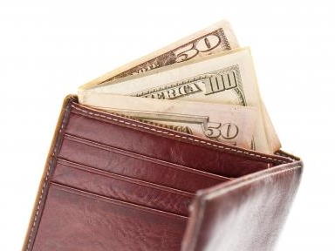
Entity vs Value Object

Slide 21
Aggregate
Entity
Entity
VO
Entity
VO
VO
Entity
VO
VO
Entity

Slide 22
Aggregate
Consists of one or more Entities or VO that changes together
Maintain invariants

Slide 23
Invariants
A condition that should always be true for the system to be in consistent state
Something in the system must be true in order for the model to be consistent or valid

Slide 24
Examples of Invariants
Total items in purchase order do not exceed limit
Two appointments do not overlap one another
End date follows Begin date
User password must be at least 8 symbols

Slide 25
Aggregate
AggregateRoot
Entity
Entity
VO
Entity
VO
VO
Entity
VO
VO
Entity

Slide 26
Aggregate Root
Just an Entity
Parent object of all members of aggregate
Enforce invariants
Notes:
- deleting of an objects cascades to deleting another object then it is likely to be AR http://i.imgur.com/zqaOlWm.png
- saving changes can save entire aggregate

Slide 27
Domain Service
When a significant process or transformation in the domain is not a natural responsibility of an ENTITY or VALUE OBJECT, add an operation to the model as standalone interface declared as a SERVICE. Define the interface in terms of the language of the model and make sure the operation name is part of the UBIQUITOUS LANGUAGE. Make the SERVICE stateless.

Slide 28
Domain Service vs Application Service
Domain services are very granular where as application services are a facade purposed with providing an API.
Domain services contain domain logic that can’t naturally be placed in an entity or value object whereas application services orchestrate the execution of domain logic and don’t themselves implement any domain logic.

Slide 29
Domain Service vs Application Service
Domain service methods can have other domain elements as operands and return values whereas application services operate upon trivial operands such as identity values and primitive data structures.
Application services declare dependencies on infrastructural services required to execute domain logic.

Slide 30
Domain Service vs Application Service
Command handlers are a flavor of application services which focus on handling a single command typically in a CQRS architecture.

Slide 31
Specification Pattern
https://en.wikipedia.org/wiki/Specification_pattern
Notes:
- deleting of an objects cascades to deleting another object then it is likely to be AR http://i.imgur.com/zqaOlWm.png
- saving changes can save entire aggregate

Slide 32
Domain Events
Just wait for the CQRS…
Notes:
- deleting of an objects cascades to deleting another object then it is likely to be AR http://i.imgur.com/zqaOlWm.png
- saving changes can save entire aggregate

Slide 33
Credits
Domain-Driven Design: Tackling Complexity in the Heart of Software
Domain-Driven Design Quickly
Implementing Domain-Driven Design
https://domainlanguage.com/ddd/howtoreadthebook/ReadingDDDForManagers.pdf

Slide 34
- S.O.L.I.D - Models for the Rescue - Domain Driven Design - Software Architecture - It is not what you think - The ROCK - STD - The Pigeon - Application Lifecycle Management - Continuous Integration, Deployment, Delivery - Generic Domain as a Service - CQRS - Event Sourcing - oAuth 2.0 & OIDC - Lucene - Hystrix - Cassandra
Coming up!
Notes:
https://github.com/Elders/be-a-better-dev/tree/master/Presentations

Slide 35
THANKS!
Any questions?

