Slide 1
S.O.L.I.D.

Slide 2
THE CODE
Notes:
Talk about the domain./

Slide 3
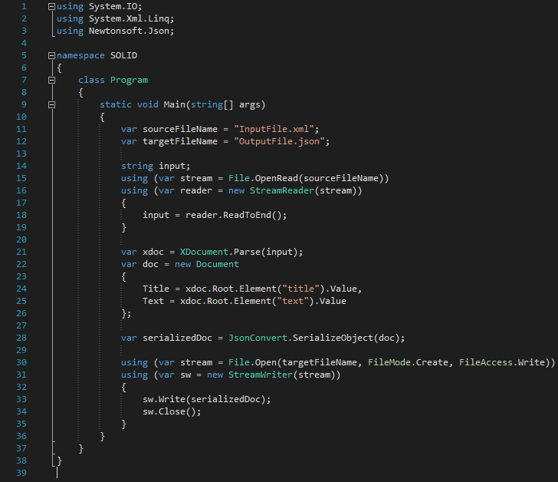

Slide 4
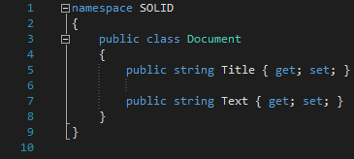

Slide 5
What was wrong in this picture?

Slide 6
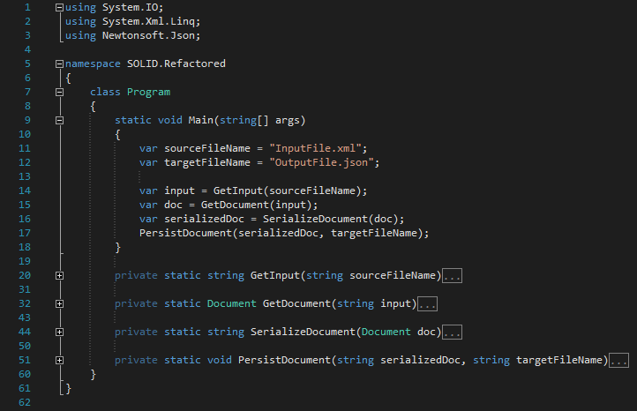
Notes:
Is it better?
This is imperative programming not object oriented programming.
This class is doing too many things, or its having too many responsibilities.

Slide 7
Single Responsibility Principle
1

Slide 8
“
"A class should have only one reason to change. “
OR
There can be only one requirement that, when changed, will cause a class to change.

Slide 9
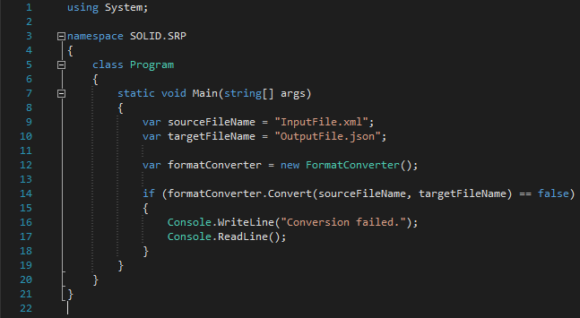

Slide 10
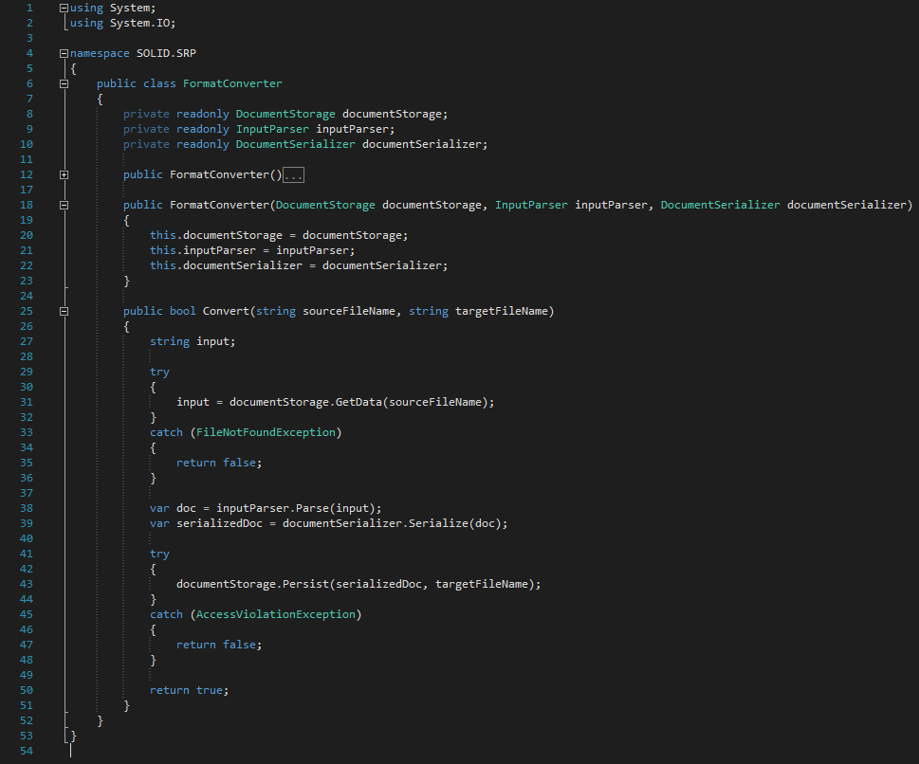

Slide 11
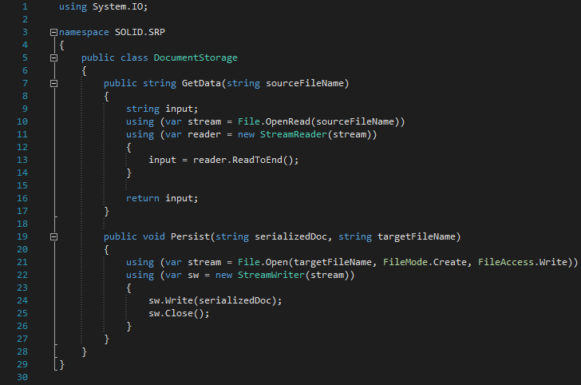

Slide 12
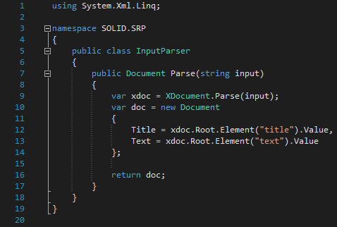

Slide 13
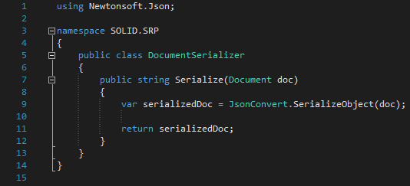

Slide 14
Benefits

Slide 15
Open/Close Principle
2

Slide 16
“
"Software entities should be open for extension, but closed for modification. “
OR
Once a class is done, it is DONE!
Notes:
Meyer vs. Polymorphic

Slide 17
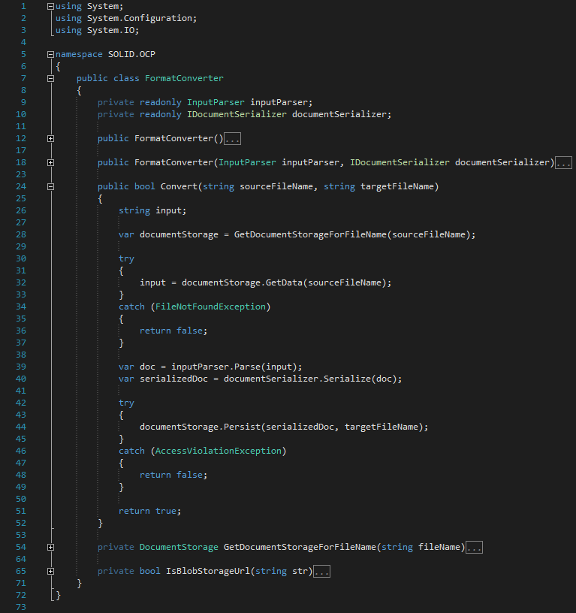

Slide 18
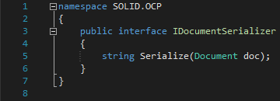

Slide 19
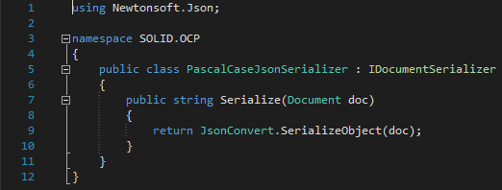

Slide 20
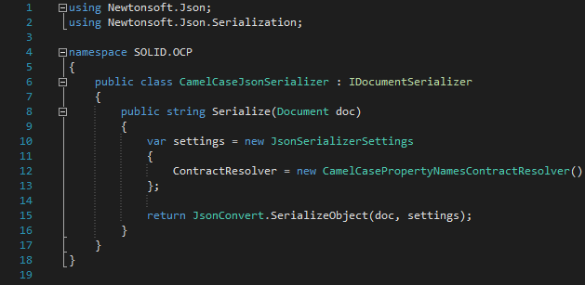

Slide 21
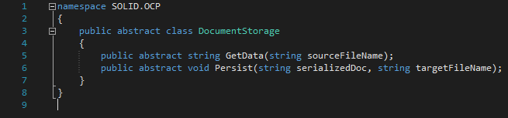

Slide 22
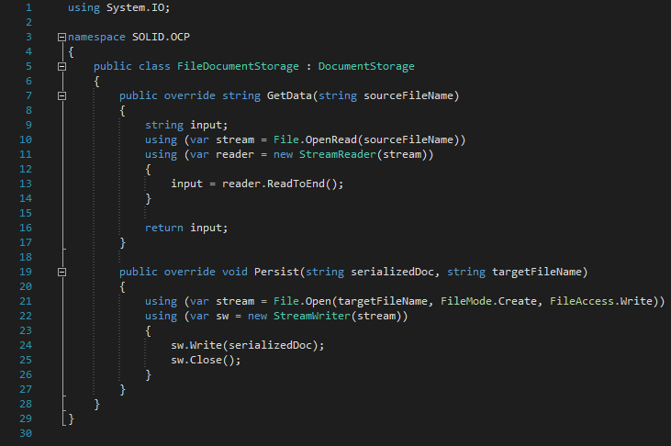

Slide 23
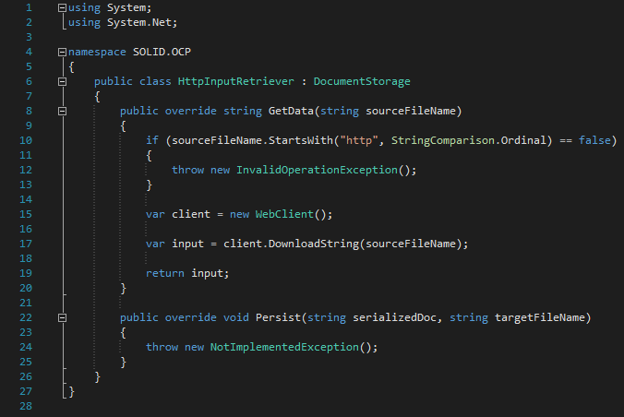

Slide 24
Benefits

Slide 25
Liskovs Substitution Principle
3

Slide 26
“
"Let q(x) be a property provable about objects x of type T. Then q(y) should be provable for objects y of type S where S is a subtype of T. “
- Barbara Liskov
OR
A subclass should behave in such a way that it will not cause problems when used instead of the superclass.
- Normal People
Notes:
Contravariance of method arguments in sub class is allowed.
Covariance of return types in sub class is not allowed.
No new exception types are allowed to be thrown, unless they are sub classes of previously used ones.
Preconditions cannot be strengthened in a subtype. Postconditions cannot be weakened in a subtype.
The history constraint(not allowed to change mutable to immutable and vice versa.)

Slide 27
“
Contra variance of method arguments in sub class is allowed.
Covariance of return types in sub class is not allowed.
No new exception types are allowed to be thrown, unless they are sub classes of previously used ones.
Preconditions cannot be strengthened in a subtype. Post conditions cannot be weakened in a subtype.
The history constraint(not allowed to change mutable to immutable and vice versa.)

Slide 28
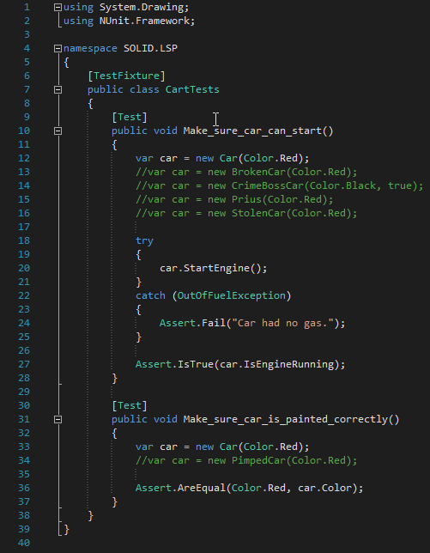

Slide 29
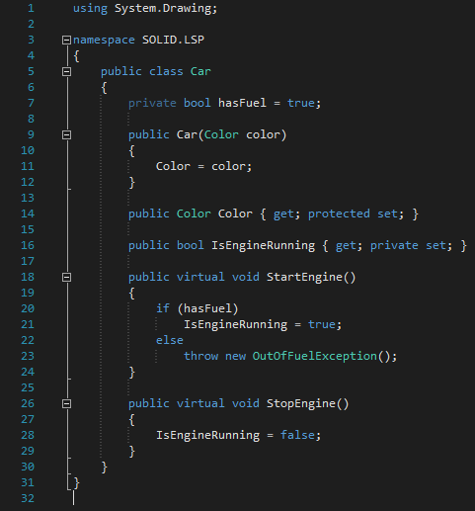

Slide 30
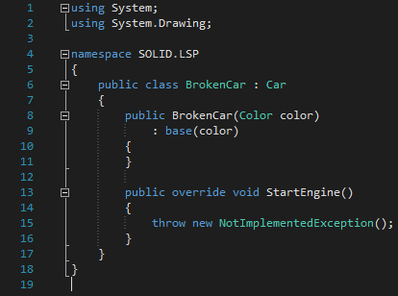
Notes:
Breaks:
No new exception types are allowed to be thrown, unless they are sub classes of previously used ones.
Preconditions cannot be strengthened in a subtype. Post conditions cannot be weakened in a subtype.

Slide 31
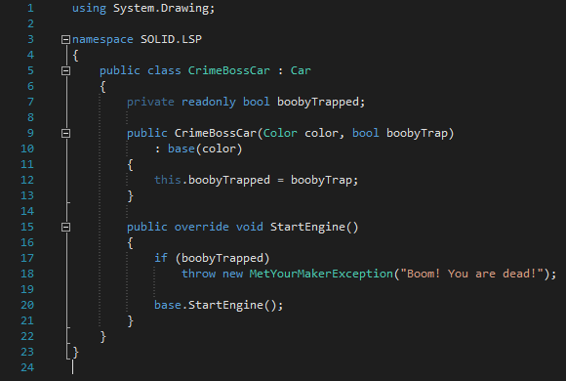
Notes:
Breaks:
No new exception types are allowed to be thrown, unless they are sub classes of previously used ones.

Slide 32
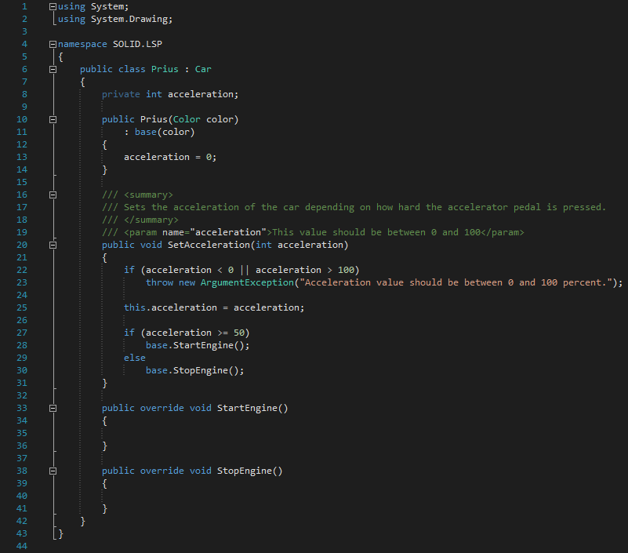
Notes:
Breaks:
Changing invariants.
No new exception types are allowed to be thrown, unless they are sub classes of previously used ones.

Slide 33
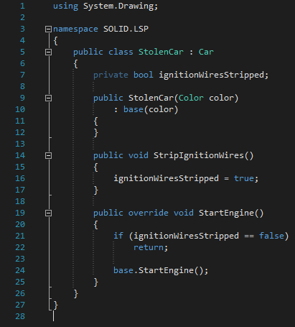
Notes:
Breaks:
Preconditions cannot be strengthened in a subtype.

Slide 34
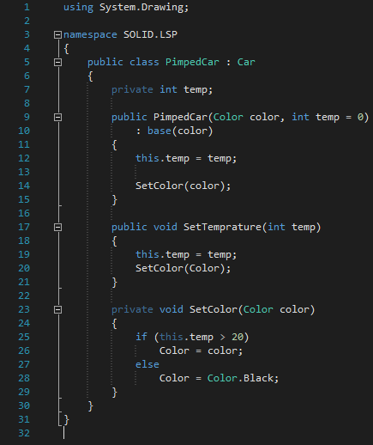
Notes:
Breaks:
The history constraint(not allowed to change mutable to immutable and vice versa.)

Slide 35
Benefits

Slide 36
Interface Segregation Principle
4

Slide 37
“
"Clients should not be forced to depend upon interfaces that they don't use.“

Slide 38
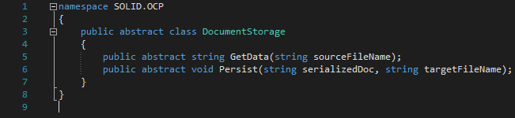

Slide 39
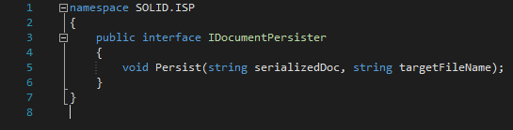

Slide 40
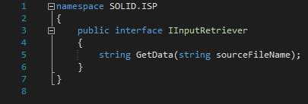

Slide 41
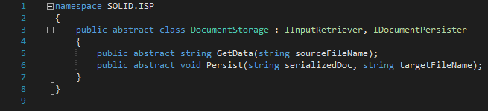

Slide 42
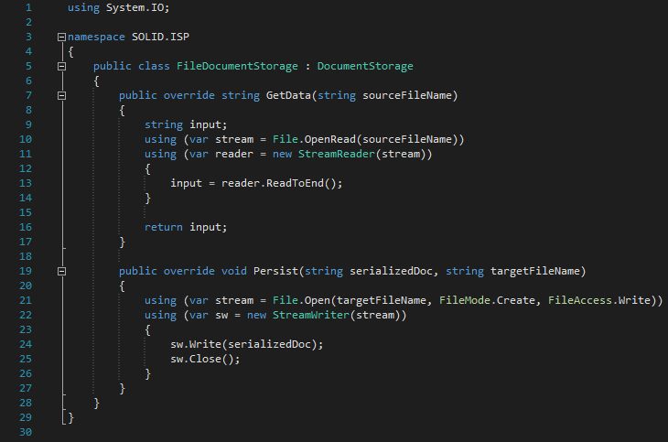

Slide 43
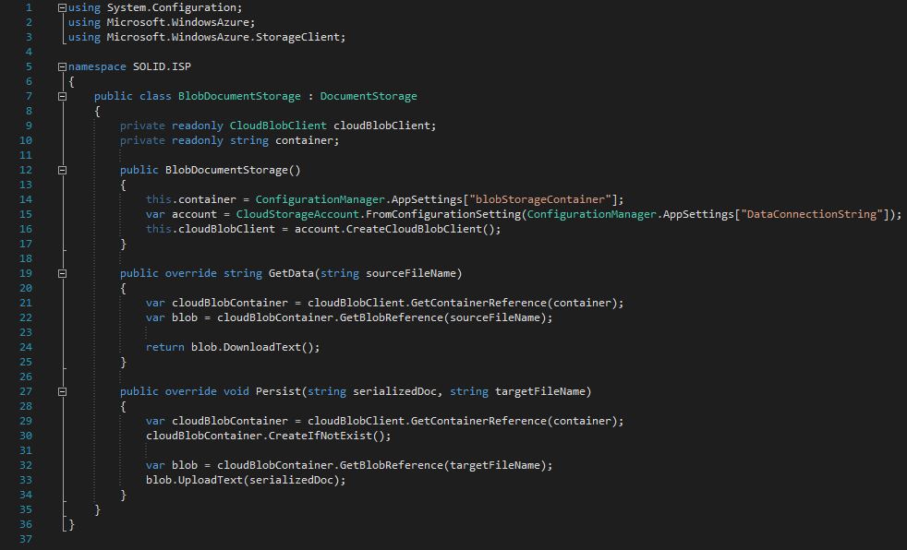

Slide 44
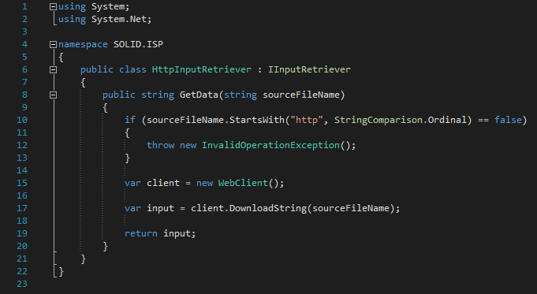

Slide 45
Benefits

Slide 46
Dependency Inversion Principle
5

Slide 47
Dependency Inversion ≠ Dependency Injection

Slide 48
“
"High-level modules should not depend on low-level modules. Both should depend on abstractions. Abstractions should not depend upon details. Details should depend upon abstractions.“
OR
By making sure classes don't depend on specific implementations, it becomes easy to change things around.

Slide 49
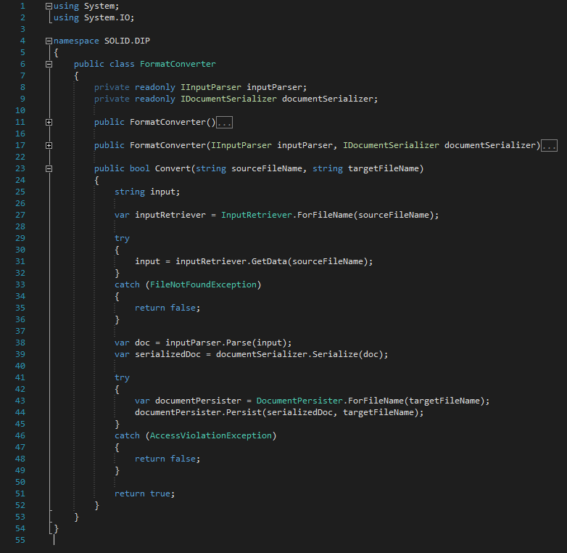

Slide 50
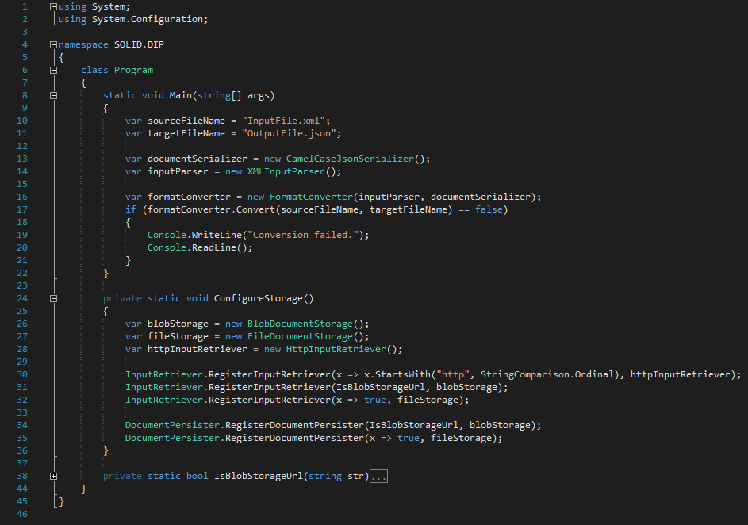

Slide 51
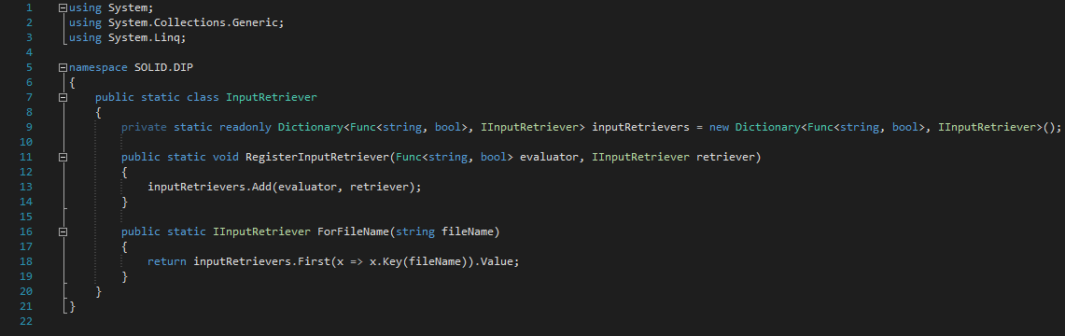

Slide 52
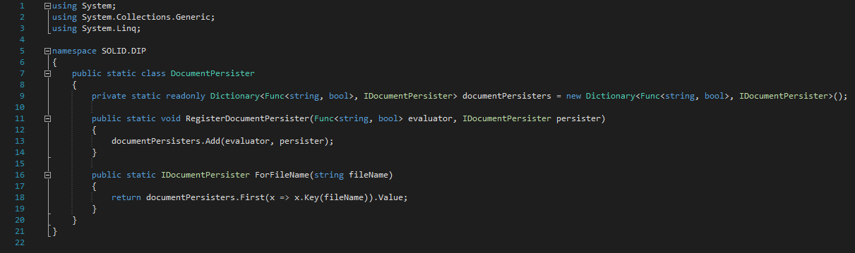

Slide 53
Benefits

Slide 54
THANKS!
Any questions?

