Slide 1
HELLO!

Slide 2
- S.O.L.I.D - Models for the Rescue - Domain Driven Design - Software Architecture - It is not what you think - The ROCK - STD - The Pigeon - Application Lifecycle Management - Continuous Integration, Deployment, Delivery - Generic Domain as a Service - CQRS - Event Sourcing - oAuth 2.0 & OIDC - Lucene - Hystrix - Cassandra
NOW!
Notes:
Strategic design is macro oriented design.
SOLID applied at system level architecture

Slide 3
Software Architecture It is not what you think
Notes:
- How the Blue book is organized. Read Part IV: Strategic Design to the end and then the whole book.

Slide 4
What is Software Architecture?
The highest-level breakdown of a system into its parts; the decisions that are hard to change; there are multiple architectures in a system; what is architecturally significant can change over a system's lifetime; and, in the end, architecture boils down to whatever the important stuff is.
- Martin Fowler

Slide 5
Logical vs Physical Architecture
Notes:
1. If two distinct logical components have been identified, that doesn’t mean they should be hosted separately.
2. Example MVC controllers.

Slide 6
How to design Software Architecture?

Slide 7
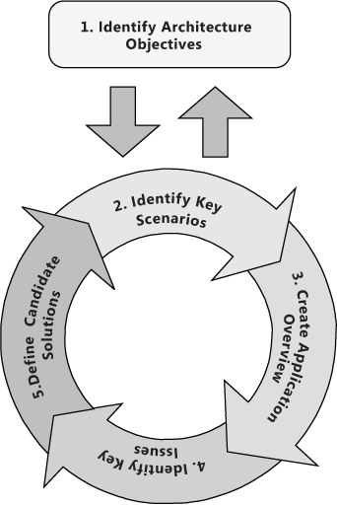
Notes:
Input
Output
Goals
Boundary
Decoupling

Slide 8
Build to change instead of building to last!!!

Slide 9
Architectural patterns
What is it?
An architectural pattern is a general, reusable solution to a commonly occurring problem in software architecture within a given context. Architectural patterns are similar to software design pattern but have a broader scope. The architectural patterns address various issues in software engineering, such as computer hardware performance limitations, high availability and minimization of a business risk. Some architectural patterns have been implemented within software frameworks.
- Wikipedia

Slide 10
Which is an architecture pattern?
CQRS, REST, TCP, Actor, Message Bus, AMQP

Slide 11
Which is an architecture pattern?
CQRS, REST, TCP, Actor, Message Bus, AMQP

Slide 12
Build to change instead of building to last!!!

Slide 13
- S.O.L.I.D - Models for the Rescue - Domain Driven Design - Software Architecture - It is not what you think - The ROCK - STD - The Pigeon - Application Lifecycle Management - Continuous Integration, Deployment, Delivery - Generic Domain as a Service - CQRS - Event Sourcing - oAuth 2.0 & OIDC - Lucene - Hystrix - Cassandra
Coming up!
Notes:
https://github.com/Elders/be-a-better-dev/tree/master/Presentations

Slide 14
THANKS!
Any questions?

