Slide 1
HELLO!

Slide 2
- S.O.L.I.D - Models for the Rescue - Domain Driven Design - DDD Introduction - DDD Strategic Design - DDD Tactical Design - Software Architecture (Parts I, II & III) - Application Lifecycle Management - Continuous Integration, Deployment, Delivery - Generic Domain as a Service - CQRS - Event Sourcing - oAuth 2.0 & OIDC - Lucene - Hystrix - Cassandra
NOW!
Notes:
Strategic design is macro oriented design.
SOLID applied at system level architecture

Slide 3
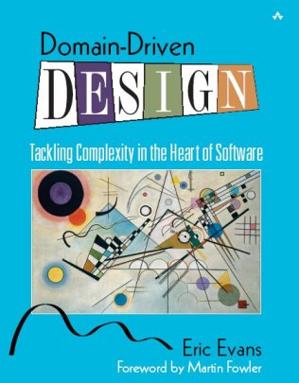
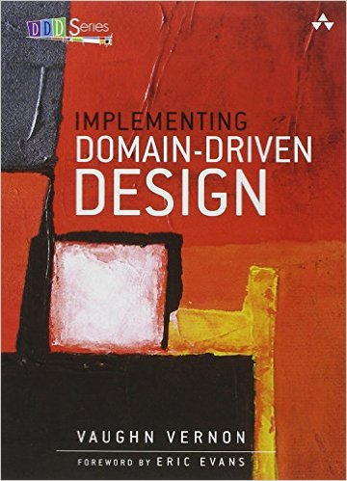
Domain Driven Design Strategic Design
Notes:
- How the Blue book is organized. Read Part IV: Strategic Design to the end and then the whole book.

Slide 4
Domain Driven Design Strategic Design
FOR MANAGERS
https://goo.gl/s5nd4C
Notes:
- How the Blue book is organized. Read Part IV: Strategic Design to the end and then the whole book.

Slide 5
Domain Driven Development

Slide 6
Domain Driven Development
Domain Driven Design

Slide 7
Recap
Big Ball of Mud
Finding the domain experts is essential
Establish Ubiquitous Language
Be aware of Conway’s Law

Slide 8
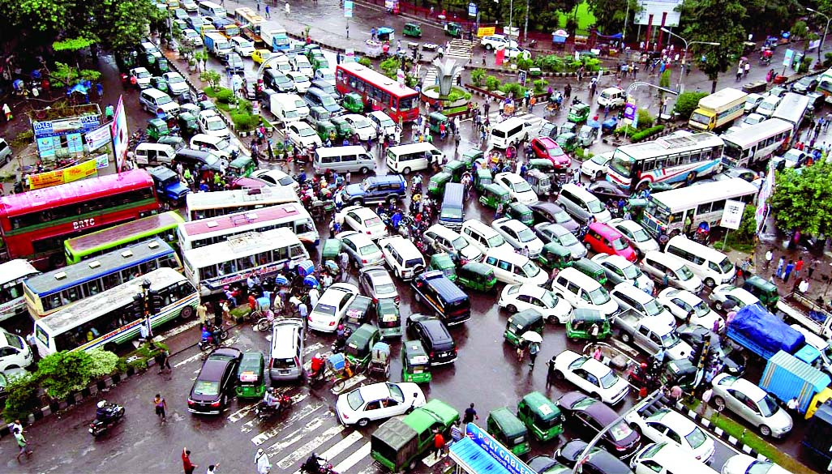

Slide 9
Chaos
None of the system can be well designed

Slide 10
Chaos
None of the system can be well designed
Precision designs are fragile

Slide 11
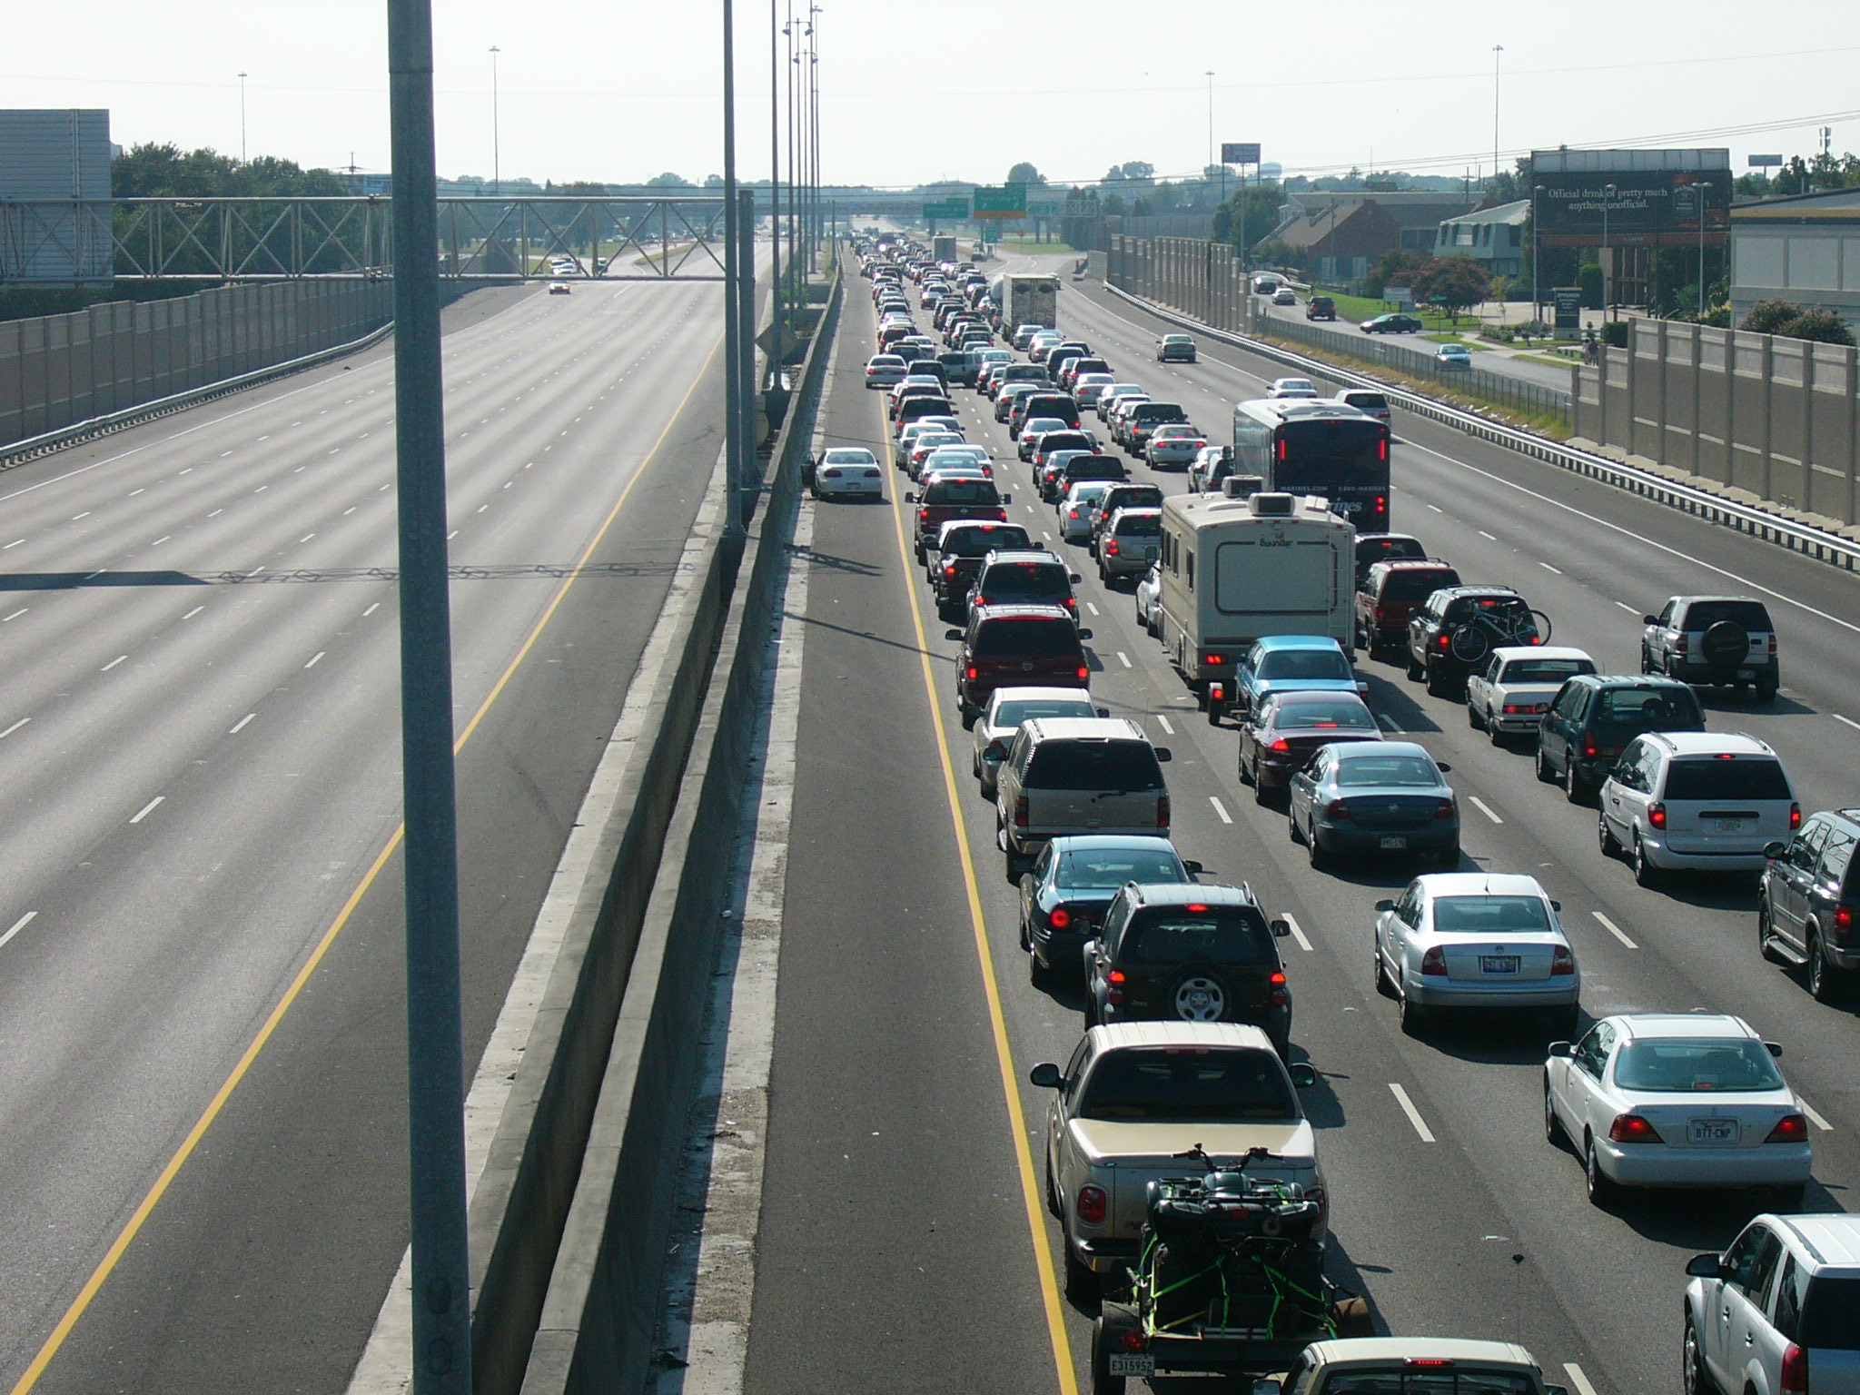
Notes:
- Boundaries achieve some level of organization/order

Slide 12

Notes:
Boundaries are not just brick walls which you cannot cross.
Boundaries can keep you away from mixing responsibilities and in general doing stupid things.

Slide 13
Organized Chaos
Boundaries
Macro vs Micro architecture
Notes:
Boundaries
It is hard to apply changes at macro level (public API)

Slide 14
Problem Space
Domain
Decompose into sub-domains
Or generic sub-domains

Slide 15
Chaos
DOMAIN

Slide 16
Distilling Core Domain
DOMAIN
CORE

Slide 17
Distilling Core Domain
DOMAIN
CORE
Supporting
Subdomain A
Supporting
Subdomain B
Generic
Subdomain

Slide 18
Solution Space
Domain model
Bounded Context

Slide 19
Context Map
What are the models?
What are boundaries within which they are used?
What are the relationships between the models?
Notes:
- One concept can exists in two contexts designed with two different models.

Slide 20
Bounded Context
DOMAIN
CORE
Supporting
Subdomain A
Supporting
Subdomain B
Generic
Subdomain

Slide 21
Credits
Domain-Driven Design: Tackling Complexity in the Heart of Software
Domain-Driven Design Quickly
Implementing Domain-Driven Design
https://domainlanguage.com/ddd/howtoreadthebook/ReadingDDDForManagers.pdf

Slide 22
- S.O.L.I.D - Models for the Rescue - Domain Driven Design - DDD Introduction - DDD Strategic Design - DDD Tactical Design - Software Architecture (Parts I, II & III) - Application Lifecycle Management - Continuous Integration, Deployment, Delivery - Generic Domain as a Service - CQRS - Event Sourcing - oAuth 2.0 & OIDC - Lucene - Hystrix - Cassandra
Coming up!
Notes:
Software Architecture
Boundaries,
CAP Theorem
Layered Architecture
Messaging
Microservices
Onion Architecture
Scalability
SOA
Logical Architecture vs Physical Architecture
Publish/Subscribe
Eventual Consistency

Slide 23
THANKS!
Any questions?

