Slide 1
Logic Apps and Azure Functions
The magic of “serverless” integration
Paco de la Cruz | Mexia
paco@mexia.com.au

Slide 2
Agenda
Background of “serverless” compute
“Serverlessness” of Logic Apps and Azure Functions
Logic Apps and Azure Functions in Integration
Overview of Azure iPaaS
Lab 4 - Logic Apps + Azure Functions

Slide 3
Logic Apps and Azure Functions The magic of “serverless” integration

Slide 4















Evolution of the Cloud (Compute)
Pre-Cloud
B.Y.O. Servers
IaaS
PaaS
“Serverless”
Managed
Business App
Business App
Task
Func
Func
Func
Task
Func
Func
Task
Func

Slide 5
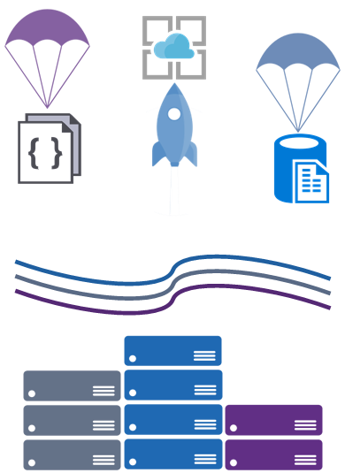
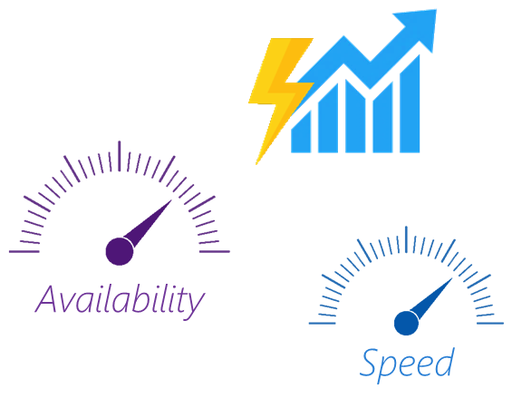

What’s “serverless”
Servers are
fully-abstracted
Scaling is event-driven
not resource-driven
Pay only
for what you use

Slide 6

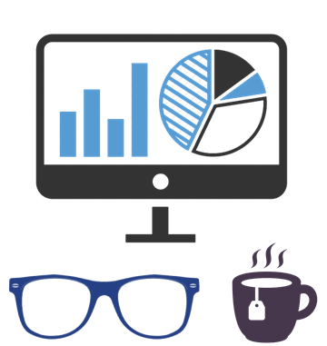
Benefits of “serverless”
Do less
Manage less
Ease of scale
Pay per
execution

Slide 7
“Serverlessness” of Logic Apps and Functions
No need to worry about VMs/PaaS VMs
No need to worry about resources but events
DevOps focus on code, deployment and managing the app, but not the platform.
Pay per action or execution time.
Born, live and die on the cloud (develop, test and ship)

Slide 8
Logic Apps and Functions in Integration
Implement and orchestrate visually designed integration workflows
Orchestrate distributed microservices
100+ Connectors (Protocols, SaaS apps and services, and hybrid)
B2B Integrations with AS2 and EDI
Languages supported: C#, F#, Node.js, Php, PowerShell, Python, bash, batch.
Different Trigger, Input and Output bindings
Implement code-based microservices
Synchronous and Asynchronous execution

Slide 9
Logic Apps Connectors (100+)
Protocols/Native
HTTP, HTTPS
HTTP Webhook
FTP, SFTP
SMTP
RSS
Compose, Query, Parse JSON
Wait
Terminate
Workflow
SaaS
appFigures
Asana
Azure API Management
Azure App Services
Azure Automation
Azure Cognitive Face API
Azure Cognitive LUIS
Azure Cognitive Text Analytics
Azure Data Lake Store
Azure Document DB
Azure Functions
Azure Machine Learning
Azure Resource Manager
Azure Service Bus
Azure SQL
Azure Storage Blob
Azure Storage Queues
Basecamp
Bing Search
BitBucket
Bitly
Blogger
Box
Buffer
Campfire
Chatter
Common Data Service
Disqus
DocuSign
Dropbox
Dynamics AX Online
Dynamics CRM Online
Dynamics CRM Service Bus
Dynamics Financials
Dynamics Operations
Easy Redmine
Eventbrite
Facebook
Freshdesk
GitHub
Gmail
Google Calendar
Google Contacts
Google Drive
Google Sheets
Google Tasks
GoTo Meeting
GoTo Training
GoTo Webinar
Harvest
HelloSign
Infusionsoft
JIRA
Insightly
Instagram
Instapaper
MailChimp
Mandrill
Medium
Microsoft Project Online
Microsoft Translator
MSN Weather
Office 365
Office 365 Users
Office 365 Video
OneDrive
OneDrive for Business
OneNote
Outlook.com
Outlook Tasks
PagerDuty
Pinterest
Pipedrive
Power BI
Project Online
Redmine
Salesforce
Salesforce Chatter
SendGrid
SharePoint Online
Slack
SmartSheet
SparkPost
Stripe
Survey Monkey
Todoist
Trello
Twilio
Twitter
Typeform
UserVoice
VS Team Services
Wordpress
Wunderlist
Yammer
YouTube
XML & EDI
XML Validation
Transform XML (+Mapper)
Flat File Encode
Flat File Decode
X12
EDIFACT
AS2
Integration Account Artifact Lookup
Hybrid
BizTalk Server
File System
IBM DB2
Informix
SharePoint Server
SQL Server
SAP
Websphere MQ

Slide 10
For everything else
Azure Functions
(Serverless)
API Apps
(PaaS)

Slide 11
Azure Functions Triggers, Inputs and Outputs
Type / Service | Trigger | Input | Output
Schedule | ü
Http Call | ü | ü | ü
Azure Blob Storage | ü | ü | ü
Azure Event Hubs | ü | ü | ü
Azure Storage Queues | ü | ü | ü
Azure Service Bus Messaging | ü | ü | ü
Azure Storage Tables |  | ü | ü
Azure Mobile Apps Tables |  | ü | ü
Azure DocumentDB |  | ü | ü
Azure Notifications Hubs |  |  | ü
Twilio SMS Message |  |  | ü
SendGrid emails (not fully documented) |  |  | ü
Cloud File Storage SaaS, such as Box, DropBox, OneDrive, FTP (not fully documented) |  |  | ü

Slide 12
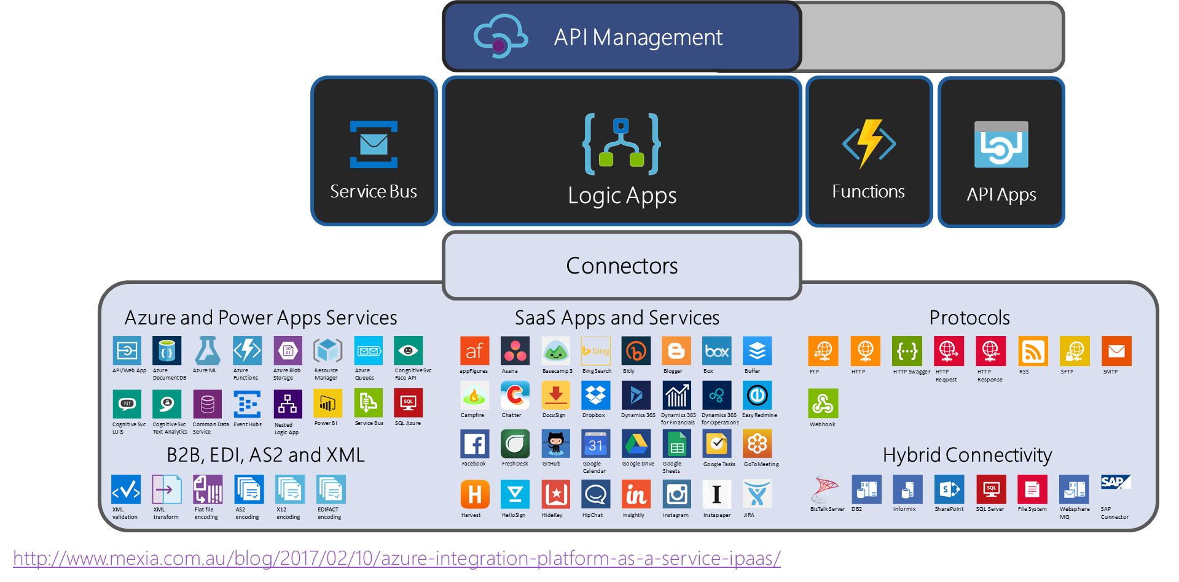
Microsoft Azure iPaaS

Slide 13
Questions?

Slide 14
Lab 4 Pre-requisites
Azure Subscription
Azure Storage Explorer (http://storageexplorer.com)
Service Bus Explorer (github.com/paolosalvatori/ServiceBusExplorer)
Outlook.com email account
Postman

Slide 15
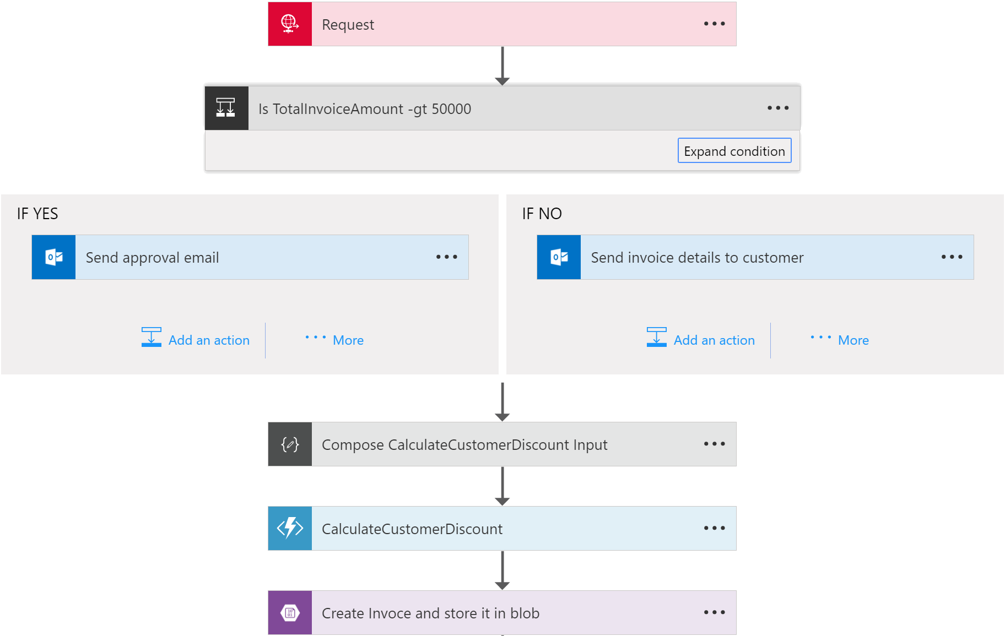
Lab 4
Create Storage Account
Create BLOB Container
Create Storage Table
Provision the Function App
Build a custom function
Provision a Logic App
Build the Logic App Definition
Test the Solution

Slide 16




Let us connect!
paco@mexia.com.au
@pacodelacruz
pacodelacruzag.wordpress.com
linkedin.com/in/pacodelacruz

Slide 17
Thanks!

