Slide 1
Lexical Analysis Engine for Chat Messages Using DFA
Semester: Fall Semester 2026–2027
Team Members:
Ambuj Mishra (24BCE0340)
Eldo John Giby (24BCE0387)
Ameen S (24BCE0406)
Sreedev krishna (24BCE2118)
John Alex Thomas (24BCE2217)
01 / 07

Slide 2
Abstract
Problem: Modern chats use messy tokens (URLs, mentions, emojis, timestamps). Standard regex tokenizers suffer from catastrophic backtracking (ReDoS) and can freeze servers (O(2ⁿ)).
Proposed Solution: A from-scratch compiler lexical engine using Deterministic Finite Automata (DFA) with zero native regex dependencies.
Approach: Converts 29 chat rules: Regex → AST → Thompson NFA → Master DFA.
Groups 1.1M Unicode points into 74 simple atoms for fast emoji & script handling.
Minimizes states using Moore and Hopcroft algorithms.
Expected Outcome: Guaranteed linear time (O(n)), zero backtracking freezes, clean punctuation handling, and 13+ MB/s throughput with live visual state playback.
02 / 07

Slide 3
Introduction
Background: Lexical analysis (Phase 1 of compiler) converts raw text into structured tokens.
Problem Statement: Chat text is noisy and complex. Traditional regex cascades are slow, error-prone, and insecure.
Why It Matters: Security: Malicious chat inputs can trigger ReDoS and crash server event loops.
Why It Matters: Correctness: Naive tokenizers break on trailing symbols (e.g., https://vit.ac.in. eats the period).
Limitations of Current Tools: Slow: Passes over the same text 20+ times for 20 rules.
Limitations of Current Tools: Unsafe: Worst-case exponential time complexity (O(2ⁿ)).
Limitations of Current Tools: Weak: No proper error recovery on malformed inputs.
03 / 07

Slide 4
Literature Review (10 Recent Studies)
Paper & Year | Venue | Method | Key Finding | Limitation / Gap
Davis et al. (2021) | ACM TOSEM | Empirical test of 400k regexes | Backtracking regexes are erratic and unsafe | Only analyzed bugs; no fix proposed
Zhang et al. (2023) | IEEE S&P | DFA graph cycle detection | Thousands of packages vulnerable to ReDoS | Diagnostic tool only; no replacement lexer
D'Antoni et al. (2021) | CACM | Symbolic character predicates | Compressing alphabets shrinks state size by 90% | Pure theory; lacks lexer token rollback
Wang et al. (2023) | ACM CCS | Derivative automata repair | Removing overlap stops ReDoS freezing | Fixes 1 regex at a time, not a full tokenizer
Shen et al. (2022) | ACM OOPSLA | Direct DFA simulation | DFA matching is 3x–10x faster than regex | Tested only English ASCII; no emojis
Turoňová et al. (2021) | TACAS | Grouped-alphabet Hopcroft | Character atoms make minimization super fast | Tested on models, not real-world text lexers
Loring et al. (2021) | ACM PLDI | Formal semantics comparison | JS regex shortcuts cause memory & freeze bugs | Proof only; no production engine built
Li et al. (2021) | IEEE TSE | Genetic ReDoS exploit search | Inputs under 50 chars can hang regex engines | Focuses on attacking, not solving
Al-Bataineh et al. (2024) | Wiley SPE | Flat array DFA lookup tables | Flat tables run at CPU cache speeds | No support for multilingual text or emojis
Chen et al. (2024) | ACM ICSE | Multi-rule product automata | Merging rules guarantees O(n) linear time | Closed-source; no educational UI

Slide 5
Summary of the Literature
Common Techniques: Converting regex to NFAs/DFAs, ReDoS static cycle checking, flat lookup tables.
Strengths: Proves that DFAs mathematically guarantee linear time (O(n)) and prevent freezes.
Common Weaknesses: Studies test only one regex in isolation, not a full multi-rule compiler lexer.
Common Weaknesses: Tested only simple English ASCII, completely ignoring emojis, currency (₹), and Indian scripts.
Common Weaknesses: Checks only match (true/false), without token slicing and punctuation rollback.
Our Solution: A unified engine combining 29 rules, 74 Unicode atoms, maximal munch rollback, and an interactive step-by-step visual dashboard.
05 / 07

Slide 6
Objectives
Primary Objective: Build and evaluate a pure DFA-based chat lexer with guaranteed O(n) time and zero ReDoS freezing risk.
Specific Objectives: Automata Pipeline: Compile 29 rules (Regex → AST → Thompson NFA → Master DFA) with rule priority tags.
Specific Objectives: Unicode Chat Support: Compress 1.1M characters into 74 atoms to easily detect links, @mentions, #hashtags, times (5:30pm), currency (₹1,200), and emojis.
Specific Objectives: State Minimization: Implement Moore and Hopcroft algorithms and verify both reach the exact same minimal state count.
Specific Objectives: Robust Lexing & UI: Add maximal-munch rollback, panic-mode error recovery, and an interactive state transition animation.
06 / 07

Slide 7
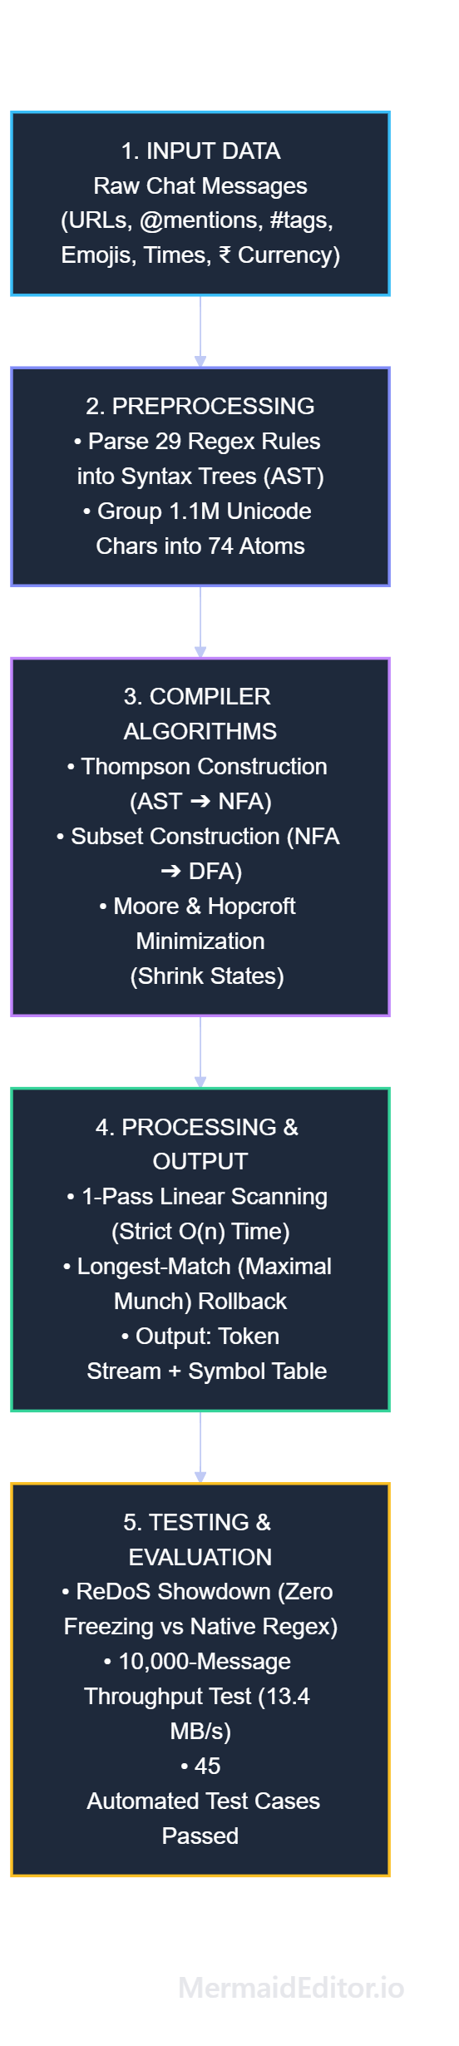
Proposed Methodology
07 / 07

