Slide 1
New Shopping center in Jakarta !!
Where ??

Slide 2
Selecting Locations
Analyze and Select Best Locations in Jakarta for new Shopping Center
Using API for get coordinates and venues info on neighborhood

Slide 3
Cluster Neighborhood
Explore the neighborhood using Foursquare API
Run K Means to cluster the neighborhood in Jakarta into 3 clusters
Visualize results

Slide 4
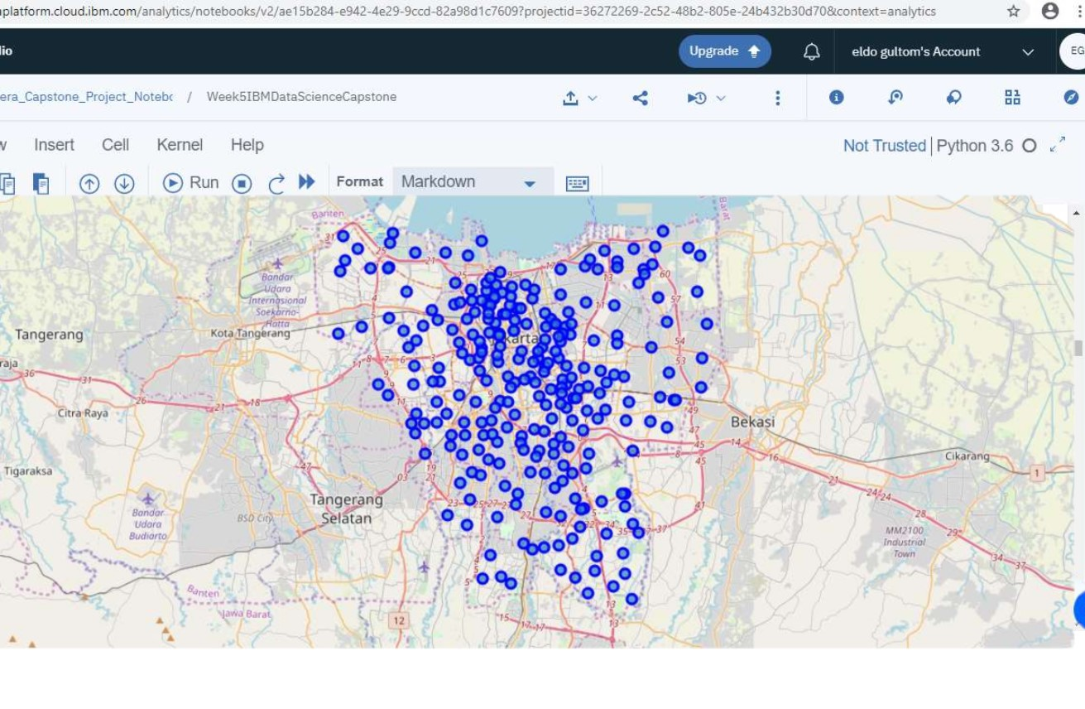
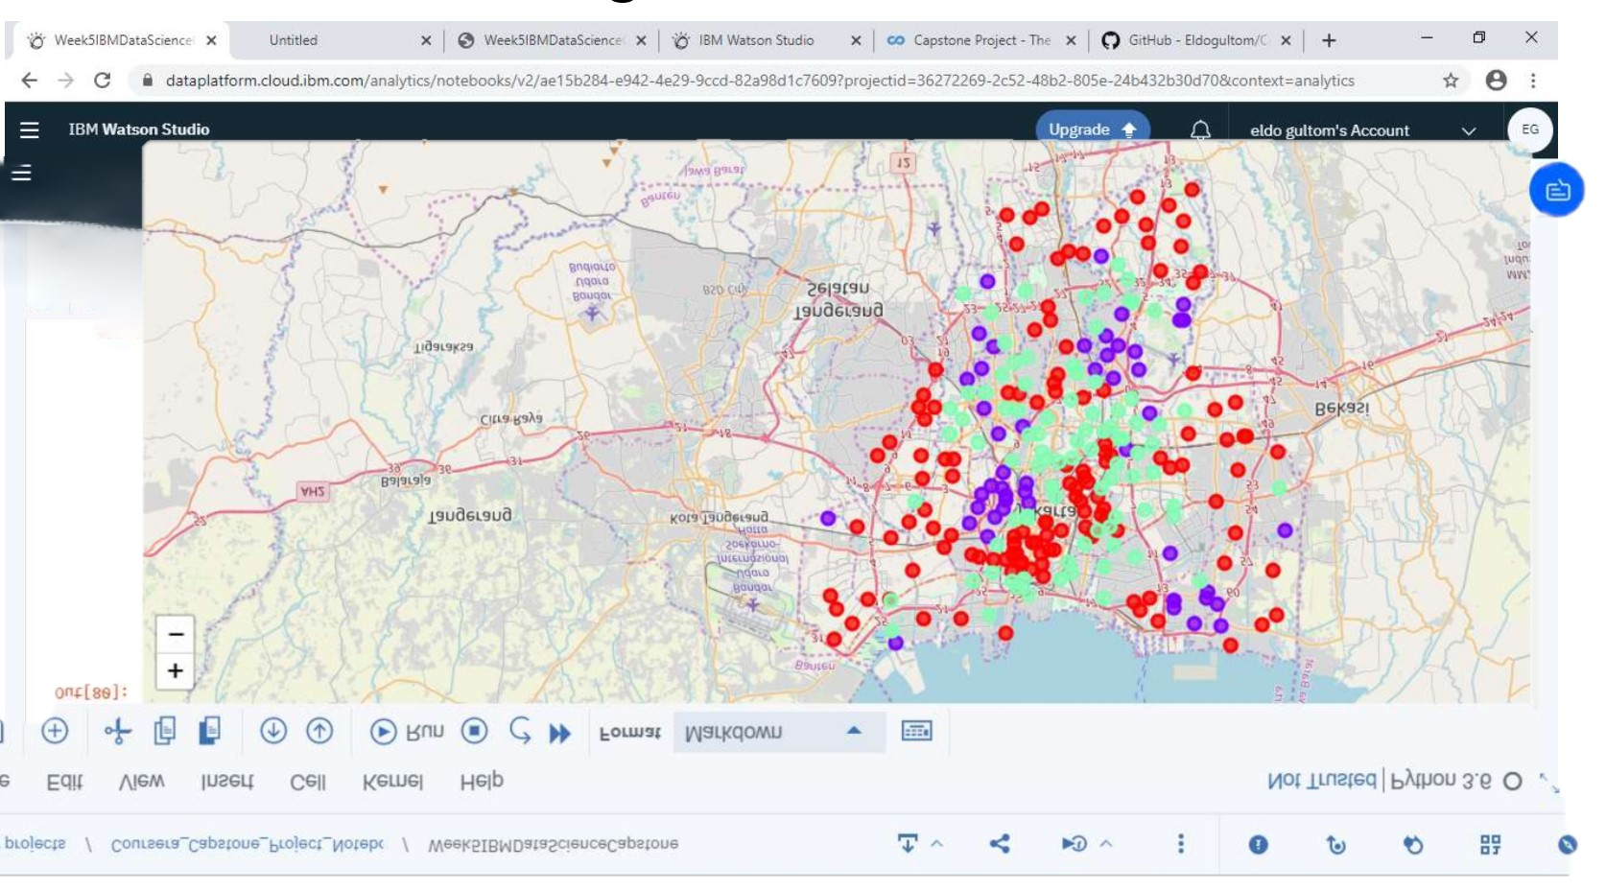
Visualize Results

