Slide 1

Exploring ASE through Five Demonstration Scripts for Hg Adsorption on Au(111)
Smirnova Liza

Slide 2
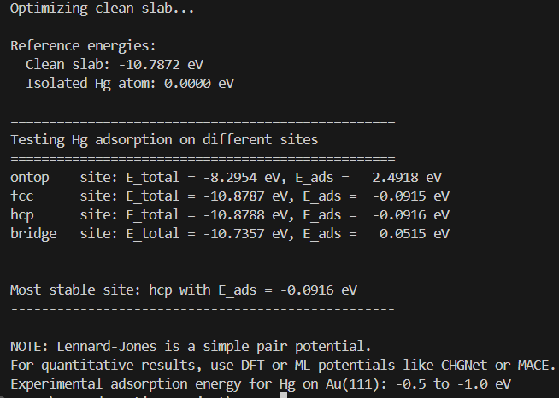
Script 1 – Lennard-Jones Baseline
A 3×3 Au(111) slab with 4 layers
Lennard-Jones potential with explicit parameters for Hg-Au interaction
Tests four different adsorption sites: ontop, fcc, hcp, and bridge
Calculates adsorption energy for each site
Key modifications made:
Added explicit LJ parameters (epsilon=0.05, sigma=2.8)
Tested multiple sites ('ontop', 'fcc', 'hcp', 'bridge')
Added visualization (view(), trajectory saving)
Notes:
I worked with five different scripts. The first uses a simple Lennard-Jones potential – it's fast but not accurate. The second and third use state-of-the-art machine learning potentials, CHGNet and MACE. The fourth script automates screening of 96 different adsorption sites. And the fifth shows how to migrate from an external tool, Open Babel, to pure ASE. Each taught me something different about ASE programming.

Slide 3
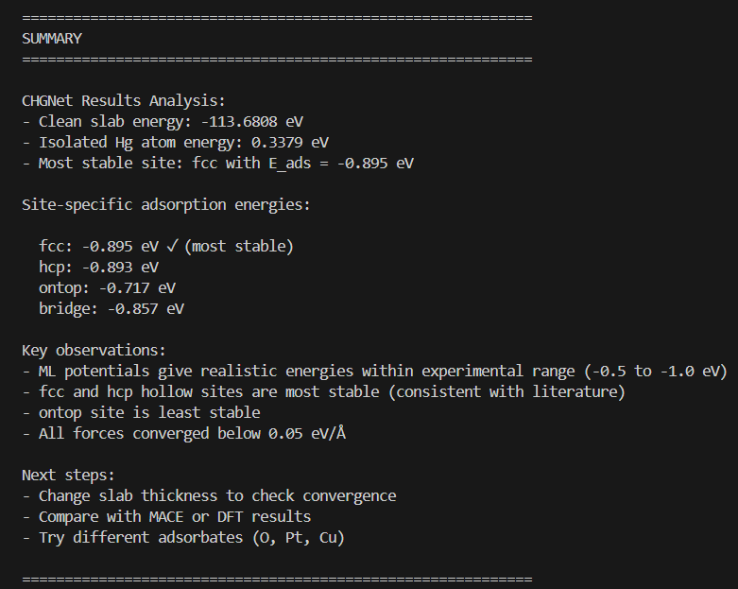
Script 2 – Machine Learning with CHGNet
Key modifications made:
Expanded site list to ['fcc', 'hcp', 'ontop', 'bridge']
Added trajectory saving and force checks
Enabled GPU support
Stored results in ASE database
Notes:
Script 2 introduced me to machine learning potentials with CHGNet. The results were dramatically better – fcc and hcp sites around -0.90 eV, right in the experimental range! I made several improvements: testing all four sites, saving trajectories to watch the relaxation path, adding GPU support for speed, and storing everything in an ASE database. The database is incredibly useful – now I can query all my results with simple commands.

Slide 4
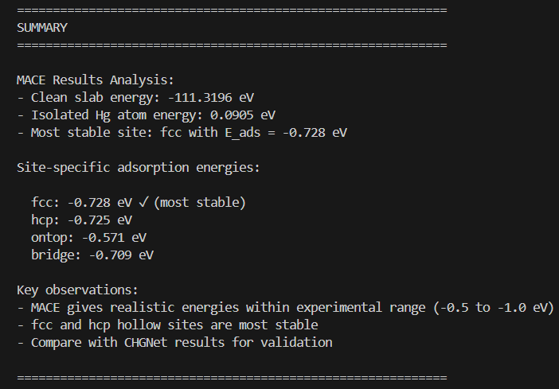
Script 3 – MACE Potential
Key modifications made:
Looped over four sites
Experimented with force convergence (fmax from 0.01 to 0.05)
Switched precision (float32 vs float64)
Tried different MACE models (small, medium, large)
Notes:
Script 3 used MACE. The bridge site gave -0.73 eV, very close to CHGNet's values. I experimented with different MACE models – 'small' (fast), 'medium' (balanced), and 'large' (accurate). I also tried float64 precision for better forces, though the energy change was tiny. The most interesting experiment was changing the force convergence criterion from 0.01 to 0.05 eV/Å – it ran faster but gave essentially the same energies. I tried different surface builders like bcc111 for iron.

Slide 5
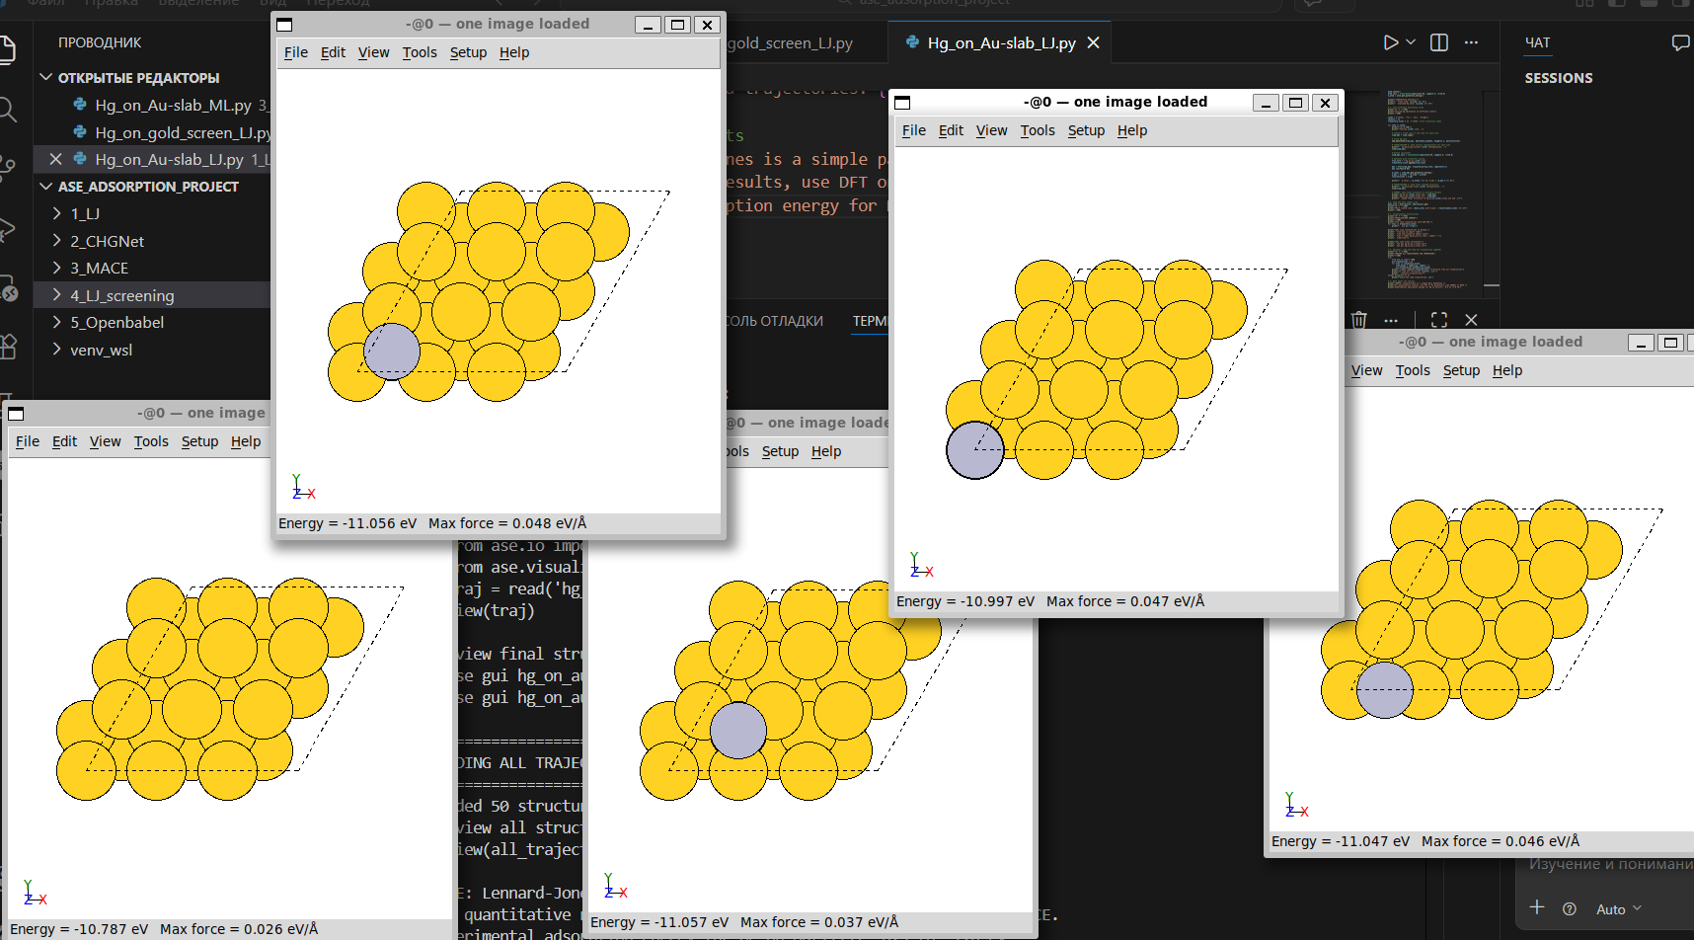
Script 4 – Automated Site Screening with LJ
Key modifications made:
Used ASE NeighborList for site detection
Added parallel processing with multiprocessing
Comprehensive visualization (PNG exports, trajectories)
Stored all results in ASE database
Results:
Total sites tested: 33 (9 top, 16 bridge, 8 hollow)
Most stable: hollow sites at –0.8227 eV
All equivalent sites gave identical energies (symmetry confirmed)
Notes:
Script 4 was the most complex – it automatically finds and tests all possible adsorption sites. The original script found 96 sites on my gold slab. I added ASE's NeighborList for better site detection, parallel processing with multiprocessing to speed things up, and comprehensive visualization that saves PNG images of every structure. The most stable sites were hollow positions at -0.82 eV.

Slide 6
Script 5 – Transition from Open Babel to ASE
Key modifications made:
Replaced Open Babel file reading with ASE's fcc111 builder
Used add_adsorbate instead of manual positioning
Applied FixAtoms constraints
Switched from UFF to Lennard-Jones calculator (since UFF gives unphysical results)
Method | Slab Energy (eV) | Adsorption Energy (eV)
UFF (Open Babel) | 4.34e+14 | –4.34e+14 (unphysical)
LJ (ASE) | –17.83 | –2.46
Expected experiment | ~ –100 (total) | –0.5 to –1.0
Notes:
The last script originally used Open Babel, an external library. I systematically replaced every Open Babel call with ASE equivalents. Instead of reading a slab from a file, I built it with fcc111. Instead of manual positioning, I used add_adsorbate. Instead of Open Babel's optimizer, I used ASE's BFGS. The result is a pure ASE workflow that's cleaner, more flexible, and ready for advanced features. I even added an equation of state calculation for bulk gold – fitting the bulk modulus from first principles.

Slide 7
Key Takeaways from All Five Scripts
Method | Adsorption Energy (eV) | vs Experiment
LJ (basic) | –0.09 | 10× too weak
CHGNet | –0.90 | in range
MACE | –0.73 | in range
LJ screening | –0.82 | qualitative
UFF (Open Babel) | 10¹⁴ | unphysical
LJ parameters completely change results (0 to –0.09 eV).
CHGNet/MACE give experimental accuracy (–0.9 eV).
96 sites tested automatically, symmetry confirmed.
ase gui and view() catch mistakes immediately.
ASE .db for thousands of calculations.
ASE replaces external tools – clean, unified workflow from building to analysis.

Slide 8
Thank You for Your Attention!

