Slide 1
Ontario_COVID-19_Data
File created on: 5/15/2020 6:13:43 PM

Slide 2
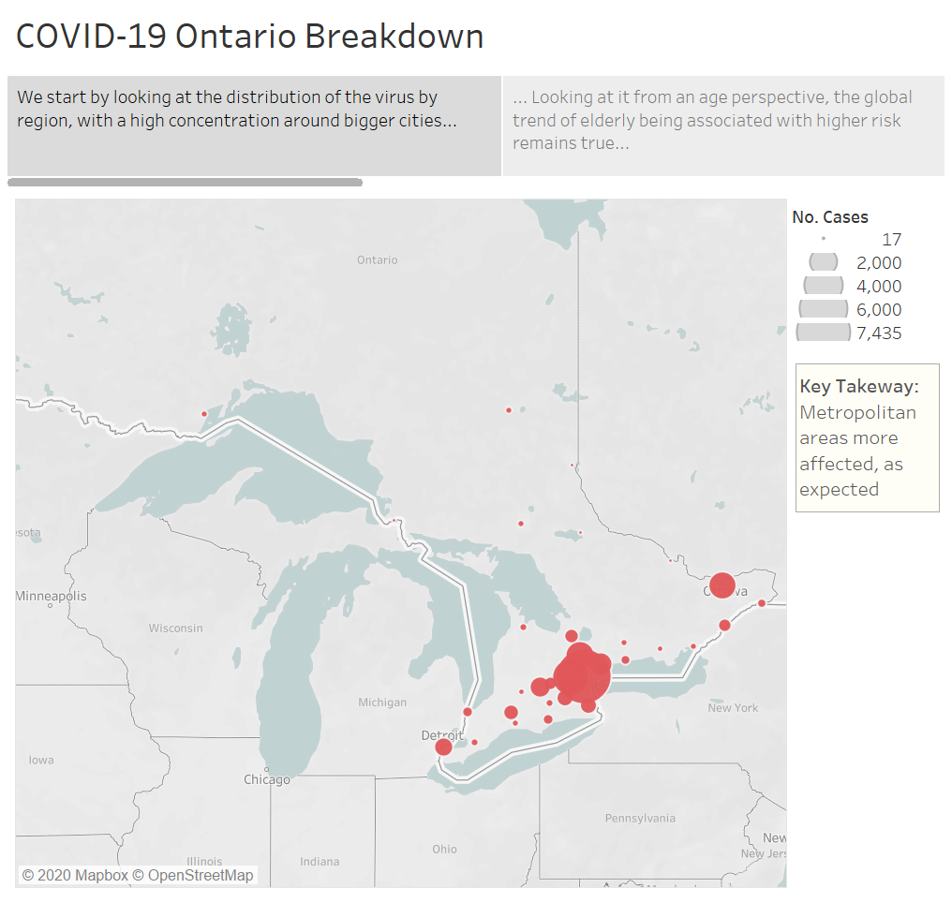

Slide 3
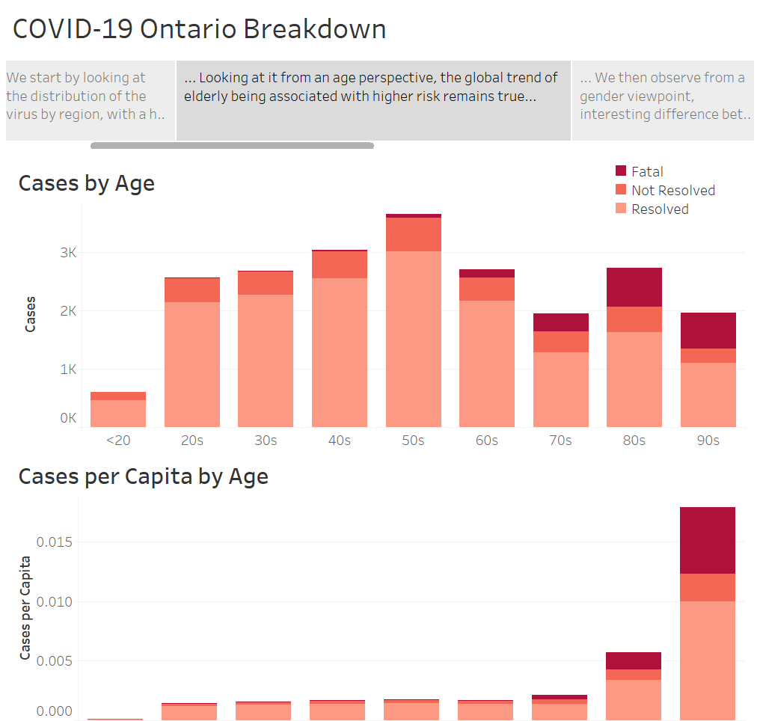

Slide 4
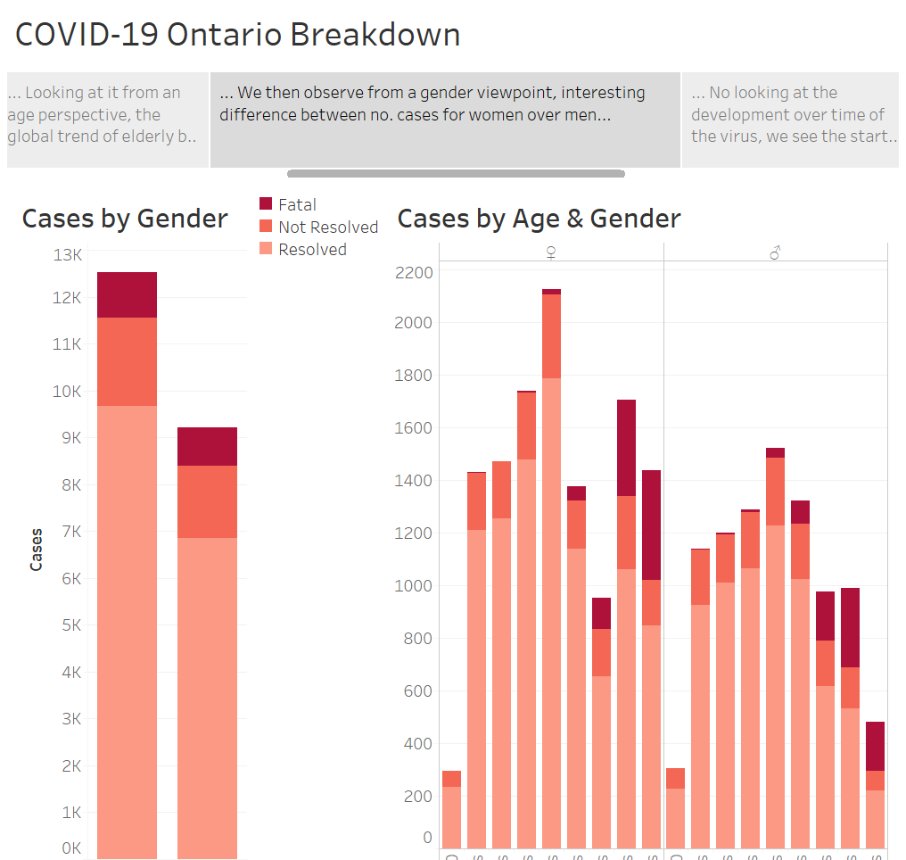

Slide 5
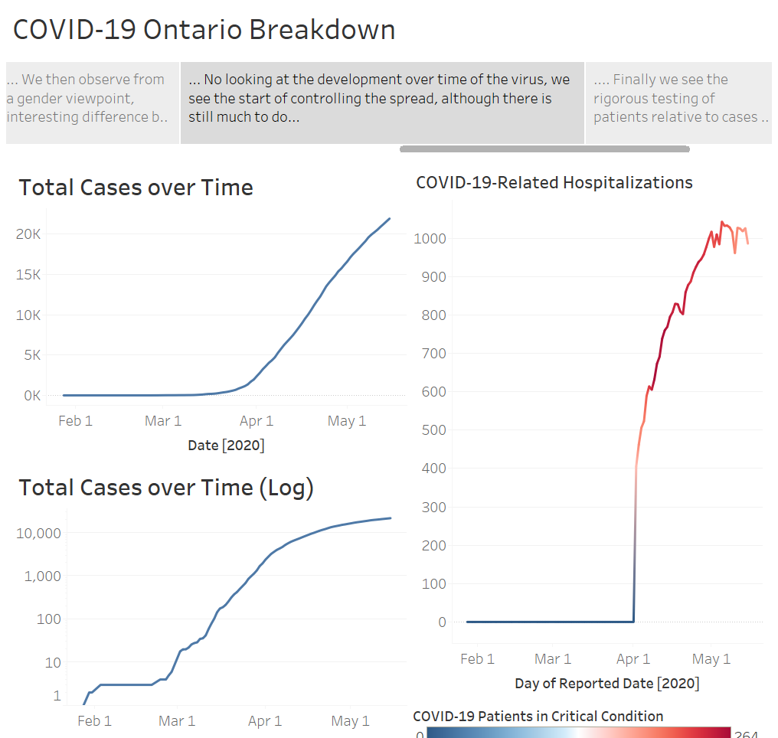

Slide 6
