Slide 1
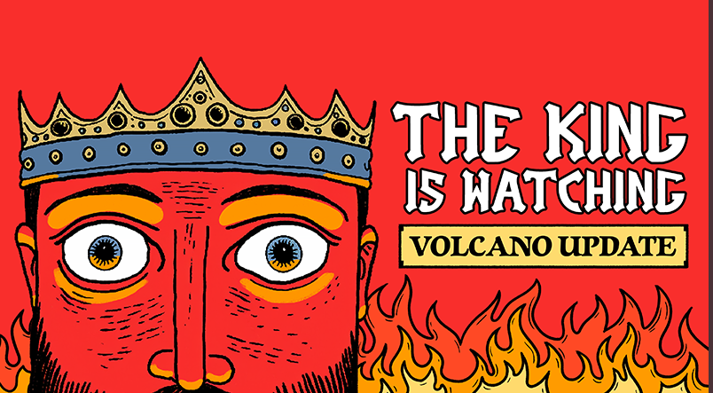

Slide 2
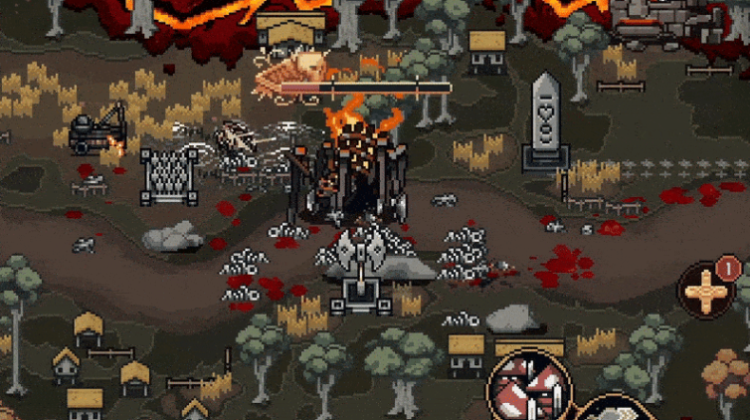

Slide 3
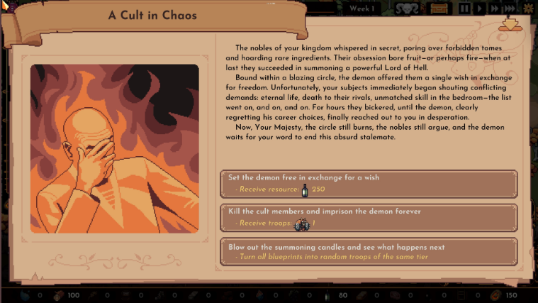

Slide 4
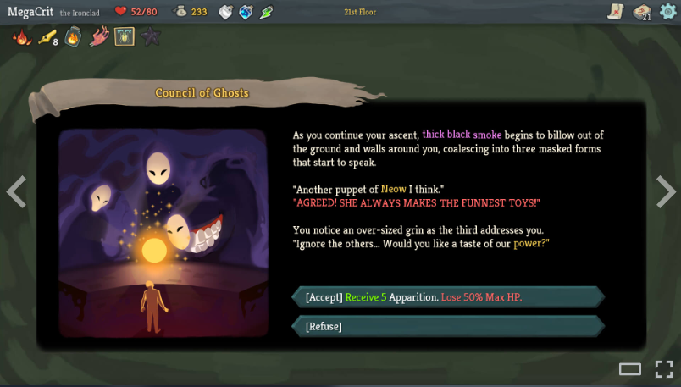

Slide 5
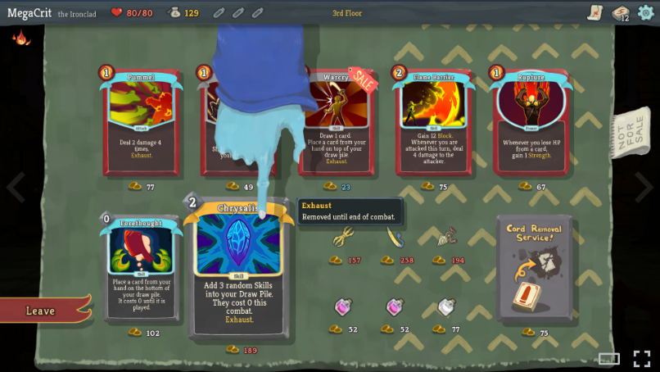

Slide 6
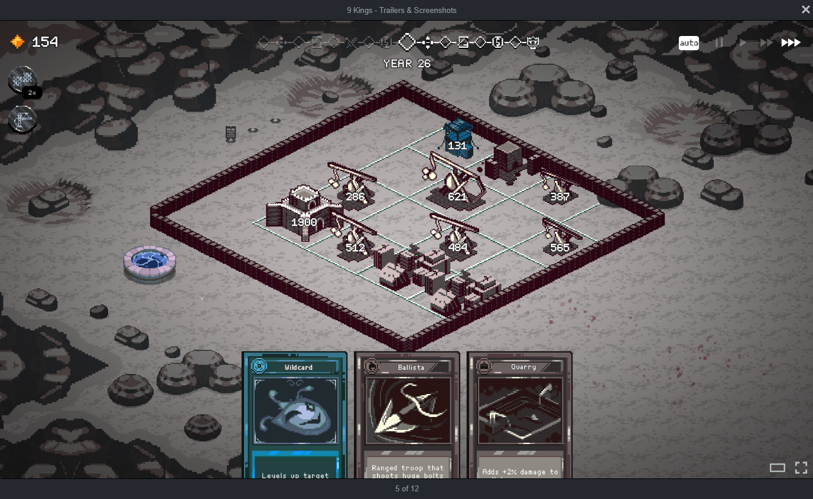

Slide 7
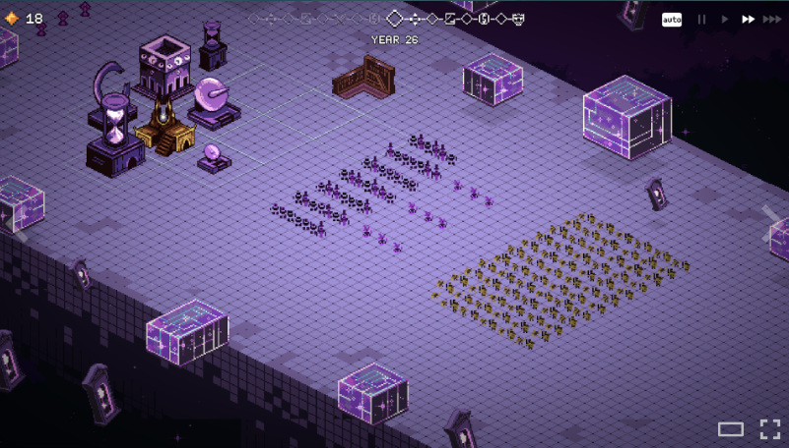

Slide 8
Palette
Use these/mixes of for card types?
Flesh
Stone
Obsidian
Jazz
Clay
Weird
Wood
Crystal
Token colours muted but still
contrast background colours

