Slide 1
The Swiss Train Network
A project in Modeling and Simulating Social Systems with MATLAB
Notes:
The SBB train crew welcomes you aboard the swiss train network presentation to Indroduction Idea and Model Results conclusion and wishes you a pleasent journey next stop introduction.

Slide 2
Content
Introduction
Idea and Models
Results
Flows
Resilience
Conclusion

Slide 3
Introduction
Crowded Trains
I hate that!
Make a Model
Flow, Capacity and Resilience
Notes:
How do you make a model that allows us to approximate the flow of people in the Swiss train network and and enables us to make statements about the traffic flow, the capacity and the resilience of it?

Slide 4
Idea and Model

Slide 5
Idea and Model

Slide 6
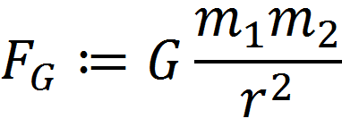
Gravity Model
Notes:
Well known formula

Slide 7
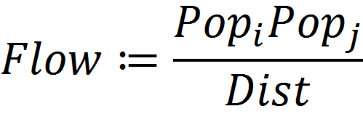
Gravity Model
Notes:
Tell about 22 cities!

Slide 8
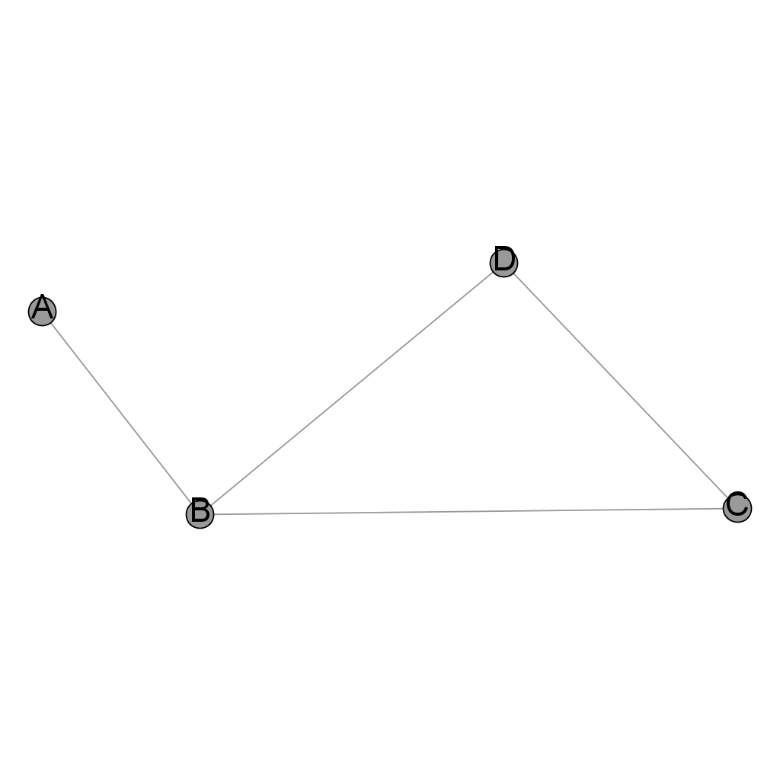
Adjacency Matrix
Node | A | B | C | D
A | 0 | 1 | 0 | 0
B | 1 | 0 | 1 | 1
C | 0 | 1 | 0 | 1
D | 0 | 1 | 1 | 0
Notes:
Don‘t forget comment on weight

Slide 9
‚Real Network‘
Looked up connections
Not fully-connected

Slide 10
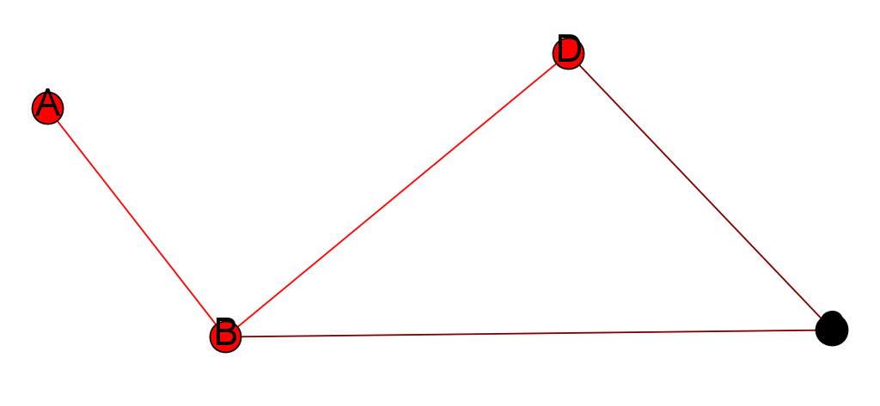
‚Real Network‘
Looked up connections
Not fully-connected

Slide 11
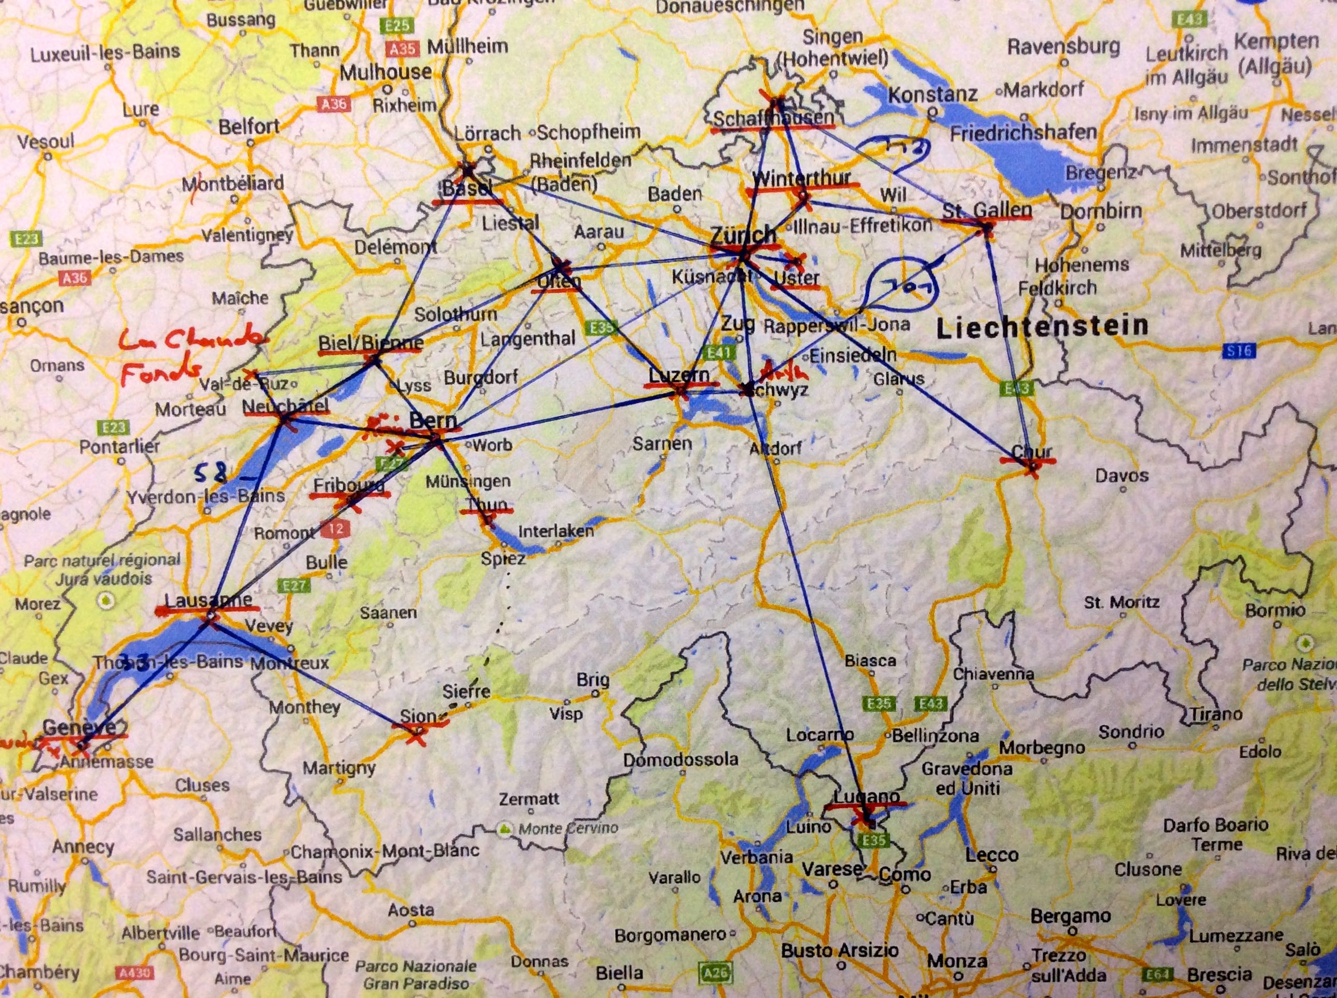
Flow

Slide 12
Flow
Number of people (de-)boarding
Gravity can be powerfull
Rush hour peaks

Slide 13
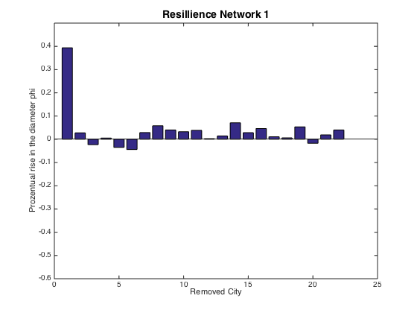
Resilience
Notes:
Comment on city vector!!! Beside Zürich very resistant (quite obvious), Zürich since it has so a huge population

Slide 14
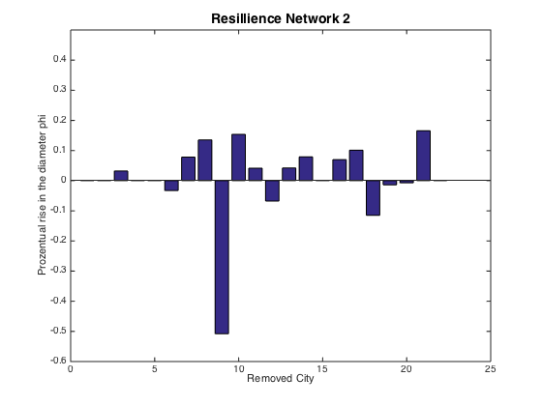
Resilience
Notes:
Remarkable effect when Lugano is removed, not every time still connect, not so resistant.

Slide 15
Conclusion

Slide 16
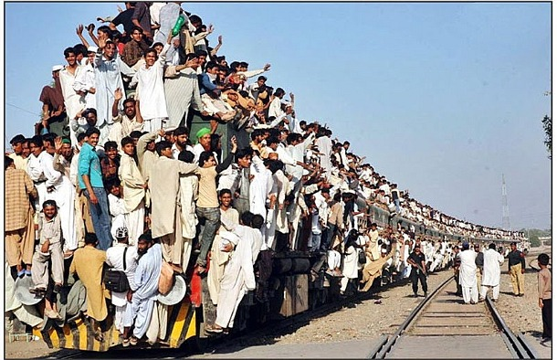
Conclusion

Slide 17
Conclusion
Flows
Peaks
Gravity can be Indicator
Resilience
Models behave diffrent
Usw
Personal:
Aim lower or have more time!

Slide 18
Thank you very much for your Attention!
Link to our work:
https://github.com/EleSwag/Elias-und-Mario

Slide 19
Structure proposal

Slide 20
Content
1. Introduction
Connect to the specific context of this talk.
2. The Models
Connect to past work in your field.//full connected
Explain what new insight you are adding. //connected
3.Results
Approx. three main results is sufficient.
Time you spent presenting a result should not be proportional to time spent working on it! yep
4.Conclusion
Recap main points made.
Emphasize the “take-home” message.
Echo of introduction as a conclusion can create
closure.

Slide 21
Idea

Slide 22
Vorschlag- Part 1
Sache usem proposal, real life connection
Usw
Swag on

Slide 23
Vorschlag- Part 2
Gravity model erkläre
Eusi idee met de removed connection
Chöne mer of ehn arbet eh dem berich referenziere?

Slide 24
Vorschlag-Part 3
Resilience: shortest distance erkläre usw
Network parameter??
Vergleich zu real data
Capacity
Peaks???
Infos vo SBB (mer münd joh 3, die fette wördi secher neh vorschloh..)

Slide 25
Vorschlag-Part 4
Sälbst erklärend…
Ev au erst doh SBB ehs spel brenge

Slide 26
Allgemeine Bemerkungen
Verweis auf Datensuche vermeiden
Fancy graphics

Slide 27
Idea
The Data Approach (failed)
The Gravity principle
Our approach
Adjacency Matrix

Slide 28
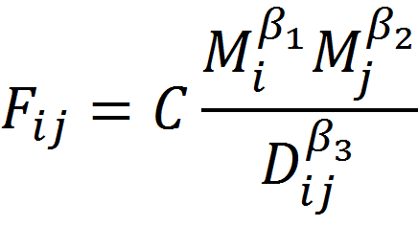
Gravity Model

