Slide 1
The Swiss Train Network
A project in Modeling and Simulating Social Systems with MATLAB

Slide 2
Content
Introduction
Idea
Results
Conclusion

Slide 3
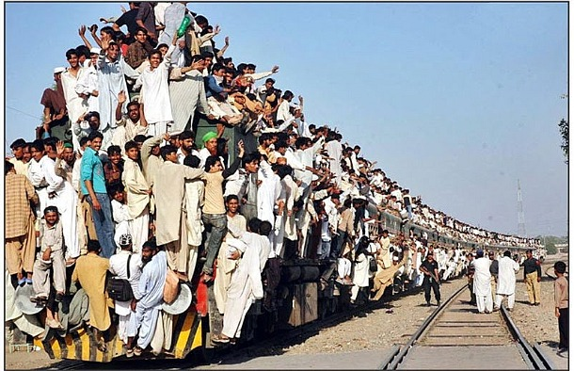
Introduction

Slide 4
Idea

Slide 5
Idea
The Data Approach (failed)
The Gravity principle
Our approach
Adjacency Matrix

Slide 6
Adjacency Matrix?

Slide 7
Structure proposal

Slide 8
Content
1. Introduction
Connect to the specific context of this talk.
2. The Models
Connect to past work in your field.//full connected
Explain what new insight you are adding. //connected
3.Results
Approx. three main results is sufficient.
Time you spent presenting a result should not be proportional to time spent working on it! yep
4.Conclusion
Recap main points made.
Emphasize the “take-home” message.
Echo of introduction as a conclusion can create
closure.

Slide 9
Vorschlag- Part 1
Sache usem proposal, real life connection
Usw
Swag on

Slide 10
Vorschlag- Part 2
Gravity model erkläre
Eusi idee met de removed connection
Chöne mer of ehn arbet eh dem berich referenziere?

Slide 11
Vorschlag-Part 3
Resilience: shortest distance erkläre usw
Network parameter??
Vergleich zu real data
Capacity
Peaks???
Infos vo SBB (mer münd joh 3, die fette wördi secher neh vorschloh..)

Slide 12
Vorschlag-Part 4
Sälbst erklärend…
Ev au erst doh SBB ehs spel brenge

Slide 13
Allgemeine Bemerkungen
Verweis auf Datensuche vermeiden
Fancy graphics

