Slide 1
The Swiss Train Network
A project in Modeling and Simulating Social Systems with MATLAB

Slide 2
Content
Introduction
Idea
Results
Conclusion

Slide 3
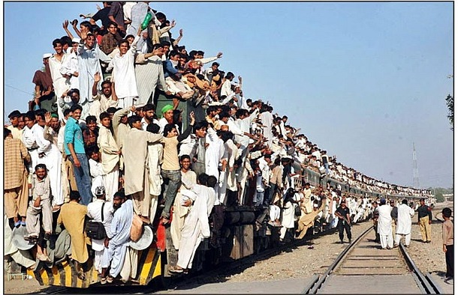
Introduction

Slide 4
Idea

Slide 5
Introduction (chame velech ou wäglo)
Crowded Train
?

Slide 6
Idea (0der)
Data Approach
Model Approach

Slide 7
Idea
The Data Approach (failed)
The Gravity principle
Our approach

Slide 8
Adjazenz Matrix

Slide 9
Idea and Bla
Adjacency matrix

Slide 10
Structure proposal

Slide 11
Content
1. Introduction
Connect to the specific context of this talk.
2. The Models
Connect to past work in your field.//full connected
Explain what new insight you are adding. //connected
3.Results
Approx. three main results is sufficient.
Time you spent presenting a result should not be proportional to time spent working on it! yep
4.Conclusion
Recap main points made.
Emphasize the “take-home” message.
Echo of introduction as a conclusion can create
closure.

Slide 12
Vorschlag- Part 1
Sache usem proposal, real life connection
Usw
Swag on

Slide 13
Vorschlag- Part 2
Gravity model erkläre
Eusi idee met de removed connection
Chöne mer of ehn arbet eh dem berich referenziere?

Slide 14
Vorschlag-Part 3
Resilience: shortest distance erkläre usw
Network parameter??
Vergleich zu real data
Capacity
Peaks???
Infos vo SBB (mer münd joh 3, die fette wördi secher neh vorschloh..)

Slide 15
Vorschlag-Part 4
Sälbst erklärend…
Ev au erst doh SBB ehs spel brenge

Slide 16
Allgemeine Bemerkungen
Verweis auf Datensuche vermeiden
Fancy graphics

