Slide 1
Lecture 2
Eleana Cabello

Slide 2
Let’s get on the same page
Windows systems – Log onto OSCER using MobaXterm
Mac systems - Find the Terminal application
Notes:
5 mins

Slide 3
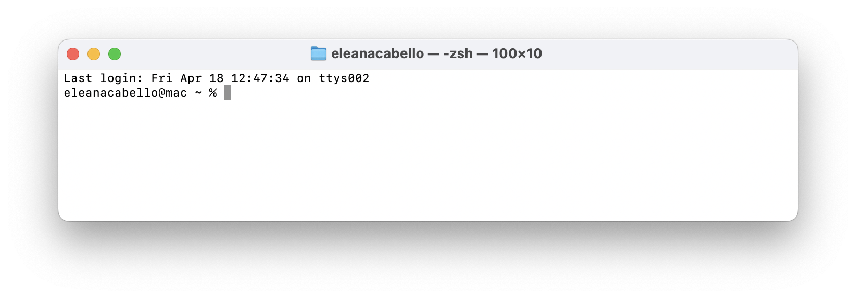
Terminal - A text-based user interface that allows users to interact with a computer by typing commands
Directory - A folder location in your computer
Working Directory - The current directory a user is in
Path - Directions to a folder or file
Notes:
3mins

Slide 4
Let's log into your guest accounts
Gather you log in information, username and password.
Type the following command to access you OSCER account: ssh USERNAME@sooner.oscer.ou.edu
It will ask for your password, start typing it. It will not appear on your screen do not be alarmed this is normal. Just make sure to enter it correctly then hit enter.
Notes:
5 mins

Slide 5
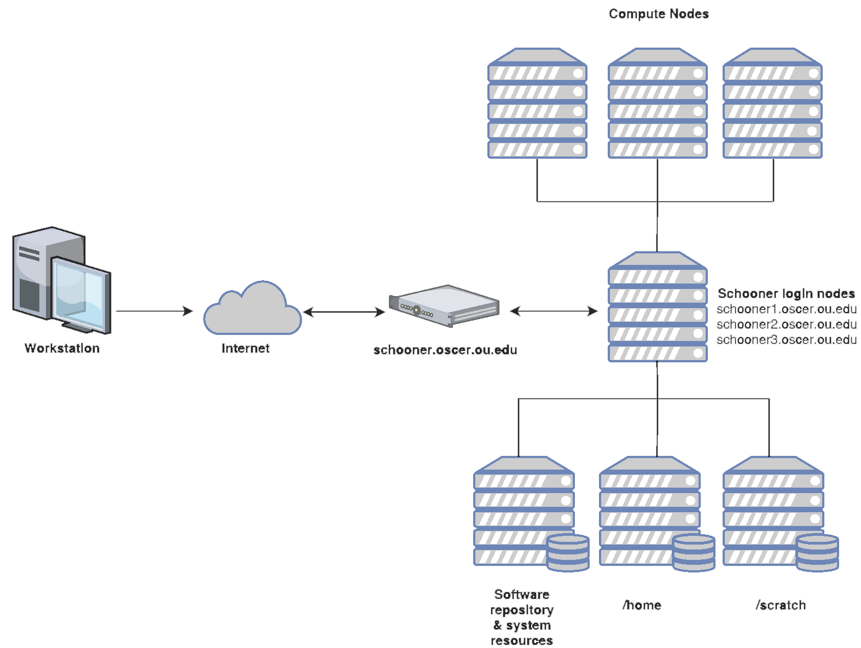
Sooner Login Nodes
sooner1.oscer.ou.edu
sooner2.oscer.ou.edu
sooner3.oscer.ou.edu
sooner4.oscer.ou.edu
sooner.oscer.ou.edu
Notes:
2min

Slide 6
Sooner Login Nodes
sooner1.oscer.ou.edu
sooner2.oscer.ou.edu
sooner3.oscer.ou.edu
sooner4.oscer.ou.edu
sooner.oscer.ou.edu
You are here
Notes:
1min

Slide 7
BASH Programming

Slide 8
From where you are type:
cp –r /scratch/elec/lecture_2 /scratch/$USER
Notes:
2min

Slide 9
Now type:
cd /scratch/$USER
Notes:
2min

Slide 10
Navigating Directories
pwd # Print working directory
ls # List contents in a directory
ls -lh # List contents in a directory in a list format and human read able sizes
tree # List directory and file tree
cd DIR # Change working directory to the entered directory
cd .. # Change working directory to parent directory of current directory
cd ~ # Change working directory to home
Notes:
10min

Slide 11
Creating, Moving, and Deleting Directories
mkdir DIR # Create directory
rmdir DIR # Remove Directory
rm -r DIR # Remove Directory
mv ONE_DIR TWO_DIR # Move directory to new directory
Notes:
8min

Slide 12
Deleting, Copying, and Moving Files
rm FILE.txt # Remove file
cp FILE.txt FILE.txt # Copy file to new directory
mv FILE.txt FILE.txt # Move file to new directory
There is no back button once things are deleted or overwritten it is gone!
Notes:
5min

Slide 13
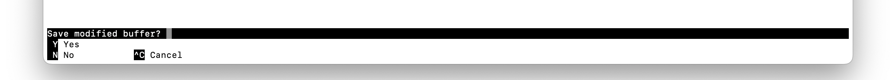
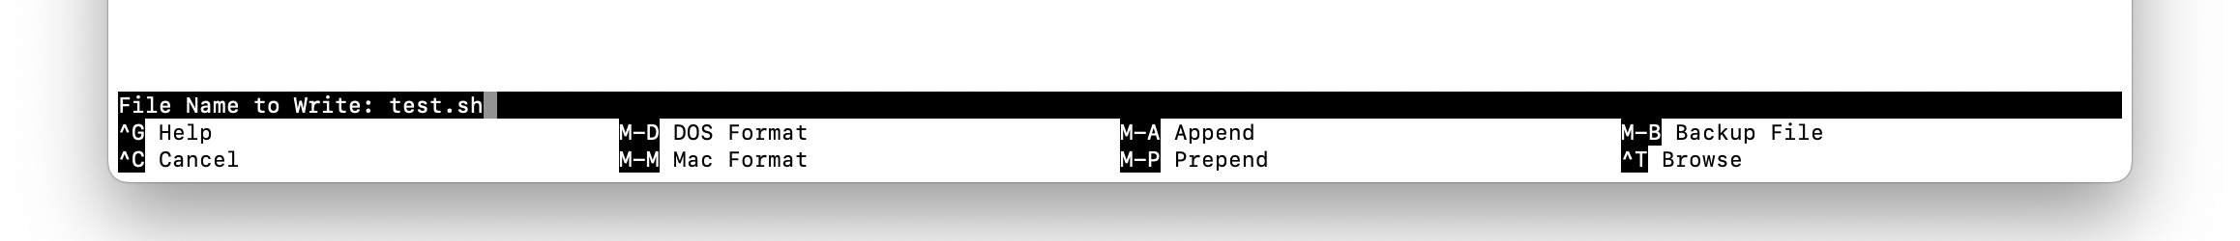
Command Line Text Editor
nano file_nano_test.txt # Opens file in line for editing
Navigate with up, left, right, and down keys
Type as usual
Exit using CTRL+ X
The above message will appear because you made changes, click Y on your keyboard
It will then ask about the filename you want to save it to, to accept click the ENTER key on your keyboard
Notes:
5min

Slide 14
#!/bin/bash
#SBATCH --partition=normal
#SBATCH --ntasks=1
#SBATCH --mem=1G
#SBATCH --output=jobname_%J_stdout.txt
#SBATCH --error=jobname_%J_stderr.txt
#SBATCH --time=1:00:00
#SBATCH --job-name=jobname
#SBATCH --mail-user=EMAIL@ou.edu
#SBATCH --mail-type=ALL
#SBATCH --chdir=/home/$USER
#SBATCH Directives
Where to send your job
Number of tasks
Memory needed
Output file name
Error file name
Time limit
Job name
Email to send updates to, PLEASE REMEMBER TO PUT YOURS
All notifications
Working directory of the job
#==============================================================================
# BASH Strict mode (i.e. "fail fast" to reduce hard-to-find bugs)
set -e # EXIT the script if any command returns non-zero exit status.
set -E # Make ERR trapping work inside functions too.
set -u # Variables must be pre-defined before using them.
set -o pipefail # If a pipe fails, returns the error code for the failed pipe
# even if it isn't the last command in a series of pipes.
#==============================================================================
Notes:
5min

Slide 15
Quick Exercise

Slide 16
Run this first:
pwd
Make sure you are in /scratch/user/lecture_2!
Then type:
nano first_exercise.sh
Notes:
2min

Slide 17
#!/bin/bash
#SBATCH --partition=normal
#SBATCH --ntasks=1
#SBATCH --mem=1G
#SBATCH --output=firstJob_%J_stdout.txt
#SBATCH --error= firstJob _%J_stderr.txt
#SBATCH --time=1:00:00
#SBATCH --job-name=jobname
#SBATCH --mail-user=EMAIL@ou.edu
#SBATCH --mail-type=ALL
#SBATCH --chdir=/scratch/$USER
#==============================================================================
# BASH Strict mode (i.e. "fail fast" to reduce hard-to-find bugs)
set -e # EXIT the script if any command returns non-zero exit status.
set -E # Make ERR trapping work inside functions too.
set -u # Variables must be pre-defined before using them.
set -o pipefail # If a pipe fails, returns the error code for the failed pipe
# even if it isn't the last command in a series of pipes.
#==============================================================================
echo "Hello World!" > helloWorld.txt
CHANGE THIS TO YOUR EMAIL as in firstname-lastname@ou.edu
> redirects output into a file
Notes:
5 min

Slide 18
Sending jobs here
Sooner Login Nodes
sooner1.oscer.ou.edu
sooner2.oscer.ou.edu
sooner3.oscer.ou.edu
sooner4.oscer.ou.edu
sooner.oscer.ou.edu
You are here
Notes:
1min

Slide 19
Before you leave today
Have R and Rstudio installed
Have JBrowse2 installed
Notes:
1min

