Slide 1
Lecture 3
Eleana Cabello

Slide 2
Let’s get started!
Log on to OSCER via Terminal or MobaXterm
Navigate to your scratch folder: cd /scratch/$USER
Copy lecture folder from /scratch/elec/lecture_3 : cp –r /scratch/elec/lecture_3 .
This dot means in current directory

Slide 3
Bulk RNA-seq steps
1. Quality check the FASTQ files
2. Align FASTQ files to a reference
a. Build reference genome index
b. Align reads to reference genome
3. Convert SAM files to BAM files
a. Sort the SAM files - this produces sorted .bam files
b. Index the BAM files - this produces .bam.bai files
4. Create count matrix from alignments
5. Differential Expression
6. Visualizations

Slide 4
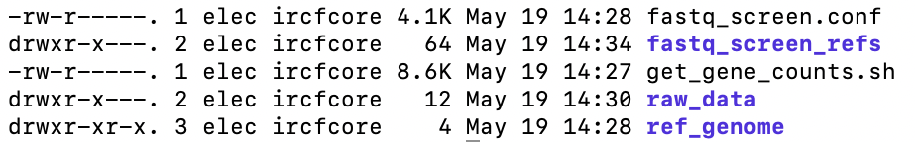
Starting Point
RNA-seq pipeline – get_gene_counts.sh
Raw data folder/directory
Reference Genome files – FASTA and GFF
Genomes and configuration file for FastScreen

Slide 5
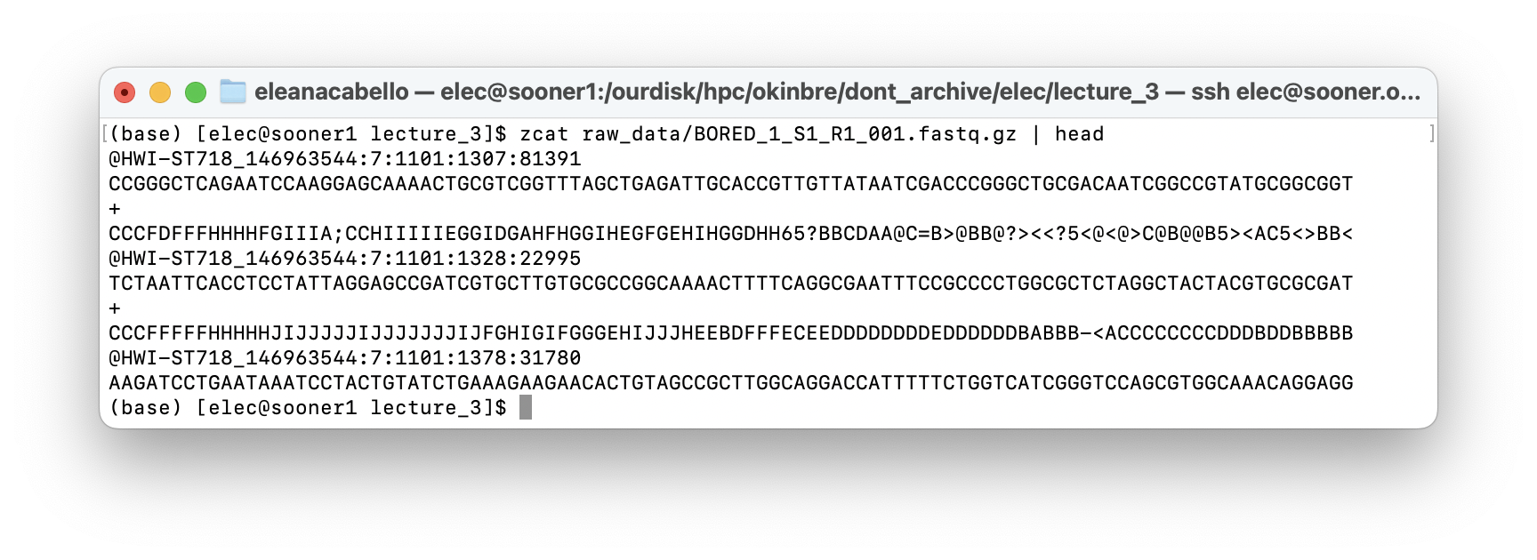
Let’s go over the data
Navigate to /lecture_3/raw_data and look inside.
Notice two fastq files per replicate, R1 and R2
Look inside file BORED_1_S1_R1_001.fastq.gz using:
zcat raw_data/BORED_1_S1_R1_001.fastq.gz

Slide 6
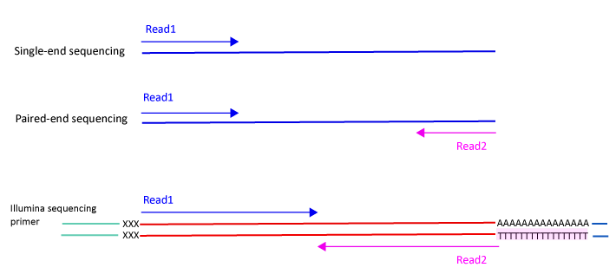
Single-end vs Pair-end Reads
SAMPLE_R1.fastq
SAMPLE_R1.fastq
SAMPLE_R2.fastq
Typically for an RNA-Seq projectss you will use Pair-end Reads.
Notes:
https://scilifelab.github.io/courses/ngsintro/1905/slides/rnaseq/presentation.html#18

Slide 7
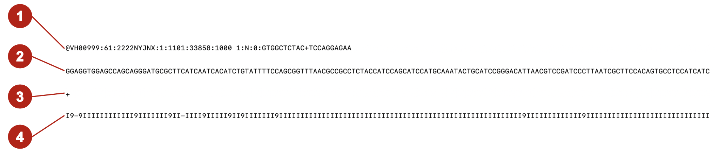
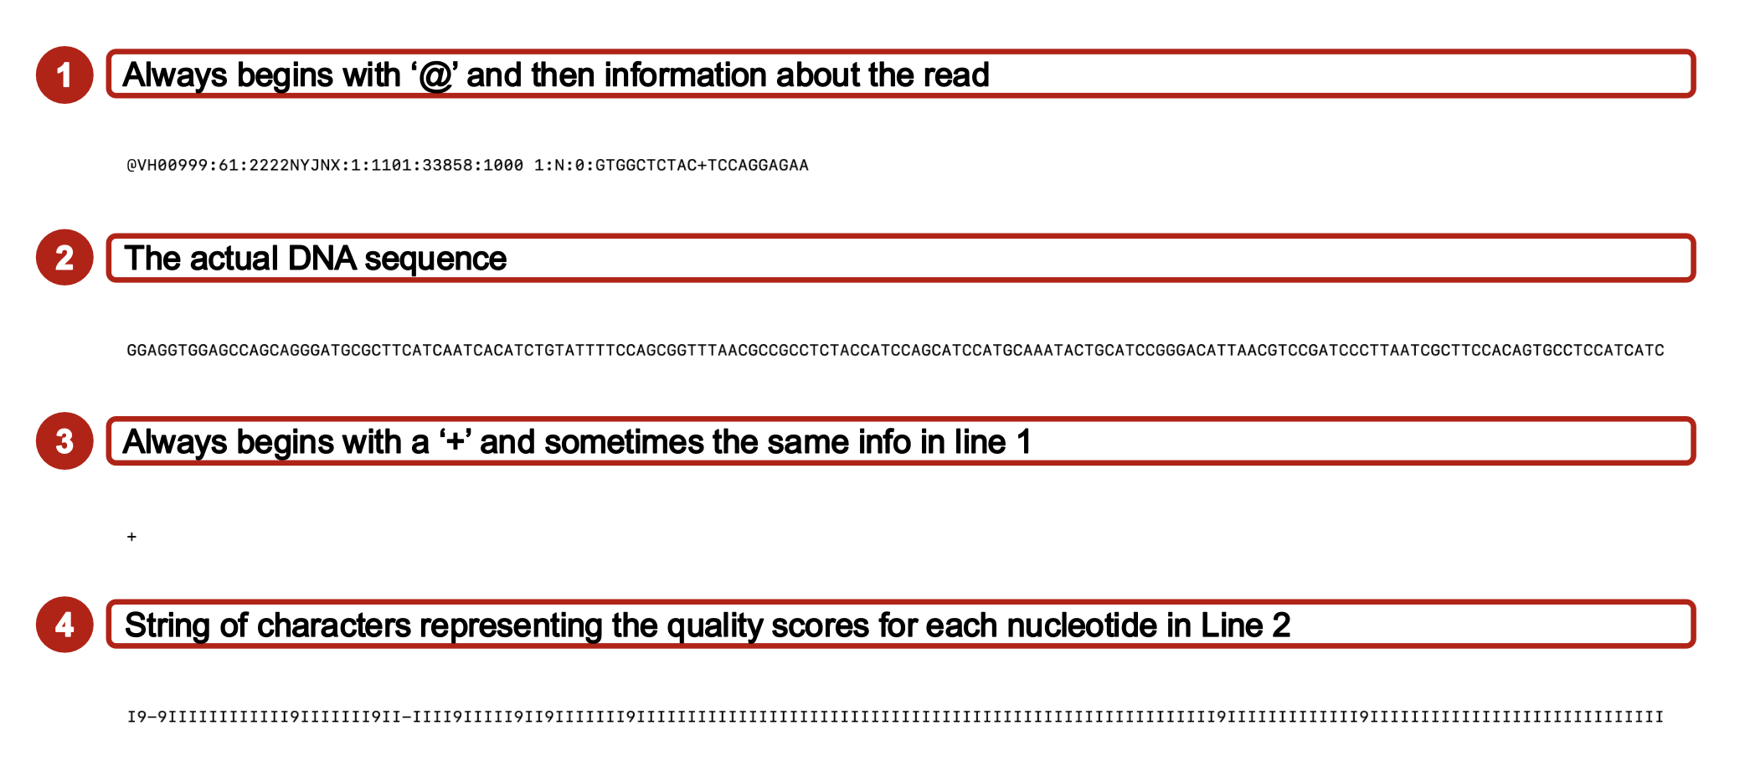
Example FASTQ
Notes:
- Millions of reads
- Consider depth, coverage, complexity of genome

Slide 8
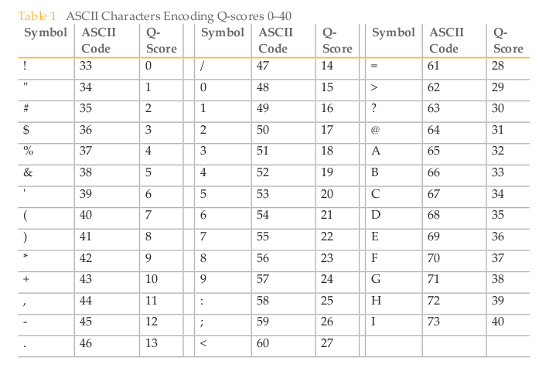
Phred score
Phred Quality Score | Probability of incorrect call | Base Call Accuracy
10 | 1 in 10 | 90
20 | 1 in 100 | 99
30 | 1 in 1000 | 99.9
40 | 1 in 10000 | 99.99

Slide 9
Let’s submit the script!
1. Make sure you are in the directory you want to work in: /scratch/USERNAME/lecture_3
2. In the beginning part of the script change YOUR EMAIL LINE:
#!/bin/bash
#SBATCH --partition=normal
#SBATCH --ntasks=1
#SBATCH --cpus-per-task=10
#SBATCH --mem=30G
#SBATCH --output=get_gene_counts_%J_stdout.txt
#SBATCH --error= get_gene_counts _%J_stderr.txt
#SBATCH --time=5:00:00
#SBATCH --job-name=get_gene_counts
#SBATCH --mail-user=YOUREMAIL@ou.edu
#SBATCH --mail-type=ALL
#SBATCH --chdir=/scratch/$USER

Slide 10
Let’s submit the script!
3.. Submit the script: sbatch get_gene_counts.sh
We will submit the script now, so that it will run while we are going over everything, and we can see the results at the end of class.
4. Let’s make sure your job is running: squeue --me

Slide 11
#!/bin/bash
#SBATCH --partition=normal
#SBATCH --ntasks=1
#SBATCH --cpus-per-task=10
#SBATCH --mem=30G
#SBATCH --output=firstJob_%J_stdout.txt
#SBATCH --error= firstJob _%J_stderr.txt
#SBATCH --time=12:00:00
#SBATCH --job-name=jobname
#SBATCH --mail-user=YOUREMAIL@ou.edu
#SBATCH --mail-type=ALL
#SBATCH --chdir=/scratch/$USER
#===============================================================================
# BASH Strict mode (i.e. "nag and quit" instead of ignoring some common errors)
set -e # EXIT the script if any command returns non-zero exit status.
set -E # Make ERR trapping work inside functions too.
set -u # Variables must be pre-defined before using them.
set -o pipefail # If a pipe fails, returns the error code for the failed pipe
# even if it isn't the last command in a series of pipes.
#===============================================================================
Bash Preamble
This section makes the script “Fail Fast”. This means it will stop running as soon as it hits an error at any step.

Slide 12
Load modules we will be using
# Load in needed programs as modules
module load FastQC/0.12.1-Java-11 # for Quality Control (QC), analyzing quality of FASTQs
module load FastQ_Screen/0.15.3-GCC-12.3.0 # for QC, comparing data to several references
module load MultiQC/1.28-foss-2024a # for combining QC reports
module load HISAT2/2.2.1-gompi-2024a # for aligning to genome, output to .sam files
module load SAMtools/1.19.2-GCC-13.2.0 # for processing/converting/indexing .sam/.bam files
module load Subread/2.0.6-GCC-12.3.0 # for featureCounts, quantifier of read counts per gene
GENOME_FASTA="ref_genome/genome.fa"
ANNOTATION_FILE="ref_genome/features.gff"
INDEX_GENOME_DIR="ref_genome/hisat2_index”
# Data directory (yes, reading from archive is fine)
FASTQ_DIR="raw_data”
# Make directories we will use during this analysis
mkdir -p 01-qc
mkdir -p 02-sam
mkdir -p 03-bam
mkdir -p 04-raw_counts
mkdir $INDEX_GENOME_DIR
Define the file paths to the data we need:
Reference genome FASTA
Annotation file GFF
Reference index folder from Hisat2
Directory with raw FASTQ reads
Create directories for each step in the analysis.
This makes it easier to find the files we need.
Try to keep things organized as much as possible!

Slide 13
# Step 1 - Quality Control
# fastqc runs a quality analysis for each fastq.gz file
fastqc --threads=$SLURM_CPUS_PER_TASK \
--outdir 01-qc \
$FASTQ_DIR/BORED_1_S1_R1_001.fastq.gz \
$FASTQ_DIR/BORED_1_S1_R2_001.fastq.gz \
$FASTQ_DIR/BORED_2_S2_R1_001.fastq.gz \
$FASTQ_DIR/BORED_2_S2_R2_001.fastq.gz \
$FASTQ_DIR/BORED_3_S3_R1_001.fastq.gz \
$FASTQ_DIR/BORED_3_S3_R2_001.fastq.gz \
$FASTQ_DIR/EXCITED_1_S4_R1_001.fastq.gz \
$FASTQ_DIR/EXCITED_1_S4_R2_001.fastq.gz \
$FASTQ_DIR/EXCITED_2_S5_R1_001.fastq.gz \
$FASTQ_DIR/EXCITED_2_S5_R2_001.fastq.gz \
$FASTQ_DIR/EXCITED_3_S6_R1_001.fastq.gz \
$FASTQ_DIR/EXCITED_3_S6_R2_001.fastq.gz
Here we make sure of the module/program ‘FASTQC’ to check the quality of each FASTQ file. 1. command “fastqc” 2. options “ -- threads= SLURM_CPUS_PER_TASK” 3. output “ -- outdir 01-qc” 4. input “$FASTQ_DIR/...”

Slide 14
Fastq _screen checks the reads against multiple organisms.
# Compare FASTQ files to references
fastq_screen --threads $SLURM_CPUS_PER_TASK --aligner bowtie2 --conf fastq_screen.conf --outdir 01-qc $FASTQ_DIR/BORED_1_S1_R1_001.fastq.gz
fastq_screen --threads $SLURM_CPUS_PER_TASK --aligner bowtie2 --conf fastq_screen.conf --outdir 01-qc $FASTQ_DIR/BORED_1_S1_R2_001.fastq.gz
fastq_screen --threads $SLURM_CPUS_PER_TASK --aligner bowtie2 --conf fastq_screen.conf --outdir 01-qc $FASTQ_DIR/BORED_2_S2_R1_001.fastq.gz
fastq_screen --threads $SLURM_CPUS_PER_TASK --aligner bowtie2 --conf fastq_screen.conf --outdir 01-qc $FASTQ_DIR/BORED_2_S2_R2_001.fastq.gz
fastq_screen --threads $SLURM_CPUS_PER_TASK --aligner bowtie2 --conf fastq_screen.conf --outdir 01-qc $FASTQ_DIR/BORED_3_S3_R1_001.fastq.gz
fastq_screen --threads $SLURM_CPUS_PER_TASK --aligner bowtie2 --conf fastq_screen.conf --outdir 01-qc $FASTQ_DIR/BORED_3_S3_R2_001.fastq.gz
fastq_screen --threads $SLURM_CPUS_PER_TASK --aligner bowtie2 --conf fastq_screen.conf --outdir 01-qc $FASTQ_DIR/EXCITED_1_S4_R1_001.fastq.gz
fastq_screen --threads $SLURM_CPUS_PER_TASK --aligner bowtie2 --conf fastq_screen.conf --outdir 01-qc $FASTQ_DIR/EXCITED_1_S4_R2_001.fastq.gz
fastq_screen --threads $SLURM_CPUS_PER_TASK --aligner bowtie2 --conf fastq_screen.conf --outdir 01-qc $FASTQ_DIR/EXCITED_2_S5_R1_001.fastq.gz
fastq_screen --threads $SLURM_CPUS_PER_TASK --aligner bowtie2 --conf fastq_screen.conf --outdir 01-qc $FASTQ_DIR/EXCITED_2_S5_R2_001.fastq.gz
fastq_screen --threads $SLURM_CPUS_PER_TASK --aligner bowtie2 --conf fastq_screen.conf --outdir 01-qc $FASTQ_DIR/EXCITED_3_S6_R1_001.fastq.gz
fastq_screen --threads $SLURM_CPUS_PER_TASK --aligner bowtie2 --conf fastq_screen.conf --outdir 01-qc $FASTQ_DIR/EXCITED_3_S6_R2_001.fastq.gz
#-------------------------------------------------------------------------------
# Step 1b (aggregate QC and other info)
# multiqc aggregates the analysis from all the fastqc outputs and other processes.
multiqc . --outdir 01-qc
Aggregates all the Fastqc files for each sample together in a comparable format

Slide 15
# Step 2 - Align reads to genome.
# Step 2a. Build index from reference genome
hisat2-build --threads $SLURM_CPUS_PER_TASK $GENOME_FASTA $INDEX_GENOME_DIR/gold_snidget
# Step 2b. Align reads to reference genome
hisat2 --threads $SLURM_CPUS_PER_TASK -x $INDEX_GENOME_DIR/gold_snidget -1 $FASTQ_DIR/BORED_1_S1_R1_001.fastq.gz -2 $FASTQ_DIR/BORED_1_S1_R2_001.fastq.gz -S 02-sam/BORED_1.sam
hisat2 --threads $SLURM_CPUS_PER_TASK -x $INDEX_GENOME_DIR/gold_snidget -1 $FASTQ_DIR/BORED_2_S2_R1_001.fastq.gz -2 $FASTQ_DIR/BORED_2_S2_R2_001.fastq.gz -S 02-sam/BORED_2.sam
hisat2 --threads $SLURM_CPUS_PER_TASK -x $INDEX_GENOME_DIR/gold_snidget -1 $FASTQ_DIR/BORED_3_S3_R1_001.fastq.gz -2 $FASTQ_DIR/BORED_3_S3_R2_001.fastq.gz -S 02-sam/BORED_3.sam
hisat2 --threads $SLURM_CPUS_PER_TASK -x $INDEX_GENOME_DIR/gold_snidget -1 $FASTQ_DIR/EXCITED_1_S4_R1_001.fastq.gz -2 $FASTQ_DIR/EXCITED_1_S4_R2_001.fastq.gz -S 02-sam/EXCITED_1.sam
hisat2 --threads $SLURM_CPUS_PER_TASK -x $INDEX_GENOME_DIR/gold_snidget -1 $FASTQ_DIR/EXCITED_2_S5_R1_001.fastq.gz -2 $FASTQ_DIR/EXCITED_2_S5_R2_001.fastq.gz -S 02-sam/EXCITED_2.sam
hisat2 --threads $SLURM_CPUS_PER_TASK -x $INDEX_GENOME_DIR/gold_snidget -1 $FASTQ_DIR/EXCITED_3_S6_R1_001.fastq.gz -2 $FASTQ_DIR/EXCITED_3_S6_R2_001.fastq.gz -S 02-sam/EXCITED_3.sam
Reference genome must be index into smaller files that make easier to align reads.
Aligning .fastq files reads to reference genome to make .sam files.
# Step 3a. - sort your aligned reads. Output is a .bam file.
samtools sort --threads 12 02-sam/BORED_1.sam > 03-bam/BORED_1.bam
samtools sort --threads 12 02-sam/BORED_2.sam > 03-bam/BORED_2.bam
samtools sort --threads 12 02-sam/BORED_3.sam > 03-bam/BORED_3.bam
samtools sort --threads 12 02-sam/EXCITED_1.sam > 03-bam/EXCITED_1.bam
samtools sort --threads 12 02-sam/EXCITED_2.sam > 03-bam/EXCITED_2.bam
samtools sort --threads 12 02-sam/EXCITED_3.sam > 03-bam/EXCITED_3.bam
# Step 3b. - index the SAM files (needed for some applications)
samtools index 03-bam/BORED_1.bam
samtools index 03-bam/BORED_2.bam
samtools index 03-bam/BORED_3.bam
samtools index 03-bam/EXCITED_1.bam
samtools index 03-bam/EXCITED_2.bam
samtools index 03-bam/EXCITED_3.bam
Sorting the .sam files and converting to .bam files
Indexing the .bam files for downstream processes.

Slide 16
# Step 4 - Create count matrix
featureCounts \
-T $SLURM_CPUS_PER_TASK \
-p \
-a $ANNOTATION_FILE \
-o 04-raw_counts/counts.txt \
03-bam/BORED_1.bam \
03-bam/BORED_2.bam \
03-bam/BORED_3.bam \
03-bam/EXCITED_1.bam \
03-bam/EXCITED_2.bam \
03-bam/EXCITED_3.bam
Use your genome feature/annotation file to count how many reads mapped to each gene.

Slide 17
Other Aligners and Methods
Splice-Aware Genome Aligners – STAR, HISAT2
Transcriptome Aligners (Pseudo/Quasi-Aligners) – Salmon, kallisto
Transcriptome-Guided Genome Aligners - HISAT2 (with GTF)

Slide 18
Output Checklist
FastQC files
MultiQC files
SAM files
Sorted BAM files
BAM File in JBROWSE2
Count matrix! And Summary file!

