Slide 1

Word Frequency Counter
By Eleasia Woolridge

Slide 2
What it does and how it works
Loads a .txt file and counts word frequencies
Shows top 10 words with counts in a GUI textbox
Tkinter window: Title, Text area, 'Open a text file' button
Select .txt via filedialog; errors via messagebox
Uses Counter from collections package to get top 10 most common words
Write results to text widget.

Slide 3
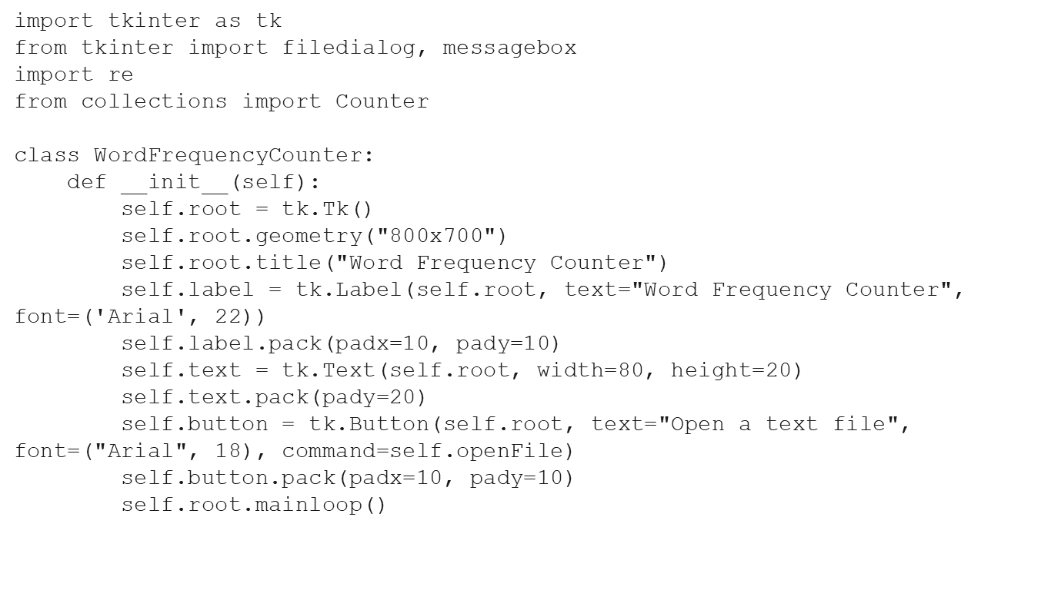
Code Snippet: GUI Setup

Slide 4
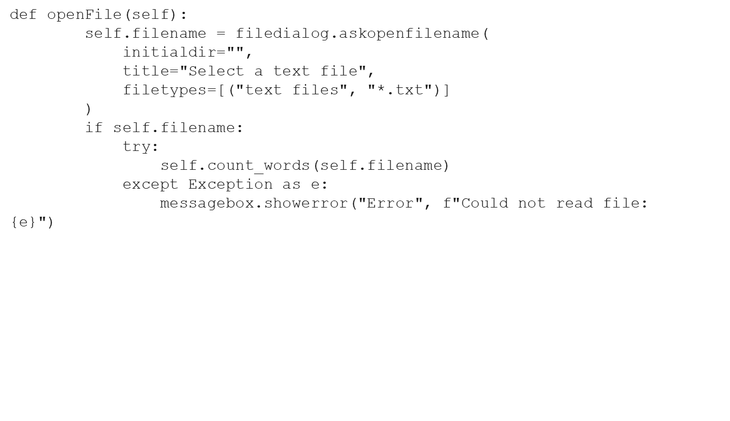
Code Snippet: File Open & Error Handling

Slide 5
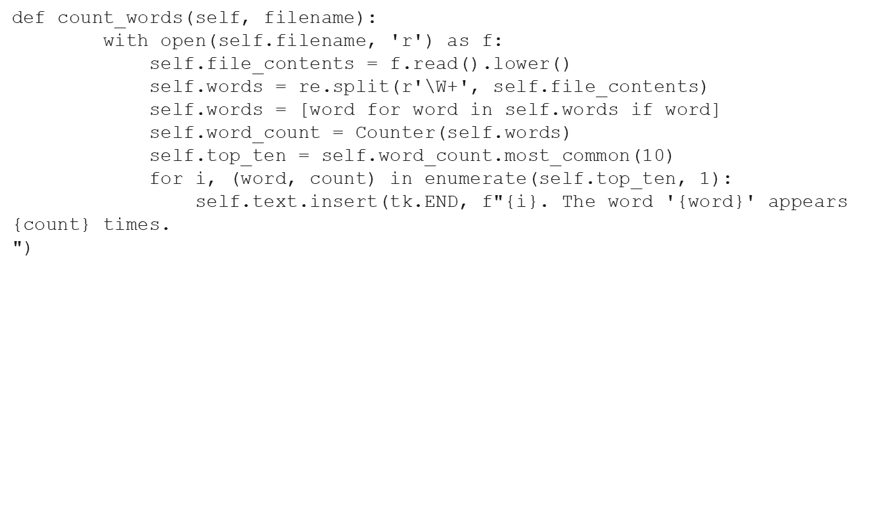
Code Snippet: Counting Logic

