Slide 1

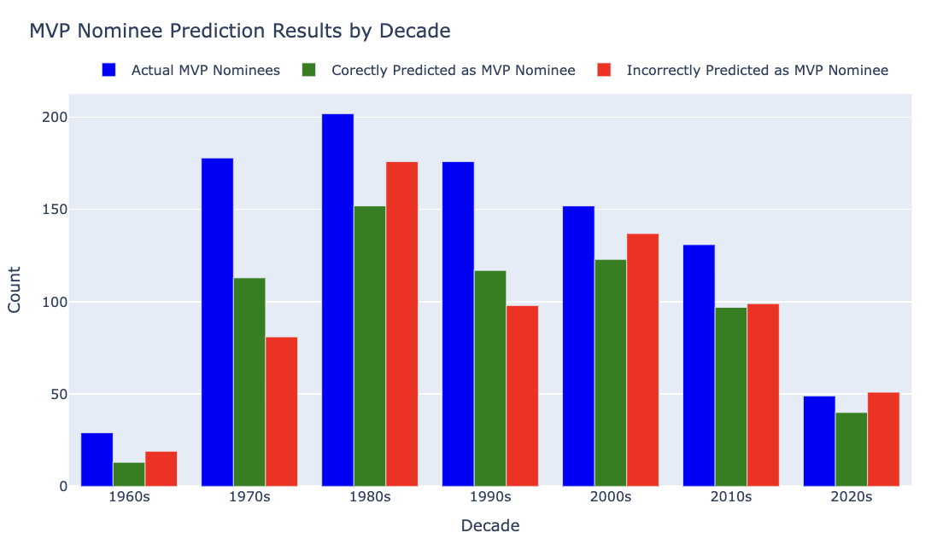
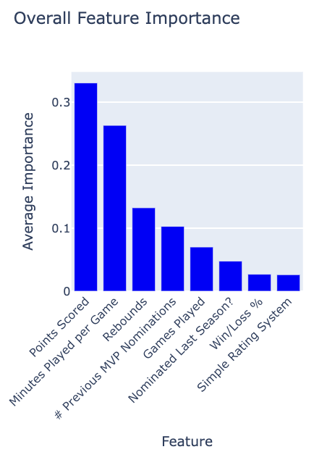
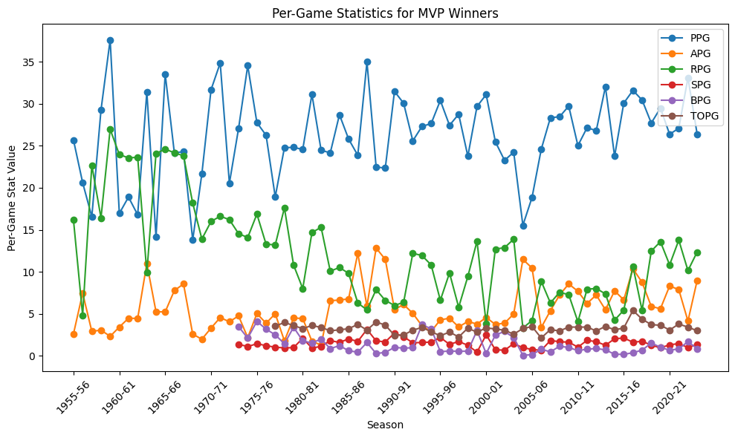
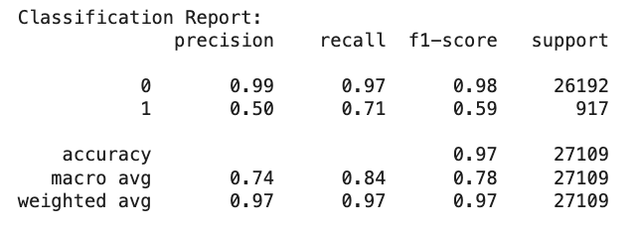
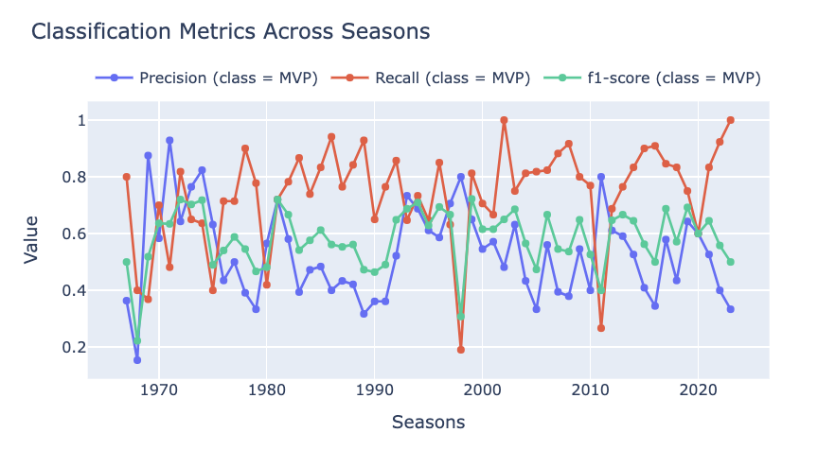
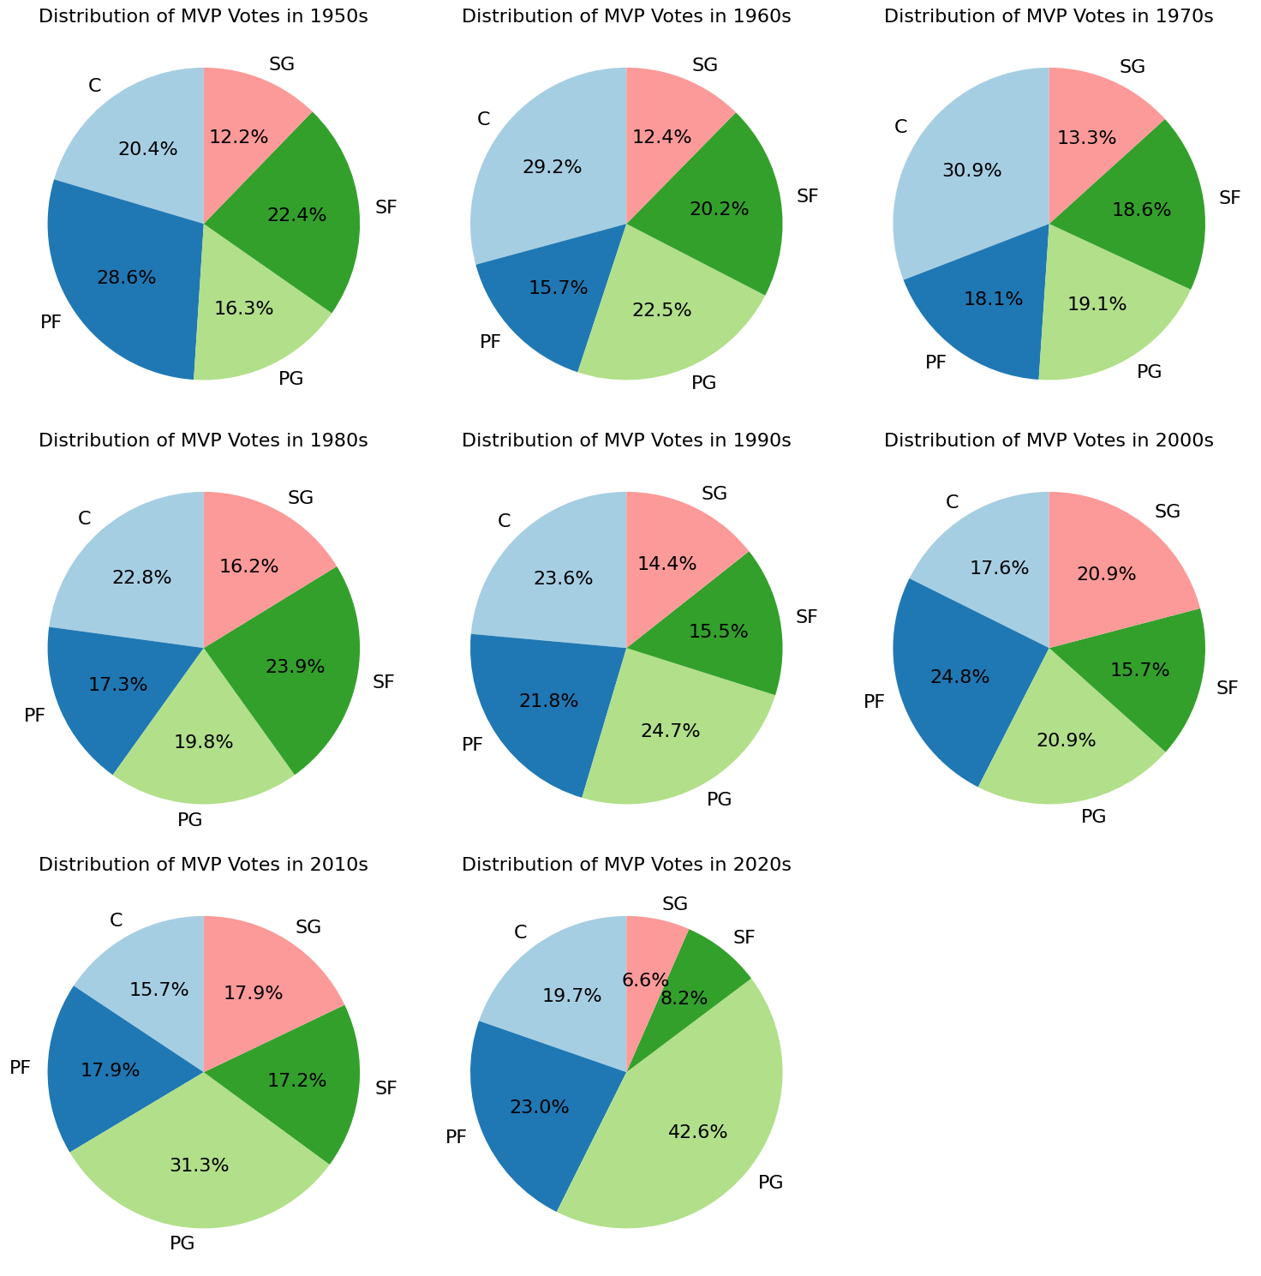
Predicting NBA MVP Awards
Eleazar Martin, Emma Gruben, Sean McGarry, Shreyan Das, Valerie Heckel
Introduction
Methods
Results
Data
Model Selection - A Classification Problem
Data for seasons 1955-56 to 2023-24
28656 total values
End of season stats including:
Team, position, in-game performance, and awards
45 total metrics
We will use a Random Forest Classifier and attempted to handle unbalanced data set by using class weights
Areas of caution based on literature review:
Black-Box Model, hard to interpret
Can overfit to the minority class(es)
Imbalance in class may still challenge predictive performance
Model correctly predicts majority of MVP nominees across decades
Closest margins in the most recent (2020’s) decade
Hypothesis
We are a sponsorship agency trying to determine the next superstar to sponsor for the coming season. We hypothesize that a player's raw stats as well as team win percentage are critical factors in determining whether they are nominated for MVP.
Most important feature is Points scored, followed by minutes played per game
Win/loss % is not quite as important as hypothesized!
Goal
Create a classification model to identity significant descriptors in predicting MVP nominees
Data is broken down into MVP 1 - MVP #
MVP 1 is the actual winner
The rest are nominees in order of votes received
Precision and Recall appear to be sacrifices of each other, as one increases the other tends to decrease.
The F1-score (green line) mirrors the balance between precision and recall, with noticeable variability across seasons
*Checking feature importance
Optimization
Optimized hyperparameters using Optuna via randomly sampling parameter space
Optimization increased recall

