Slide 1
Italian test case details
Hakan Ergun, 15.20.2020

Slide 2
Overview
The test case has been updated and merged into the develop branch
./test/data/case6_all_candidates.m
Generation and load profiles have been added
PV in central south & Sicily, wind in Sicily, time series generated with Ninja Renewables for 2019
Load profiles downloaded for the 6 market zones from the entso-e transparency platform
All profiles converted in pu (w.r.t. maximum value)
New test script created: test_italian_case.jl
Reads profile data in and creates case file
Solves the planning problem for a single year with storage, demand, ac & dc candidates
PST candidate will follow later

Slide 3
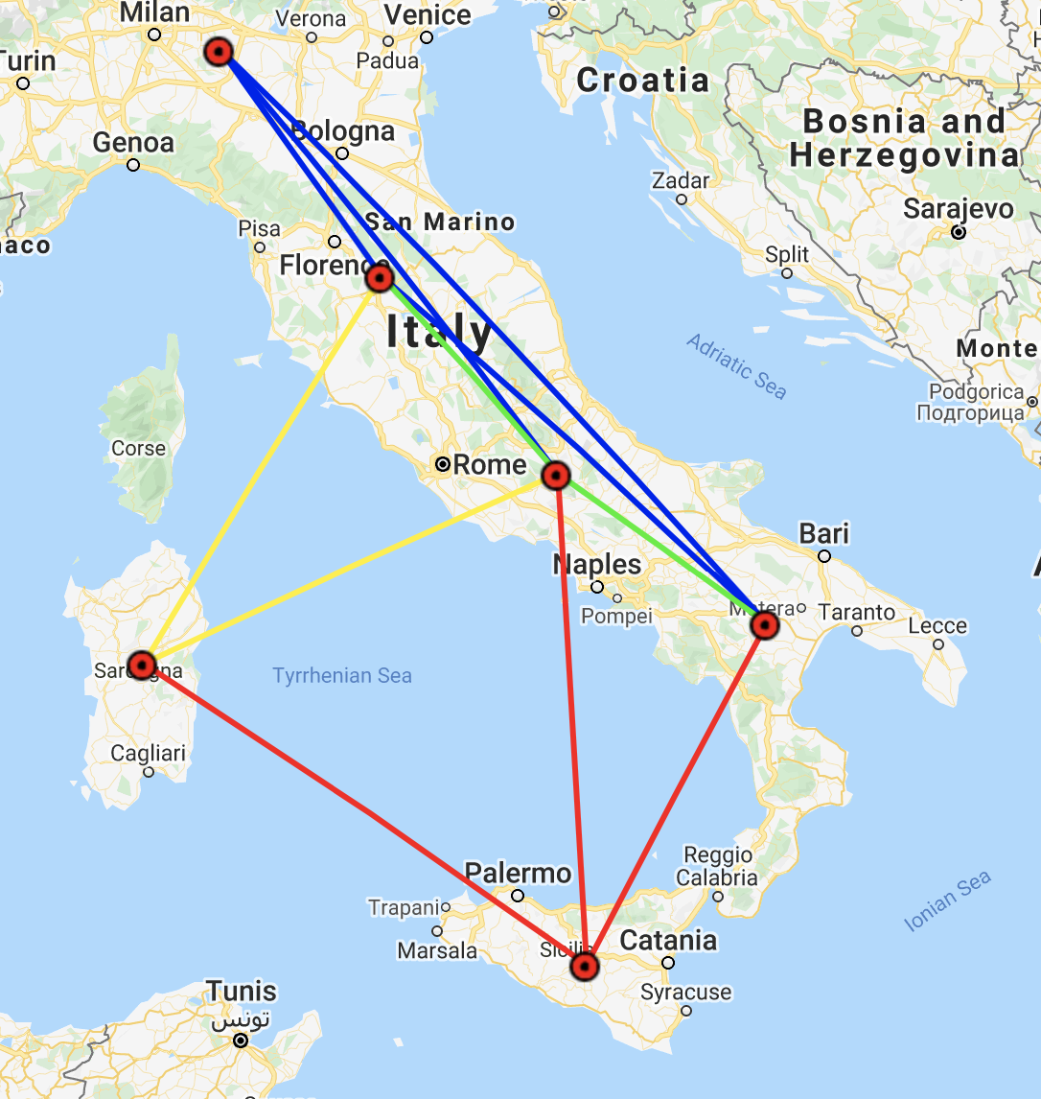
Updates
Node 2
Positions of nodes 1&2 and 5 & 6 switched
Using two HVDC links the Sardinia connections looks more Italian like
Two candidate AC lines defined
Between node 1-3 and 3-4 (green)
Three candidate HVDC connections defined
Red lines, including 6 converters
Node 1
Node 3
Node 4
Node 5
Node 6

Slide 4
Generation
Generation in bus 6 split in 3 generators
40% wind, 40% PV, 20% conventional
Generation in bus 3 split in 2 generators
50% PV, 50% conventional
All demand is defined as potentially flexible
Two storage candidates defined for bus 2 & 5.

