Slide 1
Power flow calculations – Practical session
Hakan Ergun 24 February 2025
KU Leuven – Etch / EnergyVille

Slide 2
Quick - check
Was everybody able to install software and run the code?
Any other issues, or questions so far?

Slide 3
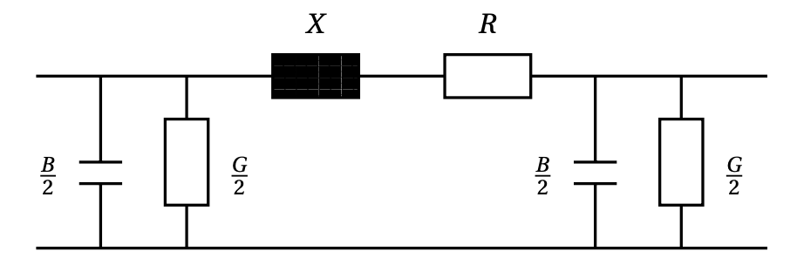
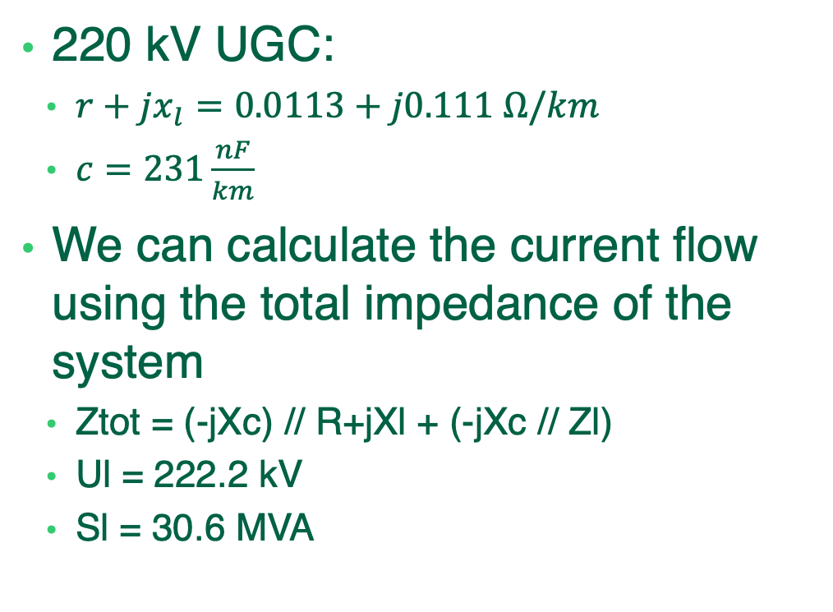
Let us play play with the single cable example
220 kV UGC:
$r+jx_{l}=0.0113+j0.111 Ω/km$
$c=231\frac{nF}{km}$
We can calculate the current flow using the total impedance of the system
Ztot = (-jXc) // R+jXl + (-jXc // Zl)
Ul = 222.2 kV
Sl = 30.6 MVA
50 km
Zl = 1613.3 Ohm (30 MVA @220 kV), purely resistive
G
Zl
Ul

Slide 4
How does the voltage profile change, if the length increases?
Can you easily analyse this in the code?

Slide 5
Comparison with last session

Slide 6
How can we see how much reactive power the cable requires from the results?
We first need to tweak our code a bit: Let’s look at a cable length of 100 km.
After solving the problem for 100 km, you can print the results as follows:
result = PowerModels.compute_ac_pf(data) #solve the problem
PowerModels.update_data!(data, result["solution"]) # write solution into data
flows = calc_branch_flow_ac(data) # calculate power flows
PowerModels.update_data!(data, flows) # write flows into data
The flows can be found under:
data[“branch”][“1”][“pf”]
data[“branch”][“1”][“pt”]
data[“branch”][“1”][“qf”]
data[“branch”][“1”][“qt”]
What are the losses in the system?
How much reactive power is needed by the cable?

Slide 7
Solution
Losses: Power flowing in the “from” direction + power flowing in the “to” direction give you the losses
Active power flow 1 -> 2: 30.800038060792765 MW
Active power flow 2 -> 1: -30.000000006189744 MW
Losses = 0.8 MW
Similarly, the reactive power demand is qf+qt
Rective power flow 1 -> 2: -358.1548007648668 Mvar
Rective power flow 2 -> 1: 4.9039280969331855e-8 Mvar
Is the result realistic?

Slide 8
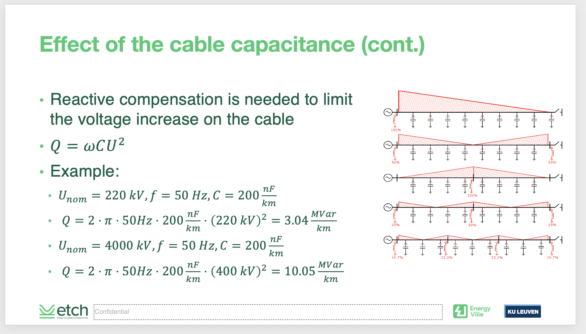

From last time…..
$$c=231\frac{nF}{km}$$

Slide 9
We also see that the reactive power needs to be all absorbed by the generator…
Table: bus
vm, va
1: 1.000, 0.000
2: 1.041, -0.011
Table: gen
pg, qg
1: 0.308, -3.582
… note this is in pu of 100 MVA -> 358.2 Mvar

Slide 10
Let’s compensate
Can you add two shunt inductances (on both sides) to compensate?
What will the reactance be in Ohm & pu
To include shunts, you can amend
data["shunt"]["1"] = Dict() # create dictionary
data[“shunt”][“1”][“shunt_bus”]= … # to which bus is it connected
data[“shunt”][“1”][“status”]= 1 # 1 is on, 0 is off
data[“shunt”][“1”][“gs”]= …. # shunt conductance in pu
data[“shunt”][“1”][“bs”]= …. # shunt admittance in pu
data[“shunt”][“1”][“index”]= 1 # index for internal book keeping, can be same as element number of dictionary

Slide 11
Calculating the value for the reactances
reactive_flow = data["branch"]["1"]["qf"] * data["baseMVA"] + data["branch"]["1"]["qt"] * data["baseMVA"]
q_comp = reactive_flow * 1e6 / 2 # divide by half because of double sided compensation
x_comp =(u_1^2 / q_comp) / zbase # calculate reactance value in pu
b_comp = 1 / x_comp # convert to shunt admittance
result = PowerModels.compute_ac_pf(data)
PowerModels.print_summary(result["solution"])
Table: bus
vm, va
1: 1.000, 0.000
2: 0.998, -0.007
Table: gen
pg, qg
1: 0.300, 0.071

Slide 12
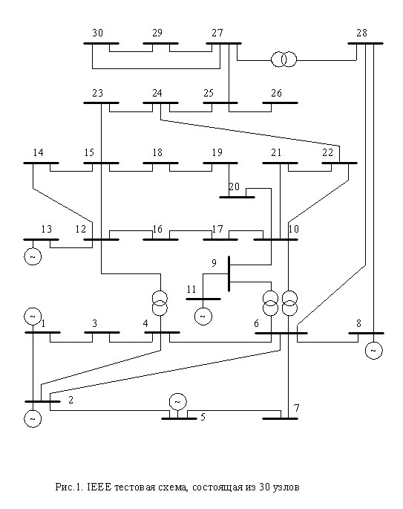
Let’s go meshed!!!
We will use the IEEE 30 bus network (case30.m, pf_meshed_grid.jl)

Slide 13
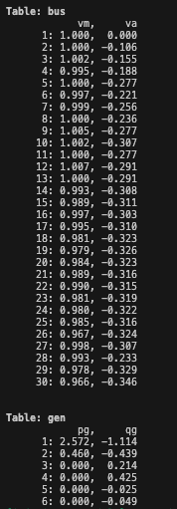
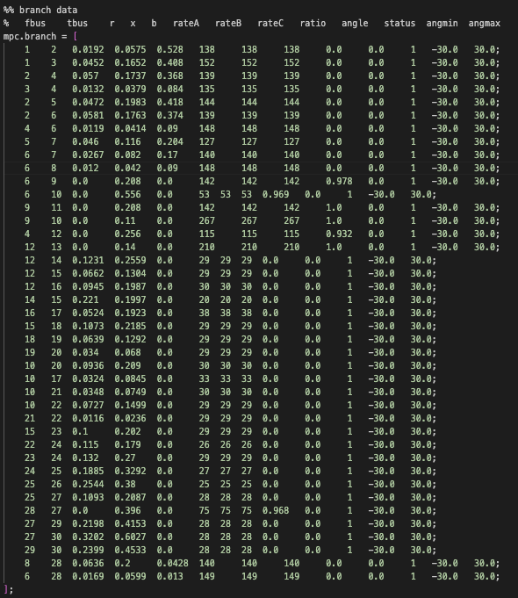
Let’s inspect the data and results
Generator 1 and 2 absorbing reactive power
Can we say which elements are inductive and which ones inductive/ capacitive?

Slide 14
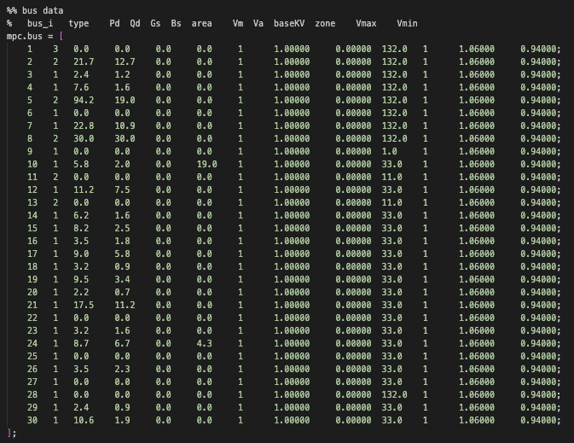
Inspecting the data and results
The branches on the lower voltage levels are purely inductive.
Branches on 132 kV level are also capacitive.

Slide 15
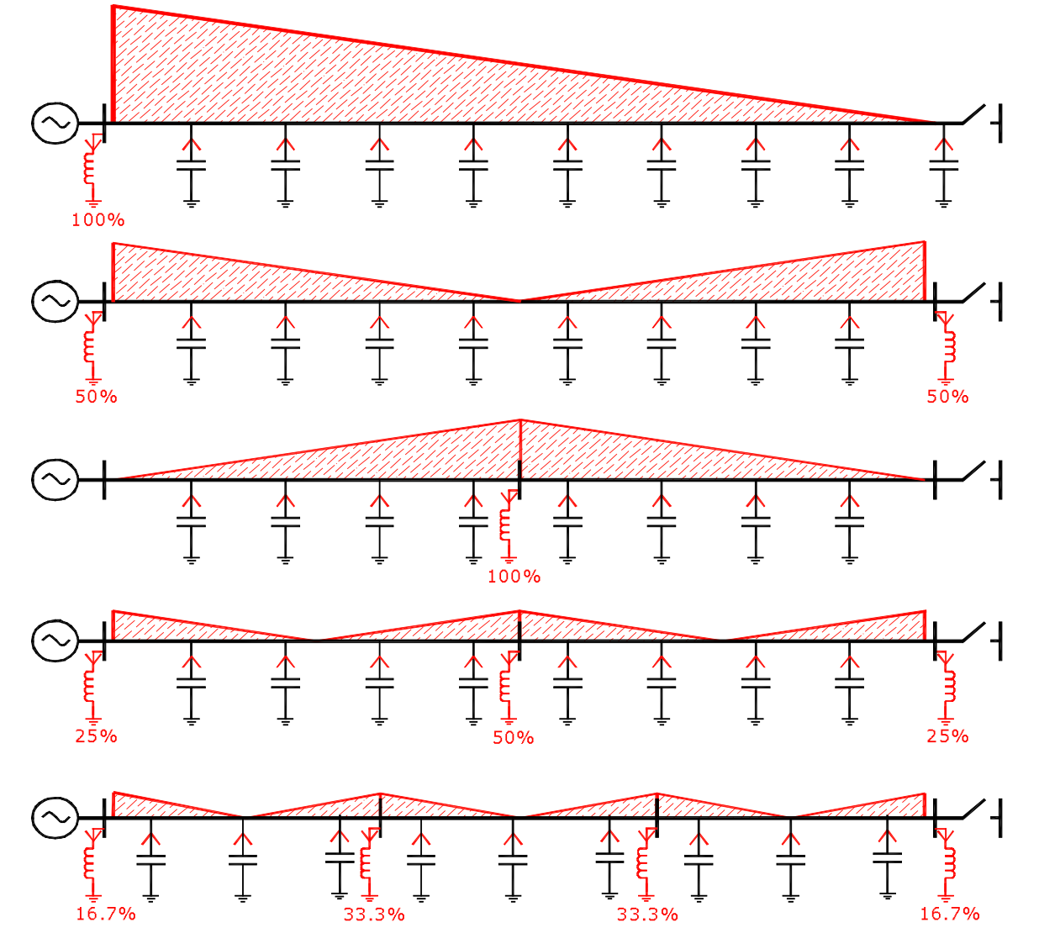
Let’s try three compensation options
Branch 2 going from bus 1 to bus 3
Option 1: On one side
Option 2: On both sides
Option 3: Midpoint
Bc = 0.408 pu

Slide 16
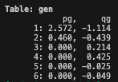
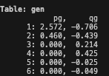
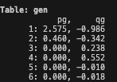
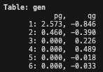

Comparing the options
Base case
Option 1a: Bus 1
Option 1b: Bus 3
Option 2:
Option 3:
WHAT DO YOU OBSERVE?

