Slide 1
LM7805 Voltage Regulator

Slide 2
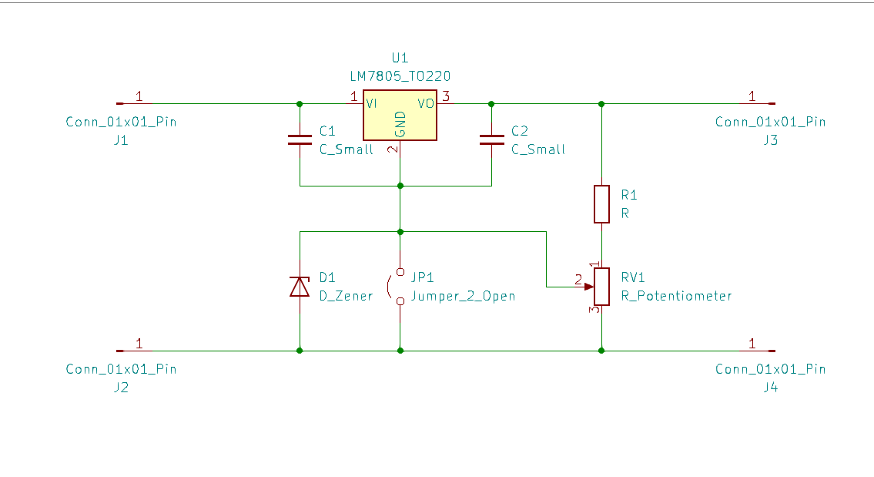
Operating Modes
Adjustable Voltage Regulator
Increasing Voltage
By added Zener diode
Normal operation

Slide 3
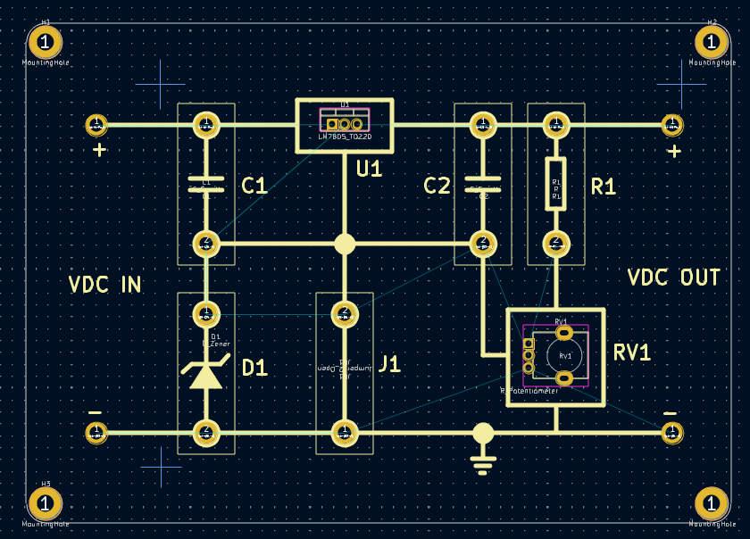
Design

Slide 4
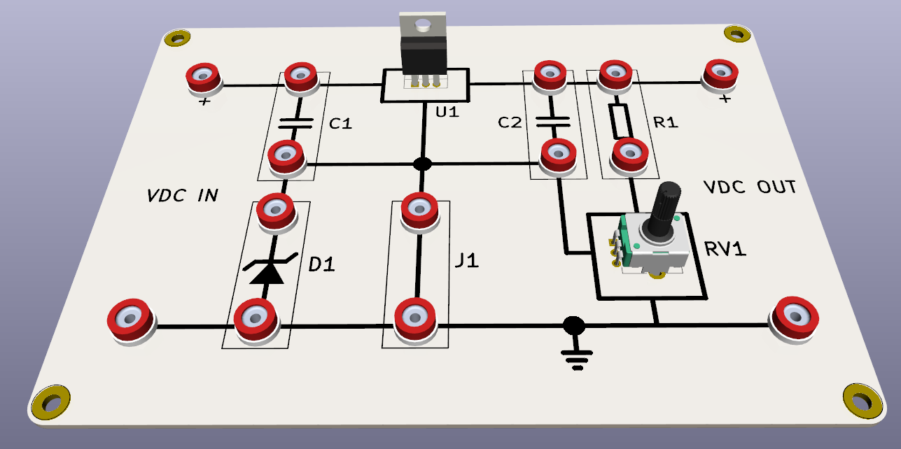
3D preview
Add Heatsink

