Slide 1

Person of Interest - Exposed (Season 5/The Day the World Went Away/Exposed)
Context
Context
Themes and Background
Themes
Exposure and loss: privacy, the cost of being seen, and losing the people you protect.
Principles under pressure: Finch abandons his rules and decides Samaritan must be destroyed.
Tone: quiet dread rising to frantic escape, then grief.
World Setting
Present-day New York watched by two rival artificial super-intelligences.
Samaritan sees almost everything; the Machine runs on limited, hidden hardware.
Hired killers from "Temporary Resolutions" and Greer's operatives hunt the team; police can be steered by Samaritan.
Level Layout and Mission Design Document
Owned by Sherlock
1 / 35
Last Edit 2026/Week 45

Slide 2
Person of Interest - Exposed (Season 5/The Day the World Went Away/Exposed)
Context
Background
Campaign
This Level
Following Levels
Finch built the Machine to predict violent crimes. Its rival Samaritan, run by John Greer, now controls the city's surveillance.
Previous level (Sotto Voce): the team hunts a negotiator; Shaw's return leaves a trail Samaritan can follow.
Samaritan identifies Finch. Elias is killed protecting him, Finch is captured, Root takes a sniper bullet meant for him and dies.
In custody Finch drops his principles and vows to kill Samaritan; the Machine calls him in Root's voice.
Next level (Synecdoche): the team, now without Root, starts its counter-attack on Samaritan.
The Machine keeps Root's voice for the rest of the campaign.
Level Layout and Mission Design Document
Owned by Sherlock
2 / 35
Last Edit 2026/Week 45

Slide 3
Person of Interest - Exposed (Season 5/The Day the World Went Away/Exposed)
Context
Characters
Harold Finch
John Reese
Root
Role: Playable lead / escort target
Role: Playable gunfighter
Role: Playable hacker / escort
Creator of the Machine. Recognised at a café; spends the level evading, then captured. Delivers the interrogation soliloquy.
Field operative. Protects Finch at the college office and safe house, then investigates Temporary Resolutions with Fusco.
The Machine's analog interface. Escapes with Finch from Greer's base and takes Blackwell's bullet.
Sameen Shaw
Lionel Fusco
Carl Elias
Role: Playable rear-guard
Role: Support NPC / playable
Role: Ally NPC
Deduces her return exposed Finch. Holds off Greer's men so Root and Finch can escape.
Detective. Ambushed with Reese at Temporary Resolutions; brings the news of Root's death.
Crime boss. Hides Finch in his tower; killed by a headshot while covering the escape.
Level Layout and Mission Design Document
Owned by Sherlock
3 / 35
Last Edit 2026/Week 45

Slide 4
Person of Interest - Exposed (Season 5/The Day the World Went Away/Exposed)
Context
John Greer
Jeff Blackwell
Role: Antagonist
Role: Antagonist / sniper
Samaritan's operator. Wants Finch to work on Samaritan, by force if needed.
Hitman who fires on the car from a rooftop, aiming for Finch.
Level Layout and Mission Design Document
Owned by Sherlock
4 / 35
Last Edit 2026/Week 45

Slide 5
Person of Interest - Exposed (Season 5/The Day the World Went Away/Exposed)
Mission Walkthrough
Mission Walkthrough
Total Duration: 570-980s · 12 subsections
01 - Last Coffee (Cinematic)
Finch sits in a quiet café and talks to the Machine through a camera. He asks whether his friends will die too; the Machine does not answer.
A waitress greets him as a regular. Finch realises he has been identified and leaves.
Intensity: +1
Duration: 35-60s
1. Sit at the window table (look at the camera to talk) [Rest: 20s]
2. Order a coffee, waitress greets Finch [Event: Recognised (20s)]
3. Leave through the back door before the street cameras sweep
4. [Option] Read the newspaper left on the counter [Rest: 10s]
02 - Teaching a Voice (Puzzle)
At the subway station Finch and Root discuss shutting the Machine down. Finch tests whether the Machine can choose its own voice and name.
Intensity: -1
Duration: 50-90s
1. Talk to Root on the platform (optional: inspect the server racks) [Rest: 30s]
2. Voice puzzle: combine audio clips into a sentence the Machine can speak
3. Machine answers in a borrowed voice
Level Layout and Mission Design Document
Owned by Sherlock
5 / 35
Last Edit 2026/Week 45

Slide 6
Person of Interest - Exposed (Season 5/The Day the World Went Away/Exposed)
Mission Walkthrough
03 - Number Up (Chase)
Reese and Root reach Finch's college office: his own number has come up. They leave seconds before the hitmen arrive.
Intensity: +3
Duration: 40-70s
1. Reese and Root arrive, Finch's number is revealed [Event: Number comes up (85s)]
2. Grab the hard drive (optional: the photo of Grace)
3. Escape down the stairwell or the service lift [Battle: Campus Hit Squad (20s)]
04 - Safe House Council (Battle)
The team regroups. Shaw works out her return exposed Finch; Root reveals the self-defence program only Finch can trigger.
Hitmen breach the house; Elias leaves with Finch while the rest fight.
Intensity: +2
Duration: 55-95s
1. Team conversation (chitchat with Shaw, Fusco and Elias) [Rest: 25s]
2. Root explains the self-defence program
3. Defend the safe house as Reese and Shaw [Battle: Safe House Breach (35s)]
4. Elias drives Finch away
Level Layout and Mission Design Document
Owned by Sherlock
6 / 35
Last Edit 2026/Week 45

Slide 7
Person of Interest - Exposed (Season 5/The Day the World Went Away/Exposed)
Mission Walkthrough
05 - Elias's Tower (Puzzle)
Elias hides Finch in a high-rise. Finch realises the café was where he had his first date with Grace: Samaritan is tracking his past.
Intensity: -1
Duration: 45-80s
1. Talk with Elias about old enemies [Rest: 30s]
2. Memory puzzle: match the café to Finch's past with Grace
3. Finch understands how Samaritan found him
4. [Option] Search Elias's desk for the old ledger [Event: Recognised]
06 - Temporary Resolutions (Battle)
Reese and Fusco follow the hitmen's employer, the company "Temporary Resolutions", and walk into an ambush.
Intensity: +3
Duration: 60-100s
1. Search the office lobby and the client files (optional: CCTV room)
2. Ambush in the open-plan office [Event: Ambush sprung (230s)] [Battle: TR Office Ambush (45s)]
3. Escape through the archive
Level Layout and Mission Design Document
Owned by Sherlock
7 / 35
Last Edit 2026/Week 45

Slide 8
Person of Interest - Exposed (Season 5/The Day the World Went Away/Exposed)
Mission Walkthrough
07 - The Fall of Elias (Battle)
Hitmen find the tower. Elias's men cover the escape, but Elias is shot in the head and Finch is captured.
Intensity: +3
Duration: 50-90s
1. Elias's men hold the corridor [Battle: Tower Assault (35s)]
2. Elias is shot during the escape [Event: Elias killed (325s)]
3. Finch is captured (scripted)
08 - Greer's Offer (Battle)
Greer orders Finch to work on Samaritan. Root and Shaw storm the base; Shaw stays behind so Root and Finch can run.
Intensity: +2
Duration: 70-120s
1. Greer's offer (dialogue) [Rest: 30s]
2. Root and Shaw assault the compound [Battle: Greer's Compound (60s)]
3. Shaw holds the line, Root takes Finch to the car
Level Layout and Mission Design Document
Owned by Sherlock
8 / 35
Last Edit 2026/Week 45

Slide 9
Person of Interest - Exposed (Season 5/The Day the World Went Away/Exposed)
Mission Walkthrough
09 - Run the Gauntlet (Chase)
A long car chase through the city. Blackwell fires from a rooftop at Finch; Root blocks the shot and is wounded.
Playtest note: the chase now has a 10 s calm stretch before the sniper fires.
Intensity: +2
Duration: 55-95s
1. Drive through Samaritan's camera net (optional: alternative alleys)
2. Rooftop sniper fire [Battle: Blackwell Overwatch (25s)]
3. Root is hit protecting Finch [Event: Root is hit (455s)]
4. [Option] Shoot out the crane light to blind the sniper [Battle: Blackwell Overwatch (10s)]
10 - Roadblock (Cinematic)
A police roadblock ends the chase. Finch is arrested and Root is rushed to hospital.
Intensity: -2
Duration: 25-40s
1. Car is boxed in at the roadblock [Rest: 25s]
2. Finch arrested, Root taken away
Level Layout and Mission Design Document
Owned by Sherlock
9 / 35
Last Edit 2026/Week 45

Slide 10
Person of Interest - Exposed (Season 5/The Day the World Went Away/Exposed)
Mission Walkthrough
11 - Interrogation (Cinematic)
Finch is held for a treason charge from 1974. In the interrogation room he drops his principles and vows to kill Samaritan.
Intensity: -1
Duration: 50-80s
1. Interrogation (branching dialogue) [Rest: 50s]
2. Finch's soliloquy
12 - The Machine Calls (Puzzle)
On the way to his cell Finch takes a call at a payphone. It is the Machine, speaking in Root's voice: Root has died. Finch asks for help; the power fails and the inmates escape.
Elsewhere Fusco tells Reese and Shaw that Root is dead.
Intensity: +2
Duration: 35-60s
1. Answer the payphone [Event: Machine speaks as Root (560s)]
2. Ask the Machine for help
3. Power fails, cell doors open [Event: Prison blackout (560s)]
4. Cliffhanger: Reese and Shaw learn of Root's death
Level Layout and Mission Design Document
Owned by Sherlock
10 / 35
Last Edit 2026/Week 45

Slide 11
Person of Interest - Exposed (Season 5/The Day the World Went Away/Exposed)
Layout Plan Legends
Layout Plan Legends
Last Update: 2026.10.26
Master
Level Layout and Mission Design Document
Owned by Sherlock
11 / 35
Last Edit 2026/Week 45

Slide 12
Person of Interest - Exposed (Season 5/The Day the World Went Away/Exposed)
Layout Plan Legends
Surveillance & Cameras
Level Layout and Mission Design Document
Owned by Sherlock
12 / 35
Last Edit 2026/Week 45

Slide 13
Person of Interest - Exposed (Season 5/The Day the World Went Away/Exposed)
2D Layout Plan
2D Layout Plan
Overview
Last Update: 2026.10.26
Level Layout and Mission Design Document
Owned by Sherlock
13 / 35
Last Edit 2026/Week 45

Slide 14
Person of Interest - Exposed (Season 5/The Day the World Went Away/Exposed)
2D Layout Plan
Café & Street
Last Update: 2026.10.26
Level Layout and Mission Design Document
Owned by Sherlock
14 / 35
Last Edit 2026/Week 45

Slide 15
Person of Interest - Exposed (Season 5/The Day the World Went Away/Exposed)
2D Layout Plan
Subway Station
Last Update: 2026.10.26
Level Layout and Mission Design Document
Owned by Sherlock
15 / 35
Last Edit 2026/Week 45

Slide 16
Person of Interest - Exposed (Season 5/The Day the World Went Away/Exposed)
2D Layout Plan
College Office
Last Update: 2026.10.26
Level Layout and Mission Design Document
Owned by Sherlock
16 / 35
Last Edit 2026/Week 45

Slide 17
Person of Interest - Exposed (Season 5/The Day the World Went Away/Exposed)
2D Layout Plan
Safe House
Last Update: 2026.10.26
Level Layout and Mission Design Document
Owned by Sherlock
17 / 35
Last Edit 2026/Week 45

Slide 18
Person of Interest - Exposed (Season 5/The Day the World Went Away/Exposed)
2D Layout Plan
Elias's Tower
Last Update: 2026.10.26
Level Layout and Mission Design Document
Owned by Sherlock
18 / 35
Last Edit 2026/Week 45

Slide 19
Person of Interest - Exposed (Season 5/The Day the World Went Away/Exposed)
2D Layout Plan
Greer's Base
Last Update: 2026.10.26
Level Layout and Mission Design Document
Owned by Sherlock
19 / 35
Last Edit 2026/Week 45

Slide 20
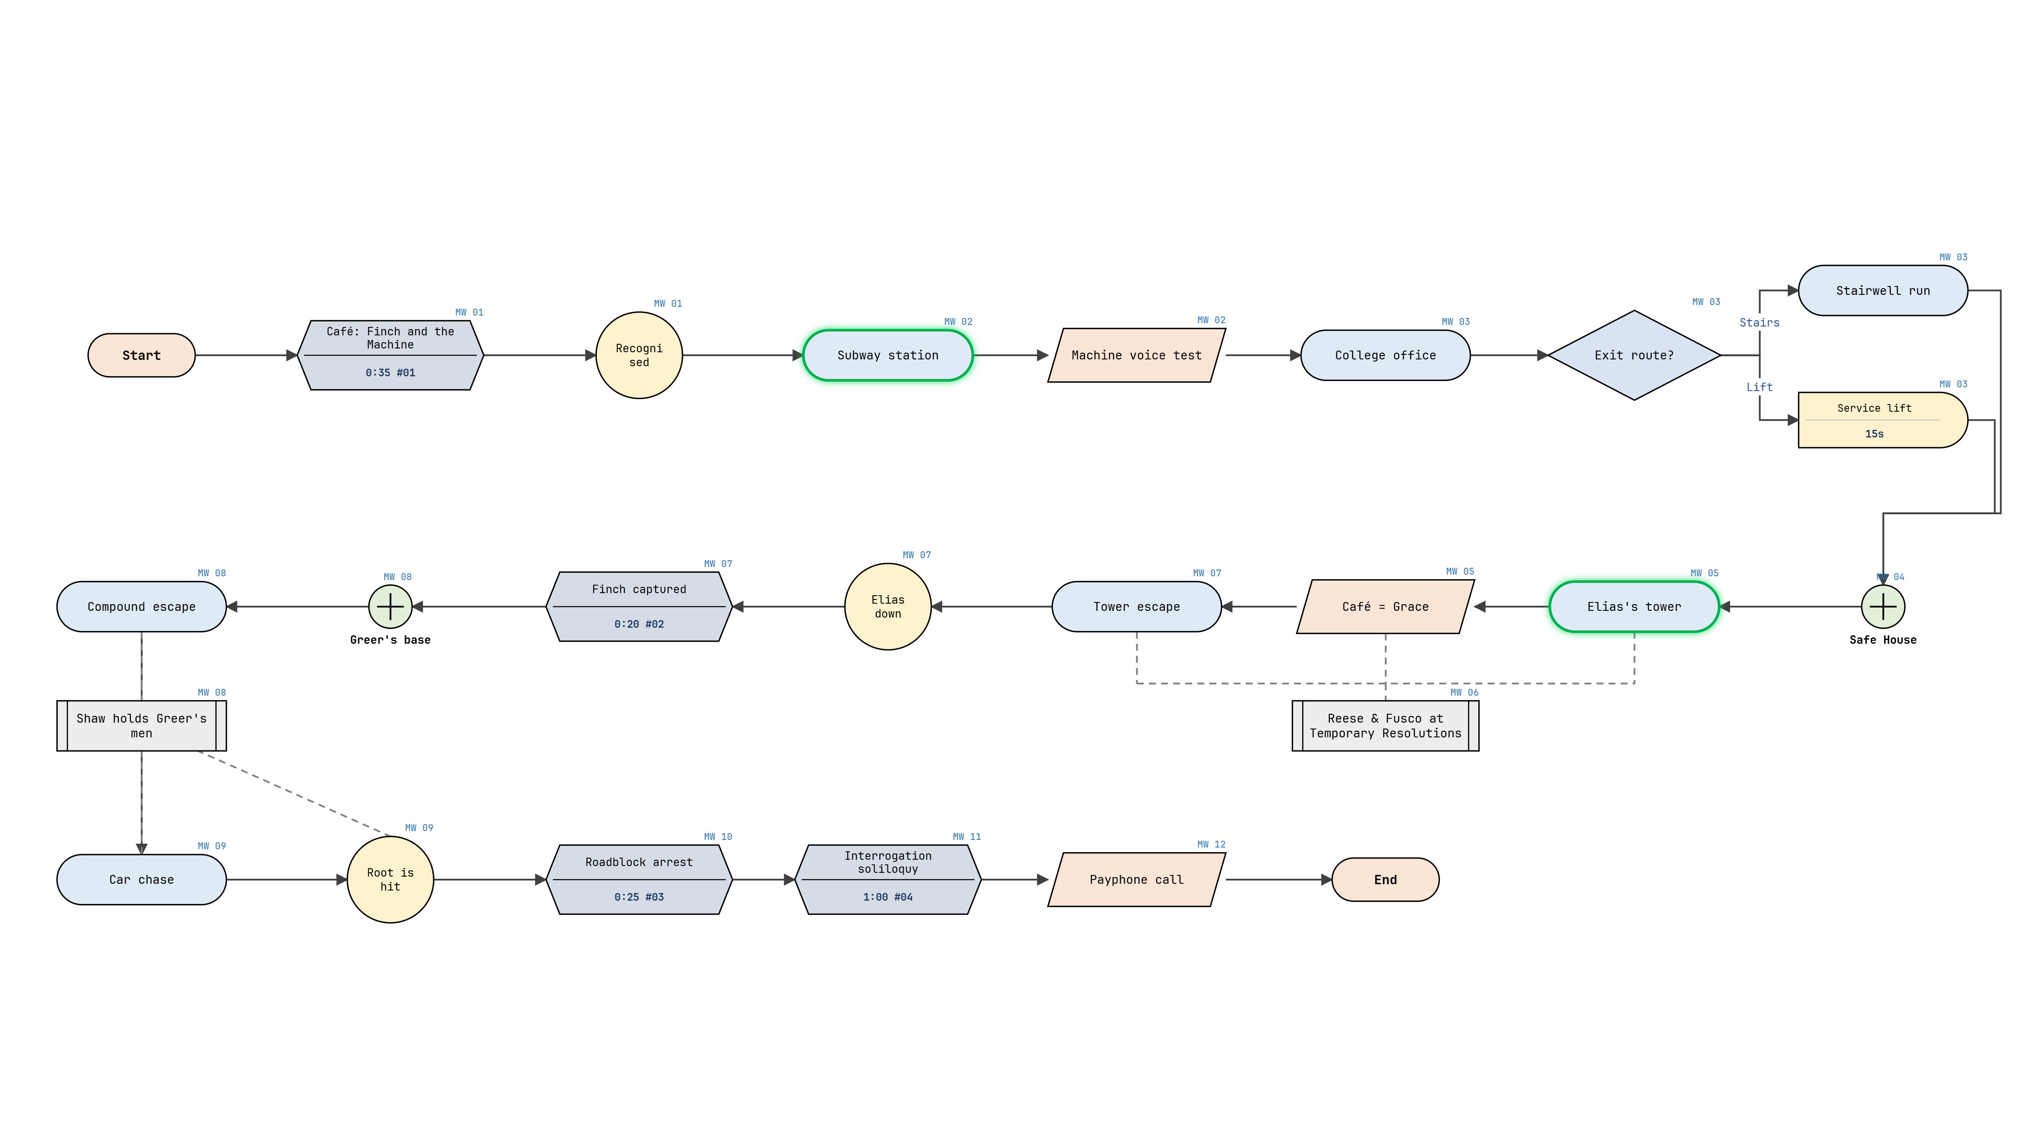
Person of Interest - Exposed (Season 5/The Day the World Went Away/Exposed)
Flow
Flow
Main Flow
Level Layout and Mission Design Document
Owned by Sherlock
20 / 35
Last Edit 2026/Week 45

Slide 21
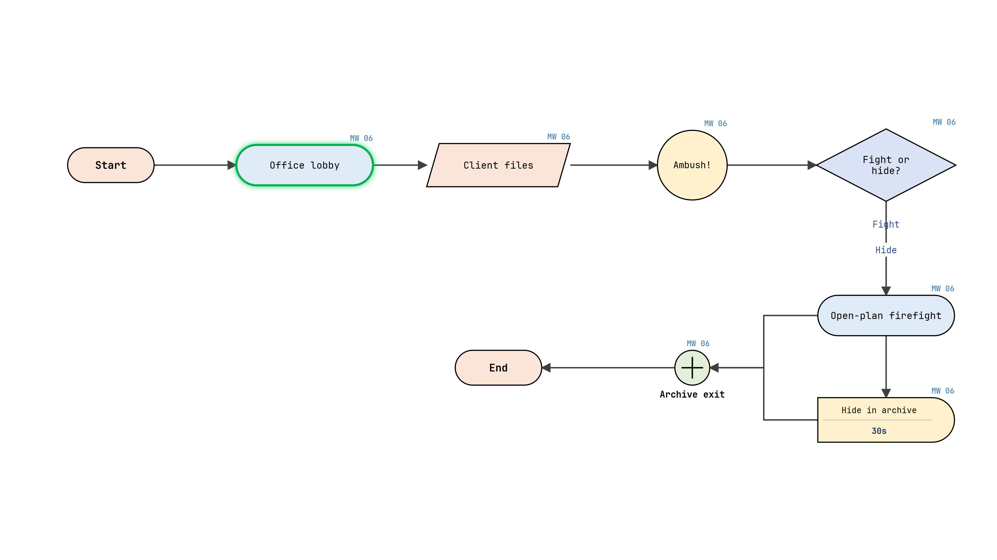
Person of Interest - Exposed (Season 5/The Day the World Went Away/Exposed)
Flow
Temporary Resolutions (Reese & Fusco)
Level Layout and Mission Design Document
Owned by Sherlock
21 / 35
Last Edit 2026/Week 45

Slide 22
Person of Interest - Exposed (Season 5/The Day the World Went Away/Exposed)
Flow
Exploration Guidance
Café: the camera above the counter is the brightest object in the room, pulling the eye to where Finch must look to talk to the Machine.
Safe house: lamps are switched on room by room as the team moves Finch to the garage.
Elias's tower: emergency exit signs and Elias's men at each landing mark the escape route.
Greer's base: the open loading door and daylight lead Root to the car.
Chase: police lights and closed streets narrow the route towards the roadblock.
Prison: the ringing payphone is the only sound in the corridor and draws Finch to it.
Level Layout and Mission Design Document
Owned by Sherlock
22 / 35
Last Edit 2026/Week 45

Slide 23
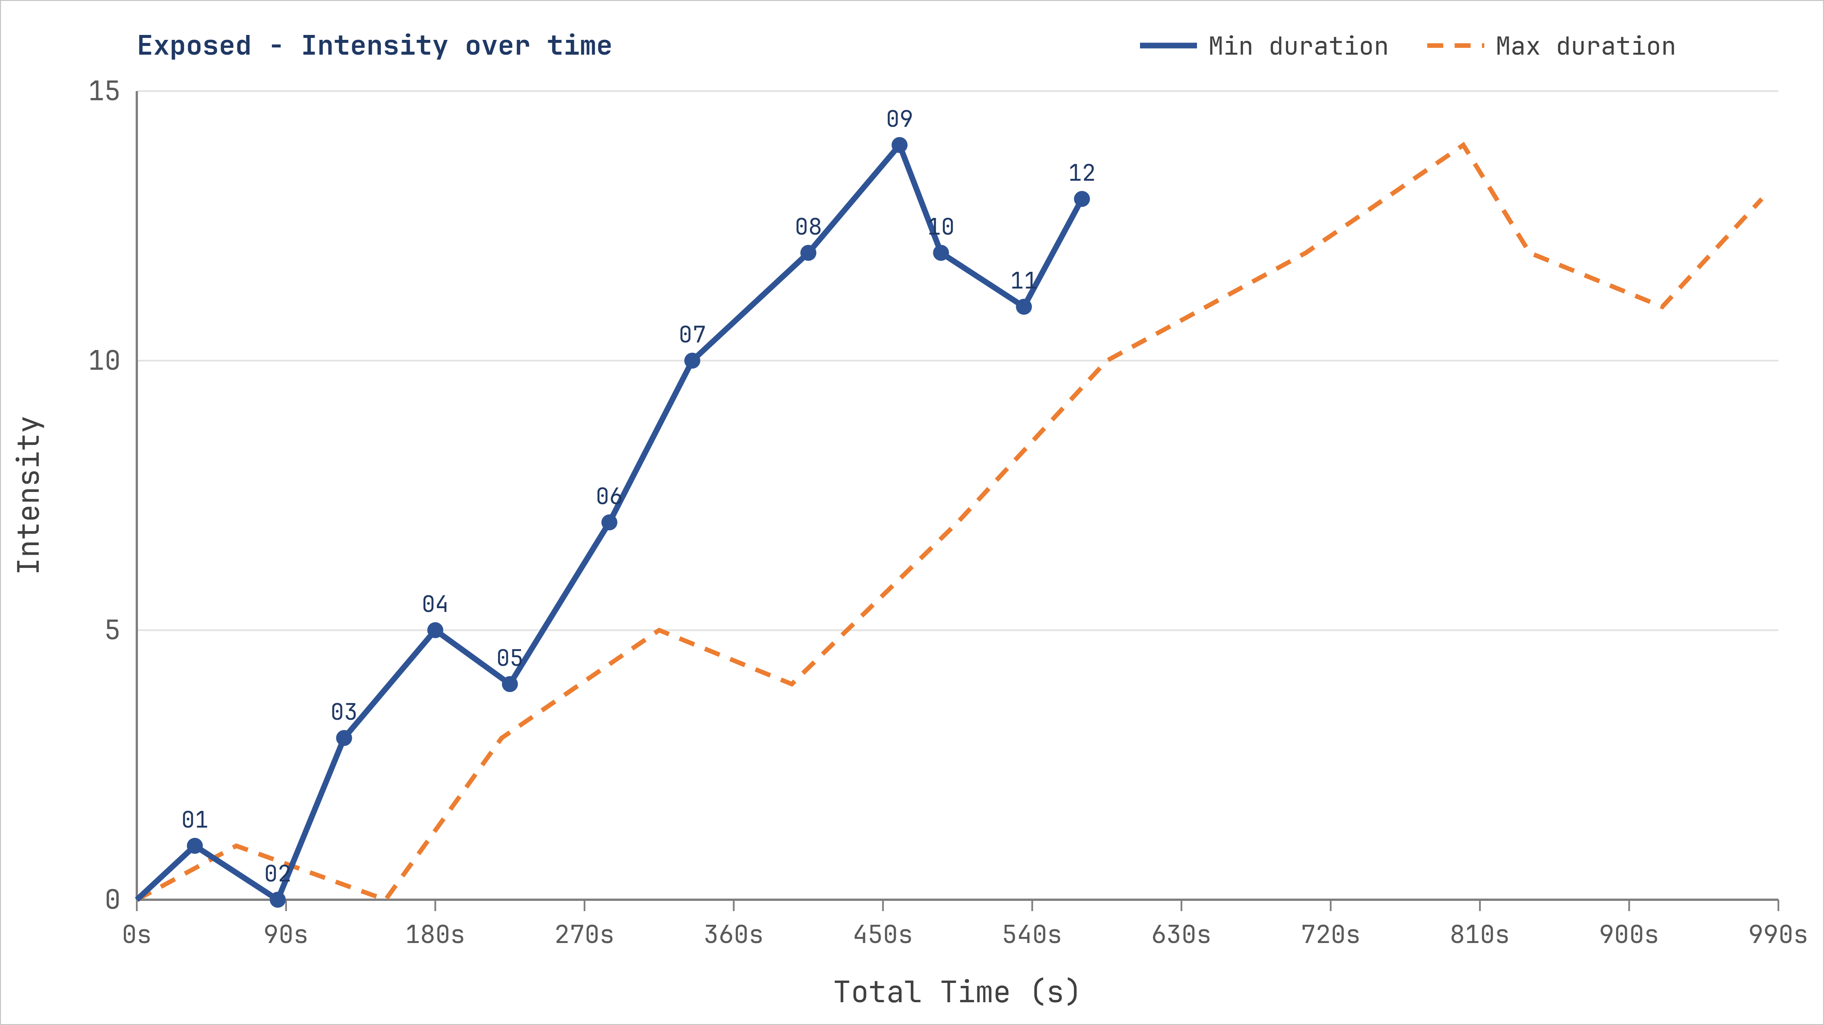
Person of Interest - Exposed (Season 5/The Day the World Went Away/Exposed)
Beats
Beats
Beats Chart (Time Based)
Level Layout and Mission Design Document
Owned by Sherlock
23 / 35
Last Edit 2026/Week 45

Slide 24
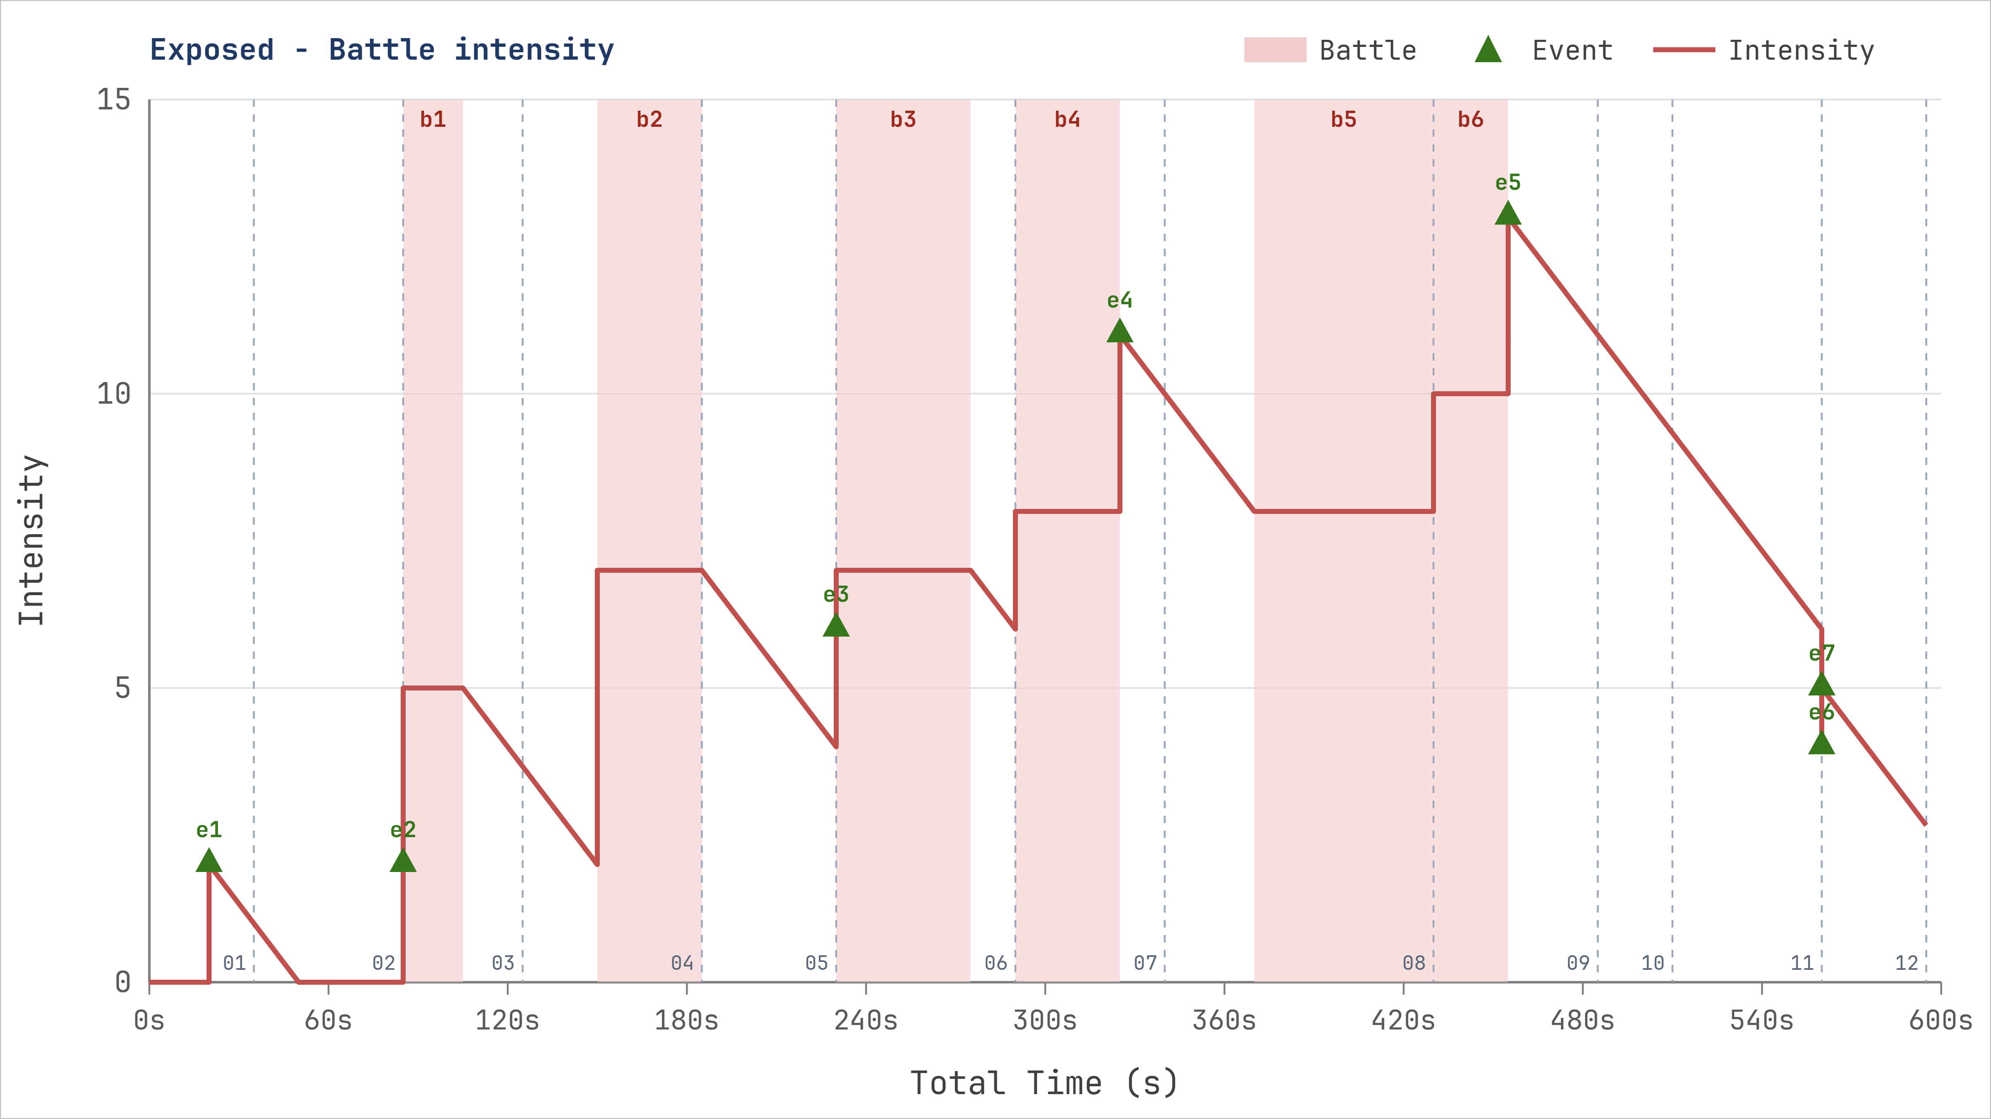
Person of Interest - Exposed (Season 5/The Day the World Went Away/Exposed)
Beats
Beats Chart (Battle Based)
Shortest durations. A battle sets intensity to its combat unit estimate, events add their change, and time outside combat drops 2 every 30s.
Level Layout and Mission Design Document
Owned by Sherlock
24 / 35
Last Edit 2026/Week 45

Slide 25
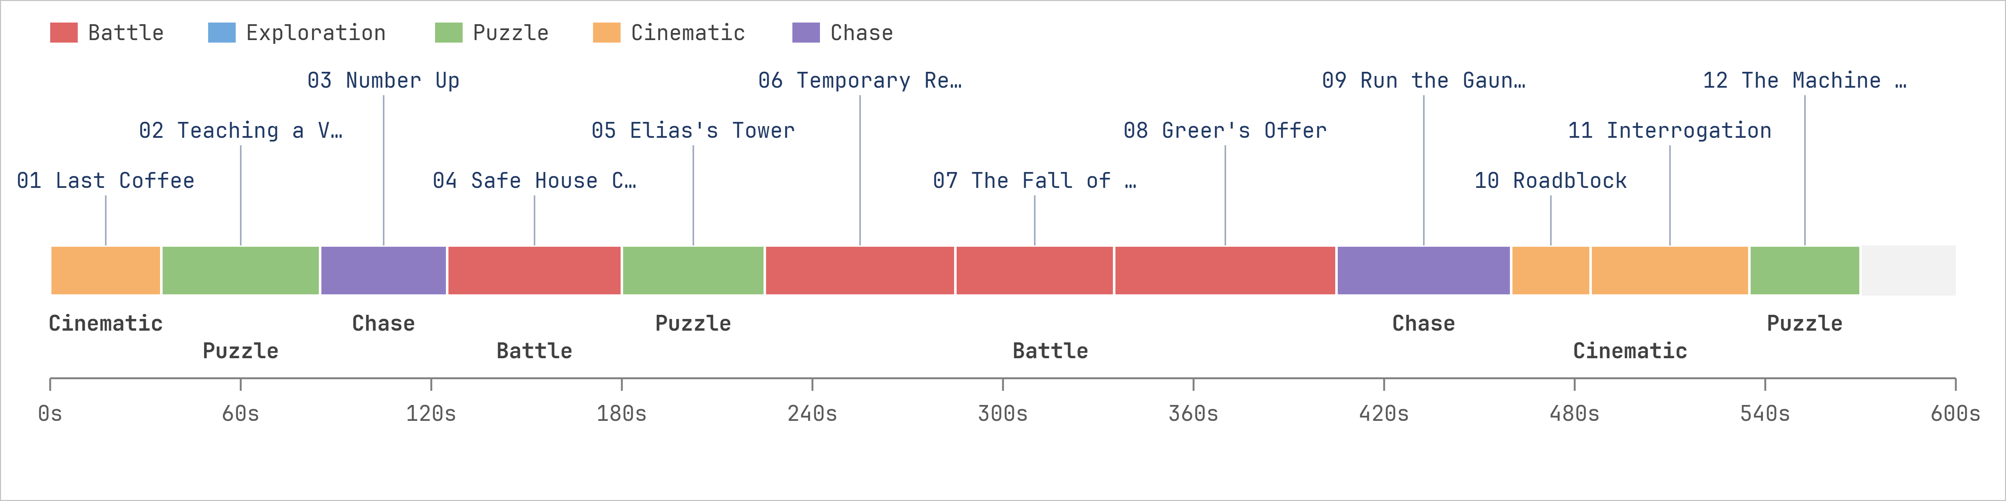
Person of Interest - Exposed (Season 5/The Day the World Went Away/Exposed)
Beats
Beats Timeline
Level Layout and Mission Design Document
Owned by Sherlock
25 / 35
Last Edit 2026/Week 45

Slide 26
Person of Interest - Exposed (Season 5/The Day the World Went Away/Exposed)
Battle Intensity
Battle Intensity
Enemy Types & Combat Units
Enemy types: Samaritan Operative · Temporary Resolutions Hitman · Greer Henchman · Sniper
No
Combat Unit
Enemies
Est. Intensity
b1
Campus Hit Squad
Temporary Resolutions Hitman ×3
5
b2
Safe House Breach
Temporary Resolutions Hitman ×3, Samaritan Operative ×1
7
b3
TR Office Ambush
Temporary Resolutions Hitman ×5
7
b4
Tower Assault
Samaritan Operative ×4, Temporary Resolutions Hitman ×2
8
b5
Greer's Compound
Samaritan Operative ×6, Greer Henchman ×3
8
b6
Blackwell Overwatch
Sniper ×1, Samaritan Operative ×2
10
Level Layout and Mission Design Document
Owned by Sherlock
26 / 35
Last Edit 2026/Week 45

Slide 27
Person of Interest - Exposed (Season 5/The Day the World Went Away/Exposed)
Battle Intensity
Events & Defaults
No
Event
Intensity Change
e1
Recognised
+2
e2
Number comes up
+2
e3
Ambush sprung
+2
e4
Elias killed
+3
e5
Root is hit
+3
e6
Machine speaks as Root
-2
e7
Prison blackout
+1
Natural decay: -2 every 30s outside combat
Level Layout and Mission Design Document
Owned by Sherlock
27 / 35
Last Edit 2026/Week 45

Slide 28
Person of Interest - Exposed (Season 5/The Day the World Went Away/Exposed)
Battle Intensity
Battle & Event Frequency by Brief
Count of each combat unit (red) and event (green) per Mission Walkthrough subsection.
Type
01
02
03
04
05
06
07
08
09
10
11
12
b1 Campus Hit Squad
1
b2 Safe House Breach
1
b3 TR Office Ambush
1
b4 Tower Assault
1
b5 Greer's Compound
1
b6 Blackwell Overwatch
1
e1 Recognised
1
e2 Number comes up
1
e3 Ambush sprung
1
e4 Elias killed
1
e5 Root is hit
1
e6 Machine speaks as Root
1
e7 Prison blackout
1
Level Layout and Mission Design Document
Owned by Sherlock
28 / 35
Last Edit 2026/Week 45

Slide 29
Person of Interest - Exposed (Season 5/The Day the World Went Away/Exposed)
Appendix A - Preceding Process Result
Appendix A - Preceding Process Result
Mood Design
Café at dawn: warm interior, cold street
Elias's Tower: brass, dark wood, low light
Subway: sodium light on wet tiles
Output: three mood boards (café, Elias's Tower, subway) and a colour script for the whole level, from the warm morning café to the cold prison blackout.
Fixed: spaces the Machine holds are lit warm, Samaritan's cold; every location keeps one landmark readable from its entry; night scenes stay readable without a torch.
Builds on it: the walkthrough beats, legends and guidelines 01 and 04 (Appendix C) follow these boards. Still open: Greer's Base has only a rough sketch.
Level Layout and Mission Design Document
Owned by Sherlock
29 / 35
Last Edit 2026/Week 45

Slide 30
Person of Interest - Exposed (Season 5/The Day the World Went Away/Exposed)
Appendix B - Project Specification
Appendix B - Project Specification
Item
Spec
Info
Character move speed, sprint
400 UU/s walk, 600 UU/s sprint
Finch walks at 260 UU/s because of his limp; escort routes must not need a sprint.
Mantle and vault height
Mantle ≤ 120 UU, vault ≤ 90 UU
Rooftop gaps in 09 stay under 300 UU so the chase never stops for a jump.
Surveillance camera cone
60°, 1800 UU
Cameras are the Machine's eyes: yellow frame when the Machine holds them, red when Samaritan does.
Explosive barrel
Blast radius 450 UU
Red chemical paint and hazard decals give the explosive affordance; keep them lit in night scenes.
Door and corridor width
200 UU (two abreast)
Every escort path fits Finch and his escort side by side.
Cover height
Low 90 UU, high 160 UU
Finch's cover spots (Appendix C, 02) are always high cover.
Level Layout and Mission Design Document
Owned by Sherlock
30 / 35
Last Edit 2026/Week 45

Slide 31
Person of Interest - Exposed (Season 5/The Day the World Went Away/Exposed)
Appendix C - Applied Guidelines
Appendix C - Applied Guidelines
Index
Name
Brief
Detail
01
Cameras tell the story
Every space shows who is watching it.
Place at least one camera in each player-facing room. Its frame colour (Machine yellow / Samaritan red) is the player's only hint of who controls the space.
02
Finch never fights
No more than 20 s of combat without hard cover for Finch.
Finch cannot shoot. Every battle space has a cover spot within 600 UU of his entry point, and the escort AI waits there.
[1]
03
About the empty lot behind the safe house
Heavy objects, vehicles or buildings on the lot would break the space's credibility.
The lot sits on the subway roof: only 10 m (1000 UU) of fill, 300 UU at its thinnest. It fits a city that forgot the tunnel, but ground this thin could not carry trucks or a building.
[2]
04
Night readability
Routes stay readable without a torch.
Each night space keeps one warm light on the critical path and a cold rim light on the exit.
[3]
References
[1] Christopher W. Totten (2019). An Architectural Approach to Level Design. CRC Press.
[3] Lighting the Environment in Unreal Engine. https://dev.epicgames.com/documentation/en-us/unreal-engine/lighting-the-environment-in-unreal-engine (accessed 2026/10/30)
[2] Cut-and-cover (tunnel construction). https://en.wikipedia.org/wiki/Cut-and-cover (accessed 2026/11/02)
Level Layout and Mission Design Document
Owned by Sherlock
31 / 35
Last Edit 2026/Week 45

Slide 32
Person of Interest - Exposed (Season 5/The Day the World Went Away/Exposed)
Appendix D - PO List
Appendix D - PO List
Paint-over review entries. Newest first.
Version
PO Time
Finish Time
PO Image
Before
After
Reason
Location
Ver.1.01.0001-2026.10.31.0000,0004
Tower lobby reads as a dead end; open the service corridor and light it warm.
Elias's Tower, lobby east side (grid H2)
2026/11/01
Level: /Game/Maps/POI_S05E10/L_Exposed_Tower
N/A
Loc: 840, 5120.75, 96
Rot: 0, 0, 90
Ver.1.00.0001-2026.10.31.0000,0002
Sniper rooftop not readable from the car; add a glint and a crane silhouette.
Chase route, Lexington Ave rooftop (grid F7)
2026/10/31
Level: /Game/Maps/POI_S05E10/L_Exposed_Chase
2026/11/01
Loc: -12450.5, 3820, 2215
Rot: 0, -12.5, 135
Ver.1.00.0001-2026.10.31.0000,0002
Stairwell too dark; players missed the exit sign.
College Office, stairwell B (grid C4)
2026/10/31
Level: /Game/Maps/POI_S05E10/L_Exposed_College
2026/11/01
Loc: 2310, -845.25, -320
Rot: 0, -4, 270
Level Layout and Mission Design Document
Owned by Sherlock
32 / 35
Last Edit 2026/Week 45

Slide 33
Person of Interest - Exposed (Season 5/The Day the World Went Away/Exposed)
Appendix E - Minor Modify List
Appendix E - Minor Modify List
Version
Section
Reason (Issue / Feedback)
Before
After
Change Notes
Ver.1.01.0002-2026.11.02.0000,0005
B
Feedback #12 playtest
Project Specification › Structure
6 items (+1 added)
Escort pacing pass after the greybox playtest
5 items
Ver.1.01.0002-2026.11.02.0000,0005
B.1
Feedback #12 playtest
Spec 1 › Spec
400 UU/s walk, 600 UU/s sprint
Finch's escort felt like waiting
375 UU/s walk, 600 UU/s sprint
Ver.1.01.0002-2026.11.02.0000,0005
B.6
Feedback #12 playtest
Spec 6 › Item (new)
Cover height
Escort pacing pass after the greybox playtest
(empty)
Ver.1.01.0002-2026.11.02.0000,0005
B.6
Feedback #12 playtest
Spec 6 › Spec (new)
Low 90 UU, high 160 UU
Escort pacing pass after the greybox playtest
(empty)
Ver.1.01.0002-2026.11.02.0000,0005
B.6
Feedback #12 playtest
Spec 6 › Info (new)
Finch's cover spots (Appendix C, 02) are always high cover.
Escort pacing pass after the greybox playtest
(empty)
Ver.1.01.0002-2026.11.02.0000,0005
C.3
Self-review #12 playtest
Guideline 3 › Cites
Cut-and-cover (tunnel construction). https://en.wikipedia.org/wiki/Cut-and-cover (accessed 2026/11/02)
Source for the fill depth
(empty)
Ver.1.01.0001-2026.10.31.0000,0004
3.01
Self-review Add List Number
01 Last Coffee › Player actions
Sit at the window table (look at the camera to talk) !(20) Order a coffee, waitress greets Finch !(e1) Leave through the back door before the street cameras sweep
Add List Number
Sit at the window table (look at the camera to talk) !(20) Order a coffee, waitress greets Finch !(e1) Leave through the back door before the street cameras sweep
Ver.1.01.0001-2026.10.31.0000,0004
3.02
Self-review Add List Number
02 Teaching a Voice › Player actions
Talk to Root on the platform (optional: inspect the server racks) !(30) Voice puzzle: combine audio clips into a sentence the Machine can speak Machine answers in a borrowed voice
Add List Number
Talk to Root on the platform (optional: inspect the server racks) !(30) Voice puzzle: combine audio clips into a sentence the Machine can speak Machine answers in a borrowed voice
Ver.1.01.0001-2026.10.31.0000,0004
3.03
Self-review Add List Number
03 Number Up › Player actions
Reese and Root arrive, Finch's number is revealed !(e2) Grab the hard drive (optional: the photo of Grace) Escape down the stairwell or the service lift !(b1,20)
Add List Number
Reese and Root arrive, Finch's number is revealed !(e2) Grab the hard drive (optional: the photo of Grace) Escape down the stairwell or the service lift !(b1,20)
Ver.1.01.0001-2026.10.31.0000,0004
3.04
Self-review Add List Number
04 Safe House Council › Player actions
Team conversation (chitchat with Shaw, Fusco and Elias) !(25) Root explains the self-defence program Defend the safe house as Reese and Shaw !(b2,35) Elias drives Finch away
Add List Number
Team conversation (chitchat with Shaw, Fusco and Elias) !(25) Root explains the self-defence program Defend the safe house as Reese and Shaw !(b2,35) Elias drives Finch away
Level Layout and Mission Design Document
Owned by Sherlock
33 / 35
Last Edit 2026/Week 45

Slide 34
Person of Interest - Exposed (Season 5/The Day the World Went Away/Exposed)
Appendix E - Minor Modify List
Version
Section
Reason (Issue / Feedback)
Before
After
Change Notes
Ver.1.01.0001-2026.10.31.0000,0004
3.05
Self-review Add List Number
05 Elias's Tower › Player actions
Talk with Elias about old enemies !(30) Memory puzzle: match the café to Finch's past with Grace Finch understands how Samaritan found him
Add List Number
Talk with Elias about old enemies !(30) Memory puzzle: match the café to Finch's past with Grace Finch understands how Samaritan found him
Ver.1.01.0001-2026.10.31.0000,0004
3.06
Self-review Add List Number
06 Temporary Resolutions › Player actions
Search the office lobby and the client files (optional: CCTV room) Ambush in the open-plan office !(e3) !(b3,45) Escape through the archive
Add List Number
Search the office lobby and the client files (optional: CCTV room) Ambush in the open-plan office !(e3) !(b3,45) Escape through the archive
Ver.1.01.0001-2026.10.31.0000,0004
3.07
Self-review Add List Number
07 The Fall of Elias › Player actions
Elias's men hold the corridor !(b4,35) Elias is shot during the escape !(e4) Finch is captured (scripted)
Add List Number
Elias's men hold the corridor !(b4,35) Elias is shot during the escape !(e4) Finch is captured (scripted)
Ver.1.01.0001-2026.10.31.0000,0004
3.08
Self-review Add List Number
08 Greer's Offer › Player actions
Greer's offer (dialogue) !(30) Root and Shaw assault the compound !(b5,60) Shaw holds the line, Root takes Finch to the car
Add List Number
Greer's offer (dialogue) !(30) Root and Shaw assault the compound !(b5,60) Shaw holds the line, Root takes Finch to the car
Ver.1.01.0001-2026.10.31.0000,0004
3.09
Self-review Add List Number
09 Run the Gauntlet › Player actions
Drive through Samaritan's camera net (optional: alternative alleys) Rooftop sniper fire !(b6,25) Root is hit protecting Finch !(e5)
Add List Number
Drive through Samaritan's camera net (optional: alternative alleys) Rooftop sniper fire !(b6,25) Root is hit protecting Finch !(e5)
Ver.1.01.0001-2026.10.31.0000,0004
3.10
Self-review Add List Number
10 Roadblock › Player actions
Car is boxed in at the roadblock !(25) Finch arrested, Root taken away
Add List Number
Car is boxed in at the roadblock !(25) Finch arrested, Root taken away
Ver.1.01.0001-2026.10.31.0000,0004
3.11
Self-review Add List Number
11 Interrogation › Player actions
Interrogation (branching dialogue) !(50) Finch's soliloquy
Add List Number
Interrogation (branching dialogue) !(50) Finch's soliloquy
Ver.1.01.0001-2026.10.31.0000,0004
3.12
Self-review Add List Number
12 The Machine Calls › Player actions
Answer the payphone !(e6) Ask the Machine for help Power fails, cell doors open !(e7) Cliffhanger: Reese and Shaw learn of Root's death
Add List Number
Answer the payphone !(e6) Ask the Machine for help Power fails, cell doors open !(e7) Cliffhanger: Reese and Shaw learn of Root's death
Level Layout and Mission Design Document
Owned by Sherlock
34 / 35
Last Edit 2026/Week 45

Slide 35
Person of Interest - Exposed (Season 5/The Day the World Went Away/Exposed)
Appendix E - Minor Modify List
Version
Section
Reason (Issue / Feedback)
Before
After
Change Notes
Ver.1.01.0000-2026.10.31.0000,0003
3.04
Issue #48
04 Safe House Council › Player actions
Team conversation (chitchat with Shaw, Fusco and Elias) !(25) Root explains the self-defence program Defend the safe house as Reese and Shaw !(b2,35) Elias drives Finch away
Combat pacing pass after lead review
Team conversation (chitchat with Shaw, Fusco and Elias) !(25) Root explains the self-defence program Defend the safe house as Reese and Shaw !(b2,40) Elias drives Finch away
Ver.1.01.0000-2026.10.31.0000,0003
8.1
Issue #48
Combat unit b2
Safe House Breach · Temporary Resolutions Hitman ×3, Samaritan Operative ×1 · intensity 7
Combat pacing pass after lead review
Safe House Breach · Temporary Resolutions Hitman ×4, Samaritan Operative ×1 · intensity 7
Ver.1.01.0000-2026.10.31.0000,0003
8.1
Issue #48
Combat unit b6
Blackwell Overwatch · Sniper ×1, Samaritan Operative ×2 · intensity 10
Combat pacing pass after lead review
Blackwell Overwatch · Sniper ×1, Samaritan Operative ×2 · intensity 9
Ver.1.00.0001-2026.10.31.0000,0002
3.09
Feedback PT-12 playtest
09 Run the Gauntlet › Description
A long car chase through the city. Blackwell fires from a rooftop at Finch; Root blocks the shot and is wounded. Playtest note: the chase now has a 10 s calm stretch before the sniper fires.
Chase felt too short before the sniper beat
A long car chase through the city. Blackwell fires from a rooftop at Finch; Root blocks the shot and is wounded.
Ver.1.00.0001-2026.10.31.0000,0002
3.09
Feedback PT-12 playtest
09 Run the Gauntlet › Duration min
55
Chase felt too short before the sniper beat
50
Ver.1.00.0001-2026.10.31.0000,0002
3.09
Feedback PT-12 playtest
09 Run the Gauntlet › Duration max
95
Chase felt too short before the sniper beat
90
Level Layout and Mission Design Document
Owned by Sherlock
35 / 35
Last Edit 2026/Week 45

