Slide 1
MDO – Marketing Digital Outdoor
Phase 1
Embedded Systems
Group 8:
José Pires | A50178
Hugo Freitas | A88258

Slide 2
Agenda
Introduction
Context & Motivation
Problem Statement
Market Research
Project Goals
Project Planning
Analysis
Requirements & Constraints
System Overview
System Architecture

Slide 3
1. Introduction

Slide 4
Context & Motivation
COVID pandemics changed the way we think about human interaction.
Thus, it is critical to develop contactless interfaces.
People redefined their purchasing behaviors, leading to a massive growth of the online shopping.
However, some business sectors, like clothing or perfumes, cannot provide the same user experience when moving online.
Therefore, one proposes to close that gap by providing a marketing digital outdoor (MDO) for brands to advertise and gather customers with contactless interaction.

Slide 5
Context & Motivation
Scenting marketing is a great approach to draw people into stores.
Olfactory sense is the fastest way to the brain, thus, providing an exceptional opportunity for marketing [2]
“75% of the emotions we generate on a daily basis are affected by smell. Next to sight, it is the most important sense we have” [3].
Combining that with additional stimuli, like sight and sound, can significantly boost the marketing outcome.

Slide 6
Context & Motivation
Marketing also leverages from better user experience, thus, user interaction is a must-have, providing the opportunity to interact with the customer.
In this sense, when users approach the outdoor a gesture-based interface will be provided for a brand immersive experience.

Slide 7
Problem Statement
The project consists of a marketing digital outdoor (MDO) with:
sound and video display, and fragrance emission selected by the brands,
providing a gesture-based interface for user interaction to create pictures and GIFs, brand-specific,
and share them on social media.

Slide 8
Problem Statement
The MDO is comprised of several modes:
normal mode (advertisement mode):
the MDO will provide sound, video and fragrance outputs.
interaction mode:
When a user approaches, the MDO it will go into interaction mode, turning on and displaying the camera feed and waiting for recognizable gestures to provide additional functionalities, such as brand-specific image filters.
multimedia mode:
in this mode the facial recognition is applied, enabling the user to select and apply different brand-specific image filters and take pictures or create a GIF.
sharing mode:
after a user take a picture or create a GIF, it can share it across social media

Slide 9
Problem Statement
Brands can buy advertisement space and time, selecting the videoclips to be displayed and the fragrance to be used at specific times, drawing the customers into their stores.
Customers can be captivated by the combination of sensorial stimuli, the gesture-based interaction, the immersive user experience provided by the brands — feeling they belong in a TV advertisement, and the opportunity to gain several benefits, e.g., discount coupons.

Slide 10
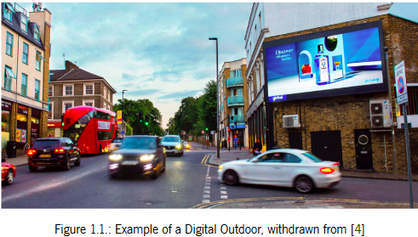
Market Research
A Digital Outdoor is essentially traditional outdoor advertising powered up by technology.
A digital outdoor captivates the attention of consumers in a more dynamic way than the traditional one.
It can also change its advertisement according to certain conditions, such as weather and/or time.

Slide 11
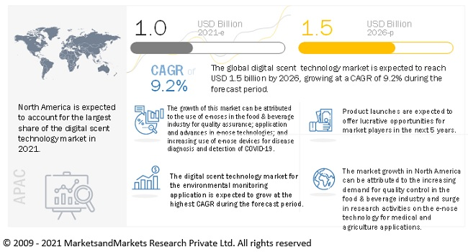
Market Research

Slide 12
Project Goals
The key goals identified and the respective path to attain them are:
devise a device with audio and video outputs, as well as fragrance diffusion:
understand audio and video streaming and study fragrance nebulizer technologies.
Create a contactless user interface based on gestures through computer vision:
identify user gestures through computer vision and match them to interface callbacks; a virtual keyboard may be required for user input.
Devise a distributed architecture to convey brand advertisement information to the local device:
understand distributed architectures and apply them for optimal data flow;
create a remote client-server model to convey information from the brands to the device through remote cloud database services;
devise adequate data frames to convey information to the local device;
create a local server to respond to the remote server requests.

Slide 13
Project Goals
The key goals identified and the respective path to attain them are:
apply facial recognition to the camera feed and subsequently apply image filters specific to each brand:
understand facial recognition algorithms and apply them to the camera feed;
apply image filters on top of the identified faces through an specialized Application Programming Interface (API).
enable image and GIFs sharing to social media for increased brand awareness:
understand how to use social media APIs for media sharing

Slide 14
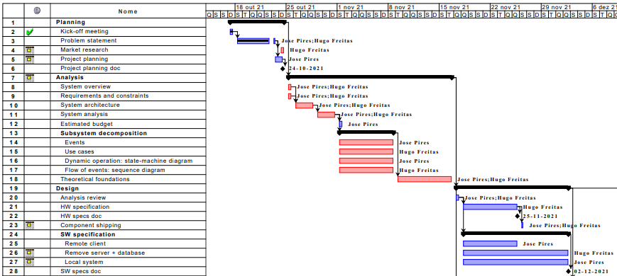
Project Planning

Slide 15
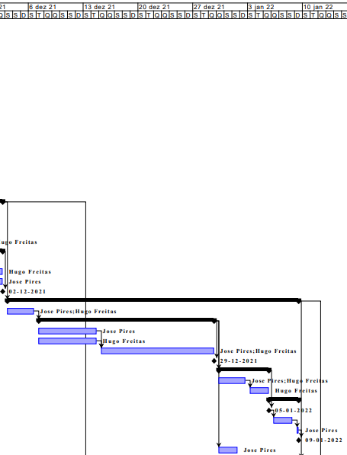
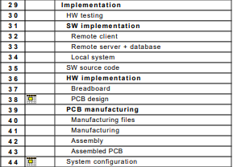
Project Planning

Slide 16
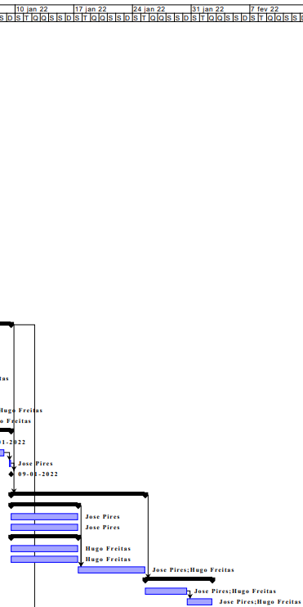
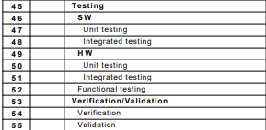
Project Planning

Slide 17
2. Analysis

Slide 18
Requirements
Functional requirements:
Advertising through a screen and speakers;
Have fragrance diffusion;
Take pictures and GIFs;
Detect a user in range of the device;
Contactless user interaction through gesture recognition;
Camera feed and facial recognition;
Apply brand-specific image filters;
Enable sharing multimedia across social media;
Provide a remote user interface for brands to purchase and configure the advertisements;
Provide a remote user interface for company staff to monitor and control the MDO local system

Slide 19
Requirements
Non-functional requirements:
Low power consumption;
Provide user-friendly interfaces;
Have low latency between local system and remote server;
Use wireless communication between the local and remote systems

Slide 20
Constraints
Technical constraints:
Use device drivers;
Use Makefiles;
Use C/C++;
Use Raspberry Pi as the development board;
Use compatible HW with the development board;
Use buildroot;
Social media APIs for sharing multimedia
Image filtering through specialized API

Slide 21
Constraints
Non-technical constraints:
Project duration: one semester (circa 20 weeks);
Pair work flow;
Limited budget
Scale model prototype

Slide 22
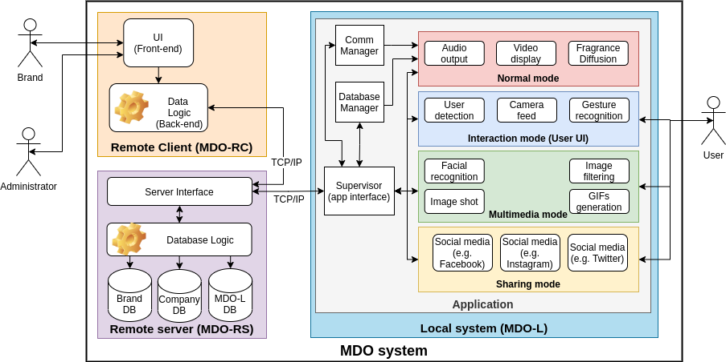
System Overview
Actors:
Brand: represents the brands contracting the advertisement services;
Administrator: the development company staff, which can monitor and control the outdoor
User: the user (the target audience of the advertisement) interacting with the system

Slide 23
System Overview
Subsystems: Distributed Architecture
Remote Client (MDO-RC)
Remote Server (MDO-RS)
Local System (MDO-L)

Slide 24
System Overview
Remote Client (MDO-RC):
The Brands and Admins need a remote UI to interact with the system:
Brand: configure the ads being displayed at the MDO and purchase them;
Admin: remotely monitor and control the operation of the MDO.
Thus, an authentication mechanism is required.
The data is then dispatched to the back-end, where it is processed and feed back to the UI user and/or sent to the remote server, via TCP/IP.

Slide 25
System Overview
Remote Server (MDO-RS):
DB management: handles UI requests for DB management
MDO-L monitoring and control: provides command dispatch and feedback to the Admin for remote monitoring and control of the device
MDO-L update: periodically check for start times of each MDO-L device and transfer the relevant data to it

Slide 26
System Overview
Local system (MDO-L): marketing device for multi-sensory ads – modes:
Normal (default): the MDO provides sound, video and fragrance outputs
Interaction (User UI): When a user approaches the device, the camera turns on and is mirrored on screen, waiting for recognizable gestures to provide additional functionalities, such as brand-specific image filters.

Slide 27
System Overview
Local system (MDO-L): marketing device for multi-sensory ads – modes:
Multimedia: the facial recognition is applied, enabling the user to select and apply different brand-specific image filters and take pictures or create a GIF.
Sharing: after a User take a picture or create a GIF, it can share it across social media
Soft real-time system: No mandatory deadlines to be met

Slide 28
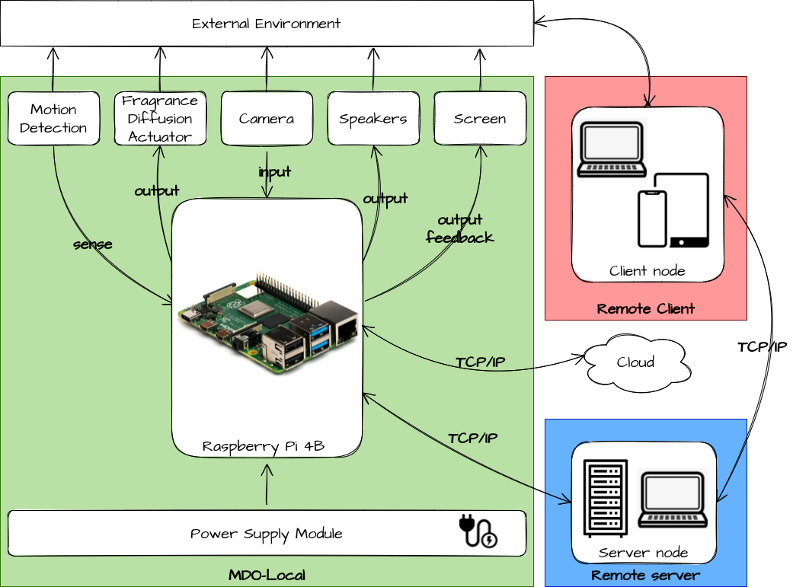
System Architecture
HW Architecture

Slide 29
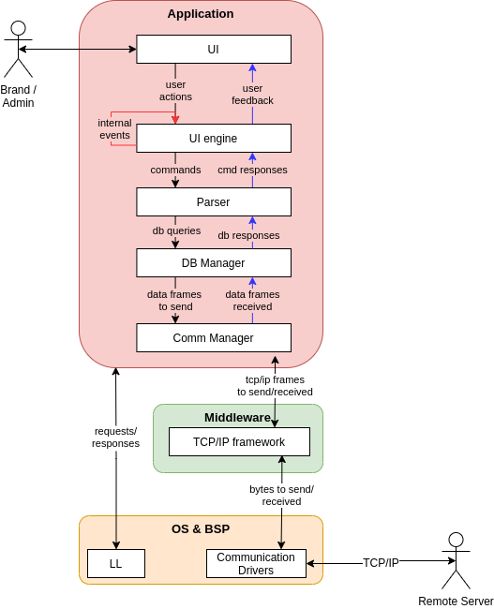
System Architecture
SW Architecture:
Remote Client

Slide 30
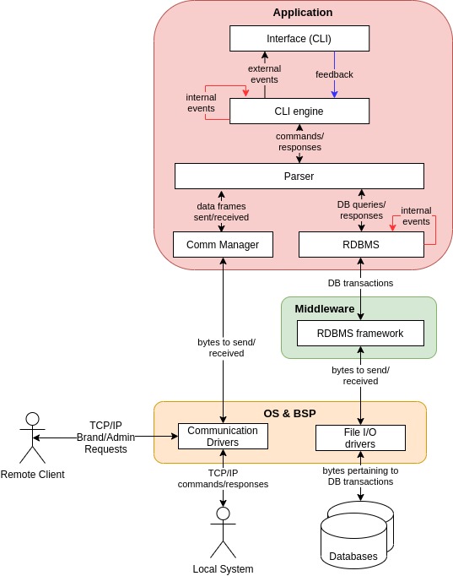
System Architecture
SW Architecture:
Remote Server

Slide 31
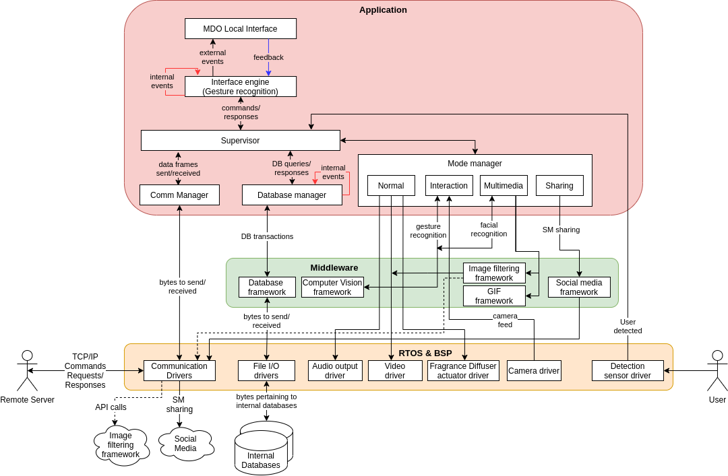
System Architecture
SW Architecture: Local System

Slide 32
Bibliography
[1] Fei Tao, Meng Zhang, and A.Y.C. Nee. Chapter 12 - digital twin, cyber–physical system, and internet of things. In Fei Tao, Meng Zhang, and A.Y.C. Nee, editors, Digital Twin Driven Smart Manufacturing, pages 243–256. Academic Press, 2019. ISBN 978-0-12-817630-6. doi: https: //doi.org/10.1016/B978-0-12-817630-6.00012-6. URL https://www.sciencedirect.com/science/ article/pii/B9780128176306000126. [2] What the nose knows. URL https://news.harvard.edu/gazette/story/2020/02/how-scent-emotion-and-memory-are-intertwined-and-exploited/. accessed: 2021-10-23. [3] Martin Lindstrom. Brand sense: How to build powerful brands through touch, taste, smell, sight and sound. Strategic Direction, 2006. [4] Digital outdoor advertising: The what, the why, the how. URL https://bubbleoutdoor.com/ digital-outdoor-advertising-what-why-how/. accessed: 2021-10-24. [5] Digital outdoor market to be worth $55 BN in 5 years. URL https://www.decisionmarketing.co.uk/news/digital-outdoor-market-to-be-worth-55bn-in-5-years. accessed: 2021-10-24. [6] Scent marketing; type of sensory marketing targeted at the olfactory sense, . URL https://www.air-aroma.com/scent-marketing/. accessed: 2021-10-24. [7] Scent basics: What is scent marketing, scent branding and ambient scent, . URL https:// reedpacificmedia.com/scent-basics-what-is-scent-marketing-scent-branding-and-ambient-scent/. accessed: 2021-10-24. [8] Digital scent technology market with covid-19 impact analysis, . URL https://www. marketsandmarkets.com/Market-Reports/digital-scent-technology-market-118670062.html. ac- cessed: 2021-10-24

