Slide 1
MDO – Marketing Digital Outdoor
Implementation: current status
Embedded Systems
Group 8:
José Pires | A50178
Hugo Freitas | A88258

Slide 2
Agenda
Gantt Diagram
Current Status
Remote Client;
Remote Server;
Local System.

Slide 3
1. Gantt Diagram

Slide 4
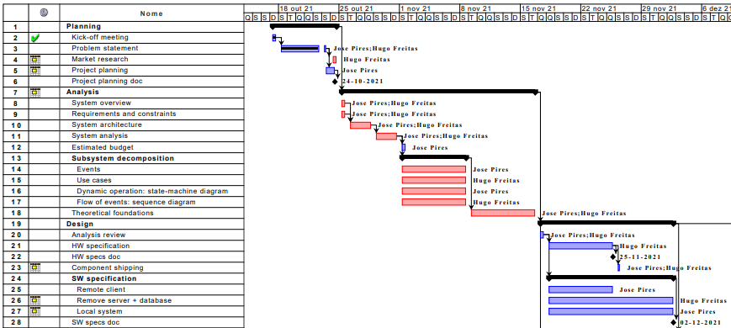
Gantt Diagram

Slide 5
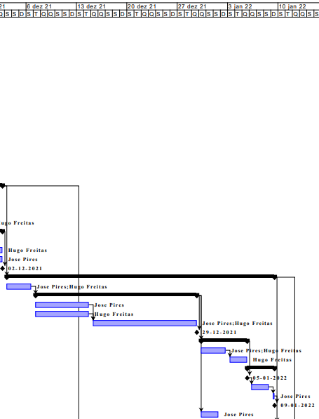
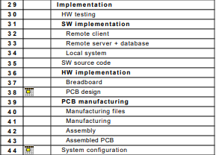
Gantt Diagram

Slide 6
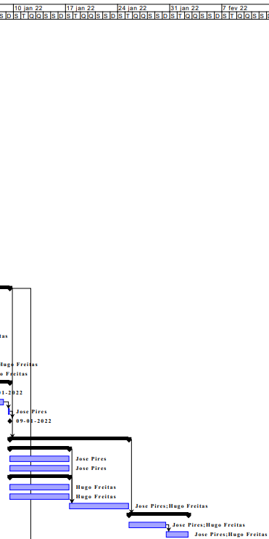
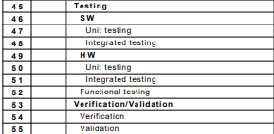
Gantt Diagram

Slide 7
2. Current Status

Slide 8
Current Status
Remote Client
Done
Graphical User Interface
Login;
Register;
Logout;
Admin Pages: handle all the users and stations;
Brand Pages: Rent an ad and watch statistics of current rented ads.
To Do
Parser
Build DB queries, receive and execute responses.
Client-Server architecture
Connect GUI with the DB Server;
Connect RC with the RS.

Slide 9
Current Status
Remote Server
On Going
DataBase server creation;
Tables are created.
To Do
Parser
Receive and process frames.
Client-Server architecture.
Build Remote Server and connect it to the DB;
Connect RC with RS and LS.

Slide 10
Current Status
Local System
Done
Implemented UI: design and navigation;
Thread to grab camera frames.
On Going
Implementation of computer vision algorithms.
ToDo
implement gesture recognition to stimulate the UI;
implement client/server architecture;
implement Twitter sharing;
implement user detection and fragrance diffusion (daemons and device drivers).

