Slide 1
MDO – Marketing Digital Outdoor
Problem Statement
Embedded Systems
José Pires | A50178
Hugo Freitas | A88258

Slide 2
Agenda
Intro
Context & Motivation
Problem Statement
Market Research
Project Goals
System overview
Project Planning

Slide 3
Context & Motivation
COVID pandemics changed the way we think about human interaction.
Thus, it is critical to develop contactless interfaces.
People redefined their purchasing behaviors, leading to a massive growth of the online shopping.
However, some business sectors, like clothing or perfumes, cannot provide the same user experience when moving online.
Therefore, one proposes to close that gap by providing a marketing digital outdoor (MDO) for brands to advertise and gather customers with contactless interaction.

Slide 4
Context & Motivation
Scenting marketing is a great approach to draw people into stores.
Olfactory sense is the fastest way to the brain, thus, providing an exceptional opportunity for marketing [2]
“75% of the emotions we generate on a daily basis are affected by smell. Next to sight, it is the most important sense we have” [3].
Combining that with additional stimuli, like sight and sound, can significantly boost the marketing outcome.

Slide 5
Context & Motivation
Marketing also leverages from better user experience, thus, user interaction is a must-have, providing the opportunity to interact with the customer.
In this sense, when users approach the outdoor a gesture-based interface will be provided for a brand immersive experience.

Slide 6
Problem Statement
The project consists of a marketing digital outdoor (MDO) with:
sound and video display, and fragrance emission selected by the brands,
providing a gesture-based interface for user interaction to create pictures and GIFs, brand-specific,
and share them on social media.

Slide 7
Problem Statement
The MDO is comprised of several modes:
normal mode (advertisement mode):
the MDO will provide sound, video and fragrance outputs.
interaction mode:
When a user approaches, the MDO it will go into interaction mode, turning on and displaying the camera feed and waiting for recognizable gestures to provide additional functionalities, such as brand-specific image filters.
multimedia mode:
in this mode the facial recognition is applied, enabling the user to select and apply different brand-specific image filters and take pictures or create a GIF.
sharing mode:
after a user take a picture or create a GIF, it can share it across social media

Slide 8
Problem Statement
Brands can buy advertisement space and time, selecting the videoclips to be displayed and the fragrance to be used at specific times, drawing the customers into their stores.
Customers can be captivated by the combination of sensorial stimuli, the gesture-based interaction, the immersive user experience provided by the brands — feeling they belong in a TV advertisement, and the opportunity to gain several benefits, e.g., discount coupons.

Slide 9
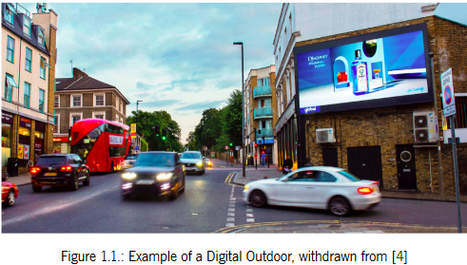
Market Research
A Digital Outdoor is essentially traditional outdoor advertising powered up by technology.
A digital outdoor captivates the attention of consumers in a more dynamic way than the traditional one.
It can also change its advertisement according to certain conditions, such as weather and/or time.

Slide 10
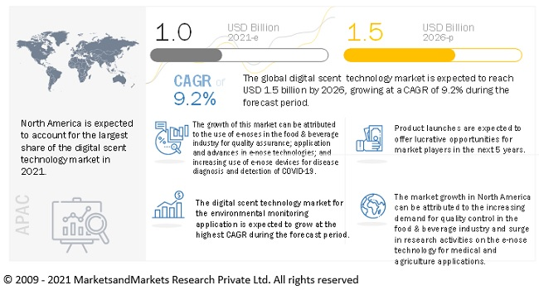
Market Research

Slide 11
Project Goals
The key goals identified and the respective path to attain them are:
devise a device with audio and video outputs, as well as fragrance diffusion:
understand audio and video streaming and study fragrance nebulizer technologies.
Create a contactless user interface based on gestures through computer vision:
identify user gestures through computer vision and match them to interface callbacks; a virtual keyboard may be required for user input.
Devise a distributed architecture to convey brand advertisement information to the local device:
understand distributed architectures and apply them for optimal data flow;
create a remote client-server model to convey information from the brands to the device through remote cloud database services;
devise adequate data frames to convey information to the local device;
create a local server to respond to the remote server requests.

Slide 12
Project Goals
The key goals identified and the respective path to attain them are:
apply facial recognition to the camera feed and subsequently apply image filters specific to each brand:
understand facial recognition algorithms and apply them to the camera feed;
apply image filters on top of the identified faces through an specialized Application Programming Interface (API).
enable image and GIFs sharing to social media for increased brand awareness:
understand how to use social media APIs for media sharing

Slide 13
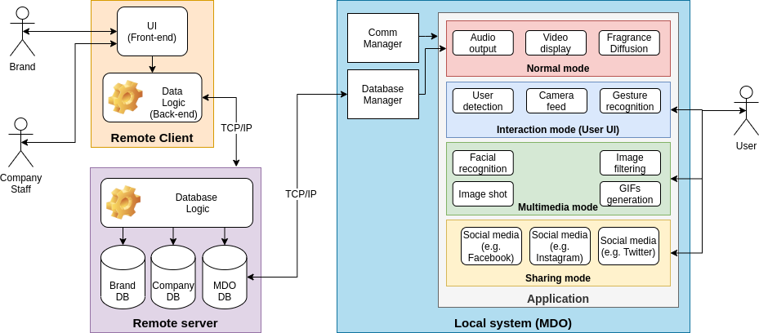
System Overview

Slide 14
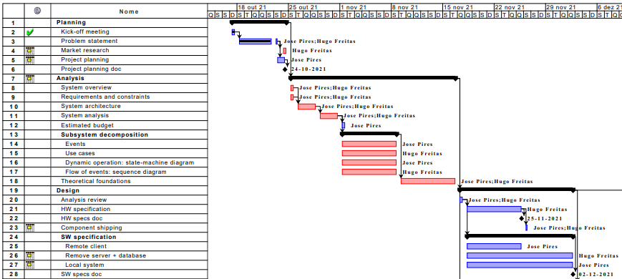
Project Planning

Slide 15
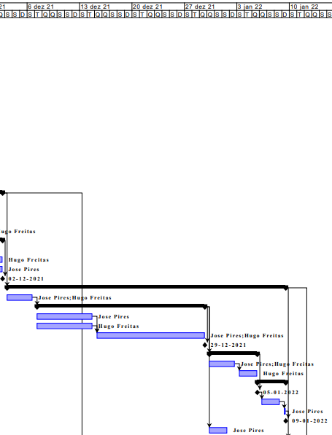
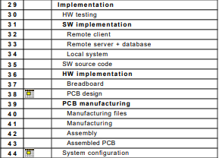
Project Planning

Slide 16
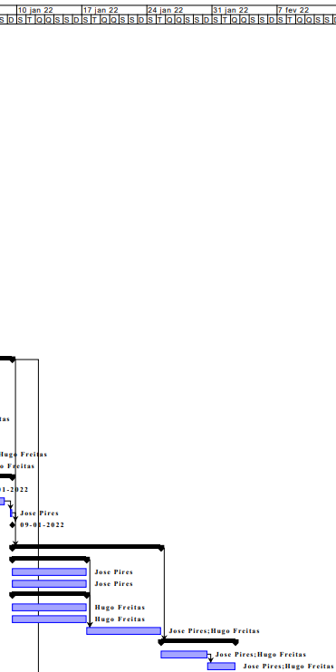
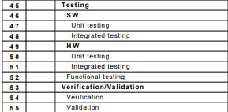
Project Planning

Slide 17
Bibliography
[1] Fei Tao, Meng Zhang, and A.Y.C. Nee. Chapter 12 - digital twin, cyber–physical system, and internet of things. In Fei Tao, Meng Zhang, and A.Y.C. Nee, editors, Digital Twin Driven Smart Manufacturing, pages 243–256. Academic Press, 2019. ISBN 978-0-12-817630-6. doi: https: //doi.org/10.1016/B978-0-12-817630-6.00012-6. URL https://www.sciencedirect.com/science/ article/pii/B9780128176306000126. [2] What the nose knows. URL https://news.harvard.edu/gazette/story/2020/02/how-scent-emotion-and-memory-are-intertwined-and-exploited/. accessed: 2021-10-23. [3] Martin Lindstrom. Brand sense: How to build powerful brands through touch, taste, smell, sight and sound. Strategic Direction, 2006. [4] Digital outdoor advertising: The what, the why, the how. URL https://bubbleoutdoor.com/ digital-outdoor-advertising-what-why-how/. accessed: 2021-10-24. [5] Digital outdoor market to be worth $55 BN in 5 years. URL https://www.decisionmarketing.co.uk/news/digital-outdoor-market-to-be-worth-55bn-in-5-years. accessed: 2021-10-24. [6] Scent marketing; type of sensory marketing targeted at the olfactory sense, . URL https://www.air-aroma.com/scent-marketing/. accessed: 2021-10-24. [7] Scent basics: What is scent marketing, scent branding and ambient scent, . URL https:// reedpacificmedia.com/scent-basics-what-is-scent-marketing-scent-branding-and-ambient-scent/. accessed: 2021-10-24. [8] Digital scent technology market with covid-19 impact analysis, . URL https://www. marketsandmarkets.com/Market-Reports/digital-scent-technology-market-118670062.html. ac- cessed: 2021-10-24

