Slide 1
R
regula
by Meridian Bank
clause
AZENTIO.AI BUILD LABS · CHALLENGE 02
obligation
Regulatory change,
resolved.
policy
task
Track the change. Assess policy, process and system impact. Prove it.
evidence
Clause redline
Impact graph
Audit chain
31 October 2026
Three people · six hours · one spine
Regula · Regulatory Change Impact Agent
01
Notes:
Open with the deadline, not the product. A circular landed on Friday. Thirty-one days. The bank has to find every policy, process and system it touches before the effective date. Regula does that in one run, and proves every decision afterwards.

Slide 2
THE PROBLEM
A circular is not a to-do list.
47
31
0
pages
days
traceable links
in a typical master-direction amendment
from publication to effective date
between clause, control and change ticket
Compliance reads it. Operations interprets it.
Technology discovers it late. Audit asks who approved it.
Clause
?
Control
?
Change ticket
The link is a person’s memory — until it isn’t.
Illustrative figures, typical master-direction amendment.
Regula · Azentio Build Labs 2026
02
Notes:
The expensive part is not reading the circular. It is proving what it changed and who owns the change. Today that link lives in someone's memory or a spreadsheet. When they leave, the evidence leaves too.

Slide 3
THE INSIGHT
Impact is a graph, not a summary.
CLAUSE
OBLIGATION
IMPACT
TASK
EVIDENCE
Section 16
Annual re-KYC
3 assets
Vikram Nair
SHA-256
→
→
→
→
24 → 12 months
quoted + referenced
CIF · policy · control
25 days · due 24 Nov
hash-chained event
A summary tells you what the regulator said.
A graph tells you what must move, who owns it, and why.
Every edge is a piece of evidence: a clause quote, a parameter, an owner, an audit event.
Regula · Azentio Build Labs 2026
03
Notes:
This is the core claim. A summariser stops at the first box. The value is in the edges: which obligation, which asset, which field, which owner, which evidence. That is what makes the output actionable and defensible.

Slide 4
THE PRODUCT
One run. Five artefacts.
01
02
03
04
05
Redline
Obligations
Impact
Plan
Evidence
What changed, word by word
What must be done, with the quote
Which asset, what gap, how severe
Who does what, by when, in what order
A hash-chained record of every decision
amended · added · omitted
21 extracted · 100% evidenced
101 impacts · 19 critical
25 tasks · 297 effort-days
SHA-256 · append-only
Deterministic
Optional LLM adapter for extraction — the audit path stays deterministic.
·
sub-30 ms per circular
·
no model call required
Regula · Azentio Build Labs 2026
04
Notes:
Five artefacts, one run. The important thing is that they are not five separate features: each one is derived from the one before, and all of them point back to the clause.

Slide 5
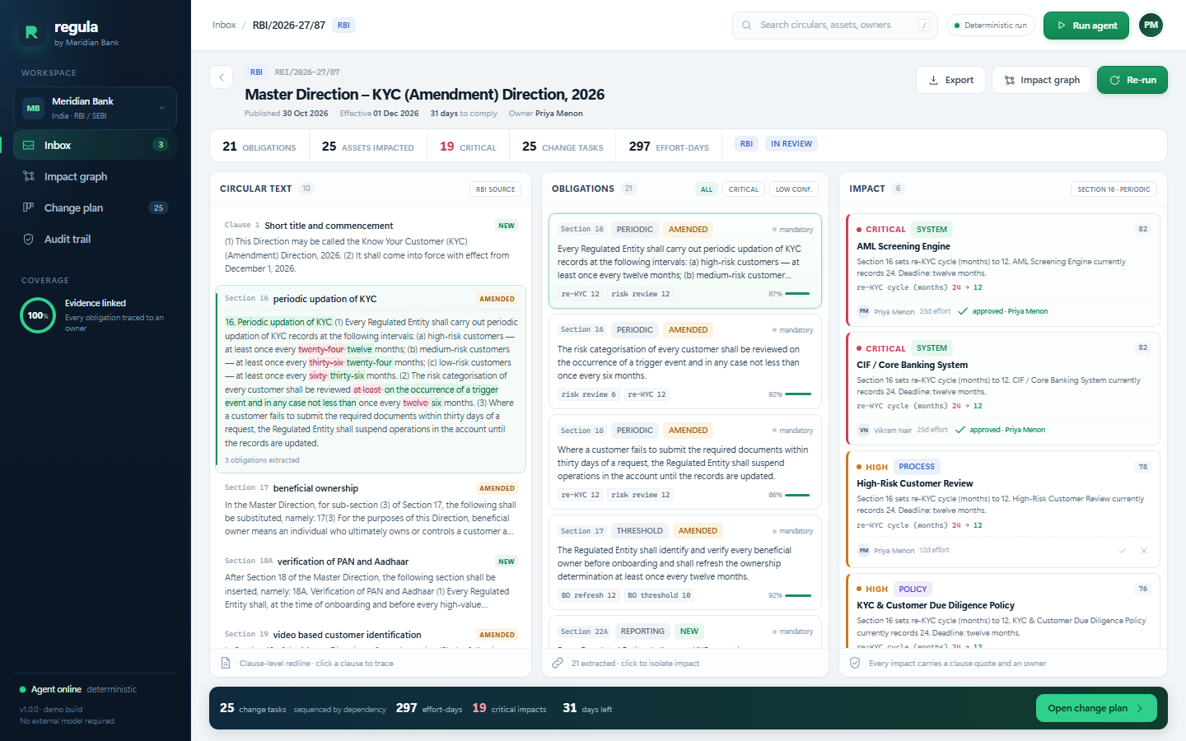
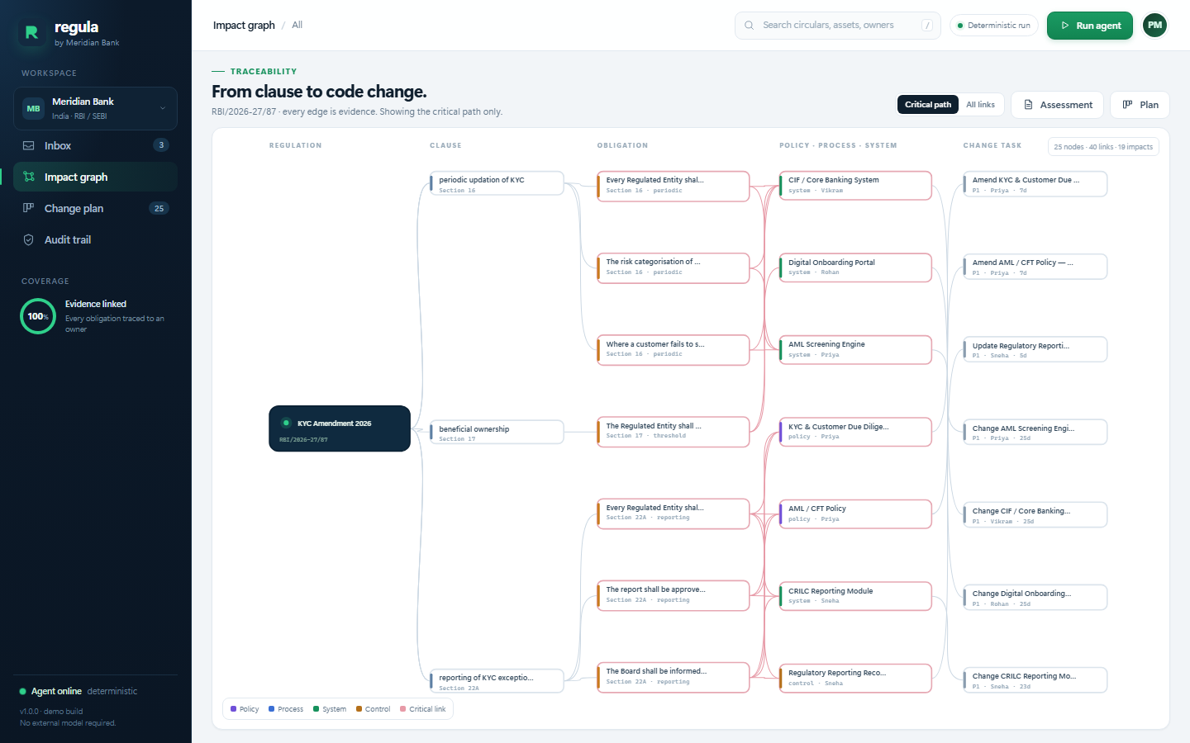
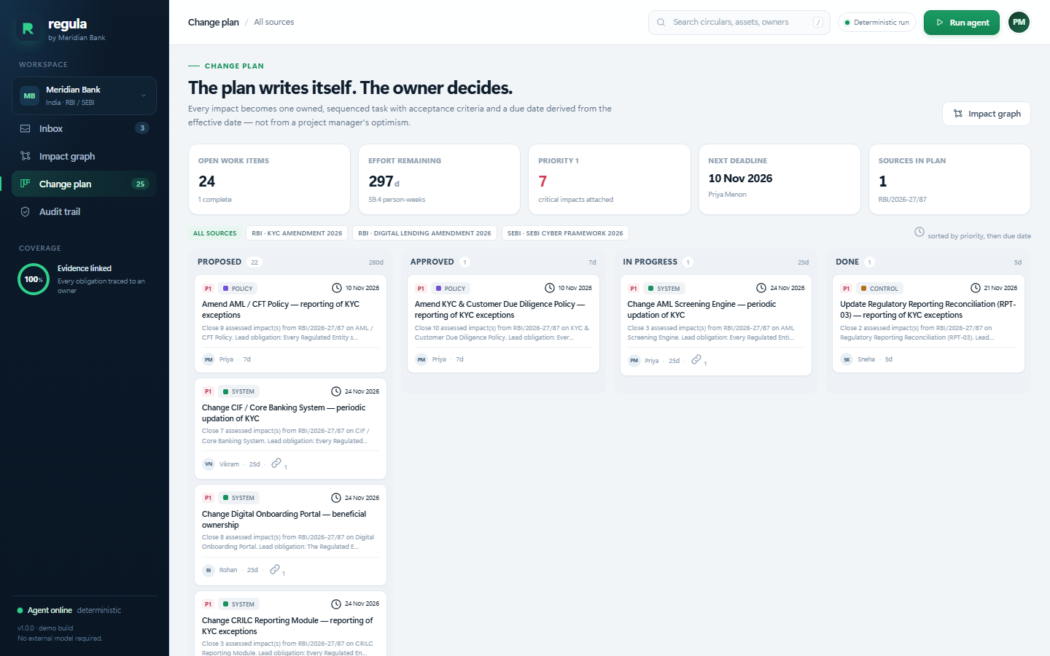
THE DEMO
From clause to change ticket in three clicks.
→
→
01
The redline
02
The impact graph
03
The plan
The old 24-month cycle is struck through; 12 months is inserted.
Clause → obligation → asset → task. Every edge is evidence.
25 tasks, 297 effort-days, every one owned and dated.
The judge’s question is not “what does it say?” It is “what do we change, and who owns it?”
Live run: 21 obligations → 101 impacts → 25 tasks · sub-30 ms
Regula · Azentio Build Labs 2026
05
Notes:
This is the storyboard for the three-minute demo. Do not walk through every screen. Show the redline, the numeric gap, and the owned task. Those three clicks carry the whole product.

Slide 6
WHY IT’S TRUSTWORTHY
The agent proposes. The human approves. The chain proves.
01
Evidence-linked
02
Deterministic
Every obligation carries a verbatim quote and a clause reference. No quote, no impact.
Same document in, same assessment out. Reproducible on stage and in an audit.
03
Human-in-the-loop
04
Tamper-evident
Approval is an explicit act. The agent never executes a change on its own.
SHA-256 chain over every extraction, score, approval and status change.
“Banks don’t buy magic. They buy defensibility.”
Regula · Azentio Build Labs 2026
06
Notes:
Judges will ask whether a bank can trust this. The answer is not 'the model is good'. It is: every output has evidence, the process is reproducible, a human approves, and the record is tamper-evident.

Slide 7
ARCHITECTURE
Six extension points. One spine.
INGEST
EXTRACT
ASSETS
SCORE
PLAN
AUDIT
PDF / text / API
rules + optional LLM
41 assets, owners
weighted, explained
tasks + dependencies
hash chain + export
DOMAIN PACK
KYC / AML
Digital lending
Cyber resilience
Same engine. Swap the regulatory corpus and the asset inventory; keep the evidence chain.
ZERO DEPENDENCIES
Python standard library + native ES modules.
Add a regulator = one text file.
Add a control = one JSON object.
Runs offline. No npm, no pip, no API key.
Regula · Azentio Build Labs 2026
07
Notes:
This slide is for the technical judge. The point is not that we built a monolith; it is that every new brief lands on one of six extension points. That is how three people can absorb a new problem statement in six hours without a rewrite.

Slide 8
IMPACT
What changes on Monday.
<30 ms
to assess a circular
100%
of obligations evidence-linked
versus 2–3 weeks of manual impact analysis
every claim anchored to a clause
25
change tasks surfaced
0
untraceable approvals
297 effort-days on one circular, before the first meeting
every decision hash-chained
90-day pilot: one regulator · one business line · one control library.
Success = every obligation owned, every impact approved, every approval evidenced.
Prototype metrics from the demo corpus; not a production accuracy claim.
Regula · Azentio Build Labs 2026
08
Notes:
Be careful here. These are demo-corpus metrics, not a benchmark. Say that before a judge does. The credible claim is workflow coverage: every obligation has an owner, every impact has evidence.

Slide 9
THREE PEOPLE. SIX HOURS. ONE SPINE.
Built to survive
the next brief.
[Your name]
Impact engine · API · integration
THE ASK
A 90-day pilot with one compliance team and one control library.
[Teammate]
Frontend · product design
github.com/<org>/regula
<contact>
[Teammate]
Narrative · data · QA
R
regula
Regulatory change, resolved.
Regula · Azentio Build Labs 2026
09
Notes:
Close on the team and the ask, not on a feature list. Three people, six hours, one spine. The next brief lands on the same spine. The ask is a pilot, not a prize.

