Slide 1
Set Up for Goomba Project (Mac)
Paul Kim

Slide 2
Programming Environment
Goomba project uses
C# programming language
Visual Studio Code
Command-line tool
This slide shows briefly how to
Install .NET
Install Visual Studio Code
Run HelloWorld program using command-line tool

Slide 3
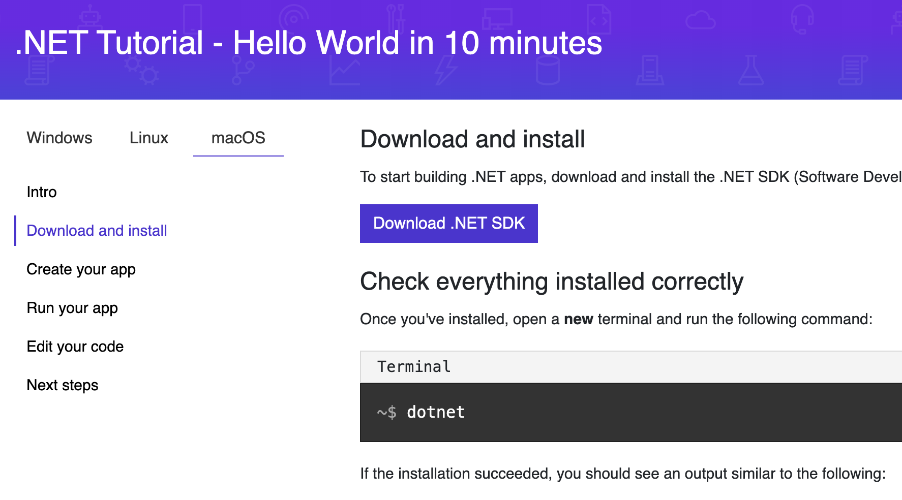
Install .NET
.NET provides environment for C# programming
Follow the below link
https://dotnet.microsoft.com/learn/dotnet/hello-world-tutorial/install

Slide 4

Install .NET
Download .NET SDK by clicking the download button

Slide 5
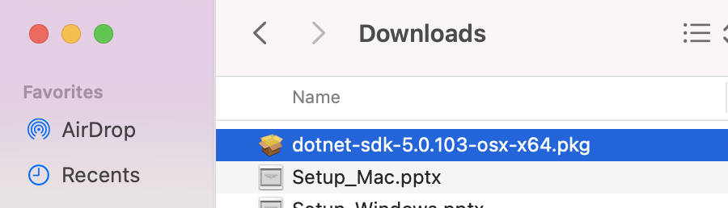

Install .NET
By clicking install file, you can install .NET SDK on your computer

Slide 6
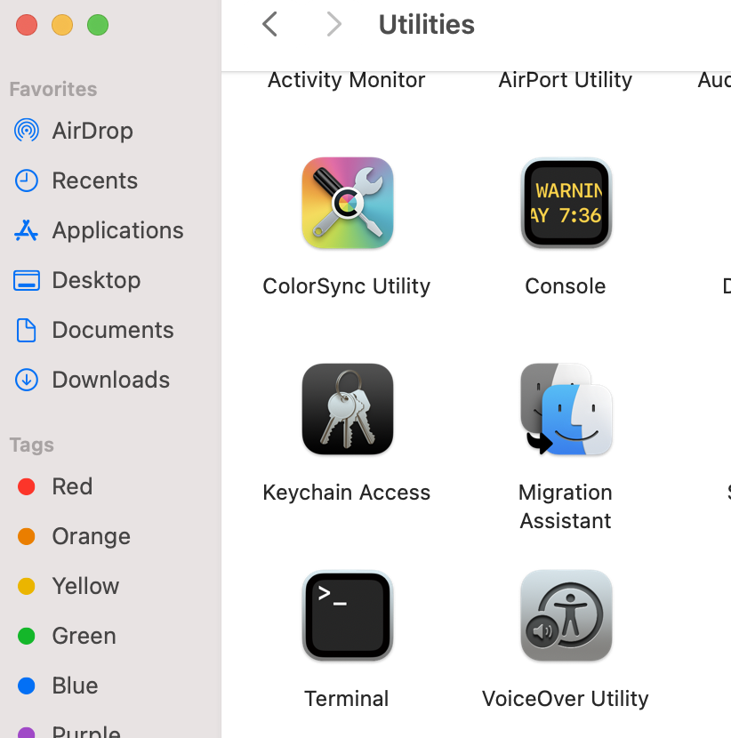

Install .NET
Open Terminal

Slide 7
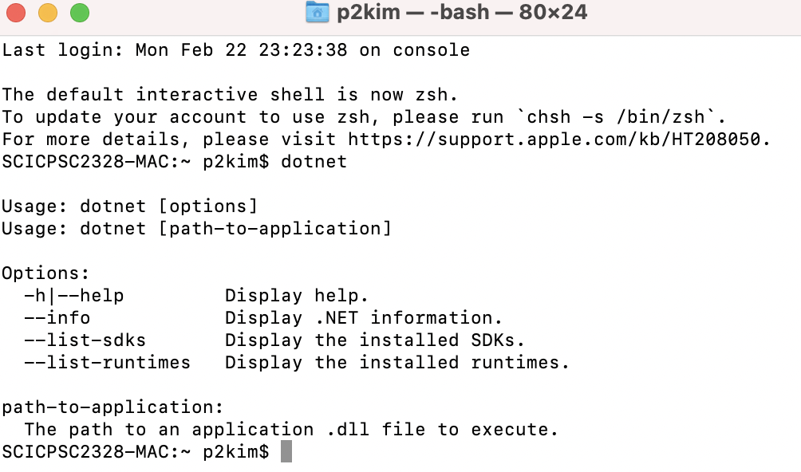
Install .NET
Type ‘dotnet’ and hit enter
If you do not have error, it means that .NET is successfully installed

Slide 8
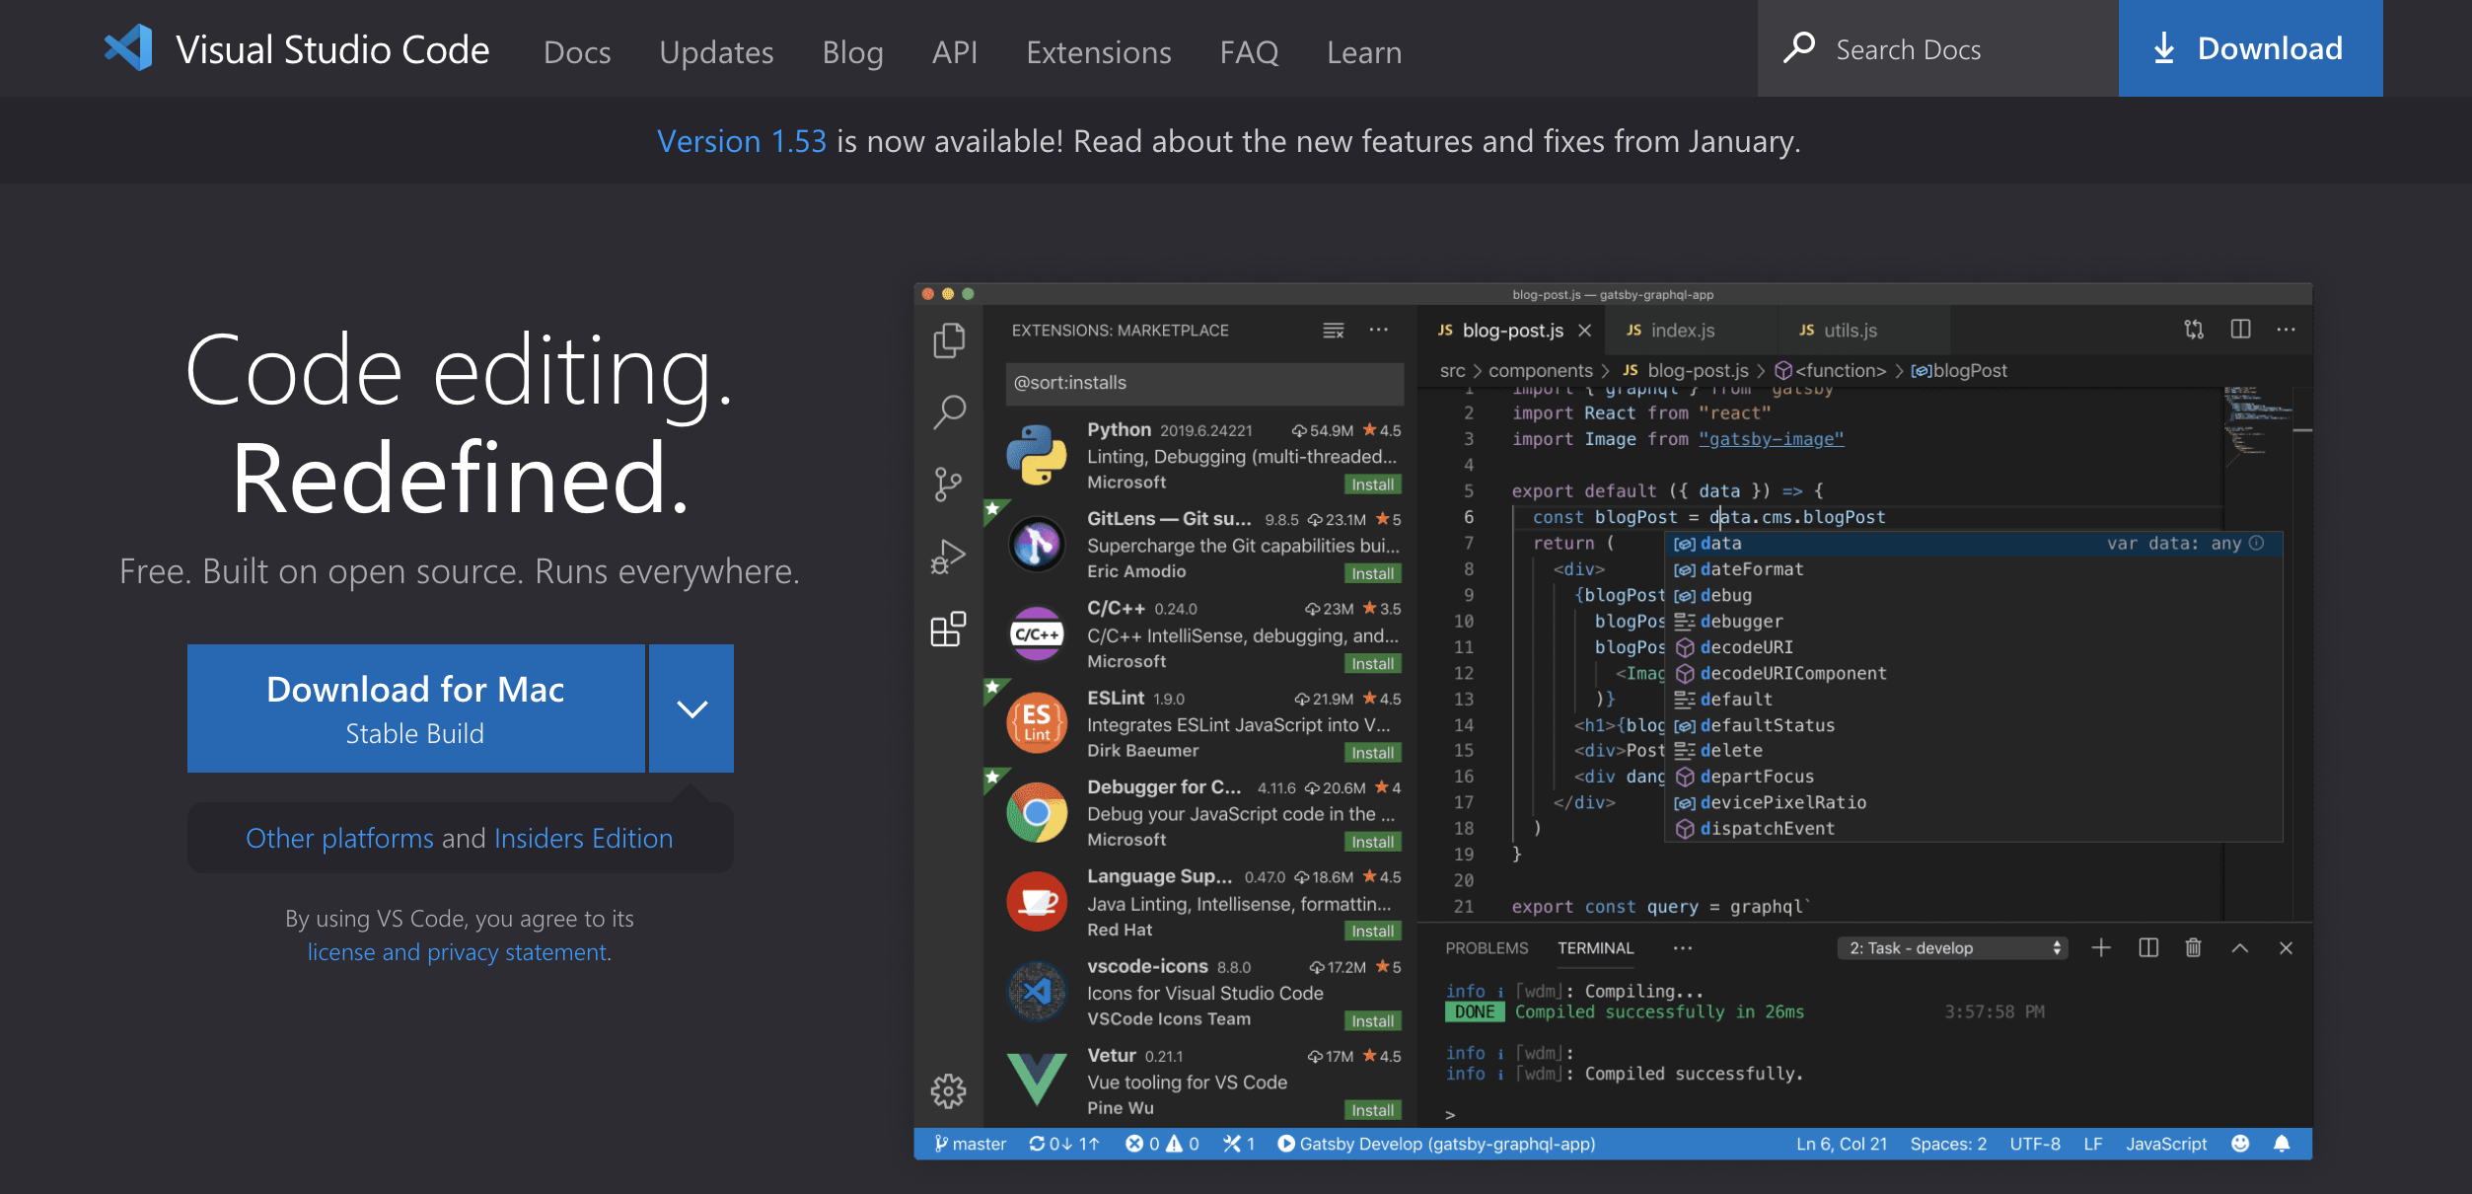
Install Visual Studio Code
Visual Studio Code is used to write C# program
Follow the link: https://code.visualstudio.com/

Slide 9
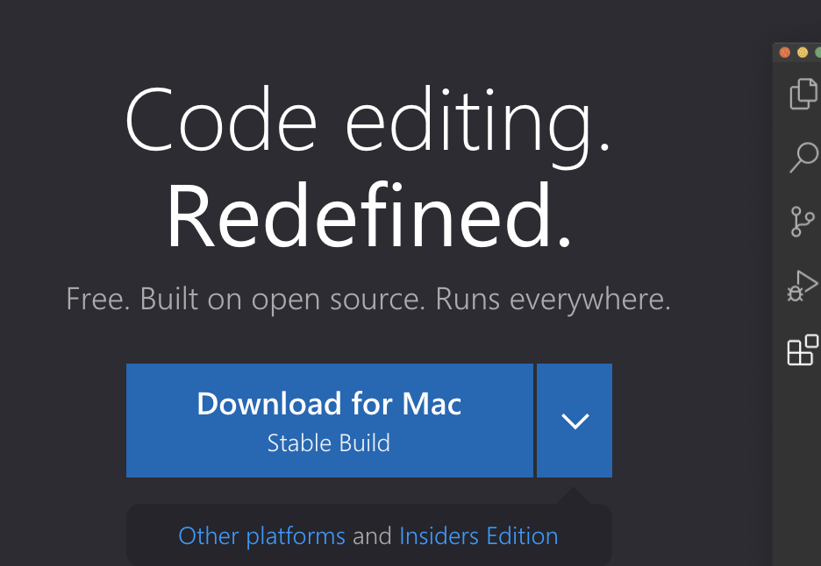

Install Visual Studio Code
Download VS Code by clicking download button

Slide 10
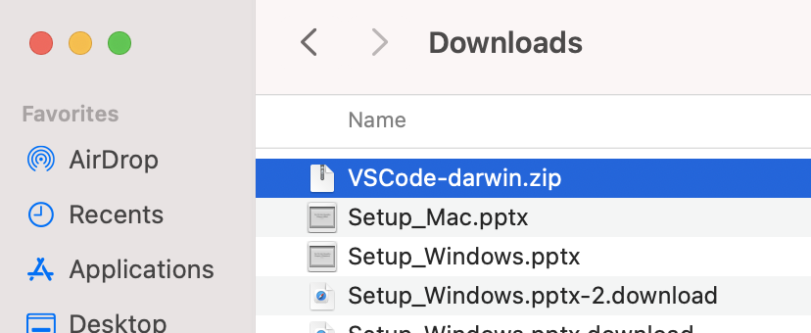
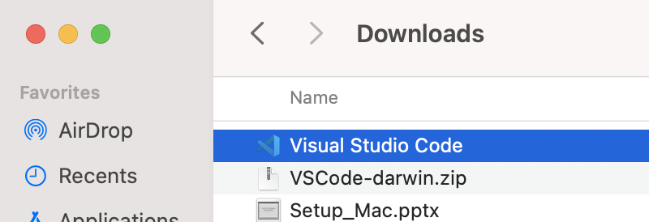
Install Visual Studio Code
By double-clicking zip file, you will have VS Code
Double-click!

Slide 11
HelloWorld Program
Will show how to run C# hello world program using command-line tool of VS Code

Slide 12
HelloWorld Program
Double-click ‘Visual Studio Code’ icon to open VS Code

Slide 13
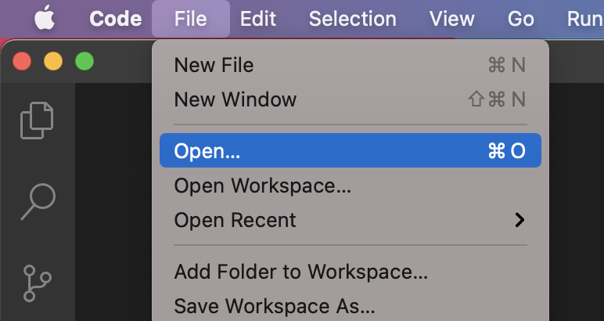
HelloWorld Program
Open folder where you want to create C# project (continued)

Slide 14
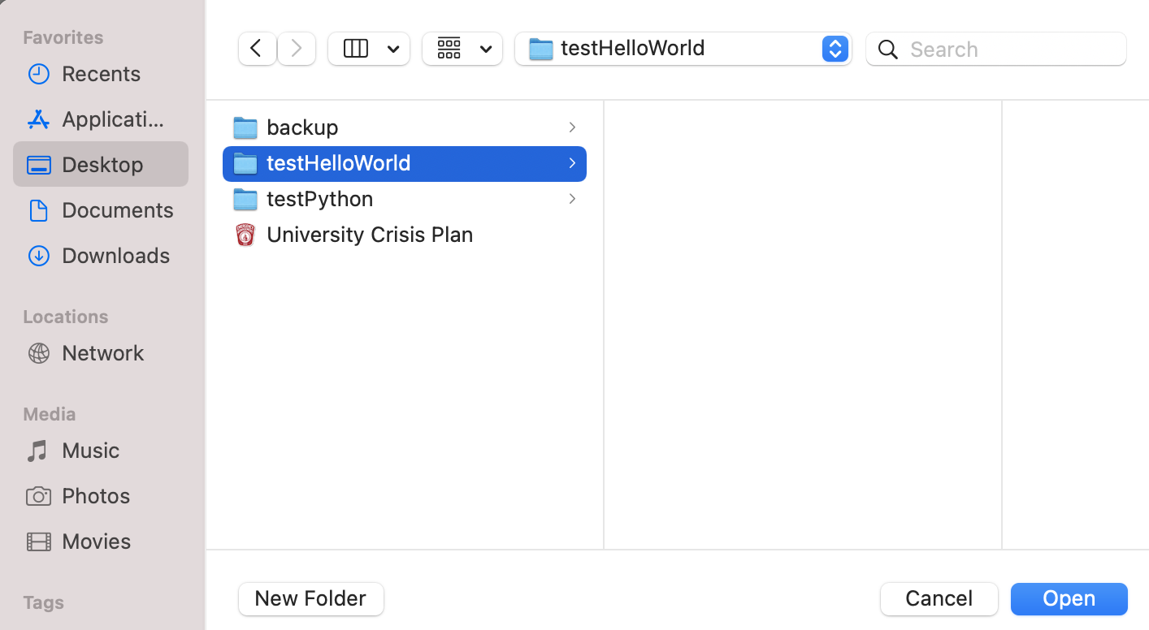

HelloWorld Program
Open folder where you want to create C# project

Slide 15
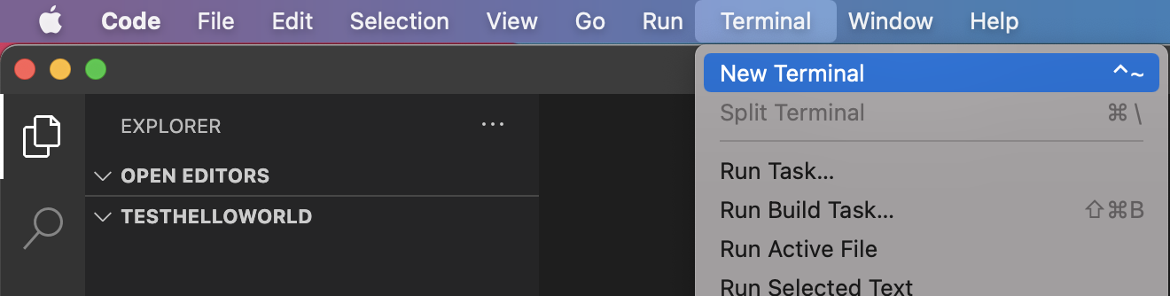
HelloWorld Program
Open new terminal

Slide 16
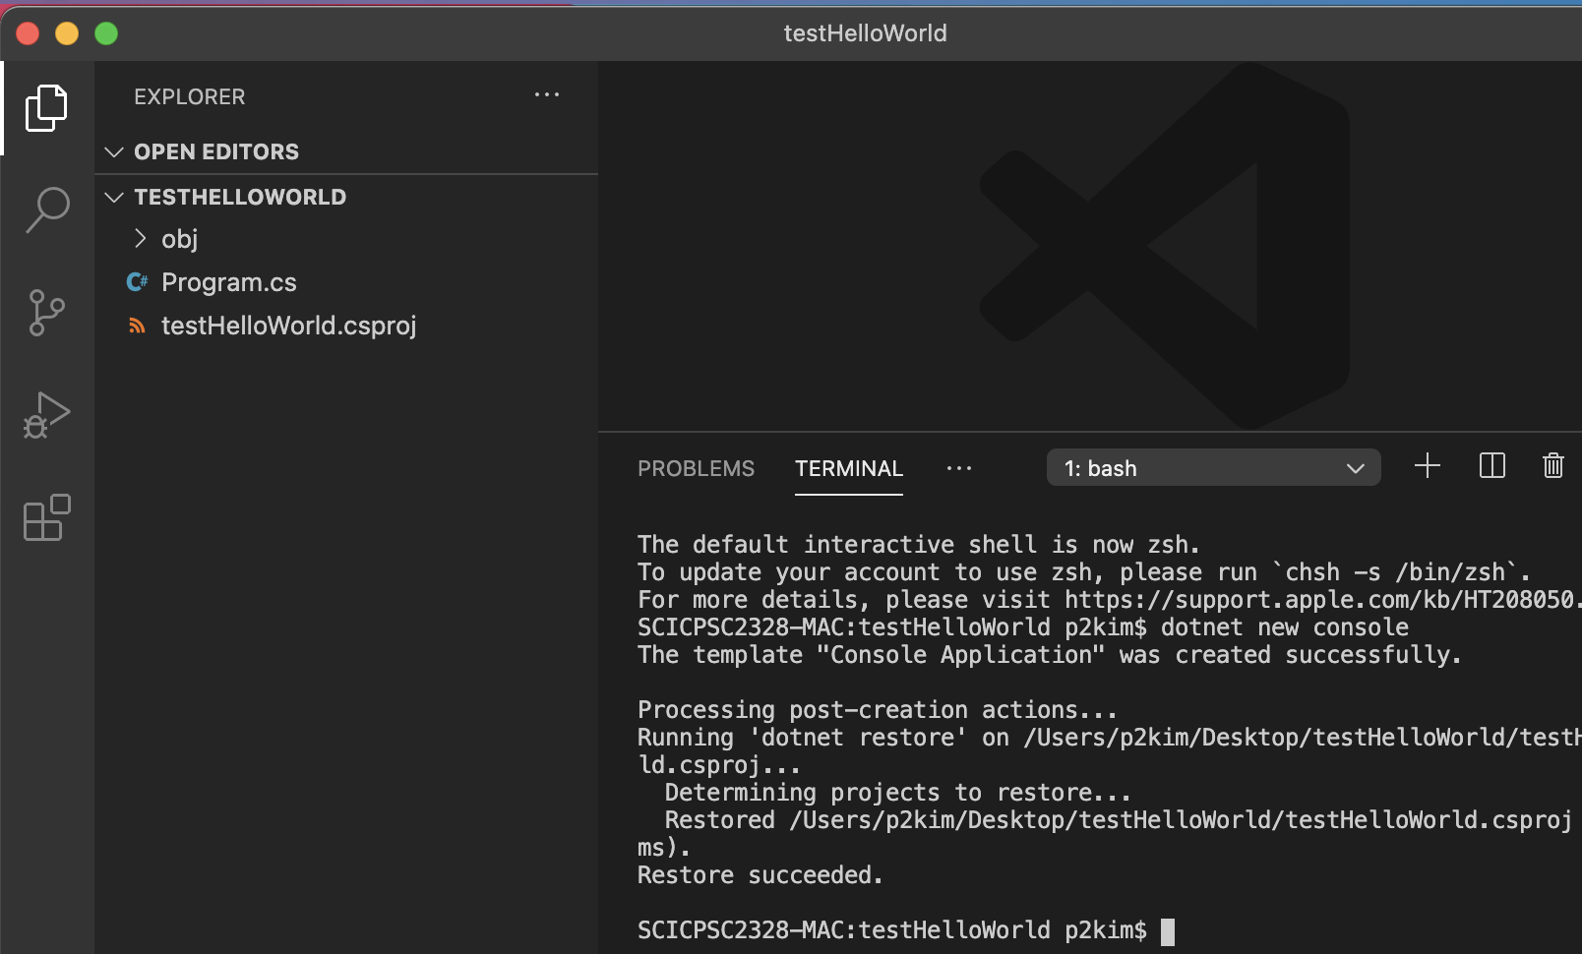

HelloWorld Program
In terminal of VS Code, type ‘dotnet new console’ and hit enter
After that, C# project is created under the same folder (includes obj folder, Program.cs, <folderName>.cspoj)

Slide 17
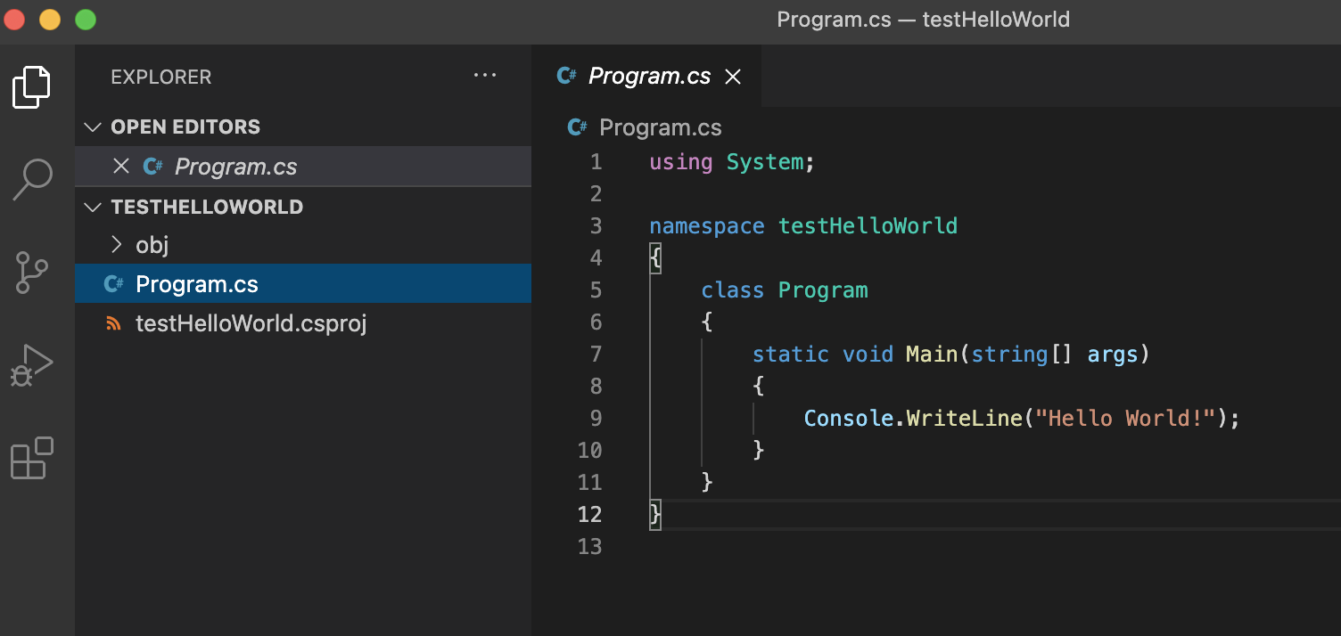
HelloWorld Program
Click ‘Program.cs’
Then, you will see that Helloworld program is already written there

Slide 18
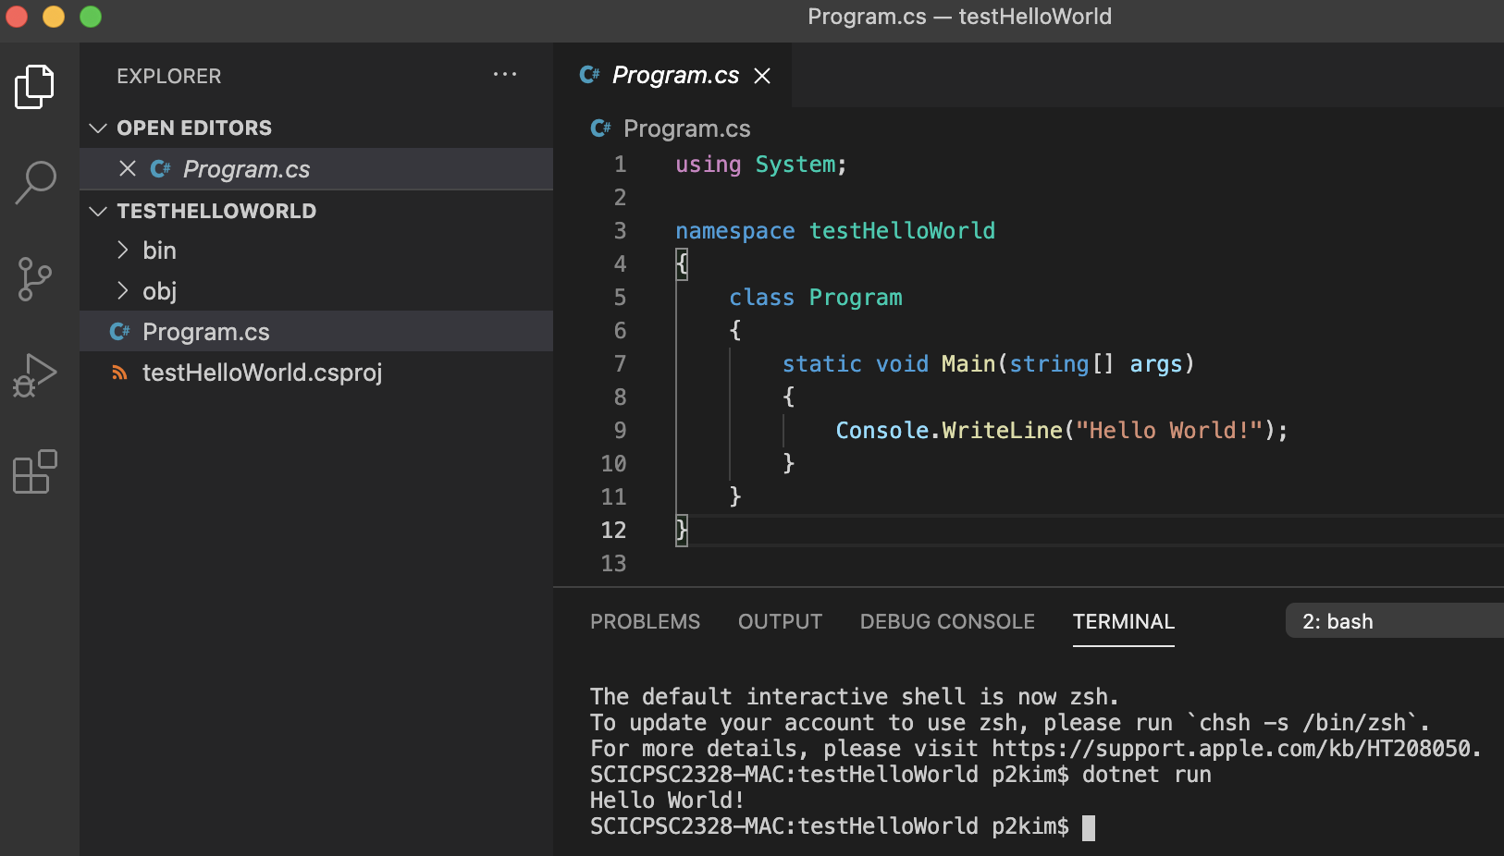
HelloWorld Program
Now let’s run this program
In terminal, type ‘dotnet run’
It runs C# program under the current C# project

Slide 19
Note
VS Code will ask to install C# extension for VS Code
Because we will use command-line tool not VS Code to run the program, you do not need to install the extension

