Slide 1
HW 6 Resources
Used this to do homework

Slide 2
HW 6 Resources
This slide is for giving guidelines (hints) to solve HW 6 assignment

Slide 3
HW 6
Add more features in parserr.py
Parsing grouped expression
Ex. 1 * (2 + 5)
Parsing single number expression
Ex. 25
Parsing negative – sign
Ex. –25 * 3

Slide 4
Grouped Expression
Need to make parser module to support ( and )
Expression inside ( ) should be calculated first
Example. (1 + 2) * 5
1 + 2 should be calculated first
Tree will not contain ( node and ) node
But ( and ) will change tree structure

Slide 5
Grouped Expression
1 + 2 * 5
(1 + 2) * 5
second
+
first
1
*
2
5
second
*
first
5
+
1
2

Slide 6
Grouped Expression
One trick to handle this feature
When scanning over sequence of tokens,
If meet (
increase precedence values of following operators
If meet )
decrease precedence values of following operators

Slide 7
Grouped Expression
Example 1
1 + (2 + 4) + 5
tokSeq
1
+
(
2
+
4
)
+
5
x = 0
treeNodeList

Slide 8
Grouped Expression
Example 1
1 + (2 + 4) + 5
tokSeq
1
+
(
2
+
4
)
+
5
x = 0
treeNodeList
1
+
1 + x = 1 + 0
= 1

Slide 9
Grouped Expression
Example 1
1 + (2 + 4) + 5
tokSeq
1
+
(
2
+
4
)
+
5
x = 0
x+4
x = 4
treeNodeList
1
+
1 + x = 1 + 0
= 1

Slide 10
Grouped Expression
Example 1
1 + (2 + 4) + 5
tokSeq
1
+
(
2
+
4
)
+
5
x = 0
x+4
x = 4
treeNodeList
1
+
2
+
1 + x = 1 + 0
= 1
1 + x
= 1 + 4
= 5

Slide 11
Grouped Expression
Example 1
1 + (2 + 4) + 5
x = 0
tokSeq
1
+
(
2
+
4
)
+
5
x = 0
x+4
x-4
x = 4
x = 0
treeNodeList
1
+
2
+
4
1 + x = 1 + 0
= 1
1 + x
= 1 + 4
= 5

Slide 12
Grouped Expression
Example 1
1 + (2 + 4) + 5
x = 0
tokSeq
1
+
(
2
+
4
)
+
5
x = 0
x+4
x-4
x = 4
x = 0
treeNodeList
1
+
2
+
4
+
1 + x = 1 + 0
= 1
1 + x
= 1 + 4
= 5
1 + x
= 1 + 0
= 1

Slide 13
Grouped Expression
Example 1
1 + (2 + 4) + 5
x = 0
tokSeq
1
+
(
2
+
4
)
+
5
x = 0
x+4
x-4
x = 4
x = 0
treeNodeList
1
+
2
+
4
+
5
1
5
1

Slide 14
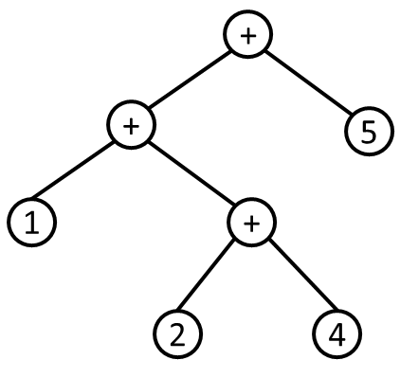
Grouped Expression
Example 1
1 + (2 + 4) + 5
treeNodeList
1
+
2
+
4
+
5
1
5
1
parser
1
1
5

Slide 15
Grouped Expression
Example 2
1 + ( (2 + 4) + 5)
tokSeq
1
+
(
(
2
+
4
)
+
5
)
x = 0
treeNodeList
1
+
1 + x = 1 + 0
= 1

Slide 16
Grouped Expression
Example 2
1 + ( (2 + 4) + 5)
tokSeq
1
+
(
(
2
+
4
)
+
5
)
x = 0
x = 0
x+4
x = 4
treeNodeList
1
+
1 + x = 1 + 0
= 1

Slide 17
Grouped Expression
Example 2
1 + ( (2 + 4) + 5)
tokSeq
1
+
(
(
2
+
4
)
+
5
)
x = 0
x = 0
x+4
x+4
x = 4
x = 8
treeNodeList
1
+
1 + x = 1 + 0
= 1

Slide 18
Grouped Expression
Example 2
1 + ( (2 + 4) + 5)
tokSeq
1
+
(
(
2
+
4
)
+
5
)
x = 0
x = 0
x+4
x+4
x = 4
x = 8
treeNodeList
1
+
2
+
1 + x = 1 + 0
= 1
1 + x = 1 + 8
= 9

Slide 19
Grouped Expression
Example 2
1 + ( (2 + 4) + 5)
tokSeq
1
+
(
(
2
+
4
)
+
5
)
x = 0
x+4
x+4
x-4
x = 4
x = 8
x = 4
treeNodeList
1
+
2
+
4
1 + x = 1 + 0
= 1
1 + x = 1 + 8
= 9

Slide 20
Grouped Expression
Example 2
1 + ( (2 + 4) + 5)
tokSeq
1
+
(
(
2
+
4
)
+
5
)
x = 0
x+4
x+4
x-4
x = 4
x = 8
x = 4
treeNodeList
1
+
2
+
4
+
1 + x = 1 + 0
= 1
1 + x = 1 + 8
= 9
1 + x
= 1 + 4
= 5

Slide 21
Grouped Expression
Example 2
1 + ( (2 + 4) + 5)
tokSeq
1
+
(
(
2
+
4
)
+
5
)
x = 0
x = 0
x+4
x+4
x-4
x-4
x = 4
x = 8
x = 4
treeNodeList
1
+
2
+
4
+
5
x = 0
1
9
5

Slide 22
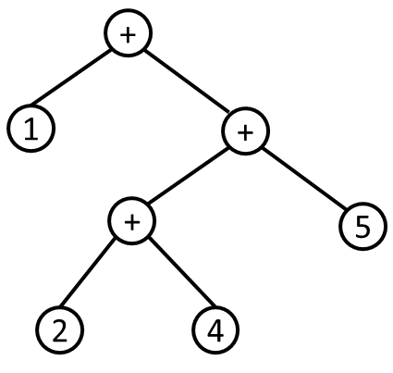
Grouped Expression
Example 2
1 + ( (2 + 4) + 5)
treeNodeList
1
+
2
+
4
+
5
1
9
5
parser
1
5
9

Slide 23
HW 6
Add more features in parserr.py
Parsing grouped expression
Ex. 1 * (2 + 5)
Parsing single number expression
Ex. 25
Parsing negative – sign
Ex. –25 * 3

Slide 24
Single number expression
Current parser module does not support single number expression
Assume that we parse expression 2

Slide 25
parsing()
dummyNode = treeNode(“DUMMY”,“”,0) treeNodeList.insert(0,dummyNode) treeNodeList.append(dummyNode) for index in range(len(treeNodeList)): node = treeNodeList[index] if node.type == “NUMBER”: lOp = treeNodeList[index-1] rOp = treeNodeList[index+1] if rOp.precedence > lOp.precedence: #Right rOp.lChild = node node.parent = rOp if lOp != None: lOp.rChild = rOp rOp.parent = lOp else: #Left lOp.rChild = node node.parent = lOp if rOp.type != “DUMMY”: while lOp.parent != None: if lOp.parent.precedence < rOp.precedence: break
lOp = lOp.parent
if lOp.parent != None: lOp.parent.rChild = rOp rOp.parent = lOp.parent rOp.lChild = lOp lOp.parent = rOp
treeNodeList
0
0
2

Slide 26
parsing()
dummyNode = treeNode(“DUMMY”,“”,0) treeNodeList.insert(0,dummyNode) treeNodeList.append(dummyNode) for index in range(len(treeNodeList)): node = treeNodeList[index] if node.type == “NUMBER”: lOp = treeNodeList[index-1] rOp = treeNodeList[index+1] if rOp.precedence > lOp.precedence: #Right rOp.lChild = node node.parent = rOp if lOp != None: lOp.rChild = rOp rOp.parent = lOp else: #Left lOp.rChild = node node.parent = lOp if rOp.type != “DUMMY”: while lOp.parent != None: if lOp.parent.precedence < rOp.precedence: break
lOp = lOp.parent
if lOp.parent != None: lOp.parent.rChild = rOp rOp.parent = lOp.parent rOp.lChild = lOp lOp.parent = rOp
treeNodeList
0
0
2
lOp
node
rOp

Slide 27
parsing()
dummyNode = treeNode(“DUMMY”,“”,0) treeNodeList.insert(0,dummyNode) treeNodeList.append(dummyNode) for index in range(len(treeNodeList)): node = treeNodeList[index] if node.type == “NUMBER”: lOp = treeNodeList[index-1] rOp = treeNodeList[index+1] if rOp.precedence > lOp.precedence: #Right rOp.lChild = node node.parent = rOp if lOp != None: lOp.rChild = rOp rOp.parent = lOp else: #Left lOp.rChild = node node.parent = lOp if rOp.type != “DUMMY”: while lOp.parent != None: if lOp.parent.precedence < rOp.precedence: break
lOp = lOp.parent
if lOp.parent != None: lOp.parent.rChild = rOp rOp.parent = lOp.parent rOp.lChild = lOp lOp.parent = rOp
treeNodeList
0
0
2
lOp
node
rOp
0
Left!
0
*
2
2
rOp
lOp
rOp
lOp
node
node

Slide 28
parsing()
dummyNode = treeNode(“DUMMY”,“”,0) treeNodeList.insert(0,dummyNode) treeNodeList.append(dummyNode) for index in range(len(treeNodeList)): node = treeNodeList[index] if node.type == “NUMBER”: lOp = treeNodeList[index-1] rOp = treeNodeList[index+1] if rOp.precedence > lOp.precedence: #Right rOp.lChild = node node.parent = rOp if lOp != None: lOp.rChild = rOp rOp.parent = lOp else: #Left lOp.rChild = node node.parent = lOp if rOp.type != “DUMMY”: while lOp.parent != None: if lOp.parent.precedence < rOp.precedence: break
lOp = lOp.parent
if lOp.parent != None: lOp.parent.rChild = rOp rOp.parent = lOp.parent rOp.lChild = lOp lOp.parent = rOp
treeNodeList
0
0
2
lOp
node
rOp
0
Left!
0
*
2
2
rOp
lOp
rOp
lOp
node
node
None
2
None child will give error in evaluation stage

Slide 29
Single number expression
One trick to handle this expression
If expression is single number expression
make parsing() return treeNodeList as itself (without any edge)
Then, findRoot() will return as root node of tree
Means that parser built tree with single node 2 without any child like below.
treeNodeList
2
2
2

Slide 30
HW 6
Add more features in parserr.py
Parsing grouped expression
Ex. 1 * (2 + 5)
Parsing single number expression
Ex. 25
Parsing negative – sign
Ex. –25 * 3

Slide 31
Negative sign
Negative sign (- unary operator) has high order in order of precedence
( ) >>> - (unary) >>> * / >>> + -
Need to make parser to support negative sign
Expression with negative sign should be at higher level in tree

Slide 32
Negative sign
Difference btw negative sign and regular minus operator
Negative sign: unary operator (prefix)
Regular minus operator: binary operator (infix)
- 1 - 5 - - 2
unary
binary
binary
unary

Slide 33
Negative sign
One trick to handle negative sign
Before building tree from expression,
First, need to figure out which – is unary operator in expression
It is your job to figure out how to detect negative sign (unary operator) from expression
- 1 - 5 - - 2
unary
unary

Slide 34
Negative sign
Second, convert unary operator - to expression with binary operator - which gives same effect
Example
- 2 → (0 - 1) * 2
- 1 - 5 - - 2 → (0-1)*1 - 5 - (0-1)*2
All – operators are now binary operator
By inputting the converted expression to parser, we will get correct tree

Slide 35
Negative sign
Example 1
-2
tokSeq
-
2

Slide 36
Negative sign
Example 1
-2
tokSeq
-
2
newTokSeq
(
0
-
1
)
*

Slide 37
Negative sign
Example 1
-2
tokSeq
-
2
newTokSeq
(
0
-
1
)
*
2

Slide 38
Negative sign
Example 1
-2
tokSeq
-
2
newTokSeq
(
0
-
1
)
*
2
treeNodeList
0
-
1
*
2
5
2
Increased because of ( )

Slide 39
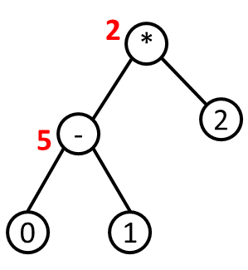
Negative sign
Example 1
-2
treeNodeList
0
-
1
*
2
5
2
parser
Will return -2 as result in evaluation stage

Slide 40
Negative sign
Need to implement grouped expression first to implement negative sign
Because tokSeq → newTokSeq, you may need to modify lexer module
But still OK to implement tokSeq → newTokSeq in parser module

