Slide 1
HISTORY OF DEEP LEARNING

Slide 2
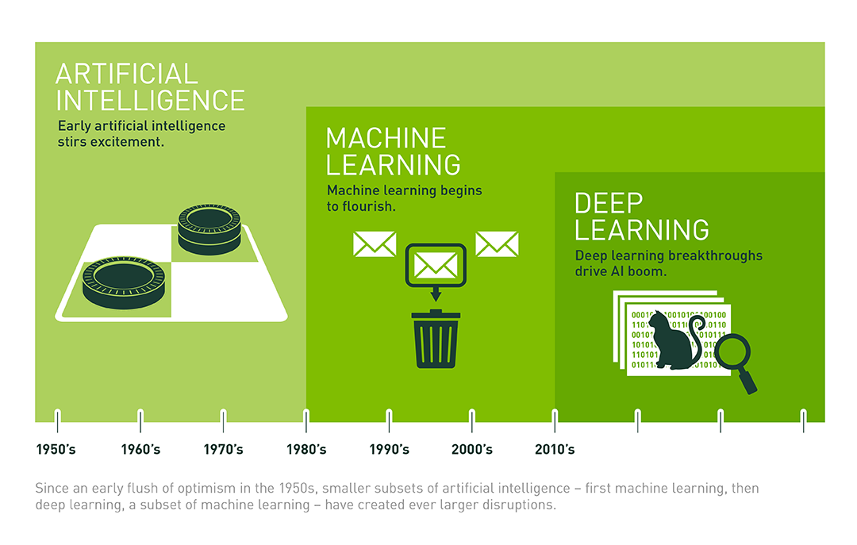
Notes:
AI ML is in our everyday life, even in your room: Alexa.
Here is the overall relationship between AI, ML and DL and the corresponding time stamp.

Slide 3
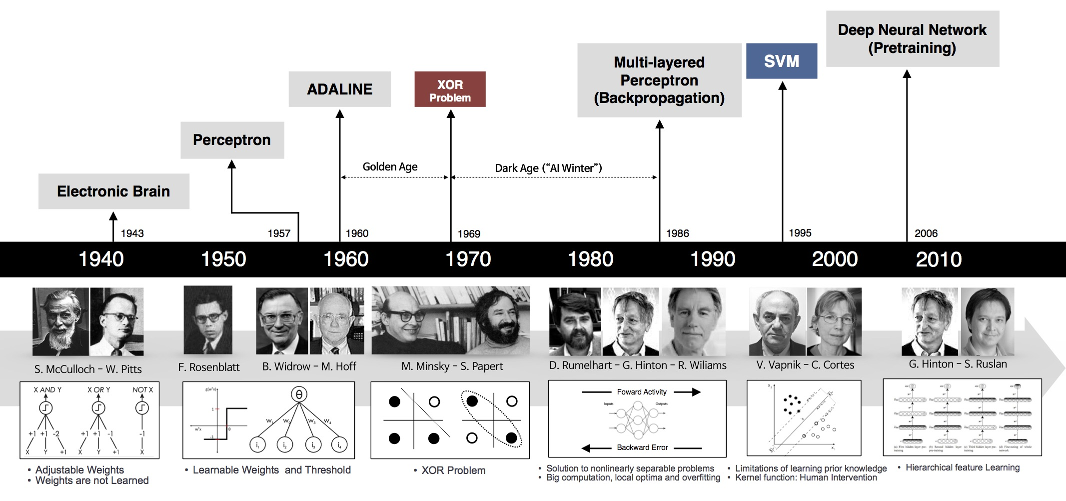
Source: Deep Learning 101- Part 1: History and Background
Notes:
DL has been booming since 2010, however, it originates from very long time ago.
https://beamandrew.github.io/deeplearning/2017/02/23/deep_learning_101_part1.html

Slide 4
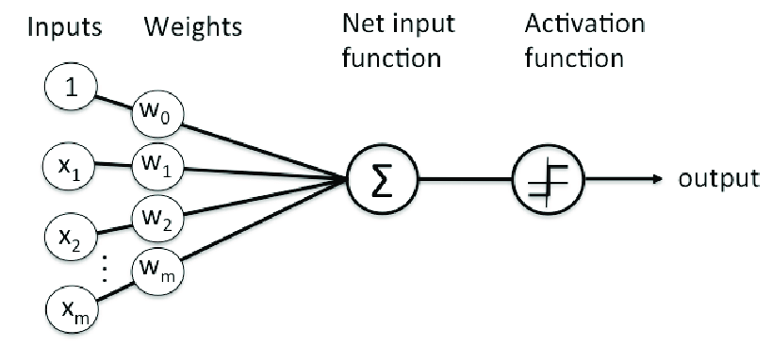
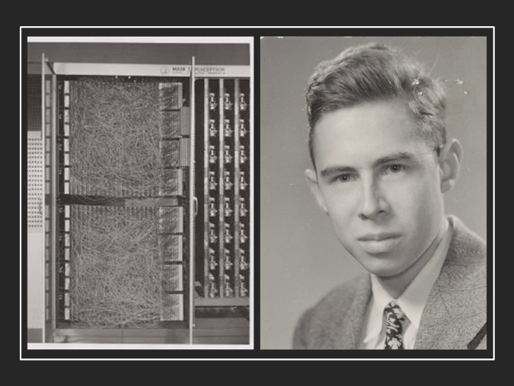
1957-1958: PERCEPTRON
Perceptron is one of the very first base of DL.
It was developed by Rosenblatt in 1957 (funded by US Naval Research)
It is a supervised learning model and applicable if the 2 datasets are linearly separable
Organization of Perceptron (Rosenblatt, 1958)
1958: [The perceptron is] the embryo of an electronic computer that [the Navy] expects will be able to walk, talk, see, write, reproduce itself and be conscious of its existence.

Slide 5
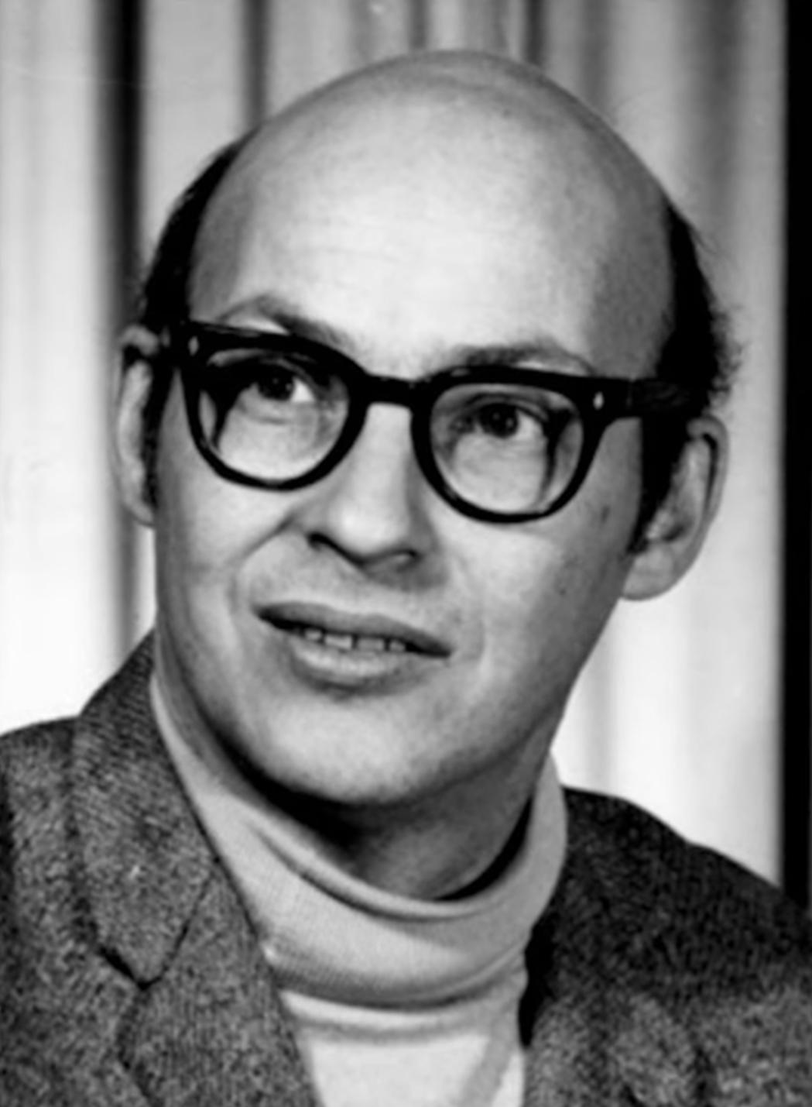
However, I started to worry about what such a machine could not do. For example, it could tell ‘E’s from ‘F’s, and ‘5’s from ‘6’s—things like that. But when there were disturbing stimuli near these figures that weren’t correlated with them the recognition was destroyed.
1969: THE FIRST AI WINTER
Perceptron gains a decade of attention until Marvin Minsky – often thought of as on of the father of AI, sensed something off:
In a book named “Perceptron”, Minsky and Seymour Papert proved that perceptron was incapable of learning the simple exclusive-or (XOR) function (Now it is obvious that Perceptron is a linear model while XOR is non-linear)
This finding shocked the AI community and Perceptron was interrupted for 20 years, all research related Perceptron was halt.

