Slide 1
DEEP LEARNING WORKSHOP
Notes:
Idea follow Vblog: machinelearningcoban and Deep Learning 101
Machine Learning cơ bản (machinelearningcoban.com)
Deep Learning 101 - Part 1: History and Background (beamandrew.github.io)

Slide 2
HISTORY OF DEEP LEARNING
Notes:
Idea follow Vblog: machinelearningcoban and Deep Learning 101
Machine Learning cơ bản (machinelearningcoban.com)
Deep Learning 101 - Part 1: History and Background (beamandrew.github.io)

Slide 3
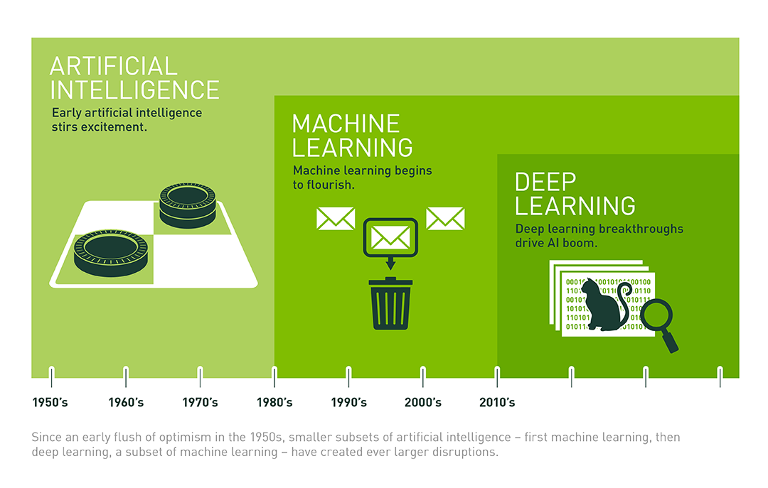
Notes:
AI ML is in our everyday life, even in your room: Alexa.
Here is the overall relationship between AI, ML and DL and the corresponding time stamp.

Slide 4
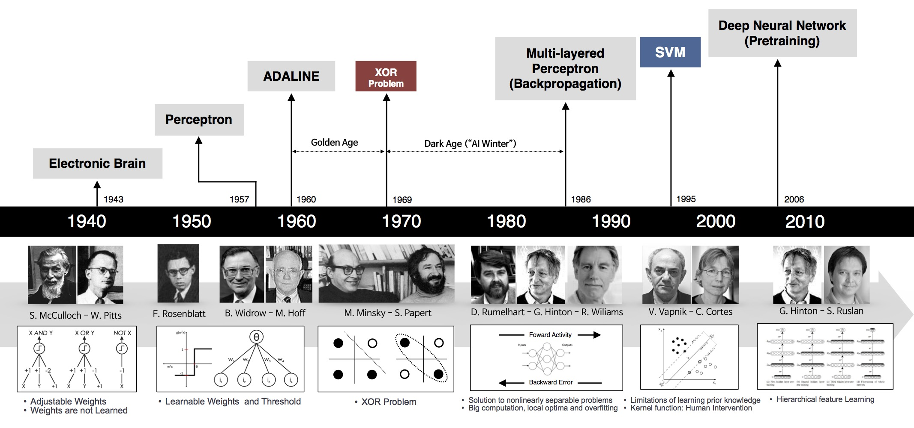
Source: Deep Learning 101- Part 1: History and Background
Notes:
DL has been booming since 2010, however, it originates from very long time ago.
https://beamandrew.github.io/deeplearning/2017/02/23/deep_learning_101_part1.html

Slide 5
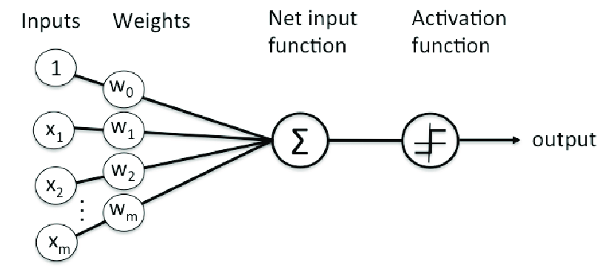
1957-1958: PERCEPTRON
Perceptron is one of the very first base of DL.
It was developed by Rosenblatt in 1957 (funded by US Naval Research)
It is a supervised learning model and applicable if the 2 datasets are linearly separable
Organization of Perceptron (Rosenblatt, 1958)
1958: [The perceptron is] the embryo of an electronic computer that [the Navy] expects will be able to walk, talk, see, write, reproduce itself and be conscious of its existence.

Slide 6
However, I started to worry about what such a machine could not do. For example, it could tell ‘E’s from ‘F’s, and ‘5’s from ‘6’s—things like that. But when there were disturbing stimuli near these figures that weren’t correlated with them the recognition was destroyed.
1969: The First AI WINTER
Perceptron gains a decade of attention until Marvin Minsky – often thought of as on of the father of AI, sensed something off:
In a book named “Perceptron”, Minsky and Seymour Papert proved that perceptron was incapable of learning the simple exclusive-or (XOR) function (Now it is obvious that Perceptron is a linear model while XOR is non-linear)
This finding shocked the AI community and Perceptron was interrupted for 20 years, all research related Perceptron was halt.

Slide 7
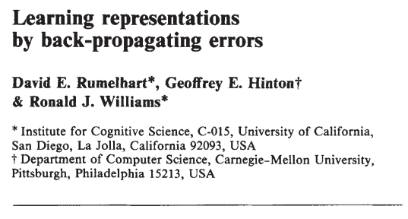
1986: The BACKPROPAGANDISTS emerge
Geoffrey Hinton (PhD in Neural Science) published in Nature: “Learning representations by back-propagating errors”.
The authors showed that NN with many hidden layers (Multi-Layer Perceptron - MLP) could be effectively trained by a relatively simple procedure called “Backpropagation”.
This allows NN to overcome the Perceptron’s weakness with the ability to learn nonlinear function (with activation function like sigmoid, ReLU)
NN has ability as “universal approximation theorem” and it gets back to the race

Slide 8
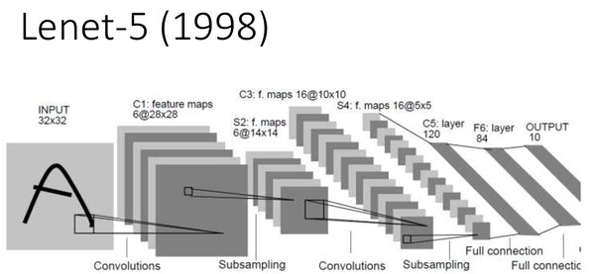
1986: CNN - LeNet
Backpropagation leads to some early success (notably Convolution Neural Network: CNN)
CNN was spearheaded by Yann LeCun at ATT Bell Labs to recognize handwritten digits.
This model has been used widely in US Banks and Post Office to read handwritten check and postal code
LeNet was the best algorithm at that time. It is better than regular MLP with the ability to filter in 2D

Slide 9
1990-2000: The 2nd AI Winter (Deep Freeze)
Several disadvantage of CNN and MLP:
Limited in 2D data (images) for training (digital camera was not popular since then)
The ability of computation machine still limited when the number of hidden layers increase => “vanishing gradient”
That leads to the Deep Freeze of NN in this decade.
Support Vector Machine emerged during this time with kernel technology to find the optimal parameters
NN went back to storage and researchers started to move to SVM, except few stubborn researcher …

Slide 10
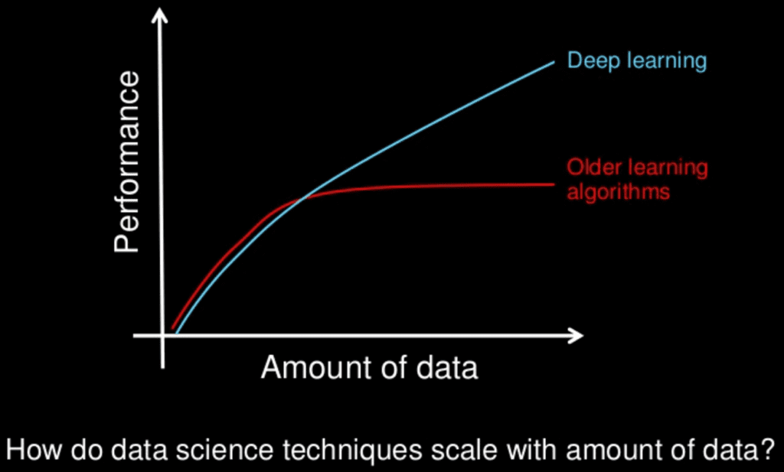
2006: Deep Learning (Rebranding)
Hinton once again declared he knew how brain works
He introduced: “Unsupervised Pretraining” and “Deep Belief Nets” – DBN
These technique could partially resolve the “vanishing gradient” problem.
Using this technique, people could train the NN that were deeper than previous attempt => rebranding to “Deep Learning”

Slide 11


2010: ImageNet
Feifei Li (a Stanford professor) and her group created the dataset named “ImageNet”
The “ImageNet” has millions of images with thousand of assigned labels
The project was supported by the booming of internet, digital cameras.
This dataset has been updated annually and used in the competition named: ImageNet Large Scale Visual Recognition Challenge (ILSVRC)
2010 & 2011: many teams participated in the competition, they used mostly SVM and the top models had error rates of 28% (2010) and 26% (2011)
14,197,122 images, 21841 synsets indexed

Slide 12
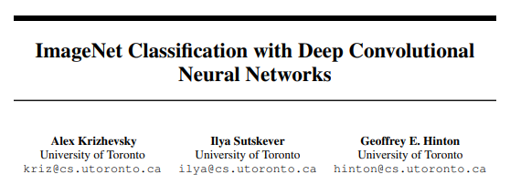
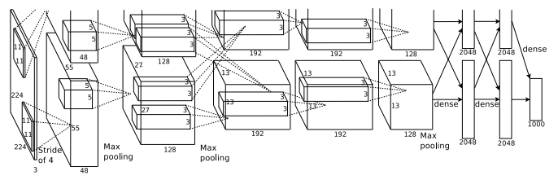
2012: Breakthrough
2012, Hinton and his student Alex Krizhevsky attended and got first prize in ILSVRC with error rate of 16% (!!!) that surprised the community: the born of Deep CNN or “AlexNet”
In this competition, there are few key contributions:
Introduction of Rectified Linear Activation function (ReLU) to partially overcome “vanishing gradient” and increase the computation speed
Introducing “Dropout” method to shutoff some unused unit, help to avoid Overfitting (Similar to Ensemble in ML)
AlexNet has great contribution from using GPUs that accelerated the computational speed from using CPUs

Slide 13
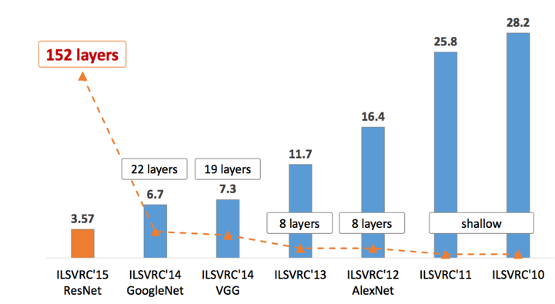
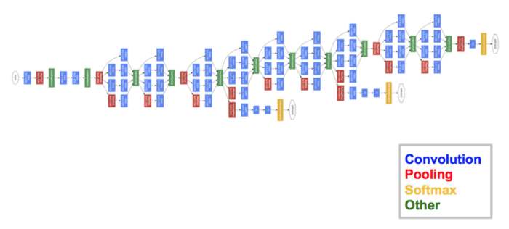
2013: Since then …
After AlexNet, deeper and deeper NN have been applied to ILSVRC
Increase in hidden layers => decrease error rate
GoogLeNet 2014

Slide 14
Discussions:
What brings up the success of Deep Learning?
New and new heavy datasets born with labels (e.g: ImageNet)
Ability of GPUs in parallel computing
More activation function to overcome vanishing gradient (ReLU), exploding gradient (Gradient clipping)
Contribution of tech company (GoogLeNet, ResNet,…) and other technology like transfer learning, finetuning
More and more regularization/ensemble technique to avoid overfitting: Dropout, Batch Normalization, Data Augmentation
More and more library (many developed by Tech Company): Tensorflow, Pytorch, …
New Optimization technique: Adam, RMSProp,…

Slide 15
APPLICATIONS OF DEEP LEARNING
Notes:
Idea follow Vblog: machinelearningcoban and Deep Learning 101
Machine Learning cơ bản (machinelearningcoban.com)
Deep Learning 101 - Part 1: History and Background (beamandrew.github.io)

Slide 16
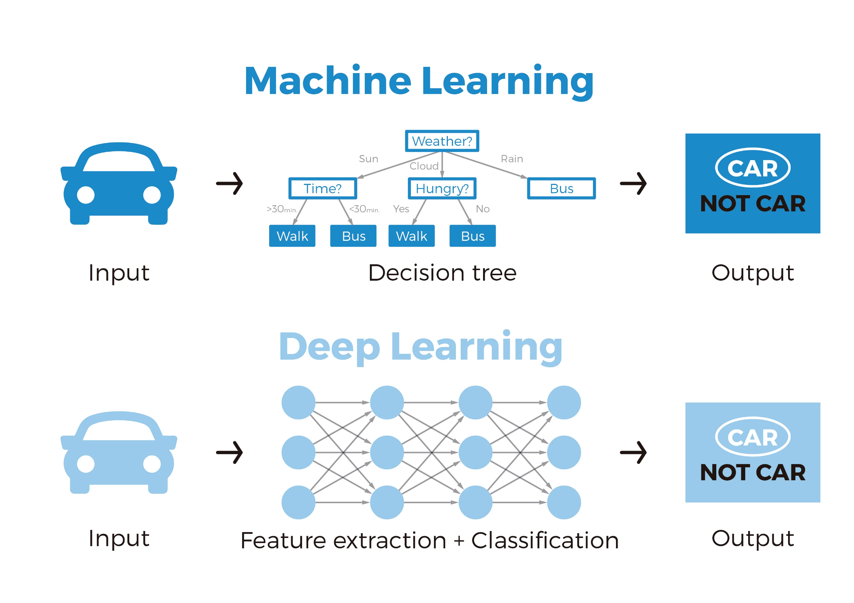

Slide 17
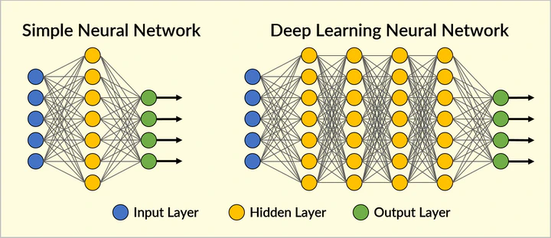

Slide 18
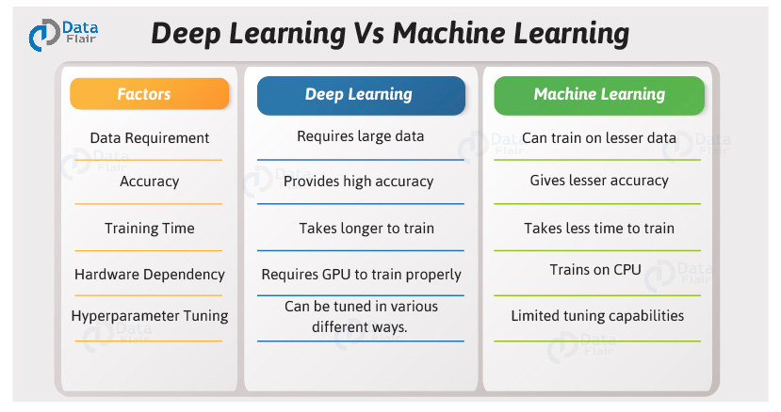

Slide 19
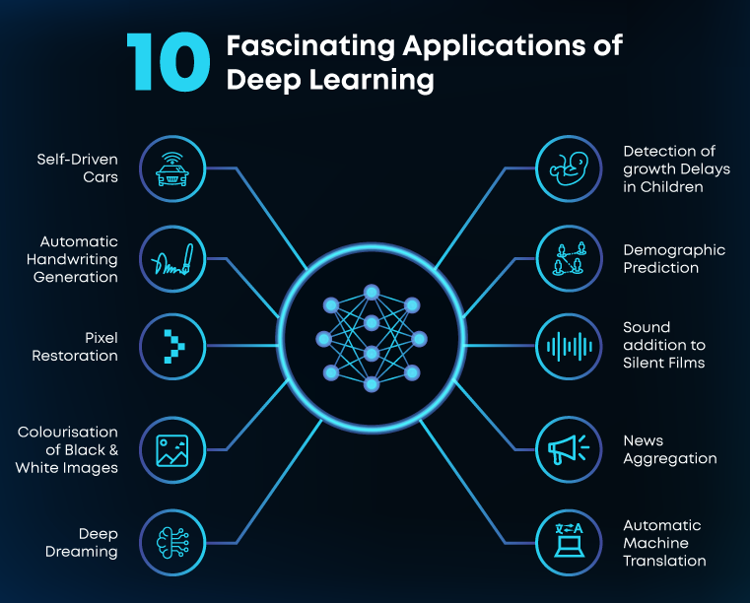

Slide 20
DEEP LEARNING FRAMEWORK
Notes:
Idea follow Vblog: machinelearningcoban and Deep Learning 101
Machine Learning cơ bản (machinelearningcoban.com)
Deep Learning 101 - Part 1: History and Background (beamandrew.github.io)

Slide 21
(1) Keras
Keras is an effective high-level neural network Application Programming Interface (API) written in Python. This open-source neural network library is designed to provide fast experimentation with deep neural networks, and it can run on top of CNTK, TensorFlow, and Theano.
Keras focuses on being modular, user-friendly, and extensible. It doesn’t handle low-level computations; instead, it hands them off to another library called the Backend.
Keras was adopted and integrated into TensorFlow in mid-2017. Users can access it via the tf.keras module. However, the Keras library can still operate separately and independently.
(2) Pytorch
Pytorch is a relatively new deep learning framework based on Lua Torch.
Developed by Facebook’s AI research group and open-sourced on GitHub in 2017, it’s used for natural language processing applications.
Pytorch has a reputation for simplicity, ease of use, flexibility, efficient memory usage, and dynamic computational graphs. It also feels native, making coding more manageable and increasing processing speed.
Strong competitor to Tensorflow
(3) Tensorflow
TensorFlow is an end-to-end open-source deep learning framework developed by Google and released in 2015.
It is known for documentation and training support, scalable production and deployment options, multiple abstraction levels, and support for different platforms, such as Android.
TensorFlow is a symbolic math library used for neural networks and is best suited for dataflow programming across a range of tasks. It offers multiple abstraction levels for building and training models.
(4) Theano
Theano used to be one of the more popular deep learning libraries, an open-source project that lets programmers define, evaluate, and optimize mathematical expressions, including multi-dimensional arrays and matrix-valued expressions.
Theano was developed by the Universite de Montreal in 2007 and is a key foundational library used for deep learning in Python. It’s considered the grandfather of deep learning frameworks and has fallen out of favor by most researchers outside academia.

Slide 22
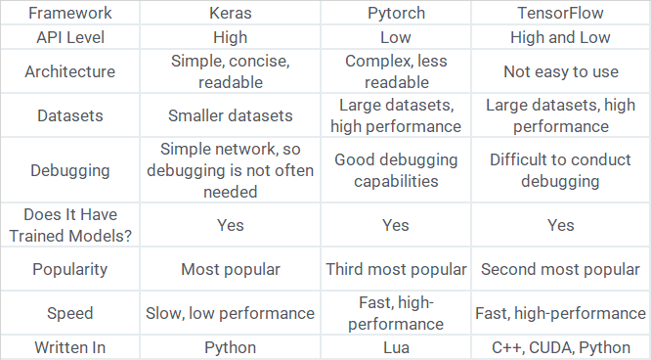

Slide 23
Conclusions:
Keras is the easiest Deep Learning Library API. It is easy to transit from Machine Learning based model
Tensorflow is the most popular DL library developed by Google. It has the most number of user.
Pytorch is developed by Facebook and gaining significant attention from users all over the world

