Slide 1

PHP Conditional Statements
Very often when you write code, you want to perform different actions for different conditions. You can use conditional statements in your code to do this.
In PHP we have the following conditional statements:
if statement - executes some code if one condition is true
if...else statement - executes some code if a condition is true and another code if that condition is false
if...elseif...else statement - executes different codes for more than two conditions
switch statement - selects one of many blocks of code to be executed

Slide 2
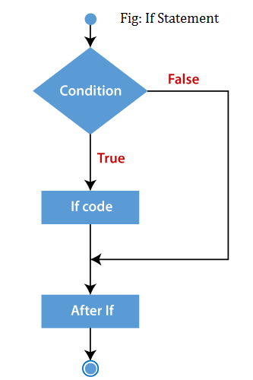
PHP if Statements

Slide 3
PHP if-else Statements
if(condition){
//code to be executed if true
}else{
//code to be executed if false
}

Slide 4
PHP if-else Statements

Slide 5
PHP if-else-if Statements
if (condition1){
//code to be executed if condition1 is true
} elseif (condition2){
//code to be executed if condition2 is true
} elseif (condition3){
//code to be executed if condition3 is true
....
} else{
//code to be executed if all given conditions are false
}

Slide 6
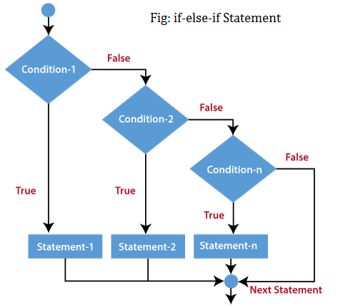
PHP if-else-if Statements

Slide 7
PHP Nested if Statements
if (condition) {
//code to be executed if condition is true
if (condition) {
//code to be executed if condition is true
}
}

Slide 8
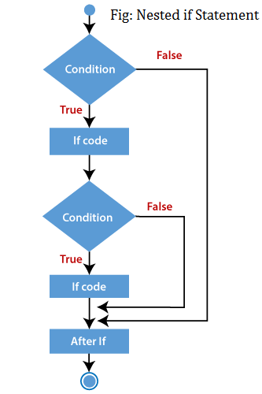
PHP Nested if Statements

Slide 9
PHP Nested if Statements
<?php
$age = 23;
$nationality = "Indian";
//applying conditions on nationality and age
if ($nationality == "Indian")
{
if ($age >= 18) {
echo "Eligible to give vote";
}
else {
echo "Not eligible to give vote";
}
}
?>

