Slide 1

PHP Conditional Statements
Very often when you write code, you want to perform different actions for different conditions. You can use conditional statements in your code to do this.
In PHP we have the following conditional statements:
if statement - executes some code if one condition is true
if...else statement - executes some code if a condition is true and another code if that condition is false
if...elseif...else statement - executes different codes for more than two conditions
switch statement - selects one of many blocks of code to be executed

Slide 2
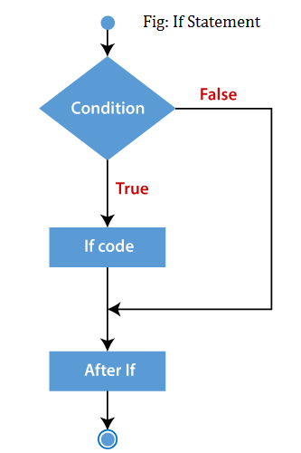
PHP if Statements

Slide 3
PHP if-else Statements
if(condition){
//code to be executed if true
}else{
//code to be executed if false
}

Slide 4
PHP if-else Statements

Slide 5
PHP if-else-if Statements
if (condition1){
//code to be executed if condition1 is true
} elseif (condition2){
//code to be executed if condition2 is true
} elseif (condition3){
//code to be executed if condition3 is true
....
} else{
//code to be executed if all given conditions are false
}

Slide 6
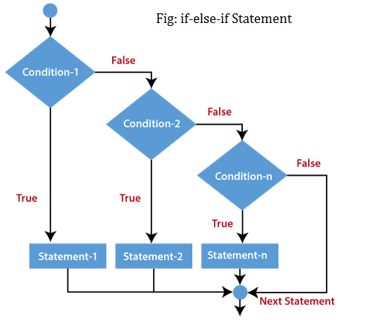
PHP if-else-if Statements

Slide 7
PHP Nested if Statements
if (condition) {
//code to be executed if condition is true
if (condition) {
//code to be executed if condition is true
}
}

Slide 8
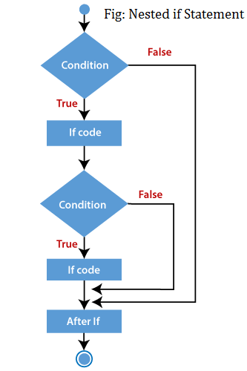
PHP Nested if Statements

Slide 9
PHP Nested if Statements
<?php
$age = 23;
$nationality = "Indian";
//applying conditions on nationality and age
if ($nationality == "Indian")
{
if ($age >= 18) {
echo "Eligible to give vote";
}
else {
echo "Not eligible to give vote";
}
}
?>

Slide 10
PHP Switch Statements
PHP switch statement is used to execute one statement from multiple conditions. It works like PHP if-else-if statement.
switch(expression){
case value1:
//code to be executed
break;
case value2:
//code to be executed
break;
......
default:
code to be executed if all cases are not matched;
}

Slide 11
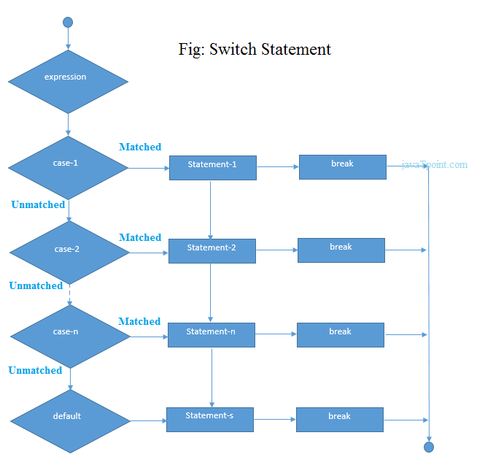
PHP Switch Statements

Slide 12
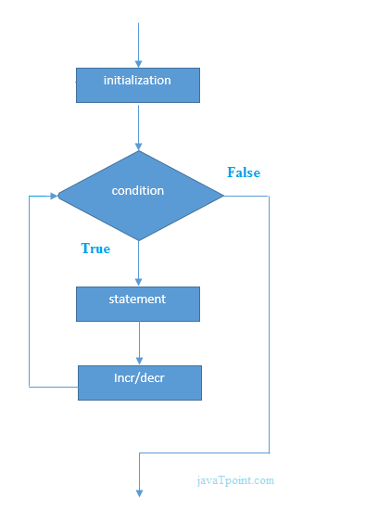

PHP Loops

Slide 13
PHP Loops
For loop
For each
While loop
do/while loop

Slide 14
PHP For Loop
PHP for loop can be used to traverse set of code for the specified number of times.
It should be used if the number of iterations is known otherwise use while loop. This means for loop is used when you already know how many times you want to execute a block of code.

Slide 15
PHP For Loop

Slide 16
PHP For Loop
Syntax :
for(initialization; condition; increment/decrement){
//code to be executed
}

Slide 17
PHP foreach Loop
The foreach loop is used to traverse the array elements. It works only on array and object. It will issue an error if you try to use it with the variables of different datatype.
The foreach loop works on elements basis rather than index. It provides an easiest way to iterate the elements of an array.
In foreach loop, we don't need to increment the value.

Slide 18
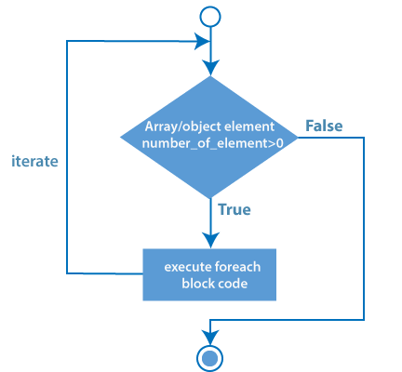
PHP foreach Loop

Slide 19
PHP foreach Loop
Syntax
foreach ($array as $value) {
//code to be executed
}

Slide 20
PHP foreach Loop
For($a=1; $a=20; $a++){
echo” electrotech solution”;
}

Slide 21
PHP While Loop
PHP while loop can be used to traverse set of code like for loop. The while loop executes a block of code repeatedly until the condition is FALSE. Once the condition gets FALSE, it exits from the body of loop.
It should be used if the number of iterations is not known.
The while loop is also called an Entry control loop because the condition is checked before entering the loop body. This means that first the condition is checked. If the condition is true, the block of code will be executed.
Syntax

Slide 22
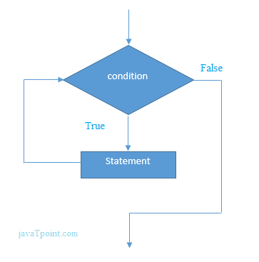
PHP While Loop

