Slide 1



foreach loop

Slide 2

Php foreach loop
The foreach loop is used to traverse the array elements. It works only on array and object. It will issue an error if you try to use it with the variables of different datatype.
The foreach loop works on elements basis rather than index. It provides an easiest way to iterate the elements of an array.
In foreach loop, we don't need to increment the value.
1
Electrotech Solution

Slide 3
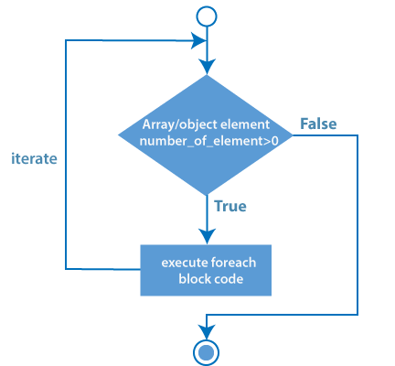
Php foreach loop
2
Electrotech Solution

Slide 4
Php foreach loop
Syntax
foreach ($array as $value) {
//code to be executed
}
3
Electrotech Solution

Slide 5
Php foreach loop
Syntax
foreach ($array as $value) {
//code to be executed
}
3
Electrotech Solution

Slide 6

Thank You
Any query

