Slide 1



while/ do-while loop

Slide 2

Php while loop
The job of any loop is to perform iteration or repetition, and the simplest construct for doing this is known as a while loop.
1
Electrotech Solution

Slide 3
Php while loop
2
Electrotech Solution

Slide 4
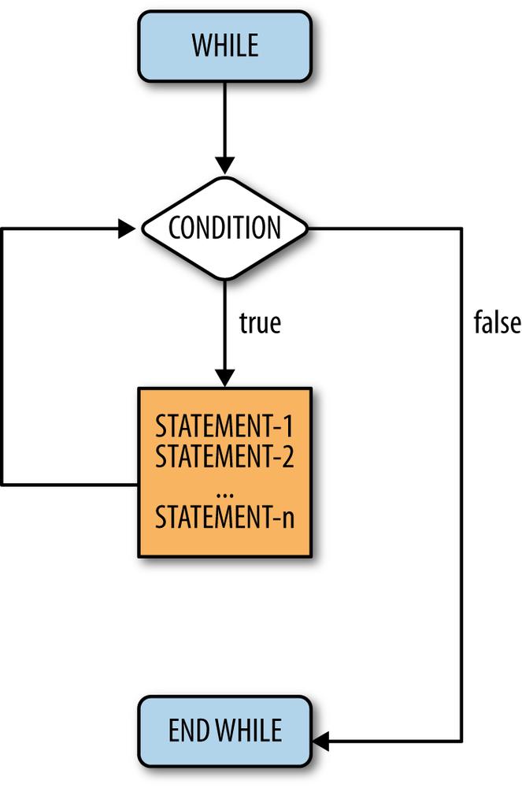
Php while loop
3
Electrotech Solution

Slide 5
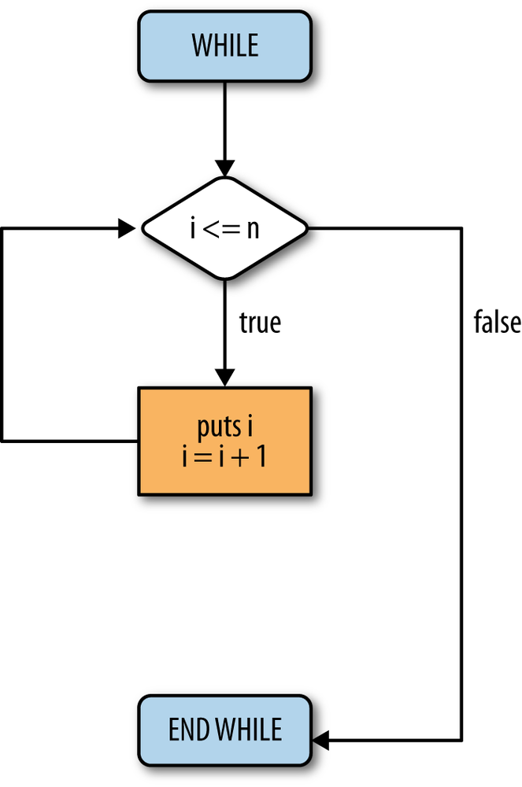
Php while loop
3
Electrotech Solution

Slide 6
Php foreach loop
1 while (condition)
2 # statement 1
3 # statement 2
4 # ...
5 # statement n
6 end
3
Electrotech Solution

Slide 7

Thank You
Any query

