Slide 1



while/ do-while loop

Slide 2

Php while loop
The job of any loop is to perform iteration or repetition, and the simplest construct for doing this is known as a while loop.
1
Electrotech Solution

Slide 3
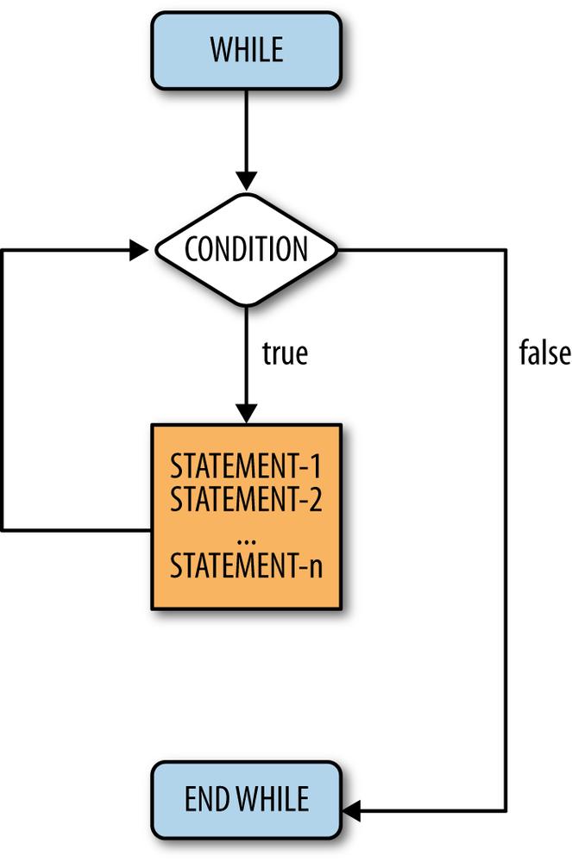
Php while loop
3
Electrotech Solution

Slide 4
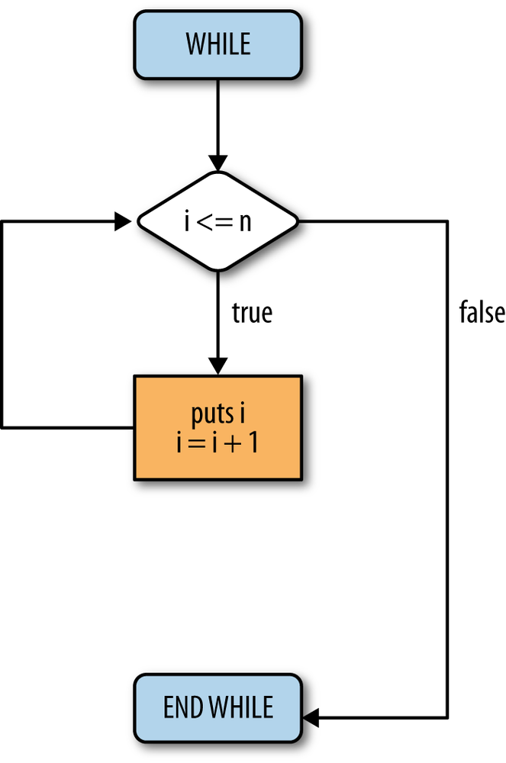
Php while loop
3
Electrotech Solution

Slide 5

Thank You
Any query

