Slide 1



Form Handling for PHP

Slide 2
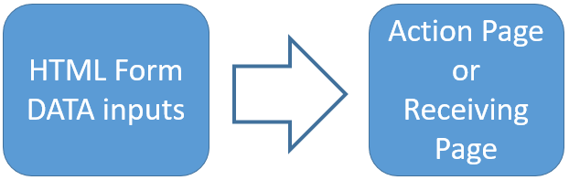

PHP Form Handling
The PHP superglobals $_GET and $_POST are used to collect form-data.
1
Electrotech Solution

Slide 3
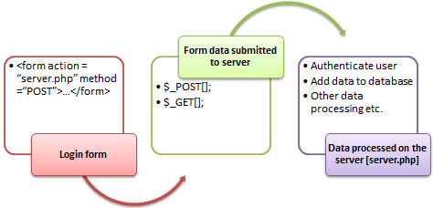
PHP Form Handling
Submit
Data Process
2
Electrotech Solution

Slide 4
PHP Form Handling
<form action="" method="post"> // Condition; </form>
3
Electrotech Solution

Slide 5
PHP Form Handling
<form action="welcome.php" method="post"> Name: <input type="text" name="name"><br> E-mail: <input type="text" name="email"><br> <input type="submit"> </form>
4
Electrotech Solution

Slide 6
PHP Form Handling
Welcome <?php echo $_POST["name"]; ?><br> Your email address is: <?php echo $_POST["email"]; ?>
5
Electrotech Solution

Slide 7

Thank You
Any query

