Slide 1

PHP Form Validation
Today jast over view how to process PHP forms with security in mind. Proper Validation if form data is important to your. Form from hackers and spammers!

Slide 2
PHP Form Validation
Name:
Email:
Website:
Comment
Gender:
Male
Female
Female
Submit
html.php

Slide 3
PHP Form Validation
Field | Validation Rules
Name | Required. + Must only contain letters and whitespace
E-mail | Required. + Must contain a valid email address (with @ and .)
Website | Optional. If present, it must contain a valid URL
Comment | Optional. Multi-line input field (textarea)
Gender | Required. Must select one

Slide 4
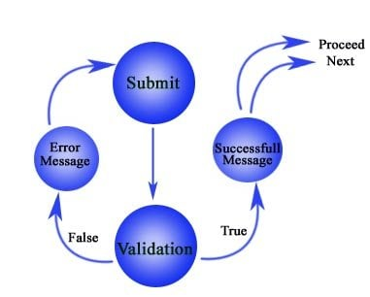
PHP Form Validation

