Slide 1

PHP Advanced File Handling Function
fopen()
fread()
fgets()
ftell()
fseek()
fpassthru()
rewind()
feof()
file ()
fgetc()
fwrite ()
fputs()
fclose()
ftruncate()

Slide 2
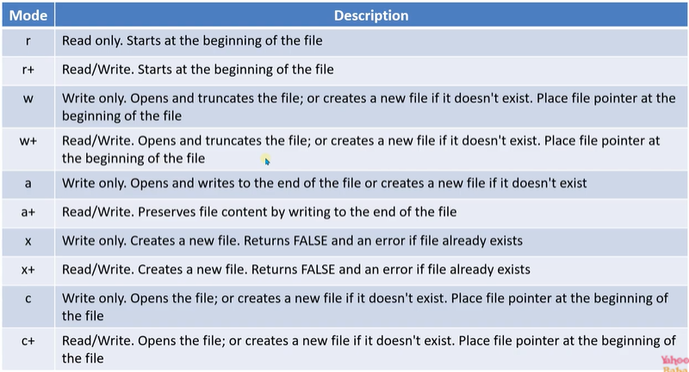

PHP Advanced File Handling Function

