Slide 1

String Type
A JavaScript string stores a series of characters like "John Doe".
A string can be any text inside double or single quotes:
length()
toLowerCase()
toUpperCase()
Includes()
startsWith()
endsWith()
search()
match()
indexOf()
lastIndexOf()
replace()
trim()
charAt()
charCodeAt()
fromCharCode()
concat()
split()
repeat()
slice()
substr()
substring()
toString()
valueOf()

Slide 2
Strings
toLowerCase(): Returns a string converted to lowercase letters, using the host's locale
toUpperCase() : Returns a string converted to uppercase letters, using the host's locale
Include() : Returns if a string contains a specified value
startsWith() : Checks whether a string begins with specified characters
endWith() : Returns if a string ends with a specified value
Search() : Searches a string for a value, or regular expression, and returns the index (position) of the match

Slide 3
Strings
match() : Searches a string for a value, or a regular expression, and returns the matches
indexOf() : Returns the index (position) of the first occurrence of a value in a string
lastindexOf() : Returns the index (position) of the last occurrence of a value in a string
Replace() : Returns a new string with a number of copies of a string
Trim() : Returns a string with removed whitespaces

Slide 4
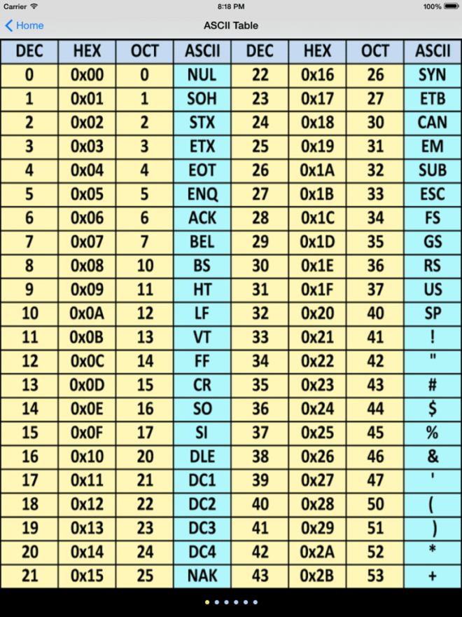
More About String

Slide 5
Splitting Strings: split and join
1. split breaks apart a string into an array using a delimiter
can also be used with regular expressions (seen later)
2. join merges an array into a single string, placing a delimiter between them
var s = "the quick brown fox";
var a = s.split(" "); // ["the", "quick", "brown", "fox"]
a.reverse(); // ["fox", "brown", "quick", "the"]
s = a.join("!"); // "fox!brown!quick!the" JS

