Slide 1

PrintNet: A Scalable 3D Print Farm Management System
Team Members: Muneer Al-Khasawneh Muhanad Al-Khasawneh Mitchell Koski
Advisor: Jeremy Hill
University of Cincinnati — CEAS Senior Design (CS 5002)

Slide 2

Goals & Background
Background
University 3D print labs commonly rely on fragmented tools such as Google Forms, spreadsheets, and manual printer monitoring. This leads to inefficiencies, limited scalability, and poor visibility into job status and printer health.
Project Goals
Centralize 3D print job submission, scheduling, and monitoring
Automate printer management using industry-standard APIs
Improve transparency for students, technicians, and lab managers
Build a scalable system adaptable to multi-printer environments

Slide 3
Intellectual Merits
Technical Innovation
Integrates submission intake, backend orchestration, and printer control into a single system
Uses API-driven automation to reduce manual intervention
Modular architecture allows future expansion without redesign
Original Contributions
End-to-end lifecycle ownership of print jobs
Automated job queueing and dispatch to printers
Real-time printer status visibility via backend polling
Methods
System architecture design
API integration
Containerized backend development
Iterative prototyping and testing

Slide 4
Broader Impacts
Educational Impact
Improves student access to fabrication resources
Reduces wait times and confusion during print submission
Enhances learning through reliable, transparent tooling
Operational Impact
Reduces technician workload
Minimizes printer downtime
Enables better utilization of shared resources
Scalability & Adoption
Can be adapted for universities, makerspaces, and research labs
Potential foundation for future automation in digital manufacturing

Slide 5
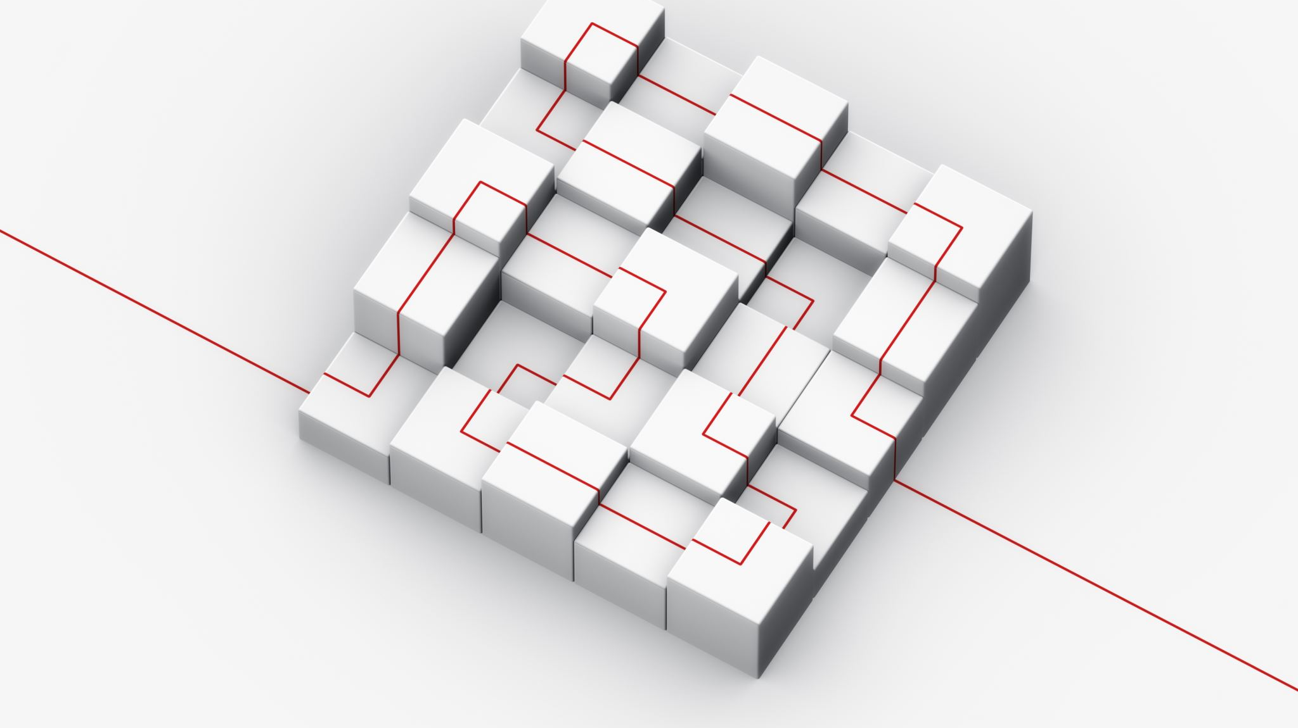
Design Specifications
System Overview
Centralized backend manages print job lifecycle
Printer communication handled via OctoPrint API
Submission data ingested from structured forms
Core Functional Requirements
Job submission and validation
Queue management and dispatch
Printer status monitoring
Error handling and recovery
Design Diagrams
System context diagram
Sequence diagram: submission → dispatch → status update

Slide 6

Technologies
Backend
Containerized service (Docker)
RESTful API architecture
Handles job orchestration and printer communication
Printer Integration
OctoPrint API for:
Uploading print jobs
Starting/stopping prints
Monitoring printer status
Data & Infrastructure
Structured submission data
Modular design to support additional printers and labs
Why These Technologies
Proven reliability in 3D printing ecosystems
Easy deployment and portability
Strong community and documentation support

Slide 7
Milestones
Deliverables
Functional backend prototype
Integrated printer control
Expo demo presentation
Date | Milestone
Fall 2024 | Problem definition & system design
Early Spring 2025 | Architecture diagrams & tech selection
Mid Spring 2025 | Backend development
Late Spring 2025 | Printer integration & testing
Expo | Live demo & final deliverables

Slide 8

Results & Current Progress
Completed
System architecture finalized
Backend service implemented
Successful communication with printer APIs
Job dispatch and status polling working
In Progress
UI refinements
Stability testing
Demo polishing
Remaining Tasks
Final demo workflow
Edge-case handling
Documentation and Expo preparation

Slide 9

Challenges & Solutions
Challenge: Fragmented Tooling
Solution: Unified backend to manage entire print lifecycle
Challenge: Reliable Printer Communication
Solution: Standardized API integration and status polling
Challenge: Scope Management
Solution: Focused Release 0.1.0 with clearly defined features
Team Contributions
Backend design and implementation
API integration and testing
System documentation and demo planning

