Slide 1
Company
Drive customer engagement and use insights to build what truly matters.
Starts from €149 /month
Start free trial
10 team members
Dashboards updated daily
5 top competitors included
All you need to collect feedback, plus:
Screen capturing with metadata
NEW! Surveys to optimise sentiment prediction – get 10 % off your price
Export data into csv, png, etc.

Slide 2



Who is IronSentiment?
In 2022, amidst Berlin's tech hub, IronSentiment emerged as a visionary force, reshaping how businesses gauge customer satisfaction. Specializing in cutting-edge sentiment analysis solutions, IronSentiment swiftly captivated companies of all sizes.
Get a demo
Get started free

Slide 3




What does IronSentiment offer?
Our tool stands out for its seamless integration with Trustpilot, a leading review platform, offering businesses a reliable source of customer feedback. We also offer custom solutions for platforms like Google Reviews and Amazon Reviews. The tool's adaptability and versatility make it suitable for businesses of all sizes
Contact our sales team

Slide 4

Company
Drive customer engagement and use insights to build what truly matters.
Starts from €149 /month
Start free trial
10 team members
Dashboards updated daily
5 top competitors included
All you need to collect feedback, plus:
Screen capturing with metadata
NEW! Surveys to optimise sentiment prediction – get 10 % off your price
Export data into csv, png, etc.

Slide 5
Premium
The complete platform to accelerate customer-centric growth.
Starts from €199/month.
Start free trial
Unlimited team members
Dashboards updated real time
15 top competitors included
All you need to collect feedback, plus:
NEW! Surveys to optimise sentiment prediction – get 10 % off your price
Export data into csv, png, etc.
Onboarding session & quarterly check-ins
Consultation for your customer feedback

Slide 6
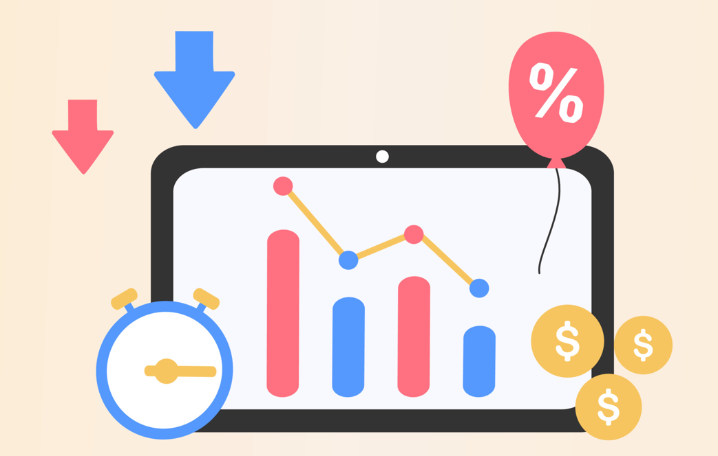
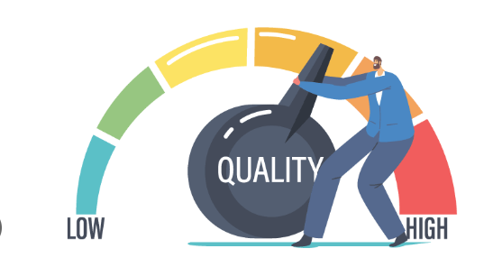
High customer acquisition costs (5-7 times) necessitate robust retention for improved returns on investment.
Positive reviews boost brand perception, fostering trust and attracting more customers.
Sentiment analysis guides product improvement, aligning offerings with customer expectations.
Positive sentiment enhances SEO, boosting search engine rankings and online visibility.
Effective review management provides a competitive advantage, helping businesses stand out in crowded markets.

Slide 7

How is customer satisfaction trending based on review ratings and sentiments?
What are the geographical variations in average ratings and sentiments?
Which sentiments are commonly associated with specific products in customer reviews?
What is the overall sentiment regarding delivery services, and are there country-specific patterns?
How does our average review rating compare with competitors in the industry?

