Slide 1
High Energy Analysis with KamLAND
And
Application to Dark Matter Search
Michinari Sakai
Univ. of Hawaii

Slide 2
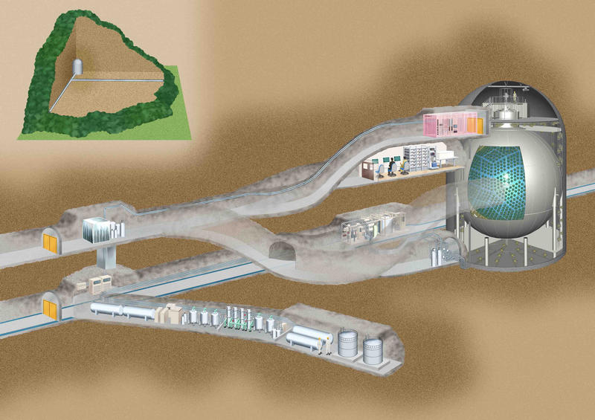
Kamioka Mine Tunnel
KamLAND
Control Room
Liquid Scintillator
Scintillator Purification Room

Slide 3
KamLAND: features
Commision: 2001
Detector medium: liquid scintillator
Size: 1kt
Photomultiplier tubes: 1325 17-inch, 779 20-inch (Hamamatsu), 34% photo-coverage
Analysis ν energy: ~MeV
Energy Resolution: (7.0 ν

