Slide 1
High Energy Event Imaging and Event Reconstruction
Michinari Sakai
University of Hawaii

Slide 2
Motivation
Want to do event reconstruction for fully contained events.
We can utilize many photons at high energies to reconstruct event track shape
Reconstructing lepton track shape and direction gives handle on neutrino direction
Particle ID

Slide 3
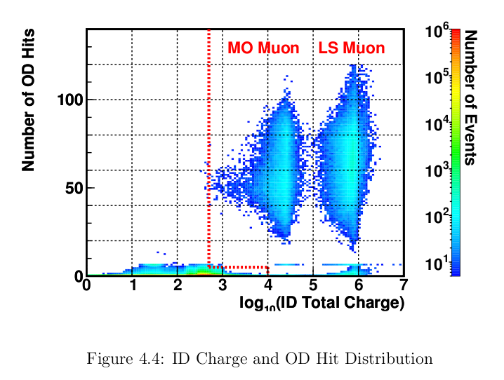
Where Are They?
Want high ID total charge and low OD hits (fully contained)
High energy events are here
Sanshiro Enamoto doctoral thesis 2005

Slide 4



Algorithm for Event Imaging
Dominikus Hellgartner
(Technische Universität München):
For any given point x in detector volume, calculate:
where
Figure of Merit for point x:
Fit track origin and direction vector to FOM values above some cut.

Slide 5
Parameters Used in Algorithm
Use only 17 inch PMTs.
Use PMT hit time resolution of 2.4ns (FWHM).
Should be 3.6ns.
Index of refraction 1.44
Muon criteria for rtq events.
All ID PMT receive hit and OD nhit < 5 for mtq events.

Slide 6
Particle ID
1GeV muon
1GeV positron

Slide 7
Particle ID
1GeV muon
1GeV positron
Fit ellipsoid and calculate ellipticity
Ellipticity = 0.48
Ellipticity = 0.73

Slide 8
Particle ID
1GeV muon
1GeV positron
Calculate length of ellipsoid
Length = 432 cm
Length = 202 cm

Slide 9
Lepton Track Angle
Real muon event in KamLAND

Slide 10
Lepton Track Angle
Real muon event in KamLAND
But using this much resolution crashes Tohoku computing nodes so we must reduce reconstruction resolution.

Slide 11
Lepton Track Angle With Reduced Resolution
Delta angle = 10.9 deg
Delta angle = 170 deg
Delta angle = 15 deg
Delta angle = 5.2 deg
Delta angle = 16 deg
Delta angle = 10.3 deg

Slide 12
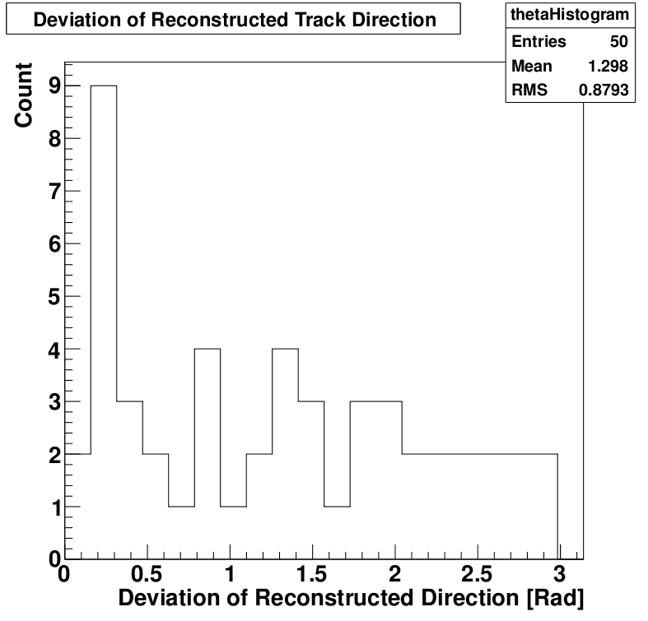
Lepton Track Angle
Old Result
This Result

Slide 13
Lepton Track Angle
Old Result
This Result
Artifact of reconstruction resolution?
Lepton direction sometimes is fitted in reverse.

Slide 14
Lepton Track Angle
Old Result
This Result
Angle reconstruction will be further improved by:
Finer reconstruction resolution.
Use fully contained events.
Better lepton direction algorithm.

Slide 15
Lepton Direction
Current Algorithm used to fit direction:
Find Max and Min values of FOM.
Divide the range between Max and Min values into 3 ranges.
Get average point of high and mid ranges along track.
Connect the two points.

Slide 16
KamLAND as a Cerenkov Detector
Discriminate particle ID.
Fit track length.
Fit track angle and direction.
Fully contained events
= KamLAND can be also utilized as a Cerenkov Detector

Slide 17
To Do

