Slide 1
High Energy Event Reconstruction
Michinari Sakai

Slide 2
Known Geometry Problem with KLG4 for High Energy Analysis
High energy event produces many photons
→ photons “warp" from ID to OD
This is a problem when placing OD cuts to find fully contained events
Cause due to PMT geometry overlap in KLG4

Slide 3
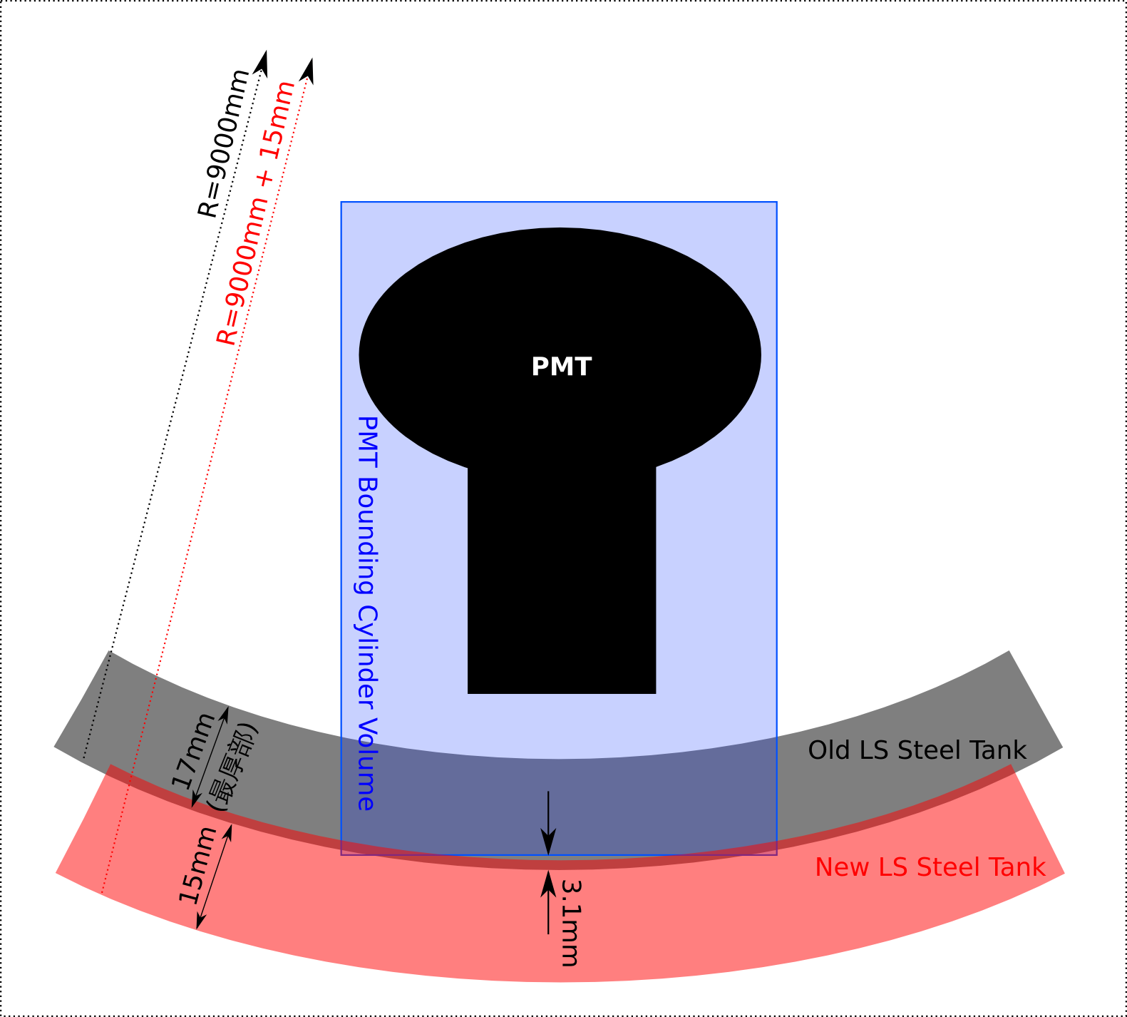
Known Geometry Problem with KLG4 for High Energy Analysis
Problem will be officially fixed in repository.
ID
OD
Hole in Steel Tank

Slide 4
PMT Prepulsing at High Energies
PMT prepulsing occurs when many photons (>~100)
Prepulsing is most probable when photons hit dynode along dynode axis.
Prepulsing can give wrong bias to fitters that use PMT hit timing

Slide 5
PMT Prepulsing at High Energies
Prepulsing?
Prepulsing?
Sample muon #1
Run 5000
Event 25663
Recon Energy 2512.59 MeV
Badness 13.706
Impact Param 396.618 cm
Sample muon #2
Run 5000
Event 37715
Recon Energy 5031.46 MeV
Badness 16.4625
Impact Param 187.912 cm

Slide 6
PMT Prepulsing at High Energies
(1000 muons from RTQ run 5000~)
Early hit times (-30 ~ -50 ns of neighbor PMTs) when Fermat surface normal is parallel to PMT orientation.
Some early hit times when Fermat surface normal is perpendicular to PMT orientation

Slide 7
Agreement of
Michi Fitter / Muon Fitter
(1000 muons, RTQ run 5000~)
No cut
Prepulse cut

Slide 8
Zenith Angle of Both Fitters
(1000 muons, RTQ run 5000~)
This Fitter
Muon Fitter
Muon Fitter is fitting through-going muons well.
New fitter is less accurate for through going muons..

Slide 9
Center of time/charge vs. muon fitter
(1000 muons, RTQ run 5000~)
Exponent modifier m,n for center of (time^{m}) and (charge^{n}) was varied in steps of 0.1
Vector pointing from center of time⁻¹ to center of charge^{0.5} gave best result
Good agreement with µ fitter

Slide 10
Atmospheric Neutrino
Events from Tamae, Shimizu
Michi ν Fitter
KamLAND μ fitter

Slide 11
Atmospheric Neutrino

Slide 12
Atmospheric Neutrino

Slide 13
Atmospheric Neutrino

Slide 14
Reconstructed T2K Event Direction
Events from Ikeda Haruo

Slide 15
Reconstructed T2K Event Direction
Events from Ikeda Haruo

Slide 16
Summary
Identified KLG4 geometry problem causing photon “warp” from ID to OD.
Identified PMT prepulse problem → Solved by placing cut outside of mean ± 3σ of neighbor PMTs.
Atmospheric/T2K event candidates direction fitted with μ fitter and new fitter.

Slide 17
To Do
Explore flavor discrimination using Deep Neural Network
Improve direction fitter by improving t_0 used in center of 1/Time.
Constrain Dark Matter mass (using WIMP Sim?).
Also look at specifically very high energy events (~50 GeV?) b/c backgrounds are lower at higher energies.

Slide 18
Backup Slides

Slide 19
Zenith Angle of Both Fitters
(muons from RTQ run 5000~5099)
This Fitter
Muon Fitter
Muon Fitter is fitting through-going muons well.
New fitter is less accurate for through going muons..

