Slide 1
Program Execution Environments
as Contextual Values
Markus Raab <markus.raab@complang.tuwien.ac.at>
Franz Puntigam <franz@complang.tuwien.ac.at>
COP'14, ECOOP Uppsala Sweden
July 29, 2014
Notes:
<Nummer>

Slide 2
Program Execution Environment (PEE)
Interface of application to operating system
Configuration management
Consists of:
  Configuration Files
  Commandline Arguments
  ...
Memory, Syscalls
Program
PEE
Filesystem

Slide 3
Contextual Values (CV)
CV are variables
Values can change depending on context
Side-effects are no longer potentially global
Usage in C++
  scoped by with(out) clause:
  cout << var; with<Layer>()([]{ cout << var;})
  using (de)activate:
  cout << var; activate<Layer>(); cout << var++;

Slide 4

Outline
Motivation
Implementation
Evaluation of Elektra
  Benchmarks
  Debugging
  Persistence
Conclusion
Elektra's Logo

Slide 5

Motivation
Program Execution Environment (PEE)
  PEE error-prone on multiple levels
    Redundancy and wrong conversions within programs
    Inconsistency in documentation and semantics (behavior)
    Hardly any validation
  Applications have undefined behavior on errors
  Currently no standard way to change PEE by programs
  No support for context

Slide 6
Motivating Example
CV very useful for PEE
  sessions, modes, host, internationalization, profiles, ..
int main (int argc, char**argv) {
KeySet ks;
parseConfigfiles(ks);
parseCommandline(ks, argc, argv);
Context c;
Environment env(ks, c);
c.activate<ProfileLayer>(env.profile);
// the rest of the program works with profile
}

Slide 7
Connect PEE and CV
PEE is defined using a specification
  Generates hierarchy of CV (currently C++)
  Placeholders for layers
Code Generation
All CVs are initialized at runtime using PEE, that is:
  Configuration files
  Commandline arguments
Library
[/%language%/%country%/%dialect%/person/greeting]
type=String
[/%country%/person/visits]
type=Integer
default=0

Slide 8
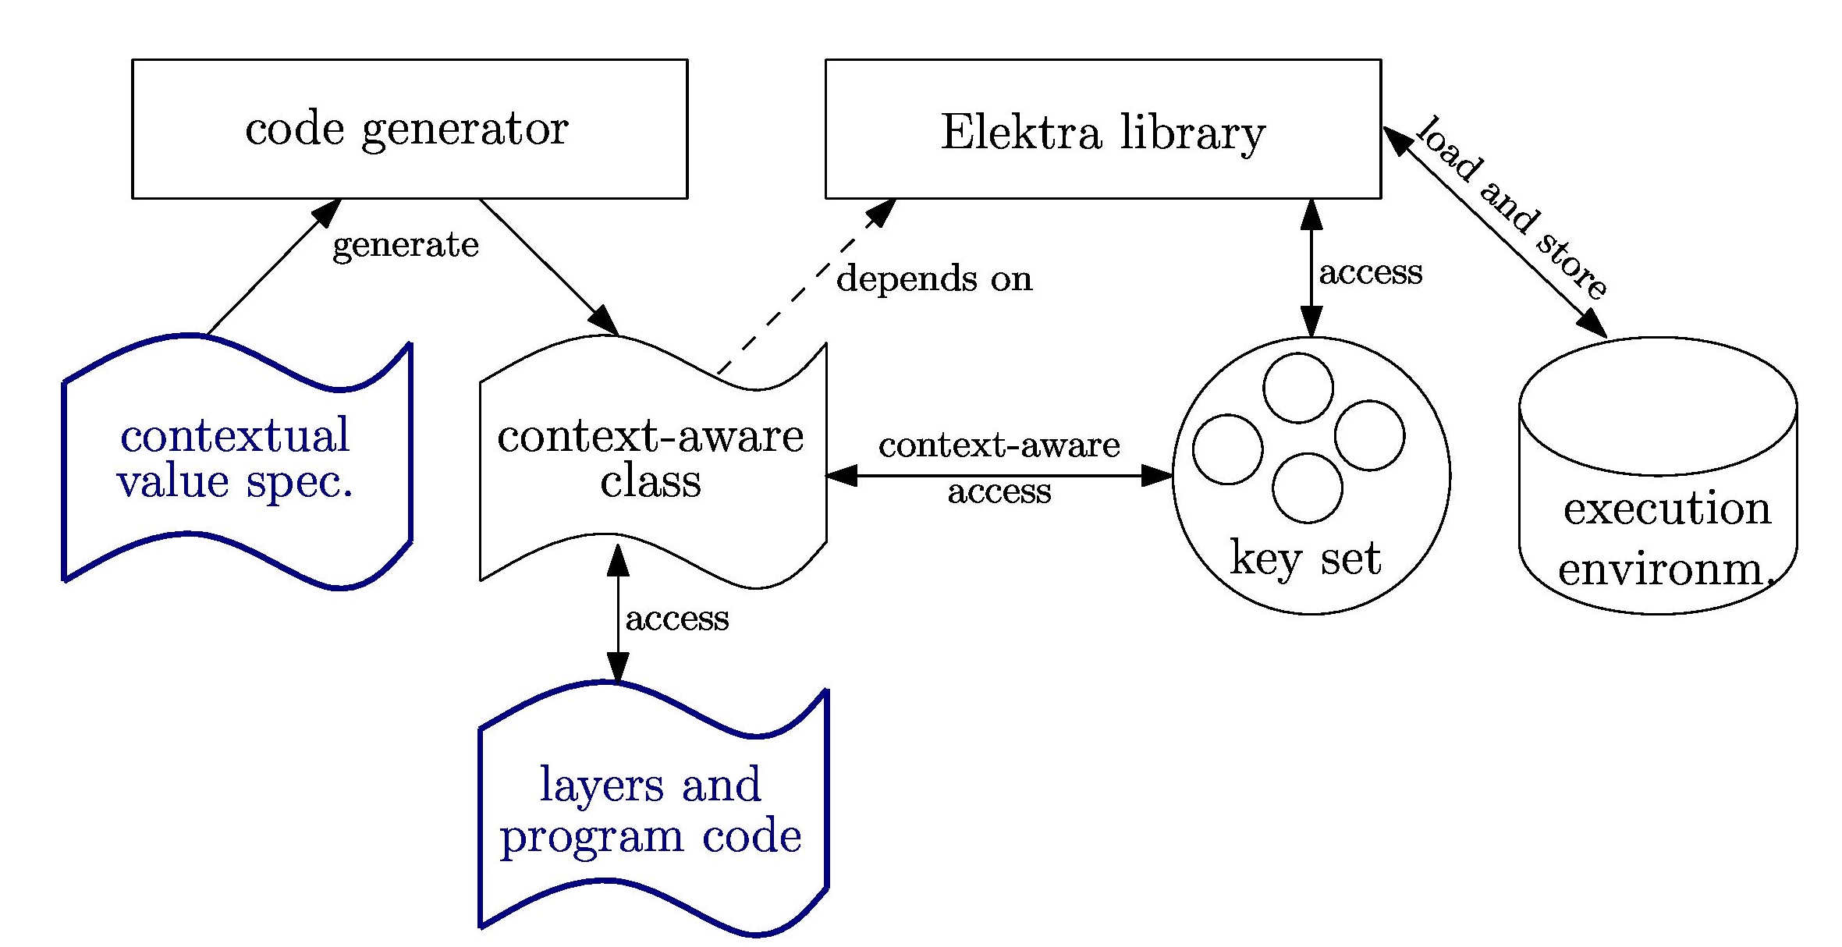
Usage

Slide 9

Problem
Implementations of COP today:
  Performance penalties 75%-99%
  (with active layers, w/o layer activation)
    But PEE is accessed frequently
  Hardly any debugging facilities

Slide 10
Methodology
Zero runtime-overhead on CV access?
Micro-benchmark
Overhead relative to native, algorithmic code
  int instead of Integer
Integer::type add_contextual (Integer const & c1 ,
Integer const & c2)
{ return c1 + c2; }
with<Layer1>().with<Layer2>() ([&c]{
int x=0;
for (long long i =0; i < iterations ; ++ i)
{ x ^= add_contextual (c,c); }
dump << x << endl;
});

Slide 11

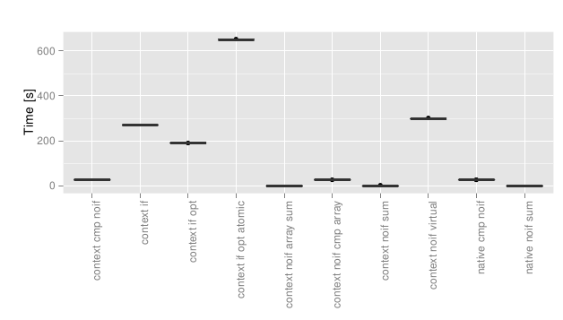
Benchmark
① Use if to check for context switch (190s, 652s)
② Virtual Dispatch (299s)
③ Native Values : 27s and 0s
￼￼①
②
③

Slide 12
Implementation
[/%language%/%country%/%dialect%/person/greeting]
type=String
[/%country%/person/visits]
type=Integer
default=0
...
...
greeting
visits
...
observers
[Layer
language
changed]
update
Context
subject

Slide 13

Implementation Choice
Member Array
  No performance impact
  But memory impact
  operator uint32_t()
  { return g_ar[m_ind]; }
Member Variable
  No performance impact
  Nearly no memory impact
  operator uint32_t()
  { return m_cache; }

Slide 14
Evaluation
Source Code released as free software within Elektra
  Code generator for CV
  Get/Set PEE ↔ CV
  Mounting many configuration file standards
http://www.libelektra.org

Slide 15
Specification
C-Code
(e.g. option parsing)
Specification
C++-Code
(e.g. CV)
generate
provides
Docu,
Manuals,
GUIs
Persistence
CV: gets value derived
from PEE
Runtime Checks
Validation
Upgrades
Integration
CV:
Connection
Of
Observers
/%/%/%/person/greeting=Hi!
/German/%/%/person/greeting=Guten Tag!
/German/Austria/%/person/greeting=Servus!
/German/Austria/t/person/greeting=Griaß enk!

Slide 16
Debugging
Assertions
Backtraces
Breakpoints
assert(i.context()["language"] == "german");
assert(i.getEvaluatedName() == "/german/%/%/test");
#3 0x0000000000407a56 in operator() at first.cpp:1521
i = @0x7fffe36b69a0: { ...
m_evaluated_name = "/german/germany/%/test" }
break 1520 if i.getEvaluatedName()
.compare("/german/germany/%/test") == 0

Slide 17

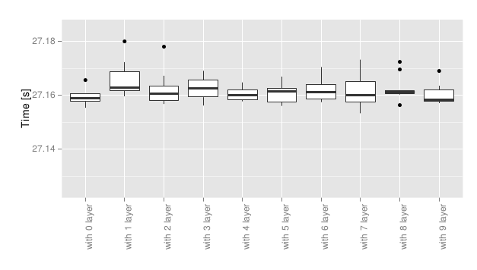
Benchmark
Number of active layers
±0.07%
→ No overhead with layers

Slide 18
Further Work
Layer switching
  Caching techniques
  Real World Benchmark
  More wildcards (still w/o ambiguity)
Specification
  More guarantees
  Validate PEE
  Generate Layers
Exploit flexibility and extensibility
  Support other programming languages
  Support more types
  ...

Slide 19
Conclusion
Motivation for PEE as CV
A specification describes PEE
A library to read/modify persistent PEE
Evaluation of Elektra
  No run-time overhead (w/o layer activation)
  Unique names support debugging and persistence

Slide 20
Thank you for your attention!
Markus Raab <markus.raab@complang.tuwien.ac.at>
Franz Puntigam <franz@complang.tuwien.ac.at>
COP'14, ECOOP Uppsala Sweden
July 29, 2014
Notes:
<Nummer>

Slide 21
References
Malte Appeltauer, Robert Hirschfeld,et al. A comparison of context-oriented programming languages.
Pascal Costanza, Robert Hirschfeld, and Wolfgang De Meuter. Efficient layer activation for switching context-dependent behavior.
Erich Gamma, Richard Helm, Ralph Johnson, and John Vlissides. Design patterns: elements of reusable object-oriented software
John Plaice and Blanca Mancilla. The cartesian approach to context.
Markus Raab. A modular approach to configuration storage.
Éric Tanter. Contextual values.
Martin von Löwis, Marcus Denker, and Oscar Nierstrasz. Context-oriented programming: Beyond layers.

Slide 22
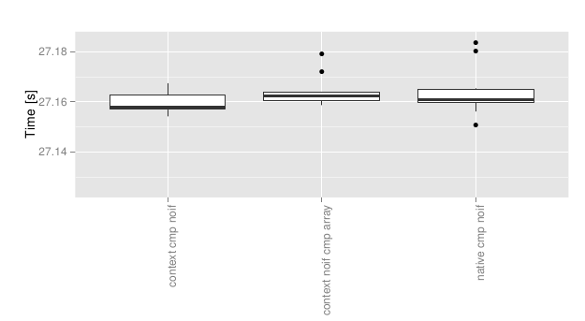
Benchmark
CV compared to native variable
Without active layer

Slide 23
Benchmark Setup
Laptop: hp ® EliteBook 8570w ™
  CPU Intel ® Core i7-3740QM @ 2.70GHz
  7939 MB Ram
GNU/Linux Debian Wheezy 7.5
gcc compiler Debian 4.7.2-5
  with the options -std=c++11, -O2 and -Dopt=unlikely
measured the time using gettimeofday
Median of eleven executions
100 billion iterations

